Slide 1
Genograms
Dr. Murray Bowen (1978)
Ecomaps
Dr Ann Hartman (1975)

Slide 2
Systems theory
The state or condition of a system, at any one point in time, is a function of the interaction between it and the environment in which it operates.
Change and conflict are always evident in a system. Individuals both influence their environments and are influenced by them. Processes of mutual influence generate change and development.
Each person in a family is part of the whole system. The whole is greater than the sum of its parts. A family can be thought of as a "holon, simultaneously a whole and a part of a larger system." (Longres, 1990)

Slide 3
Genograms
A graphic representation of a family tree that displays detailed data on relationships among individuals
A genogram will not only show you the names of people who belong to your family lineage, but how these people interact with each other.

Slide 4
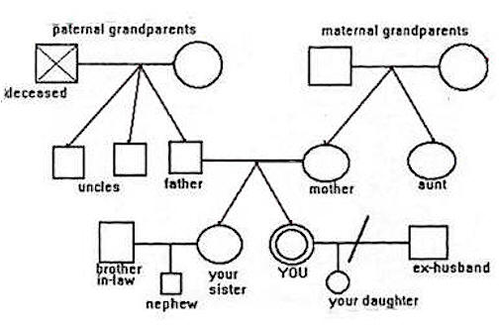
What does a genogram look like?

Slide 5
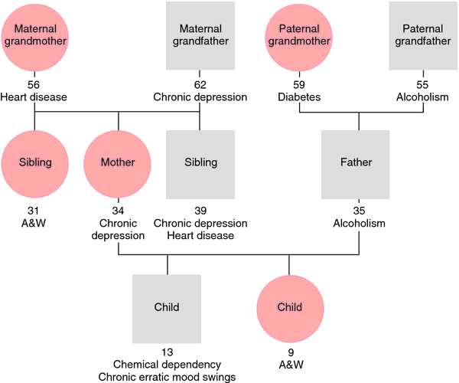

Slide 6
Genograms are not limited to family members. They can also include people who play an important role in the dynamics of the family, such as godparents, clergy members, friends, neighbours, colleagues, etc.
Genograms are often used in family therapy to help identify destructive patterns of behaviour.

Slide 7
Ecomaps
(sometimes called Ecograms)
A flow diagram that maps both family and their wider environmental systems
A social ‘solar system’ where the genogram is the sun at the centre and other significant people/institutions/activities/interests orbit the sun (e.g. work, college, extended family, recreation, social groups, friends, church, health treatments etc)
The ‘planets’ are depicted by circles and the nature of relationship to each is indicated by the type of line joining the family to it

Slide 8


