Slide 1
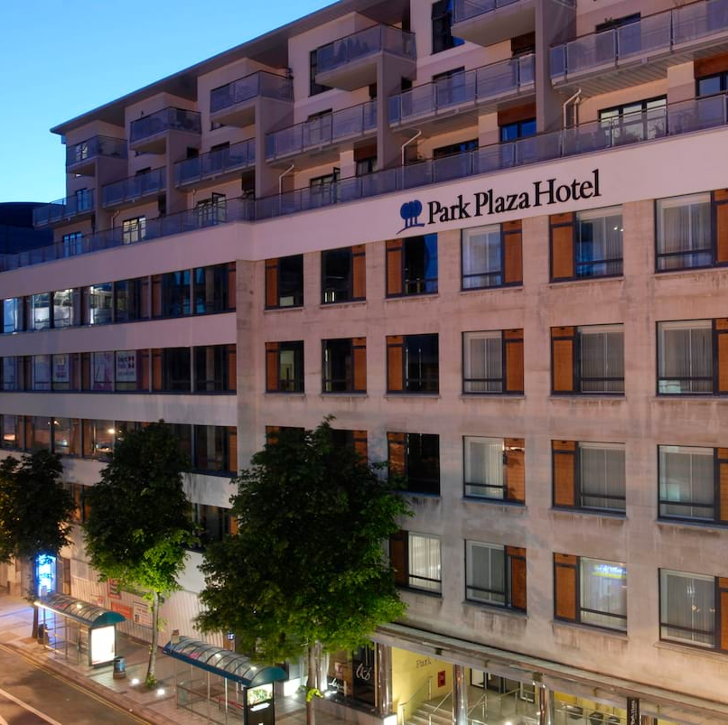
My Placement Experience at Park Plaza Cardiff
Insights from Food and Beverage, Front Office, and Hotel Facilities
Mihaela Elena Marin
2240233
Notes:
This presentation reflects my placement, detailing roles, challenges, and skills across Food and Beverage, Hotel Administration and Front Office, and Operating Hotel Facilities, shaping my hospitality career (Bardi, 2011).

Slide 2
Introduction
While working at Park Plaza Cardiff, I endeavoured in Food and Beverages, Housekeeping, Events, tasting Bar, Spa, and Reception departments.
I must admit it was wonderful; I had an opportunity to learn a lot from each of the departments.
The personnel were always friendly and provided assistance with all my requests, so I felt like one of them. Due to this, I was able to perform different tasks and understand the functionality of a hotel.
In this presentation, I will also explain what I have done in each department and the acquired skills. I will also share how this experience helped me in other roles and how I grew.

Slide 3
Food and Beverages
In Food and Beverages, I worked in the Restaurant, Bar, and Events.
In the Restaurant, I took orders and served food, making sure guests were happy. In Events, I set up a buffet for a rugby team, arranged food on tables, and cleared them after. In the Bar, I prepared cocktails, coffees, and teas, and used the computer system to manage orders.
I also completed an FSA Allergen Awareness course, which taught me about food safety. I learned skills like customer service, teamwork, and being precise.
For example, I worked with the kitchen staff in Events to serve food on time. The team was very supportive, and I felt happy working with them. Food and Beverages taught me how to handle busy situations.

Slide 4
Food and Beverages - Bar
I stayed in the Bar for two days, and it was fun. I prepared cocktails, coffees, and teas, and learned how to measure drinks properly.
I also stocked up on ice, lemons, and mint, and wiped tables inside and on the terrace.
The Bar had a computer system that sent orders from the Restaurant, which I used to prepare drinks. I learned to be precise and work quickly, especially during busy times.
The team was helpful, and I felt comfortable asking questions.
Working in the Bar improved my technical skills and helped me manage orders better (Chacón et al., 2024).

Slide 5
Food and Beverages - Events
I worked in Events for two days, and I really enjoyed it. I served a rugby team, setting up self-service meals and clearing tables. We made sure the guests had everything they needed, like more coffee, and kept the area clean.
I also helped set up big tables for 12-14 people, and my colleagues were surprised by my strength.
I learned teamwork and adaptability because we had to work fast and help each other.
The team was very friendly and even asked me to join them again. This experience showed me how to handle big groups (Siddiqui et al., 2023).

Slide 6
Hotel Administration and Front Office
I worked at Reception for the whole month of April, and I loved it.
I did check-ins and check-outs, helped guests with their luggage, and prepared executive rooms with welcome letters.
I learned how to use the Opera Cloud PMS system and handle basic guest inquiries.
There were challenges, like overbooking and noisy rooms, but I learned to solve problems by referring to senior staff. I gained skills like multitasking and customer service, and my confidence grew over time.
The team was amazing, and I felt supported every day. Reception taught me how to handle pressure.

Slide 7
Operating Facilities - Housekeeping
I spent one day in Housekeeping, and it was a good learning experience. From 8 to 11, I sat at the computer with the Housekeeping Manager to see how she prepares the shift and divides rooms for the staff.
After 12:30, I audited five rooms. I learned how to check for small details, like dust on the bed base or lamps, and how to use a checklist.
Some rooms had issues, like mirrors not fully cleaned, but the manager showed me how to fix them.
I gained skills like attention to detail and organization, which are important in hospitality (Kapelko et al., 2020).

Slide 8
Operating Facilities- Spa
I worked in the Spa for three hours on April 2, and it was a nice experience. I checked appointments, made sure everything was clean, and greeted clients with a smile.
I also prepared towels, bathrobes, and slippers for guests. The Spa had a gym, pool, and relaxation room, and I made sure guests felt welcome.
I learned communication and professionalism because I had to talk to clients and answer their questions.
The staff were very welcoming, and I didn’t see any big problems, except the parquet floor was a bit swollen. I enjoyed working in the Spa.

Slide 9
Overall Skills and Growth
Working in different departments helped me develop many skills. In Food and Beverages, I learned customer service and teamwork, which I used in Reception and Spa when talking to guests.
For example, taking orders in the Restaurant helped me be more confident when doing check-ins at Reception.
In Housekeeping, I gained attention to detail, which was useful when preparing drinks in the Bar.
Events taught me adaptability and teamwork, as I had to work fast with my team to serve the rugby team.
In the Spa, I improved my communication by greeting clients, and in Reception, I learned to multitask and solve problems, like handling guest complaints.
These skills are valuable in hospitality (Qili and Hebron, 2024).
I also grew as a person. I became more confident, especially in Reception, where I handled more tasks over time.
The feedback said I was a positive team member, and I felt happy working with everyone. My Food and Beverages experience was a big part of my learning because it taught me how to serve guests, which I used in other roles (Yue et al., 2023).
Notes:
Qili, T., and Hebron, D. E. (2024). Skill sets for the hospitality sectors: A review. International Journal for Multidisciplinary Research. https://doi.org/10.36948/ijfmr.2024.v06i05.29369

Slide 10
Conclusion
My time at Park Plaza Cardiff was amazing, and I’m grateful for the experience.
I worked in Food and Beverages, Housekeeping, Events, Bar, Spa, and Reception, and each department taught me new skills like customer service, teamwork, and problem-solving.
The staff were always supportive, and I felt like part of the team. Food and Beverages was a key part of my journey because it helped me learn how to serve guests, which I used in other roles.
I grew more confident and ready for a future in hospitality. This experience showed me how to work in a hotel and help guests.

Slide 11
References
Yue, Y., Zettna, N., Cheng, S., and Nguyen, H. (2023). A meta-analysis of the relationship between service teamwork mechanisms and customer service outcomes. Journal of Service Management. https://doi.org/10.1108/josm-08-2022-0253
Qili, T., and Hebron, D. E. (2024). Skill sets for the hospitality sectors: A review. International Journal for Multidisciplinary Research. https://doi.org/10.36948/ijfmr.2024.v06i05.29369

