Slide 1

Module: Developing and Managing Individuals and Teams
Module Code: LCLM5002
Assignment Title: Component 1- Individual Presentation
Programme: BA (Hons) Leadership and Management Skills for the Workplace
Student Name: Cristiana Gabriela Coca
Student Number:2419208
Lecturer Name:Dr Doreen Nyaa Amundam

Slide 2
Table of Contents
Particulars | Slide Number
Introduction of Tesco | 3
Introduction of Tesco | 4
Recruitment of Store Supervisor (Job Analysis) | 5
Recruitment of Store Supervisor (Job Description) | 6
Recruitment of Store Supervisor (Person Specification) | 7
Training and development needs of the store supervisor | 8
Training and development needs of the store supervisor | 9
Training and development needs of the store supervisor | 10
Use of behaviourist theory to assess training and development needs | 11
Use of behaviourist theory to assess training and development needs | 12
Use of behaviourist theory to assess training and development needs | 13
Use of Cognitivist Theory to assess training and development needs | 14
Use of Cognitivist Theory to assess training and development needs | 15
Conclusion | 16
References | 17

Slide 3

Introduction of Tesco
Tesco was established in 1919 by Jack Cohen and is a public sector retail organisation headquartered in Welwyn Garden City, Hertfordshire bearing over 10000 workers (Smith, 2023).
The business of Tesco focuses on catering to the needs of the customers, communities, and planet more effectively daily, both in-store and online (Smith, 2023).
Notes:
Tesco was founded by Jack Cohen in 1919 and is a public sector retail company headquartered in Welwyn Garden City, Hertfordshire, containing more than 10000 employees. The company’s business emphasises meeting the requirements of the consumers, communities, and Earth more efficiently regularly, both in-store and online (Smith, 2023).

Slide 4

Introduction of Tesco
Tesco Plc is the leading grocery retail store in the UK, holding a constant share of more than 27% of the country’s retail market (Statista, 2025).
The number of stores regulated by the retail chain has increased gradually over the years, with the increase in its revenue, which reached more than 4300 stores in the UK and the Republic of Ireland in 2025 (Statista, 2025).
Notes:
Tesco Plc is the leading grocery retail store in the UK, acquiring a continuous share of over 27% of the country’s retail market. The number of stores operated by the retail chain has increased gradually over the years, with an enhancement in its revenue, which reached over 4300 stores in the UK and the Republic of Ireland in 2025 (Statista, 2025).

Slide 5
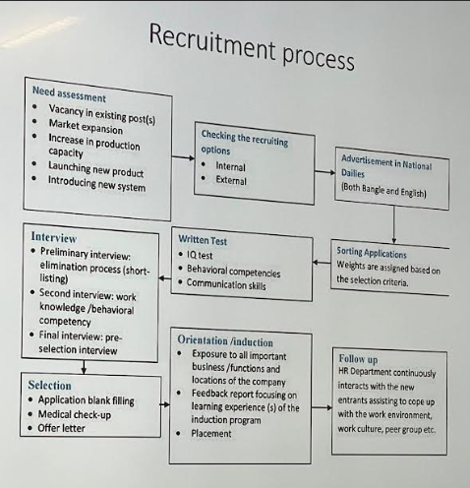
Recruitment of store supervisor (Job Analysis)
Needs assessments are tools that could be used by Tesco to acquire significant perceptions about the actions undertaken by it to effectively determine the vacancy in the company’s existing job role of a store supervisor (Indeed, 2025).
While recruiting a new store supervisor, Tesco will undertake both internal and external recruitment strategies to recruit existing workers and also attract employees from outside the retail store (Balsarini et al. 2023).
Tesco’s employers will advertise for candidates for the job role of a store supervisor in national daily newspapers that contain accurate data about the retail chain, job details, and proper application instructions (Garnett et al. 2025).
Notes:
The recognition of the process of executing this assessment might enable the new store supervisor to launch a fresh product or a new functional system that will help Tesco to achieve success (Indeed, 2025). During the recruitment of a fresh store supervisor, Tesco’s employers will undertake both internal and external recruitment policies to recruit the existing employees and also recruit workers from outside the retail store (Balsarini et al. 2023). The employers of Tesco will advertise for candidates in national daily newspapers for the job role of a store supervisor, which contains appropriate data about the retail chain, job details, and proper application instructions (Garnett et al. 2025).

Slide 6
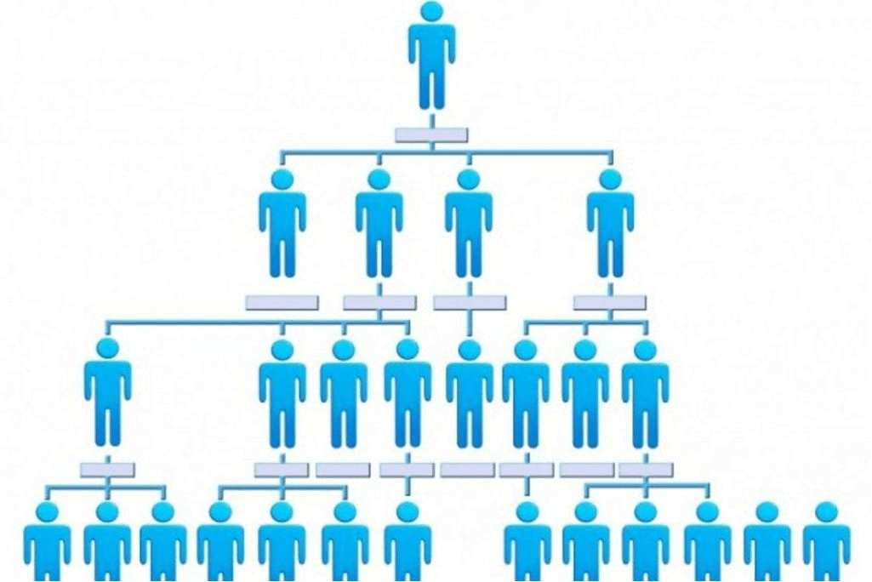
Recruitment of store supervisor (Job description)
Through the conduct of preliminary, secondary, and final interviews, employers at Tesco will assess the customer service skills of a store supervisor who helps the latter to enhance customer loyalty and develop a positive brand goodwill (Hall et al. 2025).
The employers of Tesco will arrange a written store manager test for the new store supervisors to evaluate their essential skills, like attention to detail and scheduling, necessary for the job role (Lin et al. 2022).
To make the hiring of store supervisors easier, Tesco’s employers will ask particular questions in the application forms to analyse their performance ability (Forbes, 2020).
Notes:
The fresh candidate who has applied for the job role of a store supervisor will react to the employer’s question by carefully assessing the requirements of the customers and recognising the positive feedback offered by the customers (Hall et al. 2025). The employers of Tesco will organise a written store manager test for the fresh store supervisors to assess their vital skills, like attention to detail and scheduling, which are required for the job role (Lin et al. 2022). For the flexible shortlisting of new store supervisors, the employers of the retail chain will ask specific questions in the application forms to assess their ability to perform (Forbes, 2020).

Slide 7

Recruitment of store supervisor (Person specification)
The application stage in the selection of a store supervisor at Tesco will be concerned with sorting the qualified or unqualified applicants who made applications for the specific job role (Winton et al. 2025).
Tesco’s employers will conduct an orientation for the new candidates who have applied for the job role of a store supervisor by introducing them to the customers and other employees, and showing them their work environment (Indeed, 2025b).
The new candidates who have applied for the job role of a store supervisor must send a professional email as part of their follow-up process to Tesco’s employers to verify the status of their job application (LinkedIn, 2026).
Notes:
Through the utilisation of gamified assessment methods in the selection phase, Tesco’s employers could shortlist promising candidates who are suitable for the job role of a store supervisor and deliver them offer letters after their selection (Winton et al. 2025). Tesco’s employers will arrange an orientation for the fresh candidates who have applied for the job role of a store supervisor by introducing them to the customers and other workers, and showing them their work environment (Indeed, 2025b). The fresh candidates who have applied for the job role of a store supervisor must send a professional email as part of their follow-up strategy to Tesco’s employers to check the status of their job application (LinkedIn, 2026).

Slide 8

Training and development needs of the store supervisor
Tesco will enable the new store supervisors to concentrate on job roles that will include direct customer communication, fulfill sales goals, and conduct fundamental functional tasks related to the store (Blumberg and Levenson, 2025).
After joining the retail chain, the employers must provide training to the new employees to gather adequate knowledge regarding the retail products and customer service protocols within the first 3 to 6 months (Blumberg and Levenson, 2025).
Notes:
Tesco will help the fresh store supervisors to focus on job roles that will involve direct customer communication, fulfilment of sales objectives, and the conduct of fundamental operational tasks related to the store. After joining the company, the employers must offer training to the fresh employees to collect necessary knowledge regarding the retail products and customer service protocols within the initial 3 to 6 months (Blumberg and Levenson, 2025).

Slide 9

Training and development needs of the store supervisor
Tesco will provide training to the new candidates to enable them to perform effectively in their store supervisor jobs by continuously surpassing sales objectives and maintaining higher customer satisfaction (Blumberg and Levenson, 2025).
The retail chain's employers will guide the new store supervisors to undertake extra responsibilities, such as maintenance of stock records, and also train them to develop their eagerness to undertake leadership roles (Blumberg and Levenson, 2025).
Notes:
Tesco will offer training to the fresh candidates to help them perform efficiently in their store supervisor jobs by constantly surpassing sales targets and maintaining higher customer satisfaction. The retail chain's employers will train the new store supervisors to undertake additional duties, like maintenance of stock records, and also enable them to develop their eagerness to undertake leadership roles (Blumberg and Levenson, 2025).

Slide 10

Training and development needs of the store supervisor
The employers of Tesco will help the new candidates to enhance stable leadership and interaction skills by dynamically witnessing the activities of the existing store supervisors (Blumberg and Levenson, 2025).
The retail chain’s employers will train the new store supervisors to practice offering constructive feedback, allocating tasks, and solving minor conflicts among their subordinates (Blumberg and Levenson, 2025).
Notes:
The employers of the retail chain will enable the fresh candidates to enhance stable leadership and interaction skills by dynamically observing the activities of the prevailing store supervisors. Tesco’s employers will train the new store supervisors to practice providing constructive feedback, allocating tasks, and solving minor issues among their subordinates (Blumberg and Levenson, 2025).

Slide 11
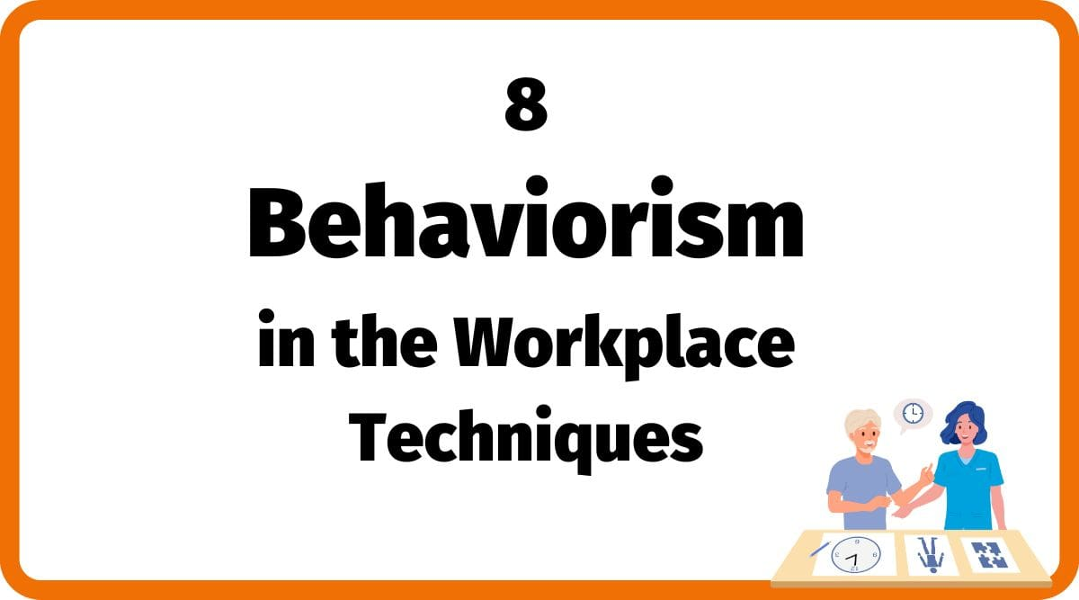
Use of Behaviourist Theory to assess training and development needs
The behavioural learning theory could be used by Tesco’s employers to enhance the involvement and motivation of its store supervisors during the execution of their tasks (Lo Iacono, 2025).
This particular theory emphasises that the work environment in the retail store of the company will frame the behaviour of the store supervisors and determine the method by which they gather information about the store operations (Lo Iacono, 2025).
Notes:
The behavioural learning theory can be utilised by the employers of the retail chain to improve the engagement and motivation of its store supervisors during the conduct of their tasks. This specific theory relies on the idea that the functional environment in Tesco’s retail store will shape the behaviour of the store supervisors and analyse the technique by which they collect data regarding the store functions (Lo Iacono, 2025).

Slide 12

Use of Behaviourist Theory to assess training and development needs
The behaviourist theory is a learning theory that reflects the procedure by which offering rewards and punishments by Tesco’s employers to store supervisors will frame their activities over time (Douphrate et al. 2025).
This specific theory concentrates on the method by which the retail chain’s employers could utilise rewards and punishments to enable store supervisors in the development of effective functional capacity (Douphrate et al. 2025).
Notes:
The behaviourist theory focuses on the techniques by which the retail chain’s employers could use rewards and punishments to help store supervisors in the enhancement of efficient operational capacity (Douphrate et al. 2025).

Slide 13
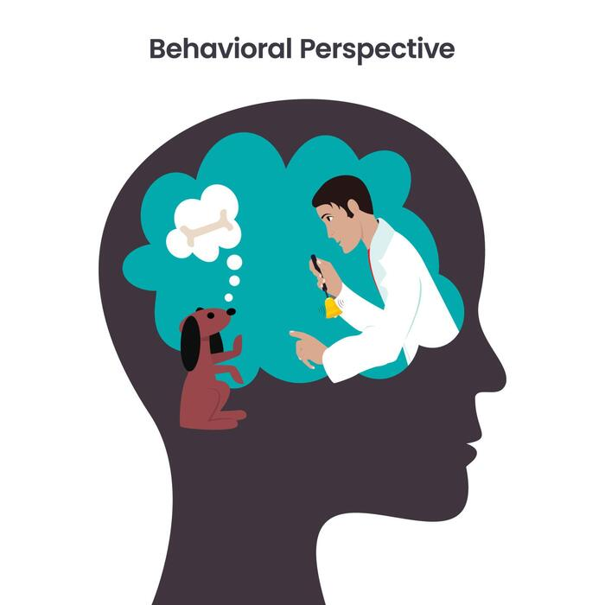
Use of Behaviourist Theory to assess training and development needs
A crucial element of the behavioural theory is positive reinforcement, which will involve rewarding the new store supervisors for reflecting expected behaviours, like bonuses, incentives, or other rewards by Tesco’s employers (Dallow et al. 2025).
This theory focuses on the acquisition of vital and direct feedback, which will enable the fresh store supervisors of Tesco to realise the accurate execution of their tasks and the areas where they need to improve their performance (Dallow et al. 2025).
Notes:
This theory concentrates on the acquisition of important and direct feedback, which will help the new store supervisors of Tesco to recognise the proper execution of their tasks and the areas where they need to enhance their performance (Dallow et al. 2025).

Slide 14

Use of Cognitivist Theory to assess training and development needs
The cognitive learning theory recommends that the new store supervisors of Tesco must actively participate in its store operations (Lawless, 2023).
This theory assumes that the new store supervisor will undertake the particular job role at Tesco by possessing their own skills, knowledge, and necessary data, which they have learned previously (Lawless, 2023).
Notes:
The cognitive learning theory suggests that the fresh store supervisors of Tesco must dynamically take part in its store functions. This theory estimates that the new store supervisor will undertake the specific job role at Tesco by acquiring their own skills, knowledge, and necessary data, which they have learned previously (Lawless, 2023).

Slide 15

Use of Cognitivist Theory to assess training and development needs
Through the application of cognitive learning theory, Tesco’s employers could enable the new store supervisors to feel involved during their training period regarding the execution of retail tasks (James, 2026).
This particular theory could motivate the new candidates to understand their job role as a store supervisor at Tesco by realising the requirements that are expected by their employers (James, 2026).
Notes:
Through the utilisation of cognitive learning theory, Tesco’s employers could help the fresh store supervisors to feel engaged during their training period regarding the execution of retail tasks. This specific theory could encourage the new candidates to recognise their job role as a store supervisor at Tesco by understanding the requirements that are expected by their employers (James, 2026).

Slide 16
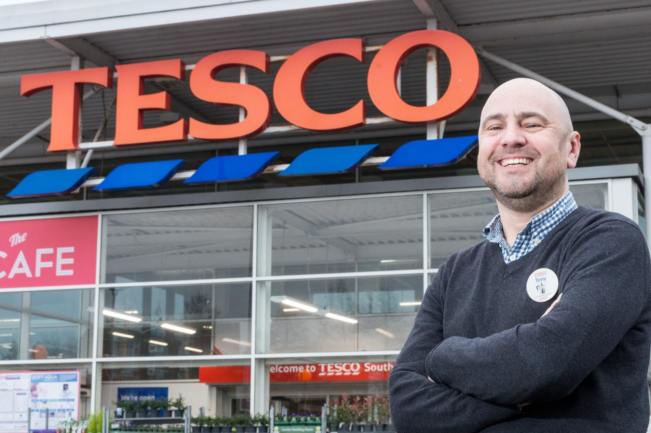
Conclusion
The presentation has offered a brief overview of the UK-based retail store, Tesco, along with providing an outline of the recruitment process for its store supervisor.
The recruitment of the store supervisor at Tesco was conducted in three stages, which are job analysis, job description, and person specification.
Notes:
The training and development requirements of the store supervisor at the retail chain were identified, including the application of suitable theoretical frameworks to analyse those requirements. The two theories that were utilised in this presentation for the assessment of the training and development requirements of Tesco’s store supervisor were the behaviourist and cognitivist theories.

Slide 17
References
Balsarini, P., Lambert, C. and Ryan, M.M., (2023). Why franchisors recruit franchisees from the ranks of their employees. In Relationship Marketing in Franchising and Retailing (pp. 68-88). Routledge. https://api.taylorfrancis.com/content/chapters/oa-edit/download?identifierName=doi&identifierValue=10.4324/9781003364351-5&type=chapterpdf
Blumberg, M. and Levenson, A., (2025). Critical edge: shaping the future of skills management for organizational success. Strategic HR Review, 24(2), pp.85-94. https://www.researchgate.net/profile/Max-Blumberg/publication/386457768_Critical_edge_shaping_the_future_of_skills_management_for_organizational_success/links/6777e4dd00aa3770e0d345a0/Critical-edge-shaping-the-future-of-skills-management-for-organizational-success.pdf
Dallow, G., Williams, L.T., Williams, E. and Rigby, R.R., (2025). Exploring behaviour change skill development during final placements: Practice educator and student perspectives. Nutrition & Dietetics. https://onlinelibrary.wiley.com/doi/pdf/10.1111/1747-0080.70015
Douphrate, D.I., Rodriguez, A., Kines, P. and Hossein Javid, A., (2025). Safety leadership training effectiveness evaluation on behavior change among large-herd US dairy farm supervisors. Workplace Health & Safety, 73(4), pp.180-192. https://journals.sagepub.com/doi/pdf/10.1177/21650799241302817
Forbes (2020), Eight Creative Ways To Sort Job Applications When You’re Short On Time And Funds, Available at: https://www.forbes.com/councils/theyec/2020/10/02/eight-creative-ways-to-sort-job-applications-when-youre-short-on-time-and-funds/ (Accessed: 12 February 2026).
Garnett, P., Mollan, S. and Richards, B., (2025). Counter-hostility as defensive strategy in a hostile takeover: The acquisition of Hillards supermarket chain by Tesco. Business History, 67(5), pp.1247-1269. https://www.tandfonline.com/doi/pdf/10.1080/00076791.2024.2321918
Hall, C.A., Ravnbøl, K. and Pedersen, J., (2025), June. Communicating Circular Design: A ReSuit case study of embedding knowledge of circularity from design to wholesale to shop assistant. In Proceedings of the 6th Product Lifetimes and the Environment Conference (PLATE2025) (No. 6). https://journals.aau.dk/index.php/plate2025/article/download/10315/8230
Indeed (2025), What Is a Needs Assessment? (Plus How To Conduct One), Available at: https://www.indeed.com/career-advice/career-development/needs-assessment (Accessed: 12 February 2026).
Indeed (2025b), Job Orientation Process: Definition and How to Prepare, Available at: https://www.indeed.com/career-advice/starting-new-job/job-orientation-process (Accessed: 12 February 2026).
James, D. (2026). Cognitive learning theory, 360Learning. Available at: https://360learning.com/guide/learning-theories/cognitive-learning-theory/ (Accessed: 12 February 2026).
Lawless, C. (2023). Applying cognitive learning theory to your corporate learning strategy, LearnUpon. Available at: https://www.learnupon.com/blog/cognitive-learning-theory/ (Accessed: 12 February 2026).
Lin, C., Shipton, H., Teng, W., Kitt, A., Do, H. and Chadwick, C., (2022). Sparking creativity using extrinsic rewards: A self‐determination theory perspective. Human Resource Management, 61(6), pp.723-735. https://onlinelibrary.wiley.com/doi/pdfdirect/10.1002/hrm.22128
LinkedIn (2026), What should you do after a retail operations interview to increase your chances of getting hired?, Available at: https://www.linkedin.com/advice/0/what-should-you-do-after-retail-operations-interview-xol5c#:~:text=After%20a%20retail%20operations%20interview%2C%20it's%20beneficial%20to%20follow%20up,points%20discussed%20during%20the%20interview. (Accessed: 12 February 2026).
Lo Iacono, D.V. (2025). Behaviorism in the workplace to engage and train employees, Symonds Research. Available at: https://symondsresearch.com/behaviorism-in-the-workplace/ (Accessed: 12 February 2026).
Smith, D., (2023). Logistics in Tesco: past, present and future. In Logistics And Retail Management insights Into Current Practice And Trends From Leading Experts (pp. 154-183). CRC Press. https://www.academia.edu/download/32403448/1322538297.pdf#page=118
Statista (2025), Tesco PLC- statistics & facts, Available at: https://www.statista.com/topics/3807/tesco-plc/#topicOverview (Accessed: 12 February 2026).
Winton, A., Howcroft, D. and Rubery, J., (2025). Sociotechnical change in British supermarkets: examining the role of labour. New Technology, Work and Employment. https://onlinelibrary.wiley.com/doi/pdf/10.1111/ntwe.70007

