Slide 1
Ethics in Research
http://www.uwtsd.ac.uk/research/research-ethics/

Slide 2
Definitions
Ethics:
"The philosophical study of the moral value of human conduct and the rules and principles that ought to govern it" (CED 2000).

Slide 3
Definitions
Moral:
1: "Concerned with or relating to human behaviour, especially in the distinction between good and bad or right and wrong behaviour".
(CED 2000)

Slide 4
Definitions
Moral:
1: "Concerned with or relating to human behaviour, especially in the distinction between good and bad or right and wrong behaviour".
2: "Adhering to conventionally accepted standards of behaviour".
(CED 2000)

Slide 5
Definitions
Ethics:
"The study of the concepts involved in practical reasoning: good, right, duty, obligation, virtue, freedom, rationality, choice.
Also the second-order study of the objectivity, subjectivity, relativism, or scepticism that may attend claims made in these terms."
(ODP 2005)

Slide 6
ESRC Guidelines
Six key principles of ethical research:
Research should be designed, reviewed and undertaken to ensure integrity and quality.

Slide 7
ESRC Guidelines
Six key principles of ethical research:
Research should be designed, reviewed and undertaken to ensure integrity and quality.
Research staff and subjects must be informed fully about the purpose, methods and intended possible uses of the research, what their participation in the research entails and what risks, if any, are involved. Some variation is allowed in very specific and exceptional research contexts for which detailed guidance is provided in the policy Guidelines.

Slide 8
ESRC Guidelines
The confidentiality of information supplied by research subjects and the anonymity of respondents must be respected.

Slide 9
ESRC Guidelines
The confidentiality of information supplied by research subjects and the anonymity of respondents must be respected.
Research participants must participate in a voluntary way, free from any coercion.

Slide 10
ESRC Guidelines
The confidentiality of information supplied by research subjects and the anonymity of respondents must be respected.
Research participants must participate in a voluntary way, free from any coercion.
Harm to research participants must be avoided.

Slide 11
ESRC Guidelines
The confidentiality of information supplied by research subjects and the anonymity of respondents must be respected.
Research participants must participate in a voluntary way, free from any coercion.
Harm to research participants must be avoided.
The independence of research must be clear, and any conflicts of interest or partiality must be explicit.

Slide 12
Problem Areas…
Research involving vulnerable groups – for example, children and young people, those with a learning disability or cognitive impairment, or individuals in a dependent or unequal relationship.
Research involving sensitive topics – for example participants’ sexual behaviour, their illegal or political behaviour, their experience of violence, their abuse or exploitation, their mental health, or their gender or ethnic status.
Research involving groups where permission of a gatekeeper is normally required for initial access to members – for example, ethnic or cultural groups, native peoples, or indigenous communities.

Slide 13
Problem Areas…
Research involving deception or which is conducted without participants’ full and informed consent at the time the study is carried out.
Research involving access to records of personal or confidential information, including genetic or other biological information, concerning identifiable individuals.
Research which would induce psychological stress, anxiety or humiliation or cause more than minimal pain.
Research involving intrusive interventions – for example, the administration of drugs or other substances, vigorous physical exercise, or techniques such as hypnotherapy. Participants would not encounter such interventions, which may cause them to reveal information which causes concern, in the course of their everyday life.

Slide 14
BBSRC
Honesty:
Regardless of discipline or institution, scientists need to be honest in respect of their own actions in scientific research and in their responses to the actions of other scientists.
This applies to the whole range of scientific work, including experimental design, generating and analysing data, publishing results, and acknowledging the direct and indirect contributions of colleagues, collaborators and others.

Slide 15
BBSRC
All individuals to whom this statement applies must not commit any act of scientific misconduct. Scientific misconduct includes:
  piracy: the deliberate exploitation of ideas from others without acknowledgement;
  plagiarism: the copying of ideas, data or text without permission or acknowledgement;
  fraud: deliberate deception, including the invention of data, and the omission from analysis and publication of inconvenient data.

Slide 16
BBSRC
Openness:
The BBSRC encourages the scientists to be as open as possible in discussing their work with other scientists and with the public.
Once results have been published, where appropriate, the BBSRC expects scientists to make available relevant data and materials to others, on request.

Slide 17
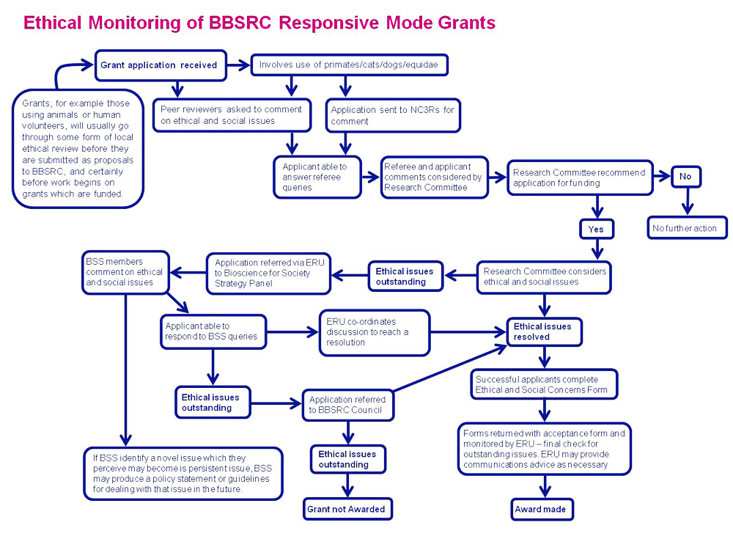

Slide 18
ESRC (again…)
The responsibility for conduct of the research in line with relevant principles rests with the principal investigator.
Where applicable, the responsibility for ensuring that research is subject to appropriate ethical review, approval and monitoring lies with the institution seeking or holding the research award. Institutions should have clear, transparent, appropriate and effective procedures in place for ethical approval whenever it is necessary.

Slide 19
References
Collins English Dictionary (2000) Glasgow: HarperCollins Publishers.
ESRC Framework for Research Ethics (2010). From: http://www.esrc.ac.uk/about-esrc/information/research-ethics.aspx
Oxford Dictionary of Philosophy (2005) Oxford, New York: Oxford University Press.

Slide 20
Links
BBSRC – Biotechnology and Biological Sciences Research Council: http://www.bbsrc.ac.uk/
ESRC – Economic and Social Research Council: http://www.esrc.ac.uk/

