Slide 1
LO3: How to plan for change

Slide 2
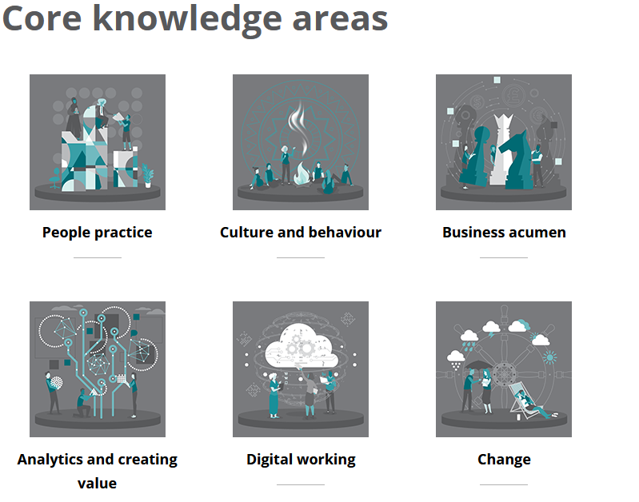

Slide 3

A Planned Approach to Change
Models focus on these stages:
Identify need for change
Define the current state
Envisage the desired future state
Identify the gap
Diagnose capacity for change including barriers and how they can be overcome
Plan actions and behaviours needed to close the gap
Implement required actions
Manage the transition
Constantly reinforce changes, sustain momentum and measure progress
Torrington et al (2017)
Are there any limitations in this approach?
Notes:
Torrington et al (2017):
There are limitations to this approach. It is lengthy, top-down and does not account for people’s emotional response to change.
Although any change initiative needs to be planned, we need to encourage a change ready organisation that is responsive to change (agile). Also need to take account of people’s reactions and involve them in the change.

Slide 4
Tools
Stakeholder mapping
Change plan template
Communications plan (see ACAS guide)
Gantt Chart

Slide 5
Using the Models
Change models are a good starting point
Need to adapt models to fit a real-life situation
Can use model as a framework for a change plan

Slide 6
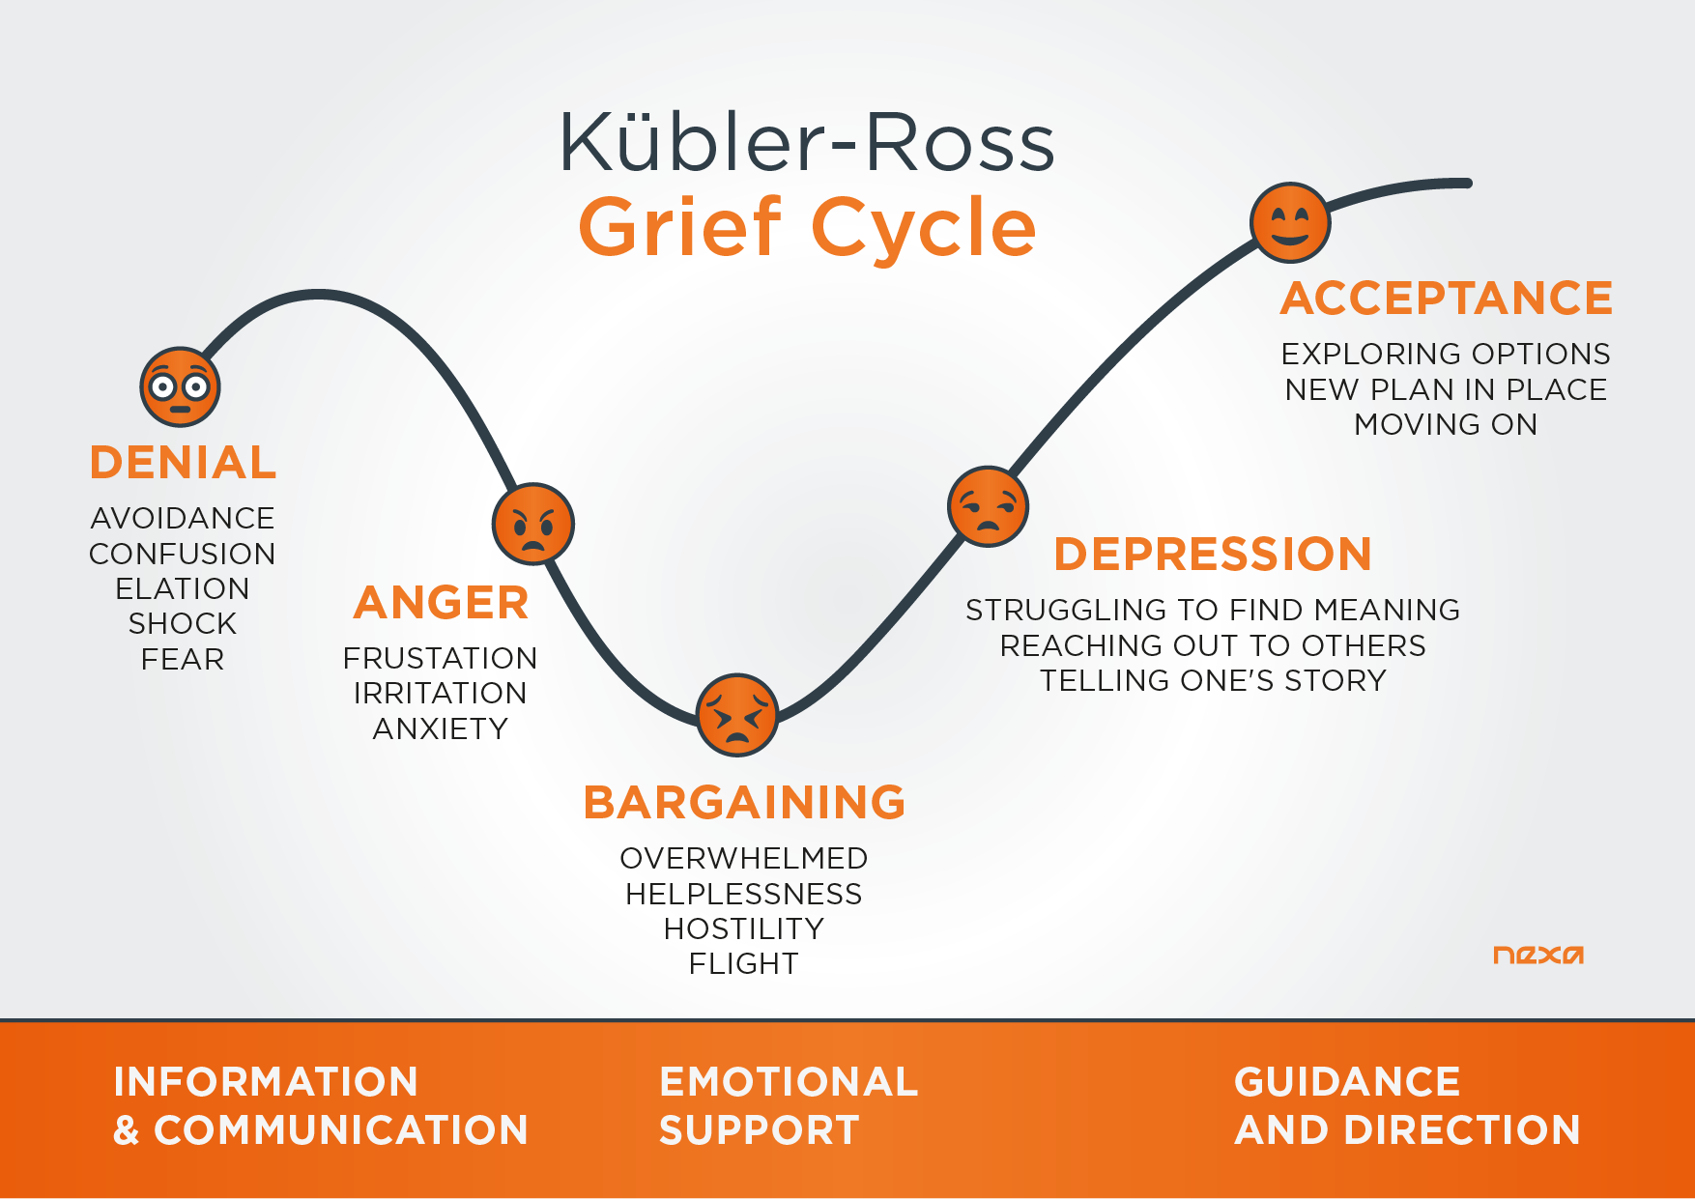
Notes:
In 1969, Elisabeth Kübler-Ross proposed a pattern, a cycle of grief having 5 stages.
We need to understand that it is not necessary that everyone experiences these stages linearly. Some may not even undergo all the 5 stages; some may trace back to the stage they already passed or even get stuck at one of the intermediate step. This cycle was formed as a result of common observations of majority of grieving people.

Slide 7
The DREC Model
How individuals cope with change.
Derived from the Kübler-Ross Model – denial, anger, bargaining, depression, acceptance. Known as the coping/change cycle.
DREC – denial, resistance, exploration, commitment (page 81, Kew and Stredwick, ‘Human Resource Management in a Business Context’, 2016)
It takes time for individuals to work through the cycle

Slide 8
Models of Change to explore
Lewin, Three-step model Unfreezing, movement, refreezing Lewin (1951)
Force-field analysis (Lewin)
Beer’s 6 stage model of change
Notes:
Three step model:
Unfreeze – take action, make changes and involve people
Move – examine the staus quo, increase driving forces for change, decrease resisting forces against the change,
Refreeze - make change permanent, establish new way of doing things, rewards desired outcomes
Force-field analysis – analysing restraining and driving forces within the organisation which oppose or support the proposed change, and then taking steps to encourage the driving forces and decrease the restraining forces.
Beer model – 1990,

Slide 9
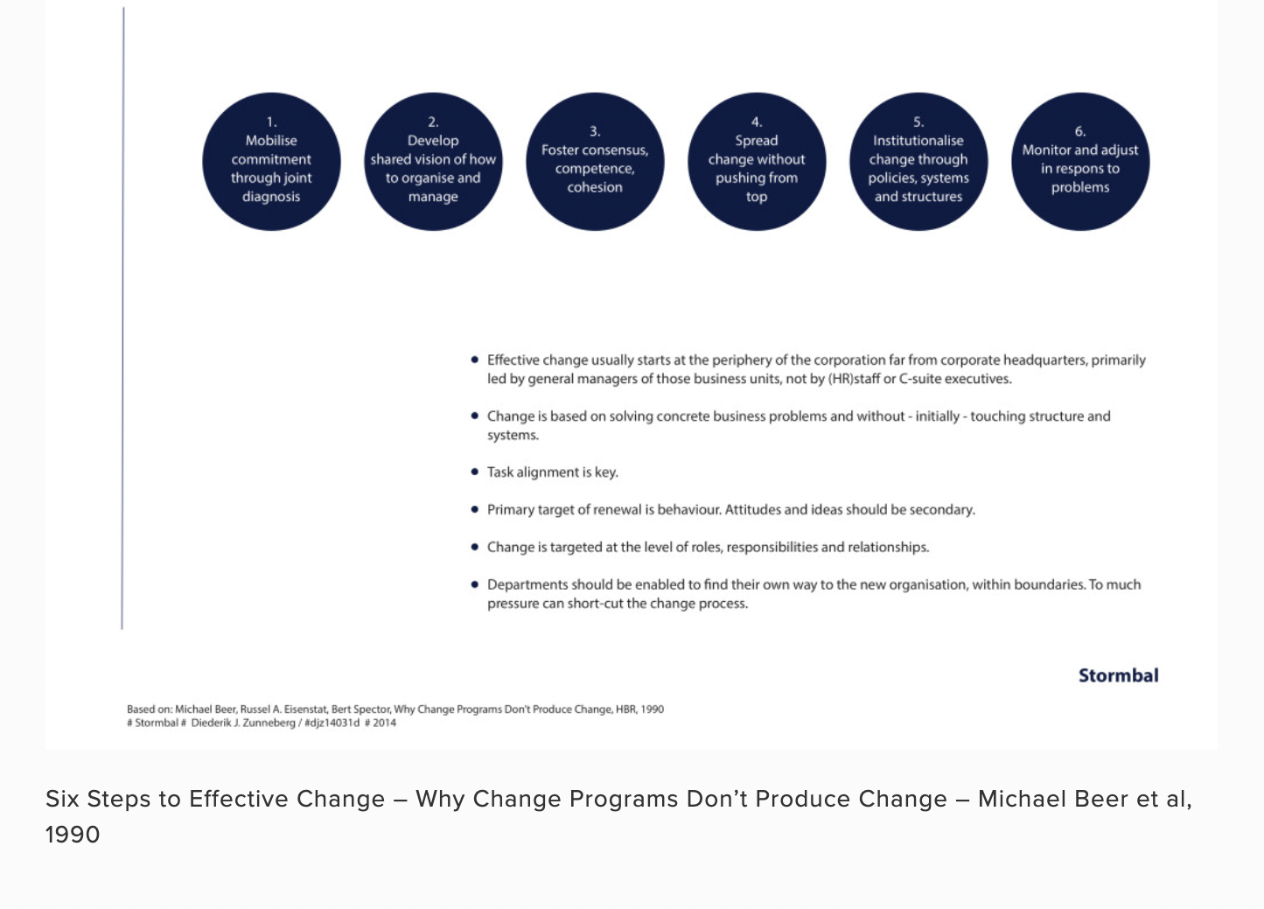
Beer model
Notes:
Beer’s model states that change is more complex than the Lewin model and requires a more in-depth look at the process of change. Beer’s model focuses on a six-step process to achieve effective change, these steps concentrate on ‘task alignment’whereby employees’ roles, responsibilities and relationships are seen as the main component to bringing about effective change. The stages are:

Slide 10

Kotter’s 8 Stage Change Model
Notes:
Useful Resource from SHRM (see Moodle) – tips and tactics for Kotter’s Change Model. https://www.mindtools.com/pages/videos/kotter-change-transcript.htm

Slide 11
Kotter (1996)
1. Establish a Sense of Urgency
2. Create a Guiding Coalition
3. Develop both a Vision and a Strategy
4. Communicate the Vision
5. Empower Employees to Act
6. Generate Short-term Wins
7. Consolidate Gains to Build more Momentum
8. Institutionalise the New Approaches
Activity:
Assess to what extent your organisation followed Kotter’s 8 steps, when the pandemic hit in March 2020.
What did they do at each stage?
Was any stage missed and what were the implications?
What could they have done to improve the management of the change?

Slide 12

Change Plans
If you were planning change, what would be your headings in your change plan?

Slide 13
Change Plan
Vision and objectives, need for change, benefits of change
Specific activities to achieve objectives
Scope of activities
People and roles
Stakeholders and parties affected
Communication strategies
Support strategies
Timings and milestones
Resources – money, time, people, equipment, materials, guidance
Monitoring activities
Success measures

Slide 14
Best Practice - Action Checklist (CMI, 2014)
Agree the implementation strategy
Agree timeframes
Draw up detailed implementation plans
Set up a team of change champions
Establish good programme management practices
Communicate clearly
Ensure participation and help to minimise stress
Personalise the case for change
Be prepared for conflict and manage it effectively
Motivate your employees
Develop skills
Maintain Momentum
Monitor and Evaluate

Slide 15
Communication is Key
Top-down channels
Bottom-up channels
Two-way discussion
Communication needs to be tailored to different groups/stakeholders.
Notes:
Top-down channels – senior managers talking to employees, bulletins, intranet, via line managers in team meetings
Bottom-up channels – employee participation and idea generation. Collective consultation, workshops.
Two-way discussion – one to one meetings with line managers and/or HR.
Communication needs to be tailored to different groups/stakeholders.

Slide 16

Communication Considerations
Level, breadth, depth of information required
Types and methods of communication
Frequency
Need to develop a Communications Plan.
Support requirements – advice, re-training, coaching, mentoring, counselling, representation

Slide 17
Using Technology to Communicate
Use social media platforms to tailor your communications
Communications need to have individual relevance, purpose and meaning (do you ignore general emails?)
Communications need to be quick – millennials expect real-time communication
Use technology to celebrate skill-building – success stories on intranets, badges/training certificates
(McKinsey, 2016)

Slide 18
Communications Road Map (SHRM, 2017)
Audience (Stakeholder) | Key Messages | Delivery Channel(s) | Frequency | Sender
Senior Managers |  |  |  | Project Manager
Staff Users |  |  |  | Supervisor
Notes:
You should determine your stakeholders, key messages, delivery channels, schedule, and responsibilities. Summarise that information in a roadmap to the overall communications plan.

Slide 19
Activity – Group Discussion
Your organisation is bringing in a new piece of software to aid employees’ training and development. For the scenario, consider:
What are your communication objectives?
Who are your stakeholders (audience)?
What are their communication needs?
Which tactics/channels should you use? (social media?)
How frequently will you communicate?
What are the risks that you may not meet your objectives?
How will you measure how successful your communication is?

Slide 20
Techniques for Maintaining Positive Relationships – Building TRUST
Regular and honest consultation and communication
Providing clear rationale for change
Recognising the impact on individuals and teams
Anticipating and acknowledging reactions
Networking and establishing change champions
Resolving differences positively
Actively monitoring relationships and taking steps to maintain them
Providing or signposting relevant support
Notes:
Providing clear rationale for change
Recognising the impact on individuals and teams
Anticipating and acknowledging reactions
Regular and honest consultation and communication
Networking and establishing change champions
Providing or signposting relevant support - EAPs, counselling
Resolving differences positively
Actively monitoring relationships and taking steps to maintain them
Any others?
training and development?
coaching?

Slide 21
4 E’s Principles of Human Change
Educate
Engage
Empower
Enable
(Geraghty, 2019)
Notes:
From the Article on Moodle - ‘Change Management: how to shift the behaviours and mindsets of your people’ (Geraghty, 2019): https://www.hrzone.com/lead/change/change-management-how-to-shift-the-behaviours-and-mindsets-of-your-people
The success of any change programme in an organisation is down to how amenable people are to the transformation – so how can you make them enthusiastic about it?
Managers make the difference when it comes to engagement (Gallup, 2019) so understanding and modifying your own behaviour an make a marked difference to successful change management.
You need to take your people with you, so stop instructing and start involving.
Successful change arises from an interdependence of behaviour and mindset.
If people understand the reason for change and assimilates it into their mindset, change will stick.
Model – 4 E’s principles of human change – a cyclical change model that enables behaviours and mindsets to feed off each other. This also enables people to engage with change and also to build the skills and outlooks required to deliver it.
Educate – provide them with understanding and rationale behind change. Help people to learn and understand. Positive vision of the future.
Engage – a consistent 2 way dialogue that evolves over time – helps buy in to change. Need to satisfy the logical and emotional sides of the brain (the who, what, why as well as job satisfaction, resonating with personal values).
Empower – give them responsibility and ownership of change. Create conditions for empowerment – delegation, trust, setting appropriate boundaries and expectations.
Enable – equip them with skills and structures they need and remove barriers
Tools – Immersion events, but these need to be supported by visible on-going leadership, effective communications and change delivery via the 4 E’s.
If using ‘Nudge’ techniques, need to ensure underlying business culture and structure supports this – no good using nudge behaviours to promote colleague interactions if the underlying culture values silo working.

Slide 22
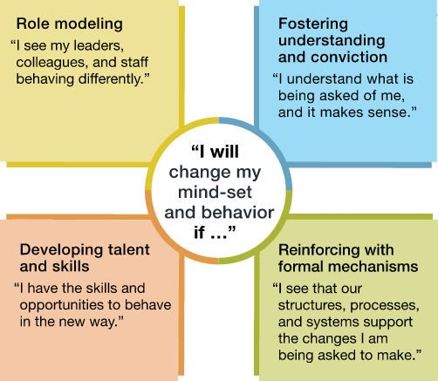
The Influence Model (McKinsey, 2016)
Notes:
Excellent article on Moodle around this – with monkey example story

Slide 23
Encouraging a Change Ready Culture
Thoroughly plan for change
Involve people in planning and implementation
Clearly communicate goals, purposes and potential benefits
Open dialogue to discuss potential issues and actual issues
Quick response to issues raised
Learn from previous change initiatives
Celebrate successful change efforts
Build capabilities – coping with change, transferable skills.
Introduce flexible structures and job descriptions
Notes:
Link to article – HBR – Unifying your companies old guard and new arrivals.
Points:
Rather than criticising elements of processes that are already in place, which may demoralise some staff. Honour the good work of leaders and invite them to help make your ideas successful by sharing their insights.
Whilst equipment, processes or technologies and approaches have been outmoded, that doesn’t mean that workers/operatives are outmoded. It is clear that they realise this.

