Slide 1
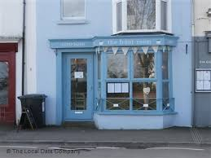
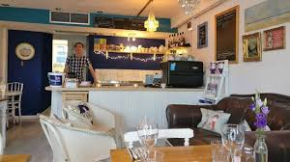
The Front Room, Mumbles
(Google.com, 2019)

Slide 2
Aims and Objectives
To give The Front Room a bigger outreach network.
To give them more connectivity.
To allow customers other ways to book or contact the establishment.
Improve social media

Slide 3
Plan
Bid - February 27th
Pid- March 13th
Report- 8th May
Occasional meetings, regular contact via e-mail

Slide 4
Rationale
Increase footfall
Increase revenue
Raise social media presence
Raise profile of the business

Slide 5
Possible Problems
Time management
Keeping in contact
Finding data out

Slide 6
Research Methodology
Primary Research - Questionnaires, observations
Mixed methods
Secondary Research - News articles

Slide 7
Bibliography
Google.com. (2019). Image: Lovely atmosphere. - Picture of The Front Room Cafe, Mumbles .... [online] Available at: https://www.google.com/imgres?imgurl=https%3A%2F%2Fmedia-cdn.tripadvisor.com%2Fmedia%2Fphoto-s%2F13%2Fbe%2F95%2F1d%2Flovely-atmosphere.jpg&imgrefurl=https%3A%2F%2Fwww.tripadvisor.com%2FLocationPhotoDirectLink-g1905478-d3399413-i331257117-The_Front_Room_Cafe-Mumbles_Swansea_Swansea_County_South_Wales_Wales.html&docid=ZSt-NbiF2Bd6jM&tbnid=pahV7qlY7UK1XM%3A&vet=10ahUKEwig7KHexNfgAhWGRBUIHXjzDaIQMwhEKAQwBA..i&w=550&h=309&itg=1&bih=657&biw=1366&q=the%20front%20room%20mumbles&ved=0ahUKEwig7KHexNfgAhWGRBUIHXjzDaIQMwhEKAQwBA&iact=mrc&uact=8 [Accessed 26 Feb. 2019].
Google.com. (2019). Image: The Front Room on Mumbles Road - Cafe & Tearoom in Mumbles .... [online] Available at: https://www.google.com/imgres?imgurl=https%3A%2F%2Flh3.googleusercontent.com%2Fr40fWCCUWduJZF-cYfHUbIxwJdHkkXRzrwEQrLjloF8d7DbwIBxT1eGrwvUI2bloRLOH3KL1zRGBJ5Qd%3Ds0&imgrefurl=https%3A%2F%2Fcitikey.uk%2Fdisplay%2Fthe-front-room-TMZZ5&docid=zlSMrrqYHMflpM&tbnid=ui7_nMhDcI38fM%3A&vet=10ahUKEwig7KHexNfgAhWGRBUIHXjzDaIQMwhFKAUwBQ..i&w=400&h=300&itg=1&bih=657&biw=1366&q=the%20front%20room%20mumbles&ved=0ahUKEwig7KHexNfgAhWGRBUIHXjzDaIQMwhFKAUwBQ&iact=mrc&uact=8 [Accessed 26 Feb. 2019].

