Slide 1
Communication in Health and Social Care
Self-Awareness Presentation
Module Title: Professional Career Development within H&SC
Module Number: LCHS4009
Assignment No: Assignment 1
Student Name: Ioana Theodora Iacob
Student ID: 2515341
Lecturer’s Name: Soban Sadiq

Slide 2
Acknowledge use of AI
NO AI tools were used in the preparation of this presentation.

Slide 3
Introduction
I am a Level 4 Health and Social Care student studying at the University of Wales Trinity Saint David.
This presentation focuses on Communication as a key skill in health and social care.
I will explain why communication is important, introduce a relevant communication model, and provide a practical example in a healthcare setting.

Slide 4

Communication
Communication is the process of sharing information, ideas, thoughts and feelings between two or more people (Skills for Care, 2024).
It involves verbal, non-verbal and written communication, active listening, and feedback.
I have developed this skill through my university studies, presentations and everyday life.

Slide 5
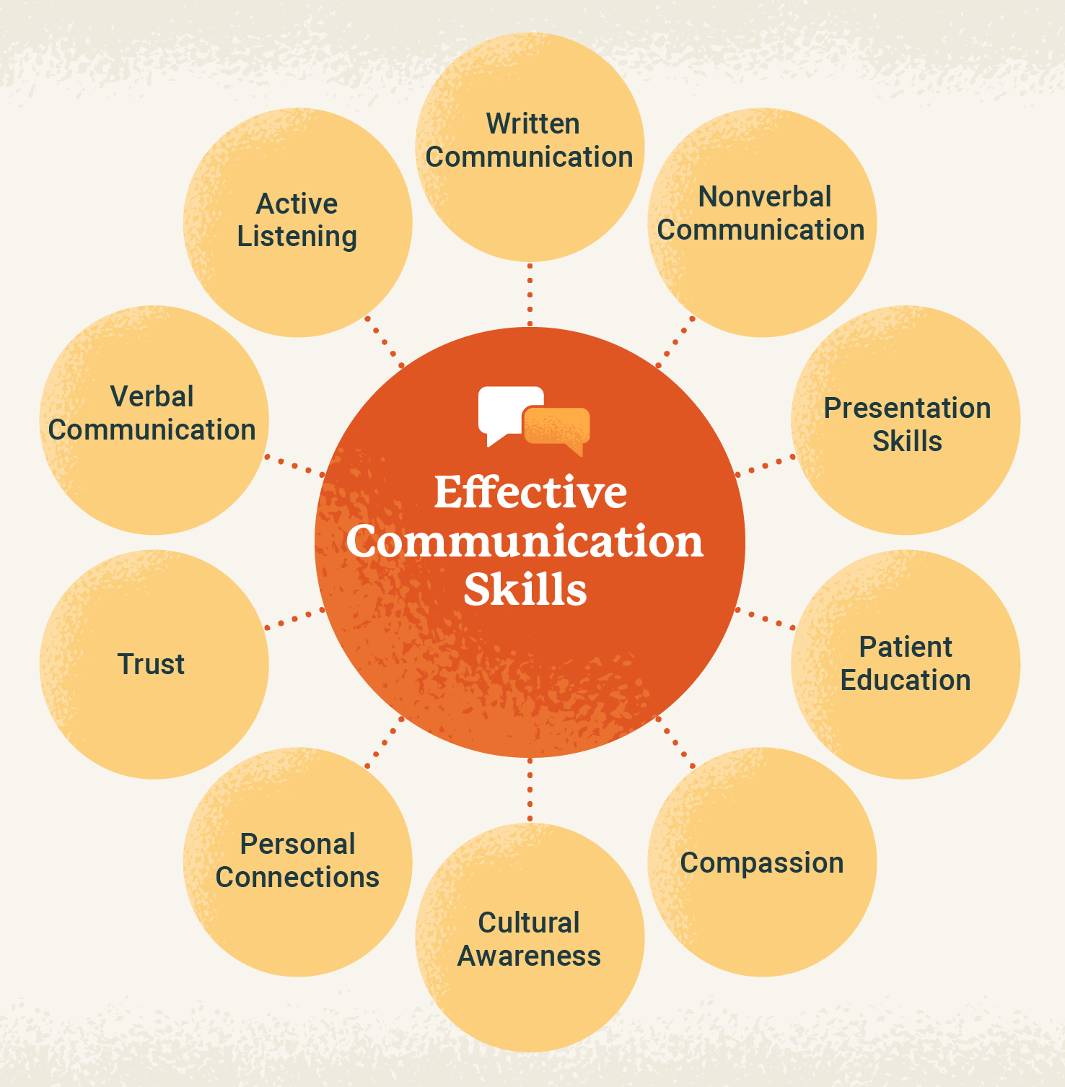
Importance of Communication in professional practice
Communication is essential because it:
Improves patient safety and reduces misunderstandings (Skills for Care, 2024).
Builds trust and positive relationships with service users and colleagues.
Supports teamwork and information sharing between professionals.
Helps organisations to provide safe, person-centred and high-quality care.
Poor communication can lead to errors, delays in care and lower patient satisfaction (NHS England, 2024).

Slide 6
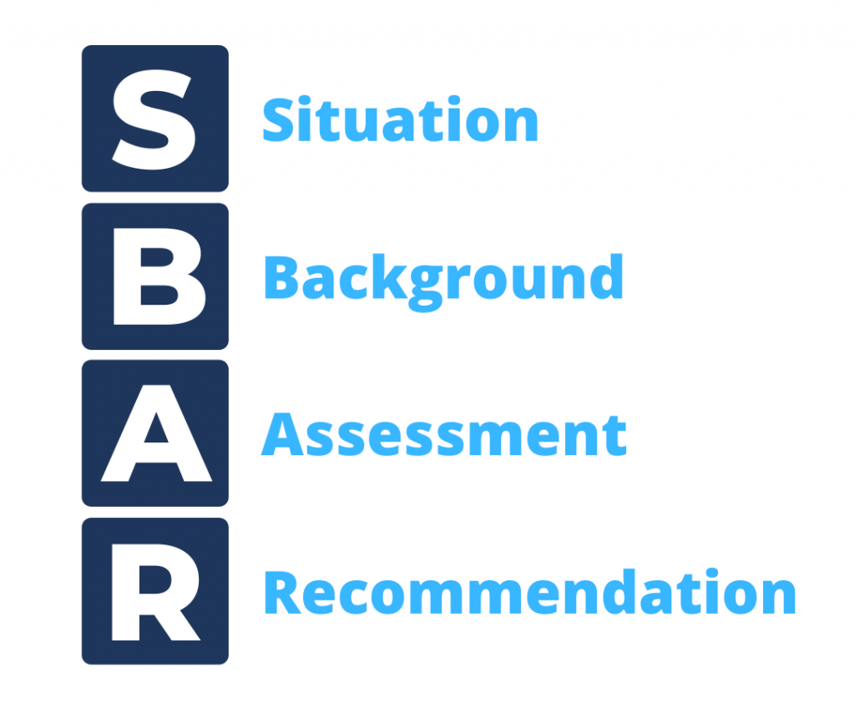
SBAR Communication Model
What is SBAR?
A structured communication tool used in healthcare (NHS England, 2023).
Supports clear and effective communication.
Key stages:
S- Situation
B- Background
A- Assessment
R- Recommendation
How does SBAR help in professional practice?
Improves communication between professionals.
Reduces misunderstandings.
Supports patient safety (NHS England, 2023).
Helps professionals make timely decisions.

Slide 7

Applying Communication in Practice
Where would you use this skill?
Healthcare Assistant on a hospital ward.
What might be the situation?
A patient suddenly develops severe chest pain.
I would use the SBAR communication tool to report the patient’s condition clearly to the registered nurse.
How does the skill guide your actions?
I communicate accurate and relevant information in a structured way to support quick clinical decisions.
What is the impact on care?
Faster response from the healthcare team.
Improves patient safety and quality of care.
Reduces communication errors and misunderstandings (NHS England, 2023).

Slide 8

How does communication support my future career?
Why is this skill important for?
Improves my employability.
Helps me work safely in health and social care.
Reflect briefly on:
I am confident in communicating with others, but I want to improve my communication skills by gaining more practical experience and confidence.
Link to learning outcomes:
This skill helps me provide safe, person-centred care and prepares me for my future career (NHS England, 2023).

Slide 9
Conclusion
Communication is essential for safe and effective health and social care.
The SBAR communication model supports clear and structured communication.
Good communication improves teamwork, patient safety and quality of care.
I will continue developing my communication skills to become a confident healthcare professional.

Slide 10
References List
NHS England (2023) SBAR Communication Training for Primary Care and Community Teams. Available at: https://learninghub.nhs.uk/catalogue/SBAR/about (Accessed: 3 July 2026).
NHS England (2024) The NHS Patient Safety Strategy. Available at: https://www.england.nhs.uk/patient-safety/the-nhs-patient-safety-strategy/ (Accessed: 3 July 2026).
Skills for Care (2024) Effective communication. Available at: https://www.skillsforcare.org.uk/Support-for-leaders-and-managers/Developing-leaders-and-managers/Manager-induction-standards/4-Effective-Communication.aspx (Accessed: 3 July 2026).

