Slide 1
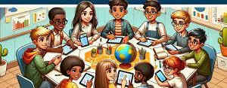
Collaborative Learning in Global Business
Student name: Monica Tamara Antonache

Slide 2
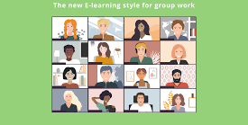

Introduction to Collaborative Learning
Through Collaborative Learning, individuals can have the opportunity to build skills in effective communication, listening and coordinating with others on global business teams working in multiple cultures, countries and time zones (Chen & Hird 2006).
Interactions in group settings introduce learners to many cultural perspectives, allowing them to modify their communication style and build cultural sensitivity. That will prepare them to communicate effectively in a workplace that operates within a global environment (O'Donnell & Hmelo-Silver 2013).

Slide 3


Enhancing Motivation for Global Teamwork
Collaborative Learning has enhanced learners' motivation to succeed within global teams by providing a peer-supportive environment that emulates global team dynamics where cooperation leads to successful outcomes (Cantwell and Andrews 2002).
When learners engage in collaborative learning, they will gain confidence and demonstrate greater levels of engagement and interest in the professional workplace, traits that directly correlate with enhanced performance within multinational organisations (Chen 2008).

Slide 4

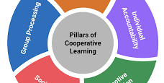
Digital Collaboration Skills
The use of technology within Collaborative Learning Environments creates the needed development of digital fluency and the skill set necessary for successful remote teamwork and the ability for effective collaboration within an increasing hybrid/virtual business environment (Valtonen, et al. 2021).
Technology-enabled Collaborative Learning has produced many similar workflows to those commonly utilised within International Corporations (Voogt et al. 2015).

Slide 5
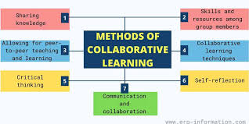
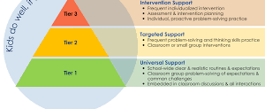
Collaboration Improves Global Problem-Solving
Collaborative Learning promotes the way learners think analytically and allows them to approach business issues from a multidisciplinary and multicultural viewpoint (Johnston et al. 2000).
The process of Collaborative Problem Solving is like developing global business strategies where team members assess various cultural perspectives before developing creative solutions (Singh 2009).

Slide 6
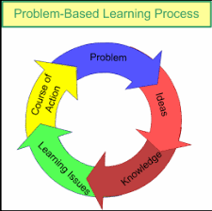
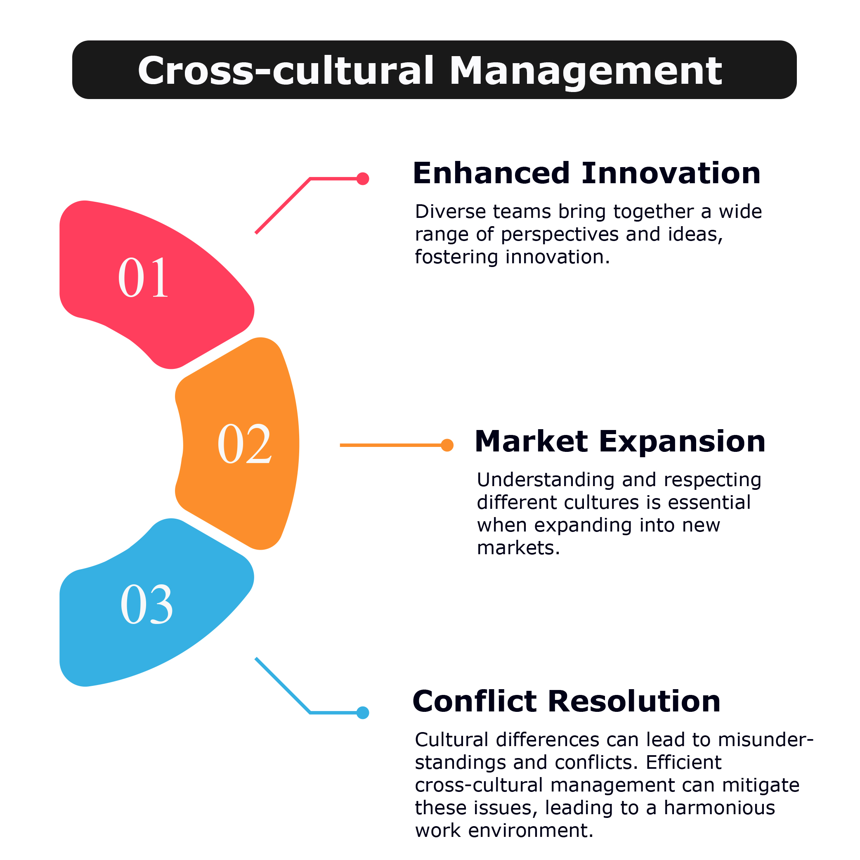
Cross-Cultural Challenges in Global Teamwork
Global Teams face common challenges including communication breakdowns, cultural misinterpretations, and different levels of expectation concerning the roles of team members. Learners who take part in collaborative learning will also face the same difficulties (Stacey 1999).
By developing a clear role structure for learners and providing them with clear communication expectations, as well as collaborative rules and guidelines, global businesses will assist learners in managing these complexities associated with global teamwork (Barfield 2003).

Slide 7
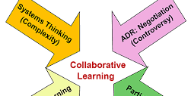

Preparing Future Professionals for Global Leadership
Through Collaborative Learning, individuals will build leadership skills, including the ability to resolve conflicts, understand and demonstrate empathy towards others, coordinate activities, and negotiate successfully, skills that will be expected from future leaders of global organisations (Boud, Cohen & Sampson 1999).
Through Diversity in peer interactions, learners will be prepared for leading multicultural teams effectively (Vygotsky 1978).

Slide 8
References
Barfield, R. L. (2003). Students’ perceptions of and satisfaction with group grades and the group experience in the college classroom. Assessment & Evaluation in Higher Education, 28(4), 355–369.
Boud, D., Cohen, R., & Sampson, J. (1999). Peer learning and assessment. Assessment & Evaluation in Higher Education, 24(4), 413–426.
Cantwell, R. H., & Andrews, B. (2002). Cognitive and psychological factors underlying secondary students’ feelings towards group work. Educational Psychology, 22(1), 75–91.
Chen, H.-C. (2008). Cooperative learning on second/foreign language education: Theory and practice. Acad J Kang Ning, 10, 197–216.Chen, R. Y., & Hird, B. (2006). Group work in the EFL classroom in China: A closer look. RELC Journal, 37(1), 91–103.
Johnston, C. G., James, R. H., Lye, J. N., & McDonald, I. M. (2000). An evaluation of collaborative problem solving for learning economics. Journal of Economic Education, 31(1), 13–29.
O’Donnell, A. M., & Hmelo-Silver, C. E. (2013). Introduction: What is collaborative learning? In The International Handbook of Collaborative Learning (p. 15). Routledge.
Singh, P. J. (2009). The nature and effectiveness of collaboration between firms, their customers and suppliers. Supply Chain Management, 14(3), 189–200.
Stacey, E. (1999). Collaborative learning in an online environment. Journal of Distance Education, 14(2), 14–33.
Valtonen, T., Leppänen, U., Hyypia, M., Kokko, A., Manninen, J., Vartiainen, H., … Hirsto, L. (2021). Learning environments preferred by university students: A shift toward informal and flexible learning environments. Learning Environments Research, 24(3), 371–388.
Voogt, J., Fisser, P., Good, J., Mishra, P., & Yadav, A. (2015). Computers for schools: Technology integration in education -The way forward. International Journal of Educational Research, 48, 133–142.
Vygotsky, L. S. (1978). Mind in society: The development of higher psychological processes. Harvard University Press.

