Slide 1
CertHE Skills for the Workplace
Module: BMSK4005
Professional Career Development

Slide 2

Overview of Session 1
Applying SWOT
SMART Goal
Go Mad model
Learning Cycle

Slide 3

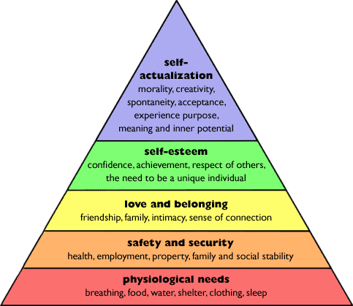
Maslow’s Theory of Needs
Notes:
A. H. Maslow (1943)developed a theory of about human motivation following research done in United states. His theory known as hierarchy of needs gives a number of hierarchical levels to explain motivation. Firstly they are physiological needs. Maslow said we are only motivated to fulfil all our safety needs when we have fulfilled our physiological ones. Thirdly there is sense of belonging wit others and fourthly we have esteem needs. the notion of self actualisation – state on top of his hierarchy of needs where a person is engaged in a an activity that they lose all track of time. Progression through his hierarchy was based on the notion that once a need was satisfied it was no loner acted as a motivator. Self actualisation was exception to this rule- once you have experienced it you want it more. It refers to the desire for self-fulfillment, namely, to the tendency for him to become actualized in what he is potentially. This tendency might be phrased as the desire to become more and more what one is, to become everything that one is capable of becoming
Classifications of motivations must be based upon goals rather than upon instigating drives or motivated behaviour. Taking time to look in depth at what motivates you and forms the basic foundations of change.
10. Motivation theory should be human-centered rather than animal-centered

Slide 4
Self assessment – Skills Audit
Organisational developments
competencies
Work itself
Demands of current post
Reflection
Aspiration/ dreams
Feedback form others
Notes:
Developing ‘extraordinarily realistic self-image (ERSI)’ – Inglis 1994 – so you know where you are at the beginning of the journey
Refelction – in our view crucial skills required for our development through refection of own abilities
Feedback – useful to check our capacity and might prvide us with food for thought – another means of feed back is psychometric & Self diagnostic questrionnres about ourselves and can leed to a slef insight and compare ourselves to others.
Organisational – its about functional or leadership competencies are an attempt to influence us by our employers with a view to working according to their strategic direction.
Work Itself – is an immediate emergency that encourages us to take action – a pressing problem that needs us to take an immediate action or we might not achieve our target.

Slide 5

Measuring Personal Effectiveness

Slide 6
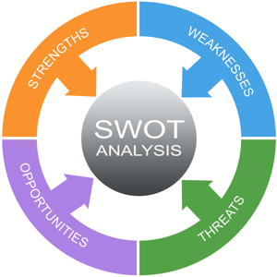
SWOT Conversion Strategies

Slide 7
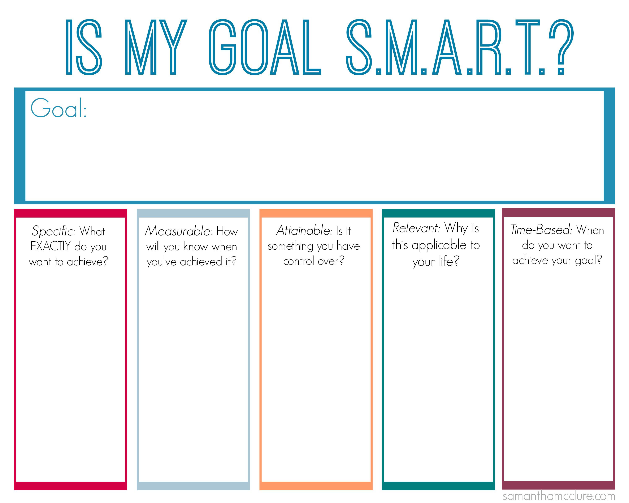

Slide 8
Complete Learning Log
Complete setting yourself a SMART gaol
Further reading: Research Go MAD model

