Slide 2
Marketing Essentials
BMIH4005

Slide 3
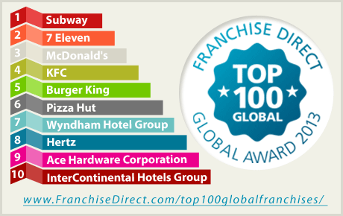
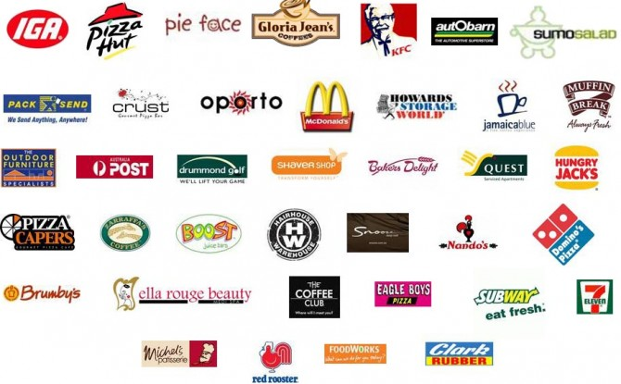
‘OST’
Licensing & Franchises

Slide 4
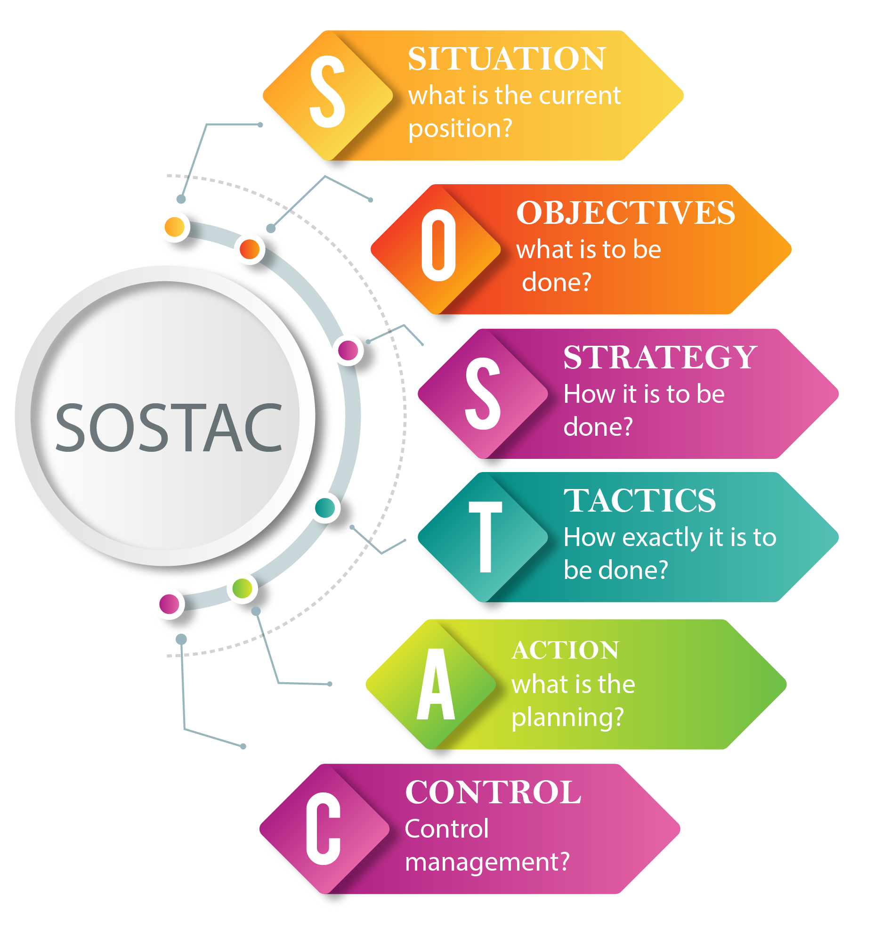
Objectives
Tactics
Strategy

Slide 5

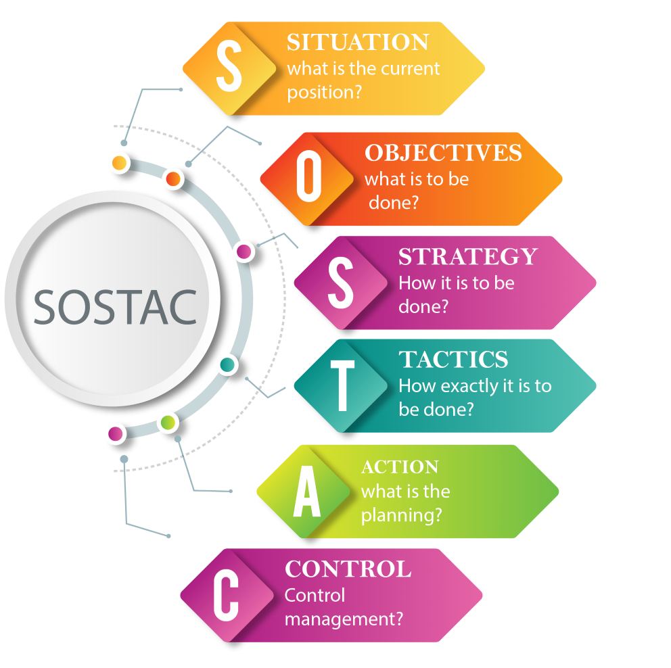
Objectives
S.M.A.R.T. Goals are…
Specific - What are you going to do? (be specific, don’t be vague)
Measurable – what will be achieved? Quantitative metric.
Attainable – This is ‘Do-able’ because?
Realistic – what's the likely outcome?
Timely – What is the deadline?
“I am going to manage a promotional campaign targeting (Customer segment/profile) addressing the concerns raised from examining customer feedback and reviews (Found from your situational analysis 5C’s)……”
“I will attract 1000 new customers and 100,000 online customer interactions over an 18 month campaign…….”
“ 55 new customers, 5,555 interactions per month over 18 months….”
“This will elevate customers concerns, raise brand awareness and attract a realistic return…….”
“By When?”

Slide 6

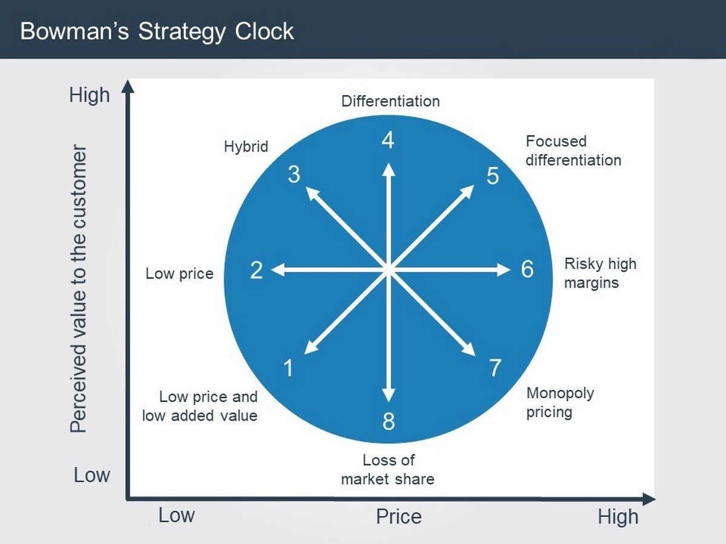
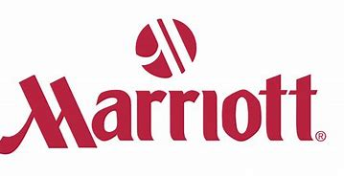

Strategy
Strategy summarises how your objectives will be achieved
Discuss and explain your organisations value proposition. A value proposition is the “the full mix of benefits on which a product is differentiated and positioned. It is the answer to the customer’s question ‘why should I buy your product?’” - Kotler et al. (2018, p.232).
How will you communicate the value proposition, how will it be delivered,
Which channels? Why? Link to customer segments/profiles.
“If you propose the brand needs repositioning you may wish to use Bowmans strategy clock to highlight the change! Or to confirm/reinforce its current position”

Slide 7
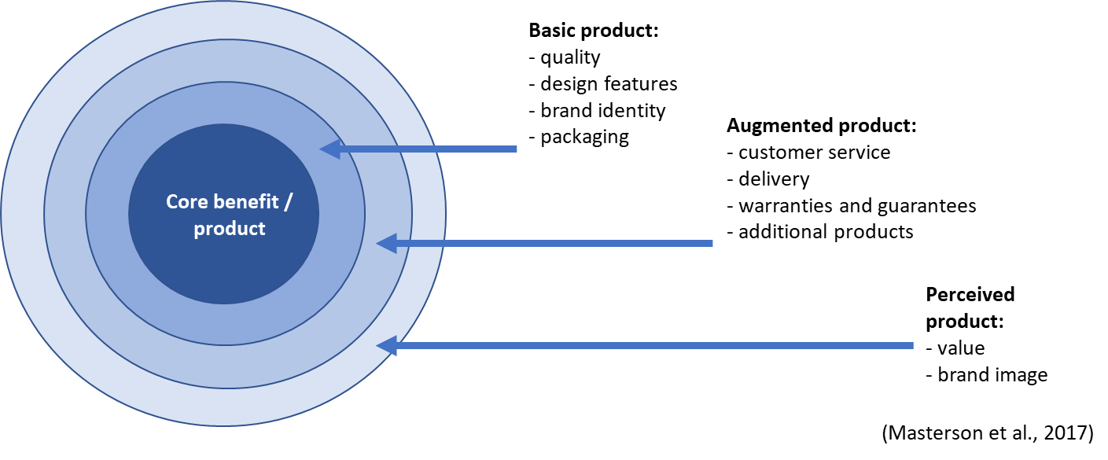
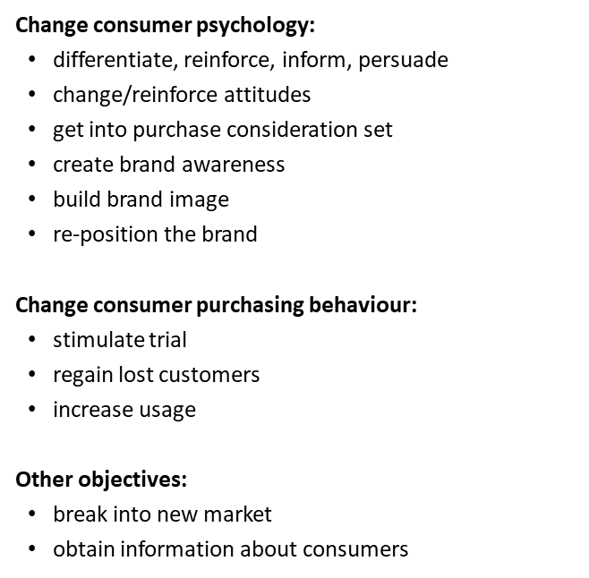
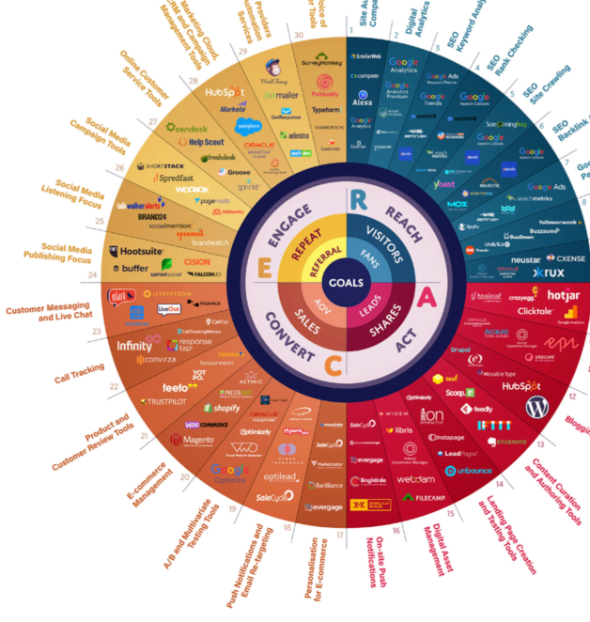
Tactics
Marketing Mix
Product – Describe the product -
are you making changes with your marketing plan?
Price – what is the pricing strategy? Promotion? Loss leader?, budget?, luxury?. Pricing strategy? Discuss…
Place - Distribution! how can a consumer make purchase/book a service? , (online, phone, etc.) Channels…
Promotion – RACE / Communications mix
what will be the purpose of communications?

Slide 8
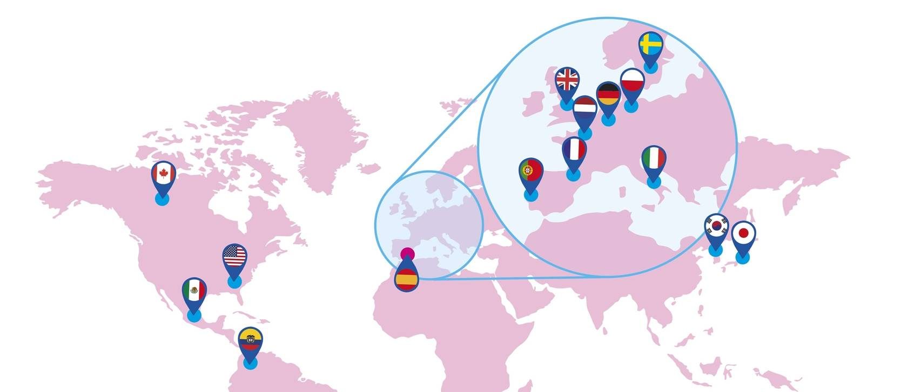
Internationalisation, Advertising & Branding Strategy
Week 8

Slide 9
Brands: The Fundamentals
A brand includes a unique name, symbol, logo, colour, or registered trademark as well as a unique package design (Foroudi et al., 2017).
A brand plays an important role in notifying consumers about the maker of a product (Jin et al., 2019).
A brand protects consumers and producers from competitors who attempt to provide similar products in a competitive market.
Kotler and Armstrong (1996) argued that a company defines its brand not only as its own product or service, but also by reference to design, a name, a trademark, or all of these elements that it uses to differentiate its products or services from those of its competitors.
A brand can be described as a “cluster of values” (de Chernatony, 2009, p. 104).
Notes:
A recap on what we have looked at with Brands.

Slide 10
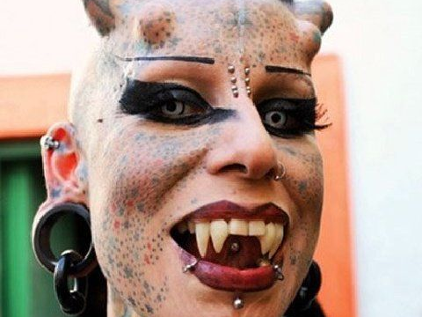
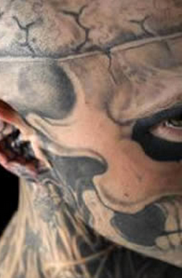
Identity
The term “identity” is widely used in various academic disciplines such as psychology, sociology, communications and marketing. Identity generally connotes individuality, uniqueness or the characteristics or distinctiveness of a given person, organization, product, or service (Ghodeswar, 2008)

Slide 11
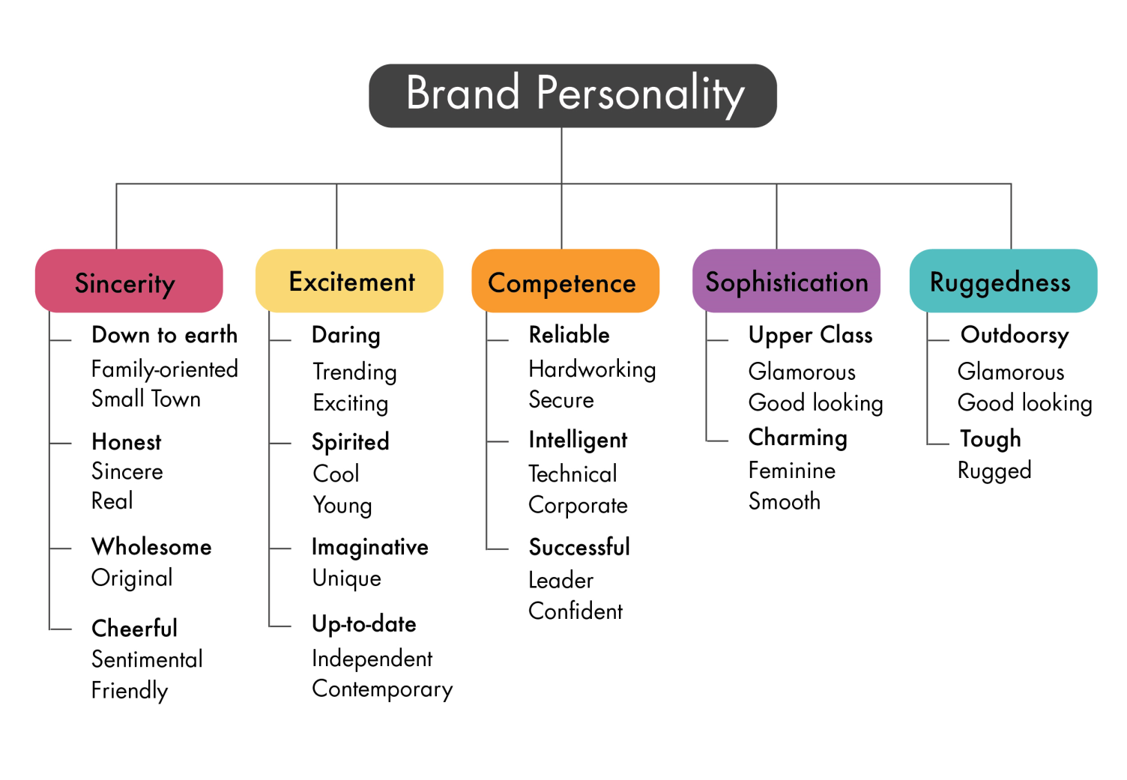
Aaker’s Brand Personality Dimension Model
Brand personality reflects “the set of human characteristics associated with a brand” (Aaker, 1997).
Brand personality forms part of a brand image held by consumers and refers to the anthropomorphisation of brands (Aaker, 1997)
Brands are treated like a person with whom one might like to form a relationship
Notes:
recap

Slide 12


Slide 13
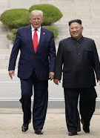
What is International Branding?
According to Whitelock and Fastoso (2007, p. 266), “international branding is a field within international marketing concerned with the challenges that companies face when their brands cross national borders. These challenges relate to the essence of the brand in terms of brand name, brand visual (e.g. logo, colours) and sound elements (e.g. jingles, music), and brand personality”.
More recently, however, international branding appears to apply to the whole complex of decisions involved in the development of a brand at an international level.
de Chernatony et al. (1995, p. 10), for instance, talk about the “international brand‐planning process” as one that affects decisions in relation to two elements of a brand: the brand's “core essence” (i.e. brand personality and positioning), and the brand's “execution” (through, e.g. media and advertising).

Slide 14
Simply……
International branding shares the basic brand management and development techniques as the domestic counterpart, except that a firm must operate in an unfamiliar macro-marketing environment.
The macro-marketing environment in any overseas market comprises, economic, sociocultural and technological elements (Preble, Rau, & Reichel, 1988; Subramanian, Fernandes, & Harper, 1993).
Compared with a firm’s domestic customers, customers within an overseas market may also have different tastes, preferences, values, expectations, and behaviours.

Slide 15
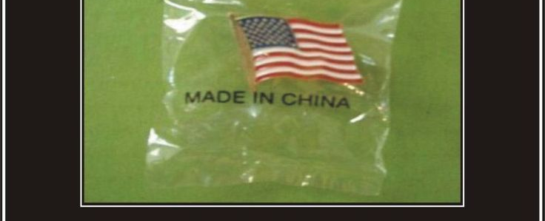

The International Problem
Advertising messages should be congruent with the values of local culture has been long advocated (Zhang and Gelb, 1996; Boddewyn et al., 1986; Belk et al., 1985; Harris, 1984; Hornik, 1980; Buzzell, 1968).
Pollay and Gallagher (1990) summarized this position by noting that cultural values are the core of advertising messages and typical advertisements endorse, glamorize and reinforce cultural values.
Empirical studies have found that advertisements reflecting (some) local cultural values are more persuasive than those that ignore them (Gregory and Munch, 1997; Taylor et al., 1997; Han and Shavitt, 1994; Hong et al., 1987; Madden et al., 1986; Marquez, 1975).
Notes:
Video discusses marketing examples of linguistic and cultural failure in internationalisation

Slide 16

Current Advocacy: Three Approaches
Global- One message no change but translated.
Glocal - standardized creative strategy with highly adapted execution depending on audience.
Local Highly adapted creative strategy accompanied with highly adapted execution, often made and managed locally to capture the social prevalent trends and idealisms (large scale coordination).
Notes:
Overal we can look at international marketing in 3 ways –
Global – the same in every way except for language, (lower cost, easier to implement, metrics can be general)
Glocal - same artistic approach and overall aim, but culture, nuances and message can be adapted)
Local – highly tailored approach marketing “nodes” where strategy will be devised and implemented locally (branding is often still centralised).

Slide 17
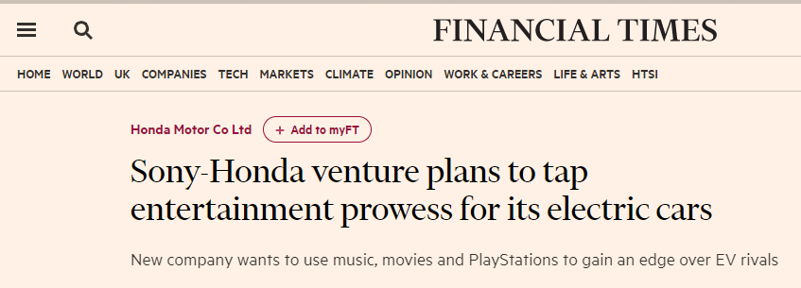
Mode of internationalisation
Contractual agreement with entity or supplier
MNE ‘buys’ a stake in the organization
Non-equity/low investment
Equity
Licensing/
Franchising
Turnkey project
(Built For sale, Leaseback)
Strategic alliance
(i.e. R&D agreement)
Wholly owned subsidiary (Buy)
Exporting (New markets)
Joint venture
Greenfield
(From scratch)
Brownfield/
Acquisition
(Development)
Notes:
MNE = multinational enterprise
Different internationalisation methods,
Equity –
Joint venture example Honda and Sony - sony to make the entertainment and some electrical systems Subscribe to read | Financial Times (ft.com) Sony Honda Mobility Inc. | Top (sony-honda-mobility.com)
Non equity –
SA – a short term agreement for joint operations on a project.
Turnkey – built to sell , business is created and sold for quick turnover (often then retained as subcontractors or suppliers)
We are going to focus on franchising/licencing/turnkey and exporting to new markets.

Slide 18
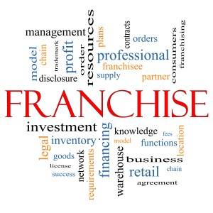
Characteristics of Hospitality Companies
What is franchising?
A franchise is a business whereby the owner licenses its operations—along with its products, branding, and knowledge—in exchange for a franchise fee.
The franchisor is the business that grants licenses to franchisees.
This Photo by Unknown Author is licensed under CC BY-NC-ND
Notes:
Ask the students how many franchise business are they aware of ? Put in chat box

Slide 19

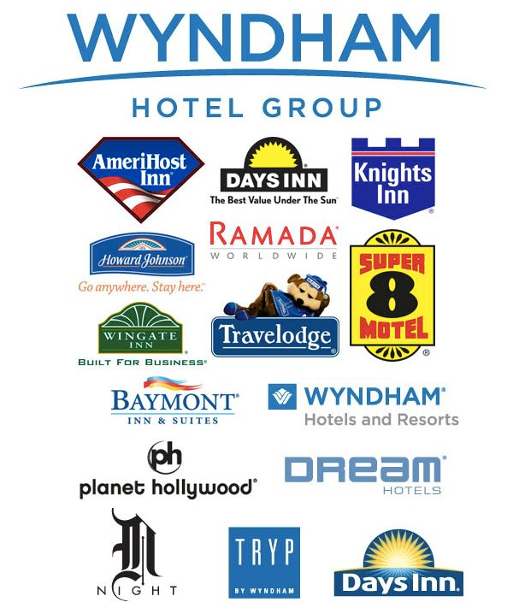

Franchise agreements
Business format franchising a franchisor develops a business concept that the franchisees replicate and operate on the franchisor's behalf (Brookes et al 2015)
The franchisees buy the right to use the franchise brand-name, trademark, operating system, and technical and marketing support for a contractually determined period.
The franchisee pays up front fees, ongoing advertising fees, & royalty fees based on a percentage of gross sales, very popular within the quick-service restaurant (QSR) sector.
With the original franchisor said to be Ray Kroc who began franchising McDonalds.
Wyndham Hotel Group are reported to be the largest hotel franchisor in the World owning Dolce, Wyndham Grand Hotels & Resorts, Wyndham Hotels & Resorts, Wyndham Garden hotels, Tryp, Baymont Inn, Days Inn, Howard Johnson, Knights Inn, Microtel, Ramada, Super 8, Travelodge, Hawthorne Suites and Wingate Inns by Wyndham.
They have approximately 7,670 hotels and nearly 667,000 rooms in more than 70 countries

Slide 20
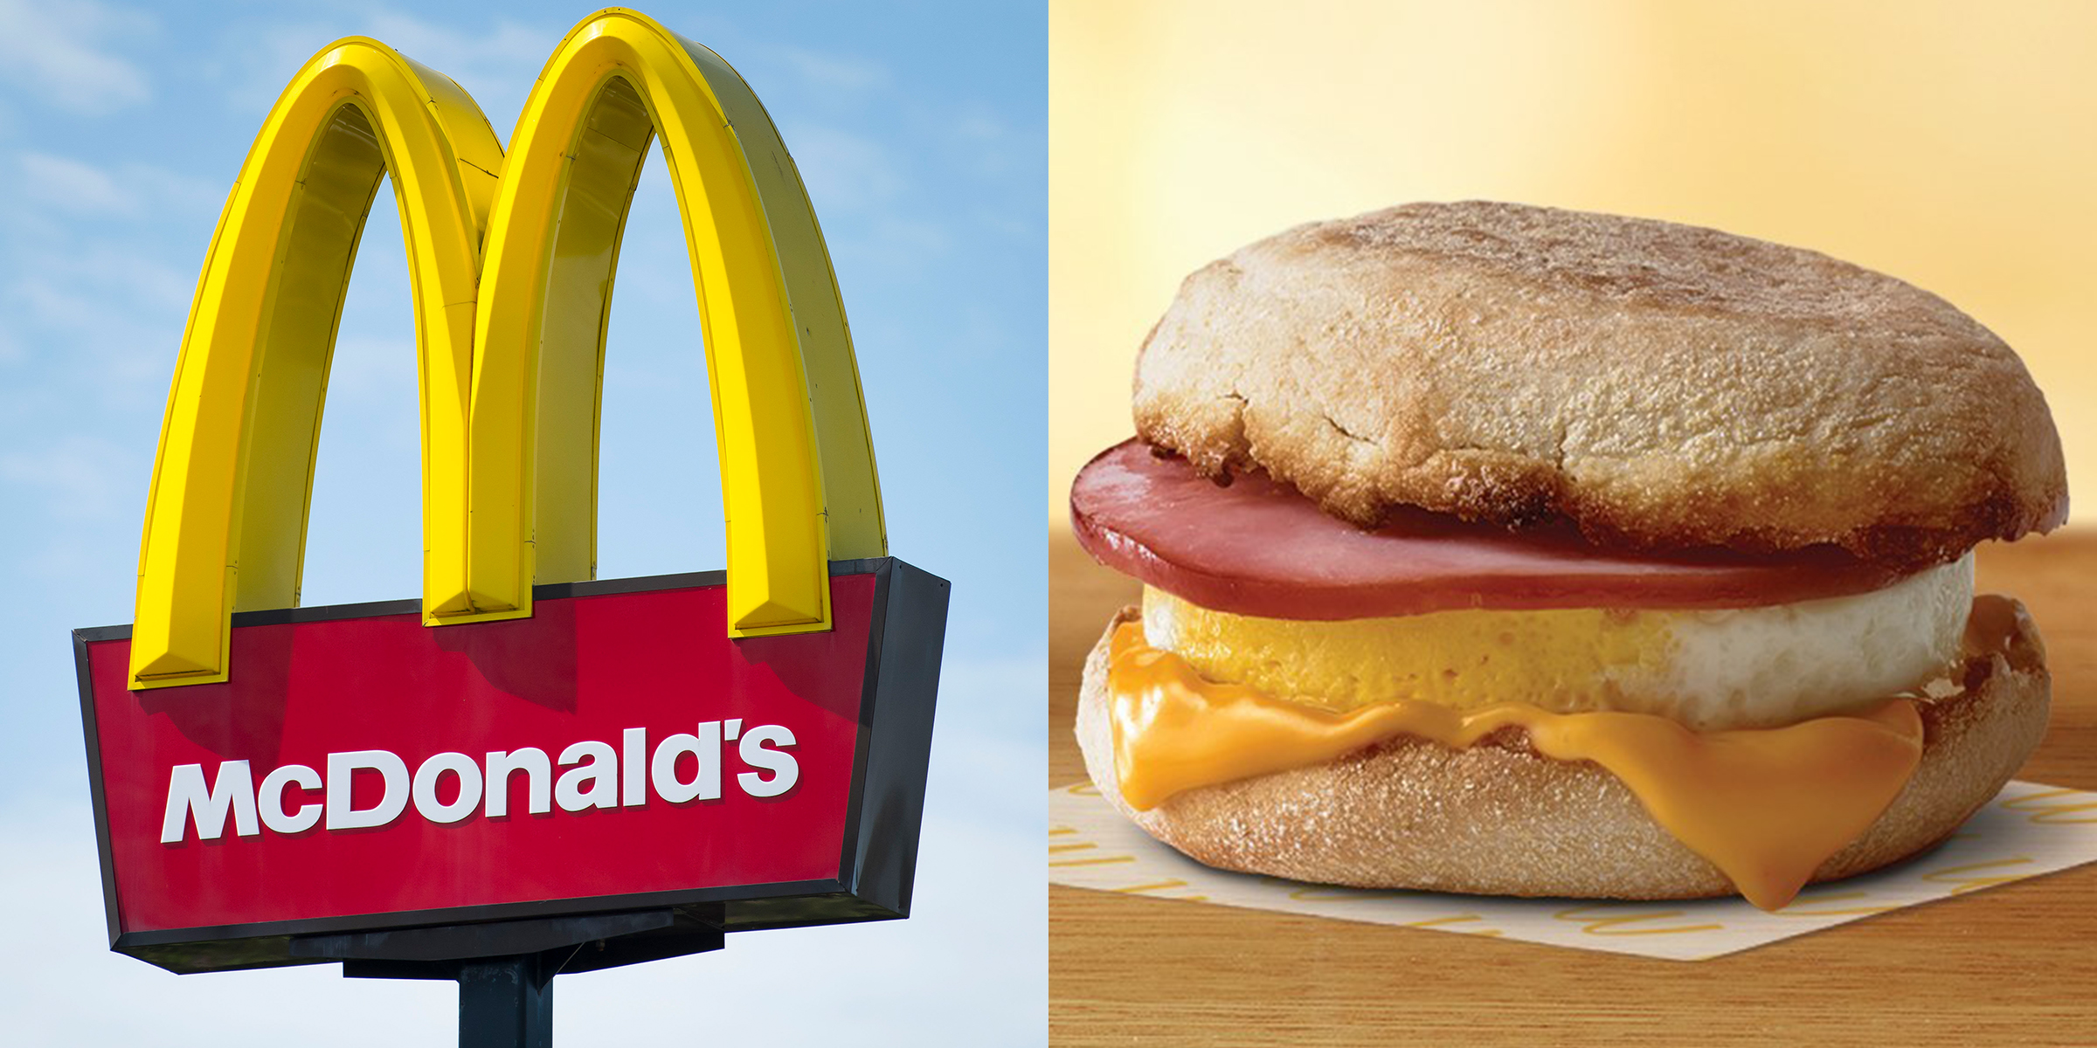
Plural organisations
McDonalds restaurants are approximately 80% franchised and 20% owned.
The logic behind this approach is that this particular mix of entry modes allows the franchisees to be more responsive to local markets, they can test new products in response to local customers, but also then have the wider support of products being tested first within owned units
The Egg McMuffin was tried and tested in corporate-owned units before it was added to menus across the franchise network, even though the idea had come from a Franchisee who saw the need of a breakfast sandwich for his local customers.

Slide 21

June 2019, 80% of all McDonald’s UK franchised restaurants had sales between £1.5 million and £4.3 million
To invest in a McDonald’s Franchise: minimum is 25% of the total investment in unencumbered funds.
The remaining 75% investment can be funded by a bank and franchisees may wish to use banks with which McDonald’s has a relationship since these provide very competitive rates
Cost of purchasing the franchise rights and equipment was between £350k and £1,85 million.
Monthly fees payable range between 12.25% and 21% of net sales.
Additional monthly service fee of 5% of the net sales for the use of the McDonald's ‘system’ as well as a contribution to the marketing fund set at 4.3% of net sales
Return on Investment (ROI) is modelled that a Franchisee has the potential to generate 20% - 25%* over a 10 year term
(The Financials - McDonald's Franchise | McDonald's UK, 2018)

Slide 22


To open a Hilton hotel franchise, a franchisee should expect to invest a minimum of $29 million and as much as $112 million, including an initial franchise fee of $75,000. The ongoing royalty percentage for Hilton Hotels and Resorts is 5% and there is also a 4% advertising royalty fee.
Accor as franchise partner:
Accor offers owners operating their own hotels access to a brand—it sells them the right to use the brand name—as well as distribution, sales, marketing and loyalty services. The hotels also enjoy other services, notably access to the Group’s central purchasing agency and to Accor Academy, where their teams can be trained.
Stimulate hotel’s sales, increase average room rate and generate additional revenue
Offer superior marketplace dynamics and inter-hotel bookings (between Group hotels)
Local experts help at every step, from integrating into the brand to marketing the franchise.

Slide 23
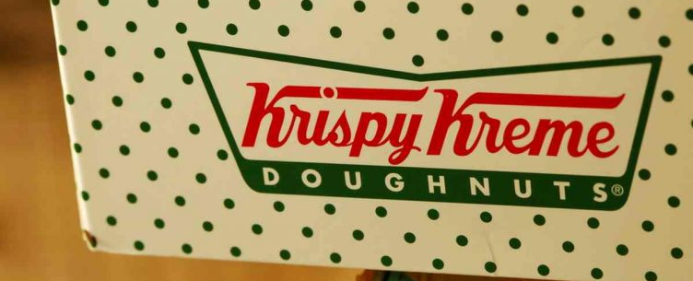
The Krispy Kreme franchise has specific information that categorizes its franchise business structure.
Uniquely the company offers franchise owners three different operation formats.
1. You can focus your investment on purchasing a manufacturing and production factory store that produces fresh doughnuts.
2. You can purchase factory store doughnuts and open a retail unit tunnel oven shop with the doughnuts being decorated with icing, etc. at your store location.
3. You can open up a fresh shop that, like a tunnel oven shop you are an outlet that is supplied by the factory store and the tunnel oven shop.

Slide 24
Advantages and disadvantages of franchising
Advantages | Disadvantages
Franchisor is relieved of costs and risks of opening a foreign market | Inhibits transfer pricing (shifting profits from location A to B)
Building up a global presence quickly (Because: franchisee often carries same brand name) | Integrity of the brand name when things go wrong.
Part of the inputs can be made by the brand owner (soft drinks)

Slide 25


Leasehold
Companies can lease their individual hotel or restaurant property from the property-owning landlord and pay commercial rents.
The physical asset therefore remains in the ownership of the landlord, but the hotel or restaurant operator maintains full control over the daily operation of the brand.
Many Hotel companies have acquired banded chains, have then sold the physical asset on to another firm and then leased them back in a process known as ‘sale and leaseback’.
Hilton purchased the Scandic Hotel Brand sold the buildings to the Royal Bank of Scotland and then leased them back to operate.
Advantages | Disadvantages
Quick means of gaining significant return from a valuable asset | May inadvertently create competitor when handing over turnkey project
Less risk involved than traditional FDI

Slide 26


Licensing
Arrangement whereby a licensor grants the rights to intangible property to another entity (the licensee)
for a specified period,
and in return, receives a royalty fee
A firm possesses some intangible property that might have a commercial application but they do not want to develop these applications themselves
IBM – Samsung Electronics
2011- Established broad, long-term cross-licensing deal that will cover their existing patents as well as those filed over the next 10 years.

Slide 27
Advantages and disadvantages of licensing
Advantages | Disadvantages
Licensee is responsible for capital injections (licensee bears financial risks (i.e. development costs for buildings) | No tight control over the manufacturing, marketing, and strategy of licensee
Focus on core competence (licensor) | Limits a firm to compete in a global marketplace (shifting of profits – transfer pricing from one country to support investments in the other)
 | Risk of losing know-how to licensee (BUT: firm can limit this risk)

Slide 29

Exporting

Slide 30
Types of export: Direct and indirect
Direct exporting: From manufacturer to end user (or other business unit in the same department)
Indirect: From manufacturer to a principal agent to end user
Firm
End-user
Firm
Agent
End-user

Slide 31
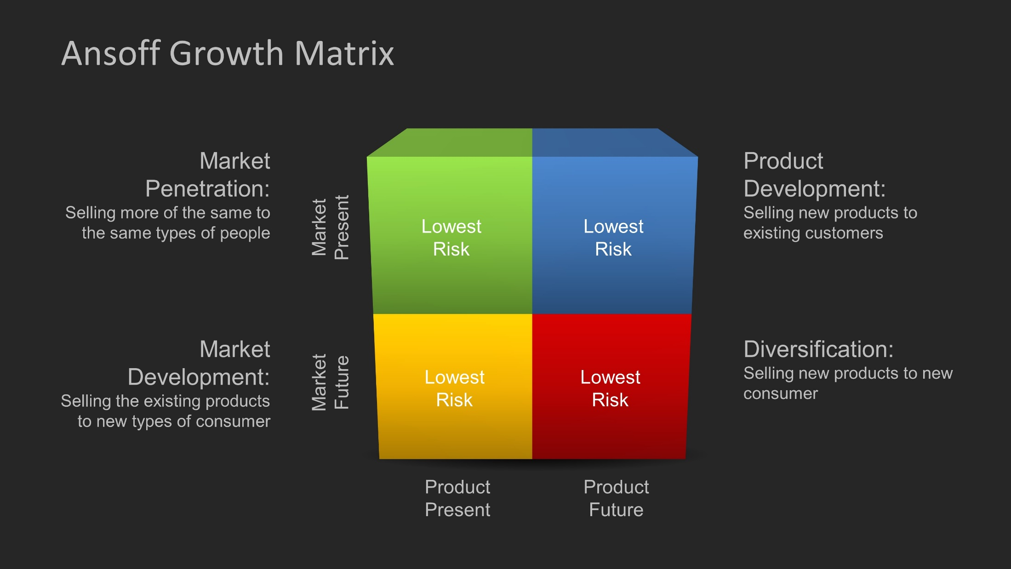
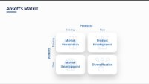
Selling what to whom?

Slide 32
Exporting
Advantages | Disadvantages
Avoids substantive costs of establishing operations in the host country | Exporting can be inappropriate in case a MNE exports to lower cost locations
Achieves initial learning curve and location economies effects | Transportation costs can make it uneconomical
Low financial risk | Tariff barriers are in place Countries initiate theses barriers to protect the domestic economic (i.e. Chinese steel imports in the US and EU) Countries initiate these barriers to increase FDI (ie., setting up a WOS might mitigate these barriers)
Often used as a toe-dipping strategy

Slide 33
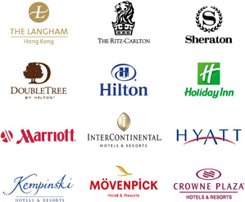
Assignment 2
What stage are you at ?
Have you chosen your hotel?
Have you thought of an idea?
Have drawn up your marketing plan?

Slide 34

Assignment 2:PESENTATION 5 MINUTES:
share some new ideas and how these could be marketed to the customers (get creative) and what you have written about with your target market.
Marketing Plan : Component 2 (50%) Marketing Plan (1250 words) submission date
The hotel should be chosen from the either Group A or Group B ; but could be situated anywhere globally. Remember the purpose of this plan is to attract new customers to your chosen hotel, be imaginative in your messaging thinking about improving, changing or introducing the new idea/s. Think about analysing the micro and macro environment (SWOT /PESTLE to provide new direction for the business. Use as many in class examples to support your case as well as industry research and evidence. (MARKETING MIX, STP etc)

Slide 35
-Introduction
(100 words)
The purpose of your marketing plan/what it is about
Who it is being prepared for?Briefly introduce the key areas/Frameworks/Theorists you will use to frame your plan SOSTAC, 4’Ps etc..
(Be concise your word count is short)
-Situation Analysis
(350 words)
5 'C's
Company: SWOT analysis (Micro analysis) - This can be in a table
Customers: Segmentation and Targeting/ Customer profile's'
Competitors: Porters five forces, This can be in a table Perceptual positioning maps
Collaborators: Demonstrate an awareness of your organisations B2B Relationships, Partnerships, Franchises.
Climate: PESTLE (Macro analysis) This can be in a table
-Objectives
(100 words)
-SMART target: Summarise the aims of your marketing plan in one sentence.

Slide 36
Strategy
(150 Words)
Discuss and explain your organisations value proposition. How the organisation differentiates, how will you communicate the value proposition, how will it be delivered.
Link value proposition to our customer segments, how will this affect targeting and positioning of the organisation.
Bowmans strategy clock
Tactics
(350 Words)
Marketing mix:
-Product - What is the destination currently offering?
-Place (Distribution) – How will customers locate the area? Which channels will be used?
-Price – What is the pricing strategy within the area? Linked to market research and/or marketing environment analysis and/or customer value, are there a variety of price points for visitors- how will this be displayed/shared.
-Promotion – How will the hotel be advertised? What strategies? RACE/ Communications Mix
Action
(100 Words)
-Gannt chart of marketing activities: Preparation, Market research, Marketing channels schedule, Gathering feedback.
Justify your marketing channels schedule, what informed your decisions.

Slide 37
Control
(100 Words)
Identify USP, Features and Benefits
Discuss how we will measure success? New customers? Positive attitudes towards brand? Increase profits? etc..
References
You will be expected to use credible reference sources (minimum of 15) for information used within your marketing plan. Your references are not part of the word count.
Appendices
Use this space to support your work, you may include tables, diagrams and secondary data to support your discussion which can be referred to in your marketing plan.
(Text here does not contribute to word count)
(Similarity here does not affect your score)

Slide 38
References
Aaker, J.L. (1997) “Dimensions of brand personality,” Journal of Marketing Research, 34(3), pp. 347–356. Available at: https://doi.org/10.1177/002224379703400304.
Brookes, M.Alinay,L. and Atkas,G (2015) opportunistic behaviour in hospitality franchise agreements. International journal of hospitality Management, 46,120-129
Connell,J .(1992) Branding hotel portfolios. International Journal of contemporary Hospitality management 4,26-32
De Chertony ,L. and Dall’Olmo Riley, F (1998) a positioning analysis of hotel brands experts' interpretations. Journal of marketing management, 14, 417-444
Delmas, M.A and Burbano, V.C (2011) The drivers of greenwashing. California Management Review, 54(1), 64-87.
Dev, C.S Morgan, M.S and Shoemaker, S (1995) a positioning analysis of hotel brands, Cornell Hotel & Restaurant Quarterly, 36, 48-55
Emery, B. (2012) Sustainable Marketing. Harlow: Pearson Education.
Fishbein ,M. and Ajzen, I. (1975) Belief, Attitude, Intention and Behaviour: An introduction to theory and Research. Reading, MA: Addision Wesley.
Frambacja, R.T Prahbhub, J. and Verhallence, T.M.M (2003) The influence of business strategy on product activity; the role of market orientation. Journal of international Research in marketing, 20,377-397.
Ghodeswar, M.B. (2008) Building Brand Identity in Competitive Market: A Conceptual Model. Journal of Product and Brand Management, 17, 4-12. Jones,P (1999) multiunit management in the hospitality industry: a late C20 phenomenon. Journal of contemporary Hospitality Management ,11,1155-1645.
Jin, C.H., Yoon, M.S. and Lee, J.Y. (2019) “The influence of Brand Color Identity on Brand Association and loyalty,” Journal of Product & Brand Management, 28(1), pp. 50–62. Available at: https://doi.org/10.1108/jpbm-09-2017-1587.
Kotler,P (2003) Marketing management,11thEd.Upper Saddle River, NJ. Pearson Prentice Hall

Slide 39
References
Kotler, P. and Armstong, G. (2018) Principles of Marketing, 1tth Edn. Harlow:Pearson.
Mcdonalds.com. 2018. The Financials - McDonald's Franchise | McDonald's UK. [online] Available at: <https://www.mcdonalds.com/gb/en-gb/franchising/the-financials. > [Accessed 9 June 2022].
Moravcikova ,D. Krizanova, A.Kliestikova,J. and Rypakova, M. (2017) Green marketing as the source of the competitive advantage of the business. Sustainability, 9 (12), 2218
Ottman, J.A. and Reailly, W.R (1998) Green marketing: Opportunity for innovation, 2nd Edn. Upper saddle River, NJ: Prentice Hall.
Porter ,M.E. (1980) Competitive strategy: Techniques for analysing industries and competitors. New York, Free Press
Ries ,A. and Trout,J. (1986) Marketing Warfare. New York, McGraw-hill.
Ross, D and Deck Jr, D.W (2011) Student guide to greenwashing. Bquest, pp. 1-20. Available at www.westga.edu/~bquest/2011/greenwashing11.pdf (accessed 17/11/2022)
Signori,S. and Forno, F (2016) Closing the attitude-behaviour gap: The case of solidarity Purchase groups. Agriculture and Agricultural Science Procedia, 8, 475-81.
J Whitelock & F. Fastoso (2007). Understanding International Branding: Defining the Domain and Reviewing the Literature. International Marketing Review, 24(3), 252-270.

