Slide 1







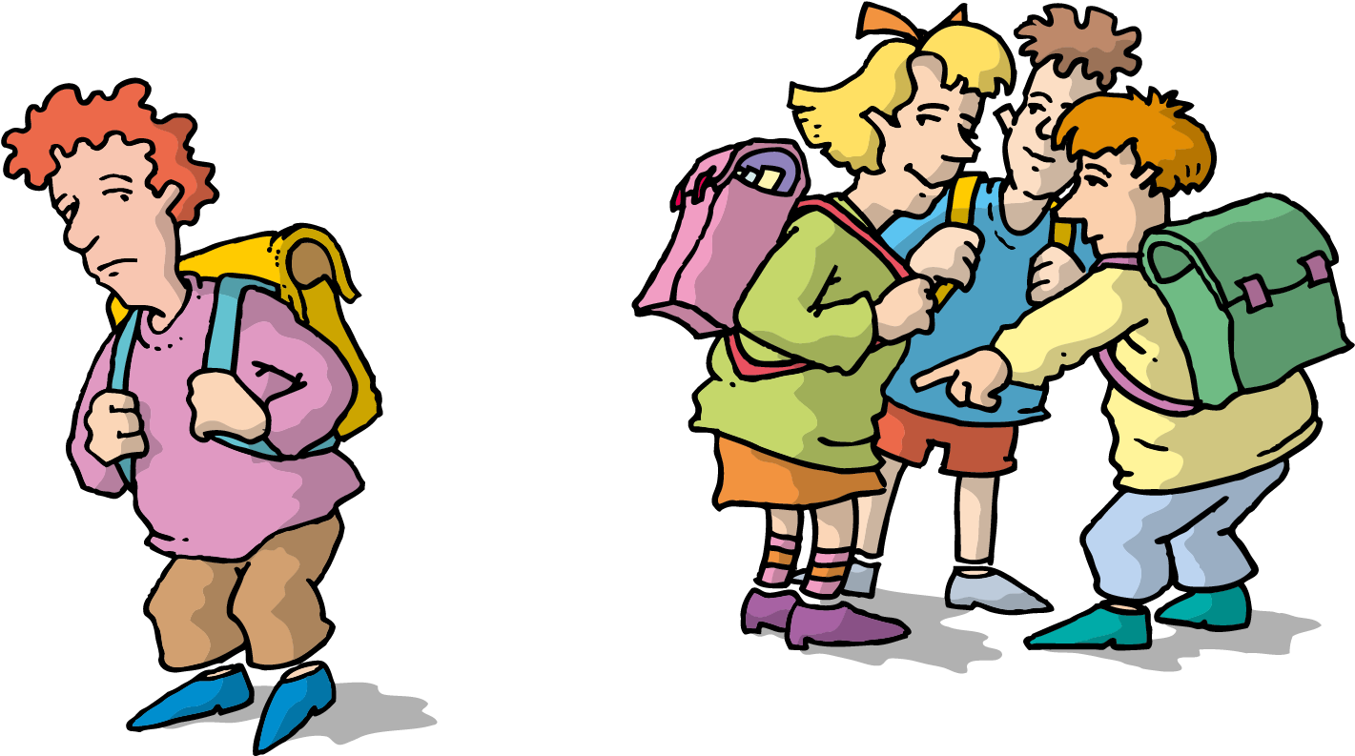
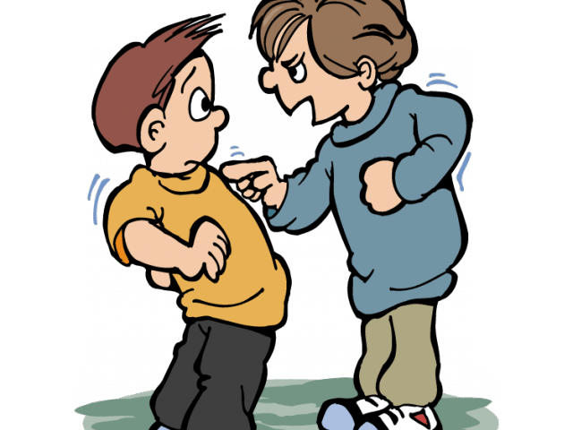
Ethel say’s we can all
HELP
Speak out tell a Teacher !
Verbal Bullying
Cyber Bullying
WHAT IS BULLYING?
Social Bullying
Physical Bullying

Slide 2
References
Allen, M and Donkin, A. Ace Report (2015) The Impact of Adverse Experiences in the Home on the Health of Children and Young People, and Inequalities in Prevalence and Effects PHE evidence review available at: -https://www.researchgate.net/publication/303691729_Matilda_Allen_and_Angela_Donkin_The_Impact_of_Adverse_Experiences_in_the_Home_on_the_Health_of_Children_and_Young_People_and_Inequalities_in_Prevalence_and_Effects_PHE_evidence_review (Accessed May 2021)
Aubrey, k and Riley, A (2019)understanding and using educational theories: Bronfenbrenner’s theory : London:SAGE publications inc.
Bandura, A (1971) social learning theory- Stanford university: New York: General learning press.
Berger, C, R (2015) Knowledge, structure and social interaction theory: ICA International Encyclopedia’s of Communication: Vol. 54, Iss. 3, (Nov 2016): 364. Wiley Blackwell- New Jersey America.
Donaldson, G (2015) Successful Futures :Available at: -https://gov.wales/sites/default/files/publications/2018-03/successful-futures.pdf Accessed April 2021)
Layard, R and Hagell, A (2015) Healthy Young Minds: Transforming the mental health of children. Report of the WISH Mental Health and Wellbeing in Children Forum 2015 : Qatar Foundation.
Burton, M (2019) Suicide and self-harm: vulnerable children and young people Available at: -https://www.magonlinelibrary.com/doi/full/10.12968/pnur. (Accessed may 2021)
Ethel porpoise (2021)[image] available at school website- unable to reference due to privacy laws.

Slide 3
Mental health organisation (2015) pg 43 Fundamental Facts About Mental Health :Mental Health Foundation Available at: -https://www.mentalhealth.org.uk/sites/default/files/fundamental-facts-15.pdf (Accessed may 2021)
Office for National statistics (2015) Measuring National Well-being: Insights into children's mental health and well-being Available at: - https://www.ons.gov.uk/peoplepopulationandcommunity/wellbeing/articles/measuringnationalwellbeing/2015-10-20 (Accessed April 2021)
O’shea, N (2020): The centre for mental Health: Forecasting needs and risks in the UK. Available at: -https://www.centreformentalhealth.org.uk/publications/covid-19-and-nations-mental-health-october-2020 (Accessed April 2021)
The United Nations Convention on the Rights of The Child (1989) Convention on the Rights of the Child. Available at:- https://www.ohchr.org/en/professionalinterest/pages/crc.aspx (Accessed April 2021)
The World Health Organisation (2018) World Mental Health Day 2018:YOUNG PEOPLE AND MENTAL HEALTH IN A CHANGING WORLD Available at: - https://www.who.int/mental_health/world-mental-health-day/2018/en/#:~:text=age%20of%2014-,Half%20of%20all%20mental%20illness%20begins%20by%20the%20age%20of,%2D29%2Dyear%2Dolds (Accessed May 2021)
Welsh Gov (2015) Policy of Future Generations Act. :Available at: -https://www.futuregenerations.wales/about-us/future-generations-act/ (Accessed April 2021)
young minds annual report (2015)Available at: - https://youngminds.org.uk/media/1233/youngminds-annual-report-15-16-final.pdf (Accessed april 2021)

