Slide 1
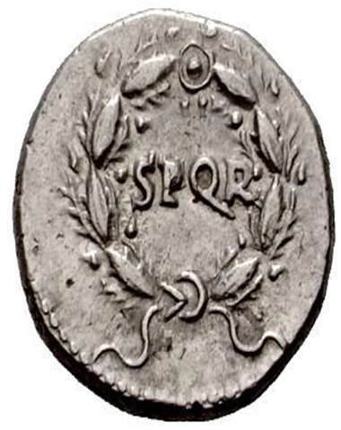
Everyday Life in Ancient Rome
Session 10 – part 1
Government Rome
HPAH4001

Slide 2
Ancient terminology vs. modern conceptions
dēmos = people / krateō = I rule.
Beware anachronism. Ancient demokratia ≠ modern democracy.
Contrast:
  monarkhia = one person’s rule.
  oligarkhia = a few people’s rule.
  tyrannis = despotic rule; tyranny.
  aristokratia = the best people’s rule - do not assume that this means best by birth; for Aristotle it means most popular (elected).

Slide 3
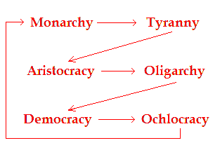
Ancient Though
Frequent “stasis” in Greek states, also contributing to intellectual debates about best types of governments.
  Major (elite) Greek thinkers on the topic are often hostile, e.g. Plato (against demokratia), Xenophon (against demokratia), Aristotle (against demokratia).
Herodotus and the Persian debate about the best system of governance.
Polybius adapts these earlier ideas to the Roman system (his ideas later influence Cicero), develops notion of anacyclosis.

Slide 4
Rome: From the Republic to the Principate

Slide 5
Roman Constitutional History
Period of Kings 753 (chronology of Varro) to 509 BC (overthrow of Tarquin the Proud).
Republic 509 to 31/30 BC – Octavian’s victory at Actium and suicide of Antony and Cleopatra.
Imperial period 30 BC to AD 476 (last Roman emperor of the West overthrown by Odoacer).
  Principate = Augustus to c. early-mid third century AD.
  Dominate = Diocletian to end of Western Empire.
Important Sources for the Republic
Polybius (c.200-118 BC) – interpreting Roman system within the framework of earlier Greek constitutional thought.
Cicero (106-43 BC) – composes speeches and write many letters to his friends and contemporaries which have been preserved – useful for late Republic.
Livy (59 BC-AD 17) – relying on earlier historical sources lost to us, potential issues of anachronism – also Dionysius of Halicarnassus, latter-half of first century BC.

Slide 6

Res Publica – The State
Res Publica – public affairs or The State.
SPQR – Senatus Populusque Romanus.
Senate.
Elected Magistracies.
Popular Assemblies.
Denarius (AR)
Lugdunum – AD 68/69
Obv – Mars Ultor
Rev – SPQR
RIC 54; BMC 23

Slide 7
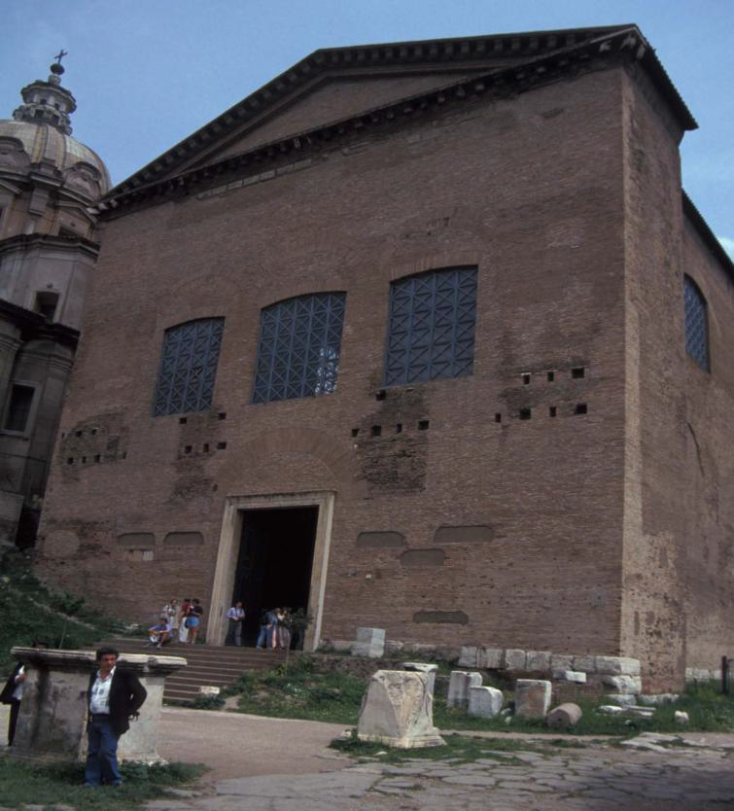
The Senate
Initially 100 Patricians appointed by Romulus.
In Republic c.300 men, goes up to 1000 by time Octavian defeats Antony, reduced to c.600.
Censors could expel members, and add them.
By time of Sulla (82-79 BC) – holding a quaestorship granted automatic entry into the Senate.
The Curia Julia, formerly Curia Cornelia, formerly Curia Hostilia

Slide 8
Cursus Honorum
*Dictatorship (exceptional office)
  grants unrestricted imperium. - emergency temporary office of six months, however, cf. Sulla, Julius Caesar.
*Censors (in theory every five years for an 18 month period)
  regulate membership of the senate and citizenship.
Consuls
  chief magistrates
  two consuls
  pro-consuls govern provinces.
  minimum age 41-42.
Praetors
  judicial administration
  6 to 8 praetorships
  pro-praetors govern provinces.
  minimum age 39.
Aediles (optional)
  maintenance of public buildings and oversight of the markets, public games, and amenities.
  no imperium
  minimum age 37.
Quaestors
  administrative duties or aids to provincial governors
  no imperium
  40 quaestors by time of Caesar
  minimum age 30.
Not necessarily part of the cursus honorum
Tribunes
  Tribune of the Plebs
  Military Tribunes
  Tribunes of the treasury.

Slide 9
Popular Assemblies
Assemblies had purely electoral function, did not debate issues like Athenian Ekklesia.
Comitia centuriata – Century assembly – voted on war, elected magistrates with imperium.
Comitia tributa – Tribal assembly – 35 tribes (31 rural, 4 city) – elect quaestors, and curule aediles – tried judicial cases (until Sulla).
Concilium plebis – Plebeian council – elects tribunes and plebeian aediles - summoned by the peoples tribunes and considers proposals put forward by them.
Also comitia curiata.
Gaining electoral support:
  Making a name for oneself – law-courts, distinguished military service.
  Public benefaction – building programmes, holding games, spectacles and public feasts.
  Electoral bribery (officially illegal, but often widespread).

Slide 10
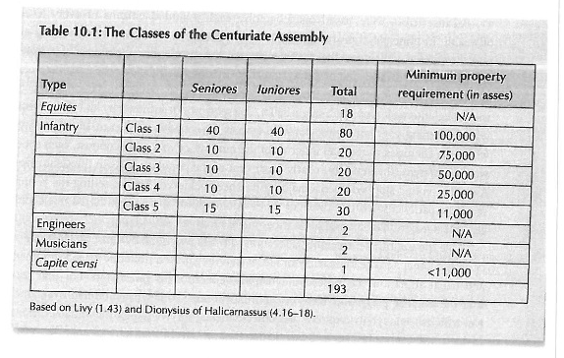

Slide 11
“Constitutional Flexibility”
Marius elected for five successive consulships (104-100 BC) to deal with the Cimbri and Teutones.
Sulla becomes dictator between 82/81 BC (Julius Caesar becomes dictator for life in 44 BC).
Pompey sole consul for 52 BC.
Formation of Second Triumvirate in 43 BC.

Slide 12
Establishment of the Principate
Augustus first of the “emperors”.
Imperator - holding imperium.
Princeps – leading citizen – Principate.
Domination of the emperors but within the framework of earlier republic institutions.
Perception of the Principate:
  Strabo Geog. 6.4 – August like a father with absolute authority.
  Tacitus Ann. 1.1 – wearied after civil strife the world subjected to Augustus under the title of princeps.
  Dio Cassius 53.17 – in reality a monarchy but without the titles.
“At the age of nineteen [44 BC] on my own responsibility and at my own expense I raised an army, with which I successfully championed the liberty of the republic when it was oppressed by the tyranny of a faction.” – Res Gestae Divi Augusti 1.

Slide 13
Decline of the Assemblies
Assemblies confirm decisions of the Augustus.
AD 14 - Tiberius transfers the election of magistrates from popular assemblies to the Senate.
Gaius “Caligula” (AD 37-41) restores election of magistrates to the popular assemblies, but this soon abandoned.
“They shed their sense of responsibility long ago, when they lost their votes and their bribes; the mob that used to grant power, high office, and the legions, everything, curtails its desires, and reveals its anxiety for two things only, bread and circuses.” - Juvenal Satires 10.77-81.

Slide 14
How to Become Emperor
“Dynastic succession” – e.g. Vespasian to Titus.
Adoption – “Five Good Emperors” – Nerva, Trajan, Hadrian, Antoninus Pius and Marcus Aurelius.
  It would be misleading to see this as non-dynastic.
    Hadrian – nephew of Trajan
    Marcus Aurelius - paternal aunt, Annia Galeria Faustina (Faustina the Elder), the wife of Antoninus Pius.
Usurpation and Assassination – e.g. Gaius to Claudius, Nero to Galba, Alexander Severus to Maximinus Thrax.
Support of military and deputy commanders vital.

Slide 15
Bibliography
Brennan, T. C. 2004: Power and Process under the Republican “Constitution”. In The Cambridge Companion to the Roman Republic, Flower, H. I. (ed.): Cambridge: 31-65.
Lewis, N. 1974: The Roman Principate: 27 B.C. – 285 A.D. Toronto.
Patterson, J. R. 2000. Political Life in the City of Rome. Bristol: Bristol Classical Press.

