Slide 1
Research of DNS attack and defense methodologies
Mircea-radu-serban dobrau

Slide 2
Background: IoT
Tens of billions of connected devices and increasing [1, p. v]
World population expected to be doubled by 2050 [2, p. 25]
Urban residents expected to grow by 60 million per year [2, p. 25]
MIoT [3, p. 112]
SIoT [2, pp. 4-5]
Smart Home [4, p. 7]
Smart City [5, p. 29]

Slide 3
Background: Prevalence of DNS attacks
77% of organizations hit with a DNS-related attack in the past year [6, p. 1]
Can impact an entire country or the entire world [7, pp. 26-28]
As of recently, targets and/or makes use of IoT devices [8, p. 119]

Slide 4
Background: Mirai botnet
The Mirai botnet process runs thus [9, p. 1]:
  Run a C&C (Command and Control) server that is connected to with the help of infected devices.
  Scan for other devices and test them for weak SSH/Telnet credentials.
  If credentials are found, send them to a separate server, which uses the said credentials, to download malware on the vulnerable devices.
  Once the device is infected, it waits for DDoS attack commands to be sent to it.
Achieving speeds of up to 1 TB/s [10, p. 4], it disabled access to hundreds of essential services such as Twitter, Netflix, Reddit etc. [11]
Involved up to 100,000 infected devices [11]

Slide 5
Background: DNSPod DNS provider
Chinese DNS provider and domain registrar [12, p. 8] attacked in 2009 [13, p. 3]
Large number of China’s DNS servers as well as the services dependent on them collapsed entirely [14, p. 309], rendering broken Internet for millions of users in over 20 Chinese provinces [15, p. 8]

Slide 6
Introduction
This thesis involves the research, practice, and discussion of DNS exploits, as well as of defense strategies, followed by their implications for the security of the Internet
Its scope is to provide an introductory level of knowledge regarding the DNS protocol and its operation, followed by both practical and theoretical research regarding DNS attacks

Slide 7
Aims and objectives
Undertake and present a review of previous literature on the topic of DNS attacks
Design a virtual network environment and software for the purpose of experimentation with, further understanding of, as well as illustration of the DNS attacks
Attempt to put into practice and succeed in launching the attacks, whilst also documenting the processes undertaken
Undertake a theoretical research of defense and mitigation methodologies regarding each attack
Evaluate the results of both the experiment and research processes, presenting the security and risk implications of each attack

Slide 8
DNS operation
DNS, or “Domain Name System” can be defined in various ways:
  A database used for distributing domain name information. In other words, the DNS database is a hierarchical, redundant and distributed database. [16, p. 1]
  The application protocol used for exchanging domain name information between a DNS server and a DNS client or another DNS server. This function is achieved with the help of DNS queries. [17, p. 31]
As a definition of its primary function [18, p. 1], DNS helps end-users add a level of abstraction to IP addresses by mapping them to a hostname and/or domain name label. Therefore, end-users can refer to a web-site, for example, by its domain name and/or hostname instead of its IP address

Slide 9
DNS operation
“www.example.com” comprised of [19, p. 7]:
  Hostname/LLD (Low-Level Domain) – “www”
  SLD (Secondary-Level Domain) – “example”
  TLD (Top-Level Domain) – “.com”

Slide 10
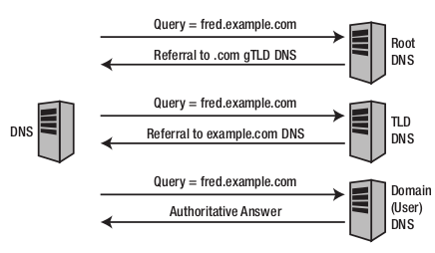
DNS operation
[19, p. 9]

Slide 11
DNS operation
Zone files store RRs pertaining to a domain [20, pp. 389-393]:
  A record – Indicates the IPv4 address of a host in the domain.
  AAAA record – Indicates the IPv6 address of a host in the domain.
  SOA record – Indicates the primary DNS server regarding the queried zone.
  NS record – Indicates the primary DNS server.
  CNAME record – Indicates an alias for a host.
  MX record – Indicates the mail server (if any) of the domain.
  SRV record – Indicates non-mail servers of the domain.
  TXT record – Contains any form of written content. It can be used for any kind of purpose.

Slide 12
Research methodology
Types
  Descriptive
  Explanatory
  Primary
  Secondary
Philosophy
  Positivist
    Some level of reliability and validity
  Phenomenological:
    High level of validity, some reliability
Approaches
  Inductive: the “how”
  Deductive: deduce whether or not DNS attacks are dangerous
Strategies
  Data collection

Slide 13
Development methods
Experiment: attempting attacks in a virtual network comprised of VMs
Software development: Two python scripts were written by the author of this work with the scope of launching two DDoS attacks

Slide 14
Data collection and evaluation
Terminal output and logs
Results of attacks, same as above
Defense and mitigation methodologies
Evaluation of attack, arguing how, why, and for whom it could be dangerous

Slide 15
Resources and planning
Computer with Internet connection
Linux distribution for research: Kali Linux
Virtualization software “virt-manager” / “virsh”
“Vim” for editing text and thesis
Online resources for research

Slide 16
Design
Virtual network comprised of three guests across three networks:
  “client.home”: Everyday user.
    IP: 192.168.101.193. Part of “client” network 192.168.101.0/24.
  “publicdns.world”: Public DNS resolver.
    IP: 192.168.100.182. Part of “world” network 192.168.100.0/24.
  “authns.company.com”: ANS of “company.com” domain.
    IP: 192.168.102.143. Part of “company.com” network 192.168.102.0/24.
  “www.company.com”: Hypothetical web-server of “company.com” domain.
    IP: 192.168.102.224. Part of “company.com” network 192.168.102.0/24.

Slide 17
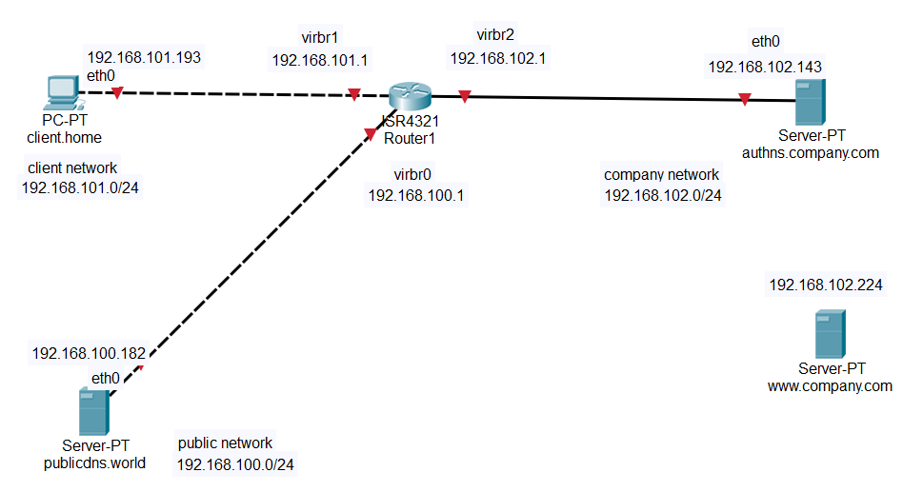
Design

Slide 18
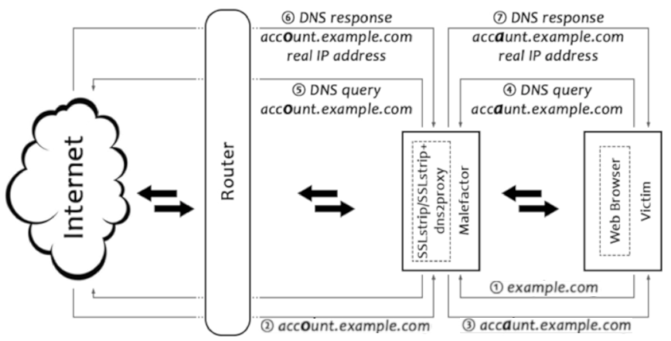
Experiment 1: DNS spoofing
Involves the tampering of zone files or MitM tampering of DNS traffic
Defenses: DNSSEC, among many other public-key cryptography solutions, as well as DNScrypt and DNSwitch
[21]

Slide 19
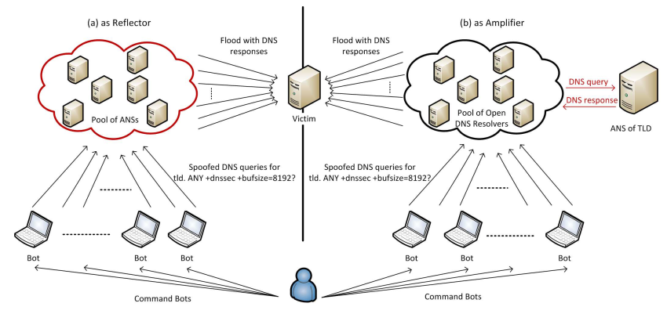
Experiment 2: DNS DDoS
Involves sending large amounts of packets to a target DNS public resolver and/or a company’s ANS
Defenses include: software/hardware IPS/IDS (Snort, Cisco IPS/IDS), rate-limiting, smart rate thresholds, DNS “threat intelligence”, blacklists/whitelists
[22]

Slide 20
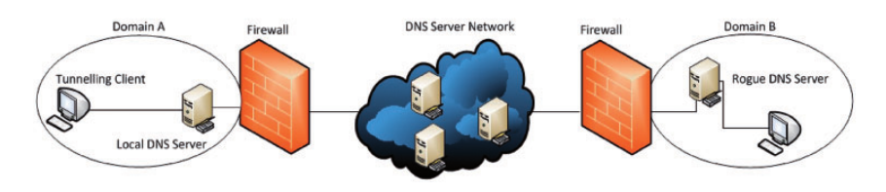
Experiment 3: DNS Tunneling
Involves using DNS as a protocol for carrying TCP traffic
Exfiltration of sensitive data
Carries TCP traffic inside of “TXT” RRs
[23]

Slide 21
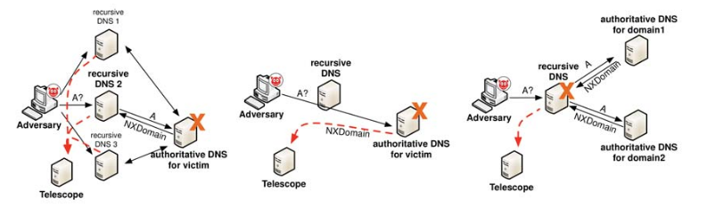
Experiment 4: DNS “water torture”
Same as DDoS mentioned previously, but with randomly generated, non-existent sub-domains
Used in the Mirai botnet attack against Dyn
Defense: Same as DDoS, in addition to randomly-generated domain detection algorithms (DGA)
[24]

Slide 22
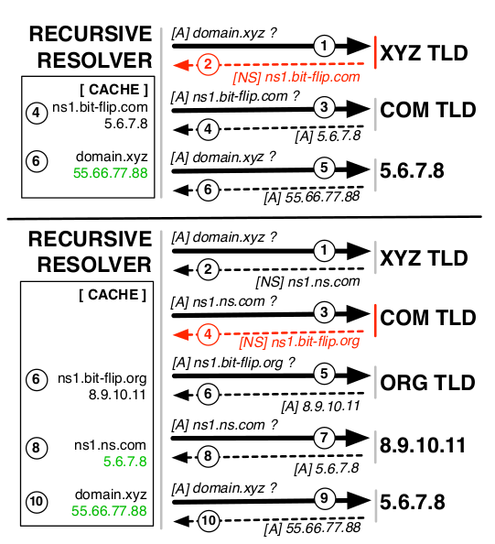
Research: Domain hijacking
Involves the malicious registration and use of domains which are typographically similar to genuine domain names
Users and DNS administrators sometimes use them when mistyping domain names
Defense: Smart domain registration, avoiding typos
[25]

Slide 23
Research: Zone poisoning
Tampering of an ANS’s zone file with the help of “non-secure dynamic updates”
Defense: Prevent DNS “UPDATE” messages, IP spoofing

Slide 24
Research: NXDOMAIN hijacking
Tamper with “NXDOMAIN” response for malicious purposes
Usually ISPs use it for redirecting users to web-pages for monetization purposes
A Google patent [26] proposes means of defending against NXDOMAIN hijacking

Slide 25
Research: DNS rebinding
Of mostly historical interest, however Ethereum was recently vulnerable against DNS rebinding attacks
Defense: Block outbound port 53 traffic inside an enterprise. Do not allow DNS servers to resolve external domains to internal IP addresses. Keep up-to-date versions of Flash Java, and web browsers. In plugins, deny sockets by default.

Slide 26
Conclusion
As can be seen, DNS presents a vulnerable and highly efficient attack vector whose impact can affect entire countries or the entire world
Additionally, non-DNSSEC related DNS attacks are relatively easy to implement due to the simple nature of the DNS hierarchy, as well as due to the fact that DNS packets are unencrypted
This research further proves the relevancy of proper knowledge regarding DNS operation, DNS attacks and DNS defense.

Slide 27
Recommendations
DNSSEC
  Cryptography solutions for unencrypted DNS traffic, integrity, authenticity
DoH
  Transport DNS over HTTP/s requests using
  “application/dns-message” content type HTTP request/response
DoT
  Transport DNS over TLS
GNU Name System
  Proposed domain name system for increased privacy

Slide 28
References
[1] S. Ziegler, Internet of Things Security and Data Protection, ser. Internet of things. Springer Nature, 2019.
[2] S. S. Ammar Rayes, Internet of Things From Hype to Reality: The Road to Digitization, 2nd ed. Springer International Publishing, 2019.
[3] A. V. V. Rajat Subhra Chakraborty, Jimson Mathew, Security and Fault Tolerance in Internet of Things, 1st ed., ser. Internet of Things. Springer International Publishing, 2019.
[4] C. Patel, Internet of Things Security: Challenges, Advances, and Analytics. Auerbach Publications, 2019.
[5] C. Dotson, Practical Cloud Security. 2019. O’Reilly Media, Inc., March
[6] “Sharp rise in costs and damage from dns-related attacks.” Network Security, vol. 2018, no. 6, pp. 1–3, June 2018.
[7] A. Liska and G. Stowe, DNS Security: Defending the Domain Name System. Elsevier Science, 2016.
[8] D. Winder, “So what should you be doing to mitigate the iot botnet threat? start with a network aud it,” PC Pro, no. 288, pp. 118–120, 2018.
[9] J. Margolis, T. T. Oh, S. Jadhav, J. P. Jeong, Y. H. Kim, and J. N. Kim, “Analysis and impact of iot malware,” in Proceedings of the 18th Annual Conference on Information Technology Education, ser. SIGITE ’17. New York, NY, USA: ACM, 2017, pp. 187–187.
[10] R. Winward, IoT Attack Handbook: A Field Guide to Understanding IoT Attacks from the Mirai Botnet to Its Modern Variants. Radware, 2018.
[11] N. Woolf, “Ddos attack that disrupted internet was largest of its kind in history, experts say,” The Guardian, vol. 26, 2016.
[12] N. Abokhodair and A. Alva, “Cyber fratricide: A literature review,” in Proceedings of the 7th International Conference on Information Warfare and Security: ICIW. Academic Conferences Limited, 2012, p. 389.
[13] F. Zou, S. Zhang, L. Li, L. Pan, and J. Li, “Detecting malware based on expired command-and-control traffic,” International Journal of Distributed Sensor Networks, vol. 13, no. 7, p. 1550147717720791, 2017.
[14] M. X. a. L. C. J. Z. Y. F. e. Qiang Li Zhao, Yan Huang Jiang, Advanced Data Mining and Applications: 6th International Conference, ADMA 2010, Chongqing, China, November 19-21, 2010, Proceedings, Part II, 1st ed., ser. Lecture Notes in Computer Science 6441 : Lecture Notes in Artificial Intelligence. Springer-Verlag Berlin Heidelberg, 2010.
[15] F. L. Greitzer, S. L. Clements, T. E. Carroll, and J. D. Fluckiger, “Towards a research agenda for cyber friendly fire,” Pacific Northwest National Lab.(PNNL), Richland, WA (United States), Tech. Rep., 2009.
[16] A. Liska and G. Stowe, DNS Security: Defending the Domain Name System. Elsevier Science, 2016.
[17] M. D. T. Rooney, DNS security management, ser. Series on networks and services management. John Wiley and Sons; IEEE Press, 2017.
[18] M. Jeftovic, Managing Mission - Critical Domains and DNS: Demystifying nameservers, DNS, and domain names. Packt Publishing, 2018.
[19] R. Aitchison, Pro DNS and BIND 10, 1st ed. Apress, 2011.
[20] [41] M. Meyers, CompTIA Network+ Certification All-in-One Exam Guide, Seventh Edition (Exam N10-007). McGraw-Hill Education, 2018.
[21] A. A. Maksutov, I. A. Cherepanov, and M. S. Alekseev, “Detection and prevention of dns spoofing attacks,” in 2017 Siberian Symposium on Data Science and Engineering (SSDSE). IEEE, 2017, pp. 84–87.
[22] M. Anagnostopoulos, G. Kambourakis, S. Gritzalis, and D. K. Y. Yau, “Never say never: Authoritative tld nameserver-powered dns amplification,” in NOMS 2018 - 2018 IEEE/IFIP Network Operations and Management Symposium, April 2018, pp. 1–9.
[23] M. Aiello, “Performance assessment and analysis of dns tunneling tools.” Logic Journal of the IGPL, vol. 21, no. 4, pp. 592–603, August 2013.
[24] H. Griffioen and C. Doerr, “Taxonomy and adversarial strategies of random subdomain attacks,” in 2019 10th IFIP International Conference on New Technologies, Mobility and Security (NTMS). IEEE, 2019, pp. 1–5.
[25] T. Vissers, T. Barron, T. Van Goethem, W. Joosen, and N. Nikiforakis, “The wolf of name street: Hijacking domains through their nameservers,” in Proceedings of the 2017 ACM SIGSAC Conference on Computer and Communications Security. ACM, 2017, pp. 957–970.
[26] M. Akcin, “Defense against nxdomain hijacking in domain name systems,” Jun. 15 2017, uS Patent App. 14/969,955.

