Slide 1
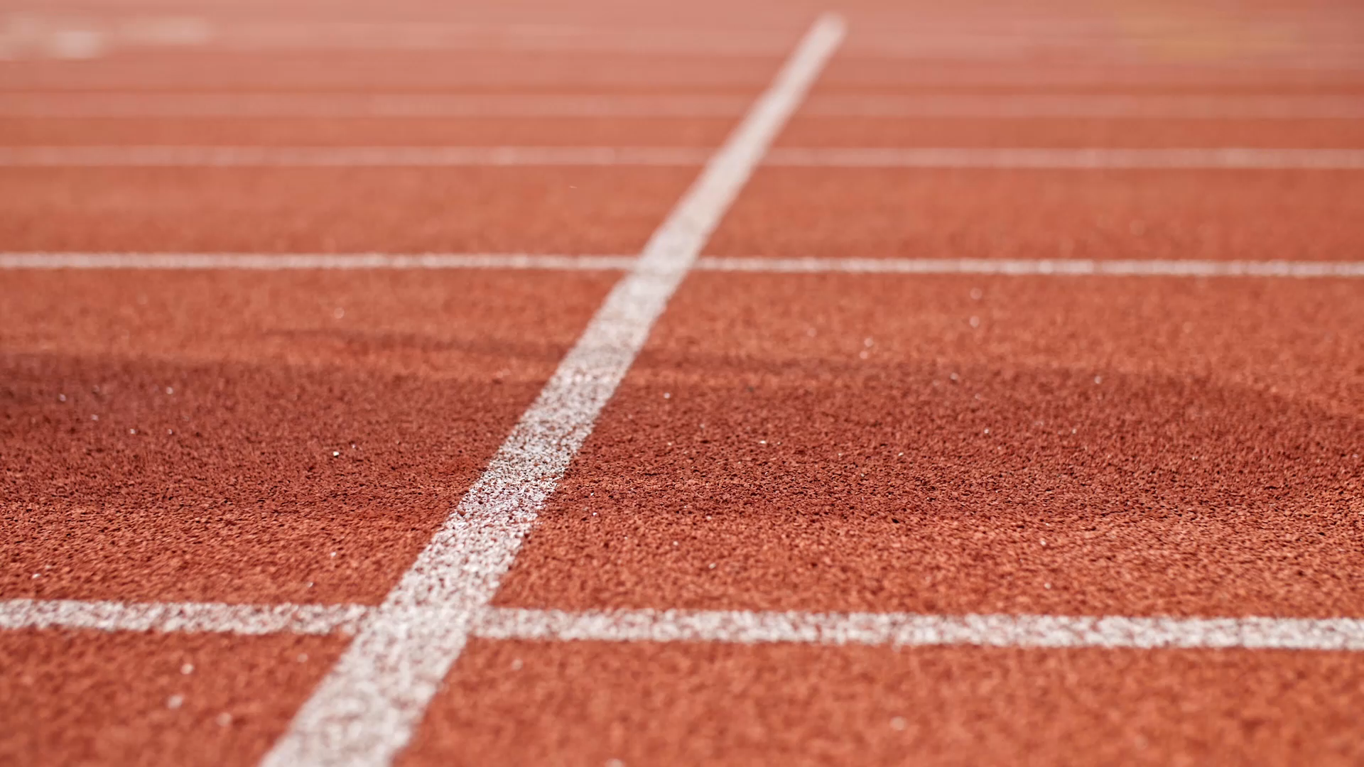
The Travelling Athlete

Slide 2
Travelling
Athletes today travel across the globe and that brings associated problems.
Preparation is important in several areas
Vaccinations are up to date – reviewed regularly with the medical staff – including Covid and the flu
Dental treatment – regular treatments
Planning – important – baggage allowance, customs, doping rules, medication rules

Slide 3
DEALING WITH JET LAG
There are several strategies that athletes can try to reduce the effects
Setting your watch through time zones
Planning flights if possible
Prescribe hypnotics
Drink plenty of water, avoid alcohol
Allowing time for acclimatisation

Slide 4
Acclimatisation
Athletes need to time to acclimatise
Heat acclimatisation can take up to 2 weeks
May need to prepare at home as well – several locations including Bisham Abbey have acclimatisation chambers and training facilities
In Swansea athletes have used to planetarium
Fluid monitoring and urine osmolality

Slide 5
AVOIDING ILLNESS
Most athletes real have to take precautions to avoid illness such as diarrhoea and vomiting
Paying particular attention to personal hygiene – take hand wash
Avoid high risk foods – raw/uncooked/unpasteurised foods. If self catering cross contamination
Avoid ice
Peel all fruit

Slide 6
Avoiding
Illness
Avoid veg unless washed in bottled water
Using bottled water
Avoid food from markets, fast food outlets
Avoid buffets , if food has been on a buffet longer than 2 hours
If food hygiene is questionable try to only eat cooked or pre packed food
Take a food thermometer- food should be over 70 deg
Probiotics
Take your own snacks and some other quick meal replacements – noodles, packs of rice, cereals.

Slide 7
Coping with D&V!
Plenty of fluids
Rest
May need some medication
When re introducing food keep to low fat and low fibre for a few days.

Slide 8
Being Prepared
Planning is important
Adapting meals and snacks when travelling
Avoid high protein meals and eat carbs as it induces sleep
Eat little and often
Drink plenty of fluids

Slide 9
Snacks to take in the kit bag!
Fruit – canned and pots
Dried fruit and nuts
Rice cakes
Pots of rice pudding
Sandwiches
Jelly
Cereal Pots
Cereal bars/biscuits/crackers
Drinks
Canned fish - tuna
Any other ideas?

Slide 10
Water Bottles
Potential source of infection
Keep them away from kit and footwear in your bag
Travel with Milton sachets to sterilise!

Slide 11
Travelling locally
This can also be a problem – may need to travel 4-5 hours to a venue
Lack of food at a venue – need to be prepared with meals, snacks and drinks
Never make any assumptions about a venue
Think about re fuelling after an event

