Slide 1

Understanding Isaac:
Applying Bowlby's Attachment Theory
to Early Years Practice
Module: LCHS4010 | Psychology in Health and Social Care
Student ID: Veronica Ornelas 2510177
Lecturer: Lou Wells
Date: 12.07.2026
Source:www.mytotalpediatriccare.com

Slide 2

Introduction: Isaac's Case
Isaac is a four-year-old attending a London Children's Centre
His mother suffers from post-natal depression and social isolation.
The family moved with 2 years of disrupted child care.
Isaac displays separation distress, language delay, and withdrawal.
Source:www.mytotalpediatriccare.com

Slide 3
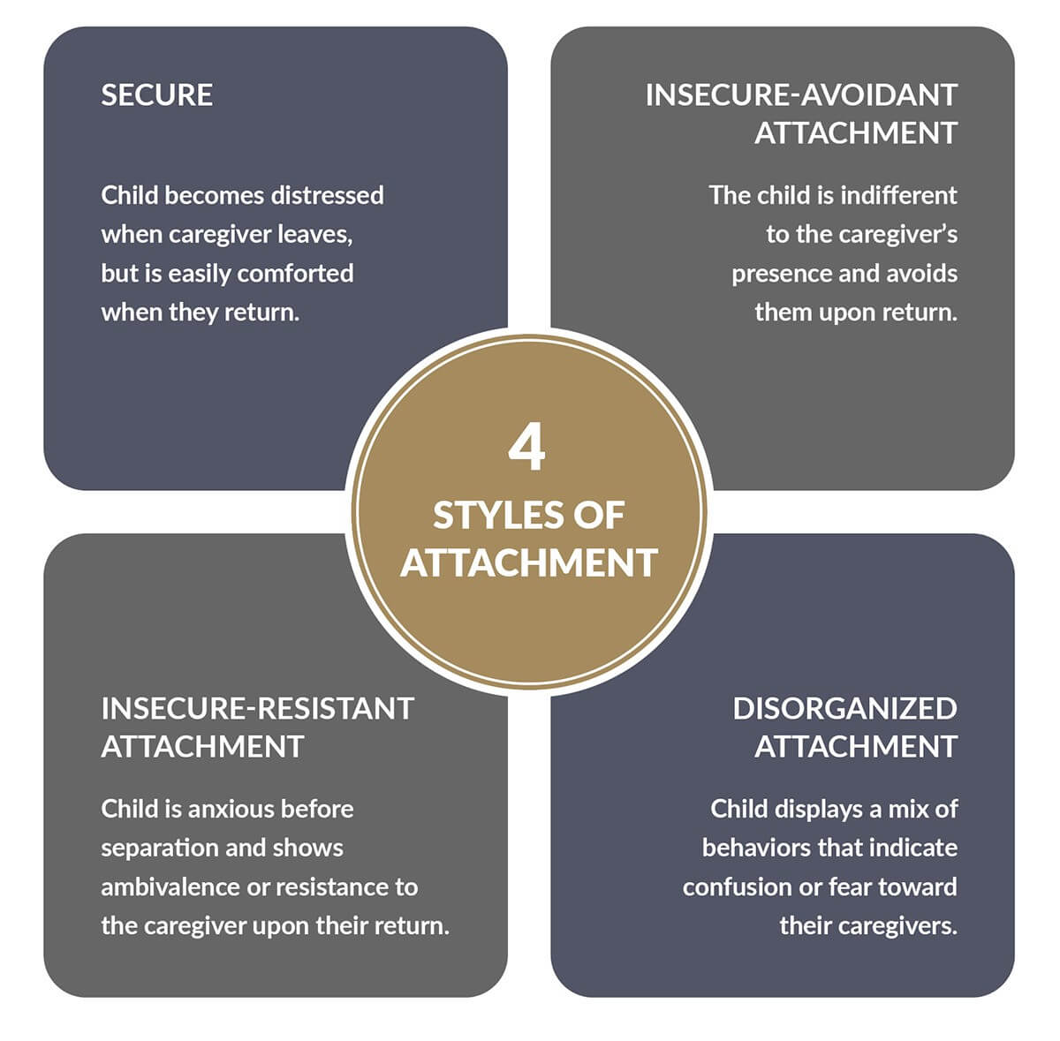
Bowlby's Attachment Theory
Children have a natural urge to connect with their caregiver in order to survive.
Bowlby's theory directly underpins the UK EYFS policy (Jarvis, 2022).
Isaac's clinginess and distress are classic signs of attachment.
Bowlby bridges emotional, cognitive, and neurological development effectively.
Source:www.positivepsychology.com

Slide 4
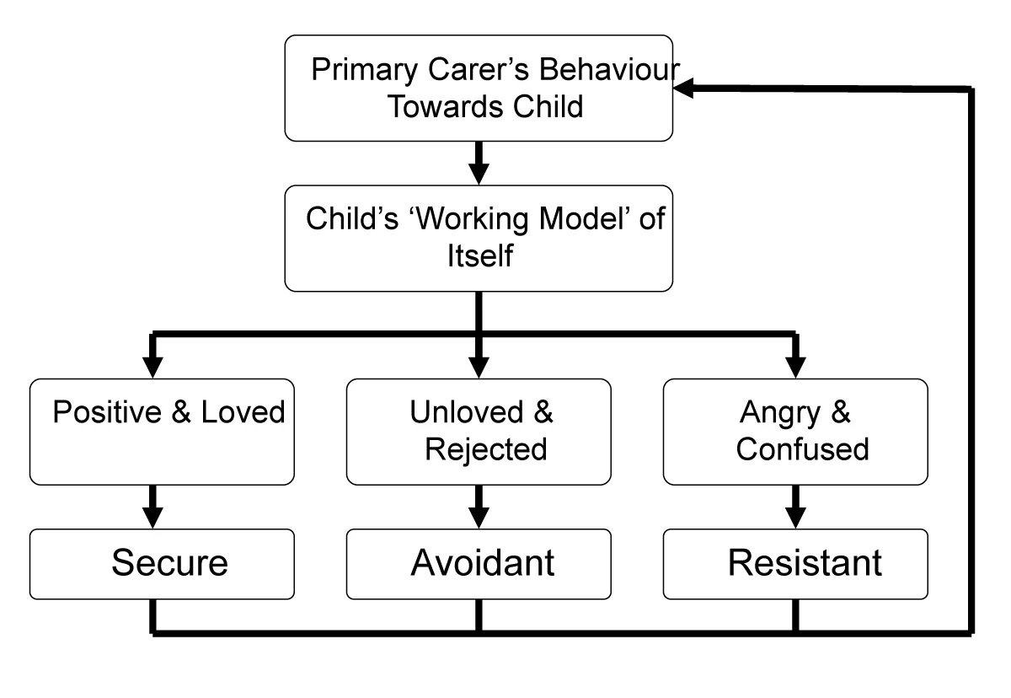
Key Concepts of Attachment Theory
The Secure Base enables children to explore their world safely
The Internal Working Model is a mental filter for all subsequent relationships.
The Critical Period is the first 2 – 3 years of life when these skills are most sensitive.
Robledo et al. (2022) identified secure, ambivalent, avoidant, and disorganised styles.
www.simplypsychology.org

Slide 5
Developmental Assumptions and Relevance to Early Childhood
Bowlby pointed out that the first five years of life were the critical years of sensitivity.
Secure Attachment correlates with Emotional Regulation and language development.
Insecure or disorganized attachment patterns always result from disrupted care.
Isaac is still in the zone of effective intervention at age 4.
Source:www.mytotalpediatriccare.com

Slide 6
Applying Attachment Theory to Isaac
Isaac is clingy, which indicates an anxious-ambivalent attachment style
Withdrawal is a sign of an insecure internal working model of relationships.
Low maternal verbal responsiveness is associated with language delay (Alharbi, 2026)
Without a steady caregiver relationship, there is a heightened likelihood of experiencing disorganised attachment.
Source:www.mytotalpediatriccare.com

Slide 7
Nature and Nurture
Bowlby believed attachment is a natural biological survival process. (Bowlby, 1979)
The constant release of cortisol, due to ongoing stress, is a major impediment to brain development.
Being depressed makes mothers less sensitive and less consistent in their care.
Isaac's family lost all networks of support due to relocation and isolation.
Source:www.mytotalpediatriccare.com

Slide 8
Practical Strategies
Isaac has a secondary attachment figure in the form of a consistent key worker.
Predictable settling-in routines minimize the distress that Isaac feels from the separation.
Urgent referral is needed for perinatal mental health care for the mother.
A multi-agency team coordinates health, speech therapy, and family support (Tongue et al. 2025).
Source:www.mytotalpediatriccare.com

Slide 9
Practical Strategies (..Contd)
Child-directed play develops trust and self-confidence with caregivers (Yu, 2022).
Language-rich activities, including stories and songs, target Isaac's speech delay.
Emotion coaching entails repeatedly identifying and accepting Isaac's emotions.
Key worker check-ins are frequent and supportive of any emotional contact behaviours.
Source:www.mytotalpediatriccare.com

Slide 10
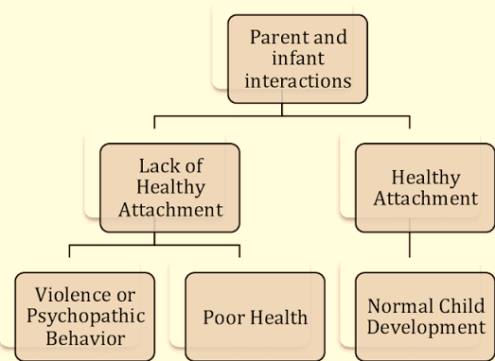
Critical Evaluation of Bowlby's Theory
The Strange Situation studies of Ainsworth offer good empirical evidence.
Čater and Majdič (2022) questioned the disproportionate focus on maternal figures in particular.
The theory was based mostly on Western and middle-class research samples
Across the diverse communities of London, shared care plays a normative role within the cultural framework.
Source:www.researchgate.net

Slide 11
Conclusion
Isaac's behaviours reflect anxious-ambivalent attachment shaped by multiple adversities.
Isaac is struggling with skills because of a combination of biology and environment.
Theory-based strategies provide practical and evidence-based assistance to Isaac.
Age 4 is an important phase to change Isaac's internal working model.
Source:www.mytotalpediatriccare.com

Slide 12
References
Alharbi, N.H., 2026. Behavioral and culturally responsive interventions: an ethnographic case study on speech and Language delays. Child & Family Behavior Therapy, 48(1), pp.1-34. (Accessed: 3rd July 2026)
Bowlby, J., 1979. The bowlby-ainsworth attachment theory. Behavioral and brain sciences, 2(4), pp.637-638. (Accessed: 9th July 2026)
Čater, M. and Majdič, G., 2022. How early maternal deprivation changes the brain and behavior?. European journal of neuroscience, 55(9-10), pp.2058-2075. (Accessed: 3rd July 2026)
Jarvis, P., 2022. Attachment theory, cortisol and care for the under-threes in the twenty-first century: constructing evidence-informed policy. Early Years, 42(4-5), pp.450-464. (Accessed: 2nd July 2026)
Mousikou, M., Kyriakou, A. and Skordis, N., 2023. Stress and growth in children and adolescents. Hormone research in paediatrics, 96(1), pp.25-33. (Accessed: 2nd July 2026)
Robledo, J.P., Cross, I., Boada-Bayona, L. and Demogeot, N., 2022. Back to basics: A re-evaluation of the relevance of imprinting in the genesis of Bowlby’s attachment theory. Frontiers in Psychology, 13, p.1033746. (Accessed: 3rd July 2026)
Tongue, J., Qualter, P. and Bond, C., 2025. “You Could Sit and Think, I’m Not Alone with This”: A Multi-Agency Early Years Creative Arts Parent Project. Education Sciences, 15(4), p.495. (Accessed: 10th July 2026)
Yu, Y., 2022. Using guided play to facilitate young children’s exploratory learning. In Early childhood development and education in Singapore (pp. 189-215). Singapore: Springer Singapore. (Accessed: 9th July 2026)

Slide 13

Thank You

