Slide 1



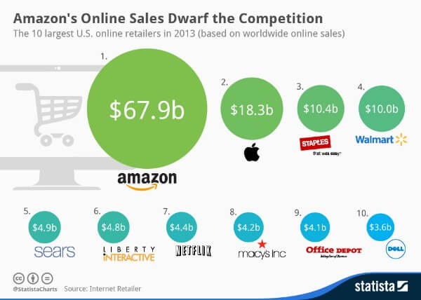
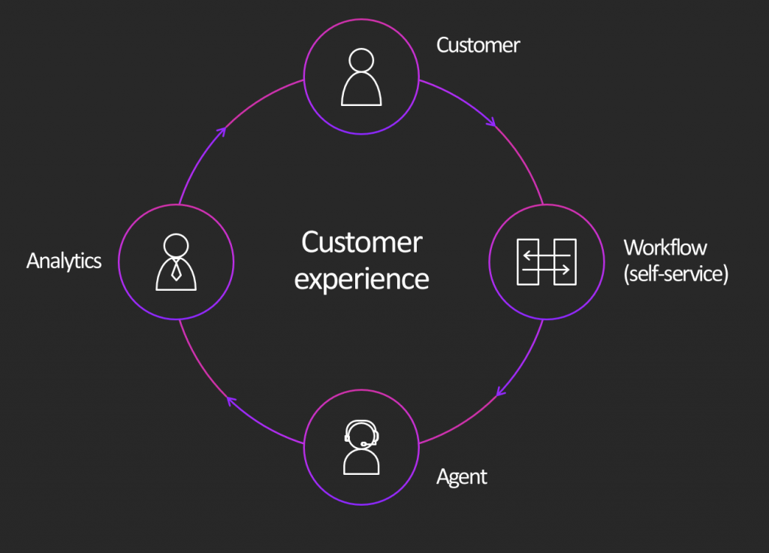
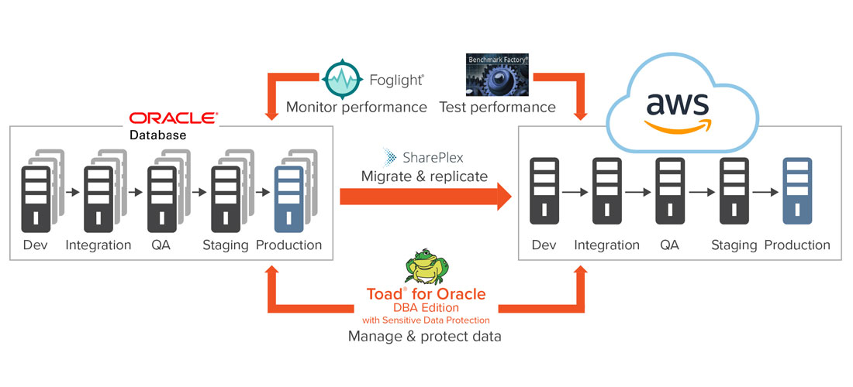
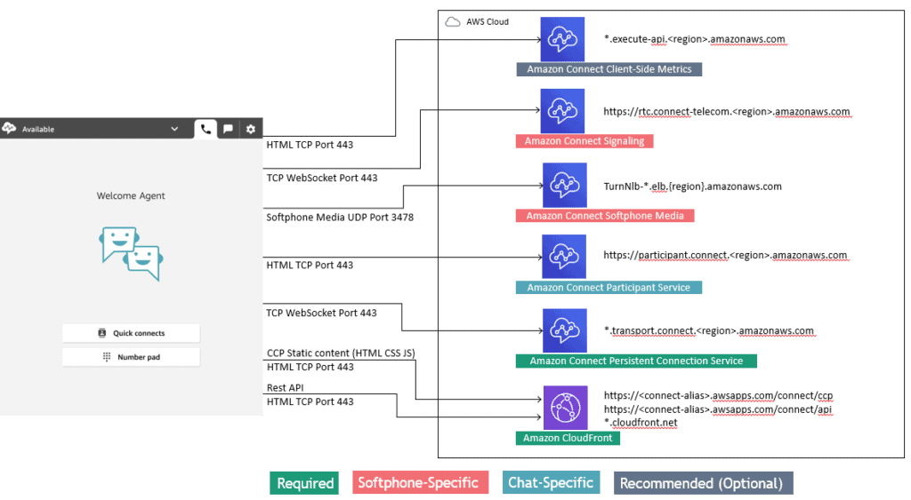
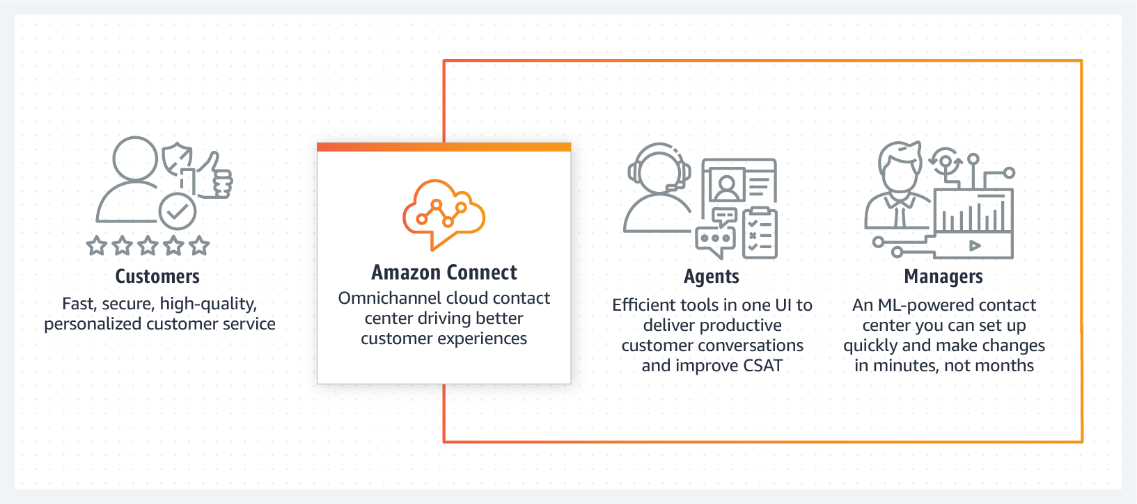

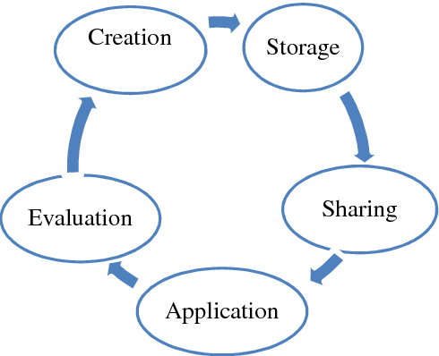
A Critical Analysis of Knowledge Management in Amazon
Process of Acquiring Knowledge
Use of Single Platform for extracting Information and knowledge
Use of Amazon Connect and Big Data application
Application of Everything Under One Roof Model
Collaborative Filtering and Application of Hewlett-Packard for acquiring information
Internal Sources
Monitoring of time spent by users in webpages
Use of Amazon Connect to collect information
External Sources
External datasets
Census data
Sort Of Information and Knowledge Amazon acquire
Qualitative and Quantitative
Customer feedbacks and reviews
Shipping details and search results of customers
Amazon Vision Statement
To be one of the most globally reached customer centric company having a widest range of products for the customers in the market
Amazon Net Revenue Comparison
Net Revenue in 2019: 280.52 billion US Dollar
Net Revenue in 2020: 386.06 billion US Dollar
Knowledge Management Typology of Amazon
Database Management System Typology
Company uses Oracle Database Management System for storing Knowledge and Information.
4C’s Knowledge Management Process in Amazon
Knowledge Capture Process
Application of Amazon Connect and Collaborative filtering to acquire customer information
Success Of the Information and knowledge system in Amazon
High
Successful in identification of customer preferences
Successful in providing the best and collaborative recommendation for the customers
Development in Prediction Model
Knowledge Construction Process
Application of two different Information Management Software
Simple Storage service incorporated to Amazon Web and Transaction Service for constructing Knowledge
Knowledge Codification Process
Application of ERP through which Transfer of Knowledge to Oracle Database Management System
Amazon Mission Statement
To Provide customers with the best selection of the product at the lowest prices and with utmost convenience
Knowledge Communication Process
Use of Feedback Process and ICT tools for communicating knowledge within the organisation
Amazon Knowledge Organisation
Amazon: Focuses on knowledge acquiring and knowledge development
The company uses customer data as knowledge and utilizes the knowledge for delivering the best product to the customer
Thus, Amazon is a knowledge Organisation
Reasons for implementation of Knowledge Acquisition System
To help customers in achieving their shopping goals
Add Significant value to the customer’s buying experience
Notes:
Introduction
The poster will try to provide a deep concept about the knowledge acquisition stage of knowledge and information management in Amazon. The various sources of knowledge acquiring processes will be discussed in an effective manner.
Knowledge Acquisition
Mission Statement of Amazon
To provide customers with the best product range selection at an affordable rate with utmost convenience for the users. Thus, according to their mission statement, the company could be stated as a knowledge organisation as it utilises customer data and knowledge for delivering the best product and service to the customers within the marketplace.
Vision Statement
To become one of the most globally reached customer centric company having a widest range of product for the customers within the market place.
Where do they get information and knowledge from?
Amazon could be stated as one of the best example for framing one of the best knowledge acquisition platform. The retail company has devised a single platform for extracting information and knowledge. The company has developed Amazon Connect which effectively uses Big data for extracting information and knowledge from the amazon website. They has mainly adopted the model of “Everything Under One Roof” (Lopes et al., 2017). The company has successfully implemented collaborative filtering for extracting the best information of the customers from the platform. The application of Hewlett-Packard servers helps in extracting and handling knowledge information in Amazon.
The 4C’s Knowledge Management Process in Amazon
The 4C’s of Knowledge Management Process in Amazon are stated below in an effective manner:
Knowledge Capture Process: The way through which the knowledge is acquired within any business organisation is known as knowledge capture process. Through the utilisation of Amazon Connect and using collaborative filtering to acquire information of customers from the website
Knowledge Construction Process: This is the process through which, the knowledge is mainly being constructed and amplified within the organisational network. In amazon, the company effectively uses two different types of information management software and its consist of simple storage service with effective integration into amazon web service and amazon transaction service. This helps in constructing the knowledge acquired from the knowledge capture process.
Knowledge Codification Process: Through effective codification process, the knowledge stored and constructed are effectively managed and therefore helps in transfer of knowledge and information. In Amazon, the codification process is being carried out through Enterprise Resource Management System from which the knowledge and information are transferred to Oracle Database Management System.
Knowledge Communication Process: This is the process through which, knowledge acquired and stored are being communicated within the organisation. In amazon, the company uses different kinds of feedback process and ICT tools for communicating the knowledge within the organisational framework.
Knowledge Management Typology
There are different kinds of knowledge Management Typologies used by different business organisations. Considering the case of Amazon, the company uses database management system typology as their Knowledge Management Typology. The company uses Oracle Database Management System to store the information and knowledge of their customers within the marketplace.
What sort of information and knowledge do they acquire?
In Amazon, mainly quantitative and qualitative information of the customers are acquired in an effective manner. Qualitative feedbacks of the customers are acquired as one type of knowledge and information. These feedbacks are analysed for making the services and product more customised in nature. The search results of the customers are also acquired as another type of knowledge information in Amazon. The reviews of the customers along with their order details and order preferences are stated as their quantitative information sources.
Theoretical link with the knowledge management theory
The knowledge acquisition process of Amazon could be stated to be interrelated with that of knowledge development phase of Weggeman Model of Knowledge management value chain. According to the knowledge development phase of the model, the development of the knowledge and information could effectively help in enhancing the process of meeting the needs of the customers and improving the growth of the business. Amazon through its Amazon Connect technology acquires information that are utilised for enhancing the business operation and sales growth (Durst and Zieba, 2019).
Reason for implementing knowledge acquisition system in amazon
Amazon from very beginning has been successful in framing the user experience in an effective manner. But as the business expanded globally formulating the user experience of the customer was proving not much success for the company. Thus, the need for incorporation of the system that would help the customers in achieving their shopping goals in a personalised manner emerged. This became the major reason for implementing the knowledge acquisition system in Amazon. Moreover, the principles of knowledge management would add significant value to the experience of the customer became another major reason for implementation of knowledge acquisition system in Amazon.
Success of their information and knowledge system in Amazon
The implementation of the information and knowledge system in Amazon has been quite successful with the incorporation of the Amazon Connect platform. The collaborative filtering of the amazon has been successful in identifying the knowledge regarding the preferences of the customers. Based on the knowledge acquired, the company has been successful in providing the best recommendation for its customers within the online platform. The prediction model has quite increased because of using Amazon connect for acquiring information in Amazon.
Do they use internal or external sources?
The company uses both external and internal sources for acquiring information and knowledge within their system. The company through Amazon Connect collects information and data from their one integrated platform. Time spent by the users for browsing their website pages and applications are some example of internal sources of data. In terms of external sources, the company uses external data sets like different kinds of census data for accumulating demographic details.
Is knowledge valued/given high currency in the organisation?
The implementation of the knowledge acquisition system has effectively helped Amazon to effectively increase its sales and revenue growth from 2007 till 2020 (Statista, 2020). Even the sales growth has also increased in last few years with the effective incorporation of the Amazon Connect. The net revenue of the company in 2019 was just 280.52 billion US dollar and this considerably increased to 386.06 billion US dollar. Thus, the knowledge valued has been successful in framing high currency to the organisation (Statista, 2020).
Comparison of Amazon knowledge acquisition with that of Arthur Anderson LLP
The strategies of knowledge acquisition of Amazon is far more better than that of Arthur Anderson LLP. The main priority of Arthur Anderson company is based on effective sharing of knowledge rather than that of knowledge acquisition and knowledge stored. Whereas in Amazon, focus is more on acquiring and storing knowledge and utilising for the betterment of the customers in the market.
Conclusion
The assessment successfully stated the application of knowledge acquisition system in Amazon. Theoretical link with knowledge management theory along with effective comparison of Amazon Knowledge with that of Arthur Anderson LLP has been portrayed in an effective manner.
References
Statista, 2020. Quarterly Revenue of Amazon [online]. Available at: <https://www.statista.com/statistics/273963/quarterly-revenue-of-amazoncom/> [Accessed 26 May 2021].
Statista, 2020. Net Revenue of Amazon [online]. Available at: <https://www.statista.com/statistics/266282/annual-net-revenue-of-amazoncom/> [Accessed 26 May 2021].
Lopes, C.M., Scavarda, A., Hofmeister, L.F., Thomé, A.M.T. and Vaccaro, G.L.R., 2017. An analysis of the interplay between organizational sustainability, knowledge management, and open innovation. Journal of Cleaner Production, 142, pp.476-488.
Durst, S. and Zieba, M., 2019. Mapping knowledge risks: towards a better understanding of knowledge management. Knowledge Management Research & Practice, 17(1), pp.1-13.

