Slide 1
My Reflective Presentation About Digital Skills for Business BMBS4003
Gina Novac
Good afternoon! Everyone!

Slide 2

I have learned during this course how to open communicate and work as a team with the help of digital skills.
Digital skills are a necessity these days !
(I have used Copilot to generate this image.)
Digital skills is a key to a new era of technology!
Digital skills help us to connect to the internet world better and quicker!

Slide 3
My Goals
I knew that attending digital skills courses will help me achieve my goals, build my confidence, and improve my digital skills. My Goals representing :
To build up my confidence
Learn new skills
To learn how to express myself
And to never give up
As according to a Chinese military strategist and philosopher called Sun Tzu quoting : “If you know the enemy and know yourself , you need not fear the result of a hundred battles. If you know yourself but not the enemy ,for every victory gained you will also suffer a defeat. If you know neither the enemy nor yourself , you will succumb in every battle.” This quote refers to understand your skills and know your strength and focus on your teaching as well.( Cybersecurity for Dummies written by Steinberg. J. publisher . Wiley-Blackweel. Published in 16/03/22.)

Slide 4

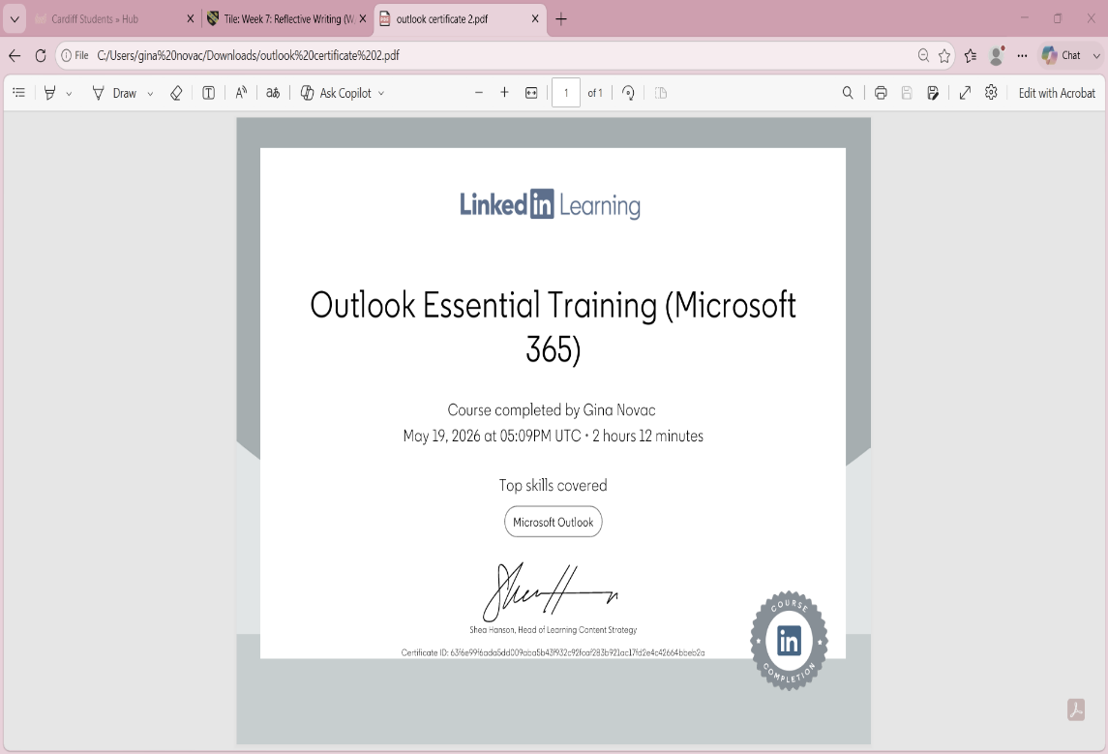
Training with LinkedIn learning
My process of learning and self-improvement began when I started using LinkedIn Learning. It gives you professional insights and makes it easier for you to achieve your goals. LinkedIn learning prepares you for a better future. (To generate the logo of LinkedIn I have used Copilot generate.)
LinkedIn learning helped me to get my outlook certificate and get close to my goals. Available at : https://www.linkedin.com/ accessed at 19/05/2026.

Slide 5

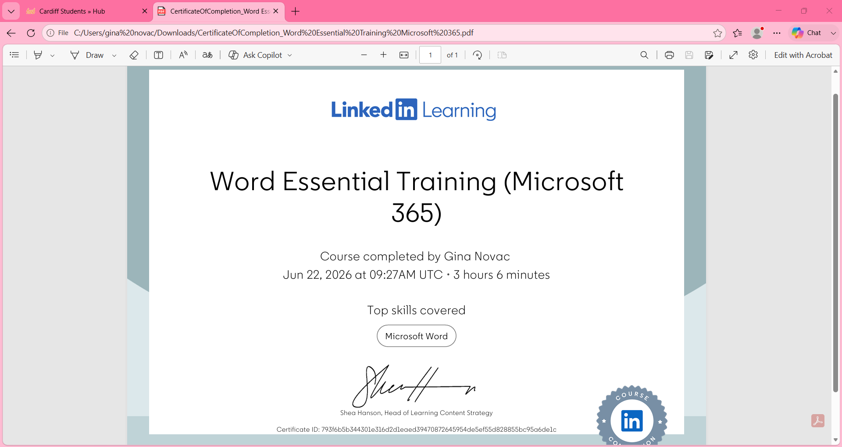
Microsoft Word!
Cybersecurity technology!
This course it give me the opportunity to understand and improve my skills using Microsoft Word.
LinkedIn Learning course helped met to get my Microsoft word certificate.
Cybersecurity is a program or technology to make people be safer in the web world!
(Generated with Copilot )

Slide 6
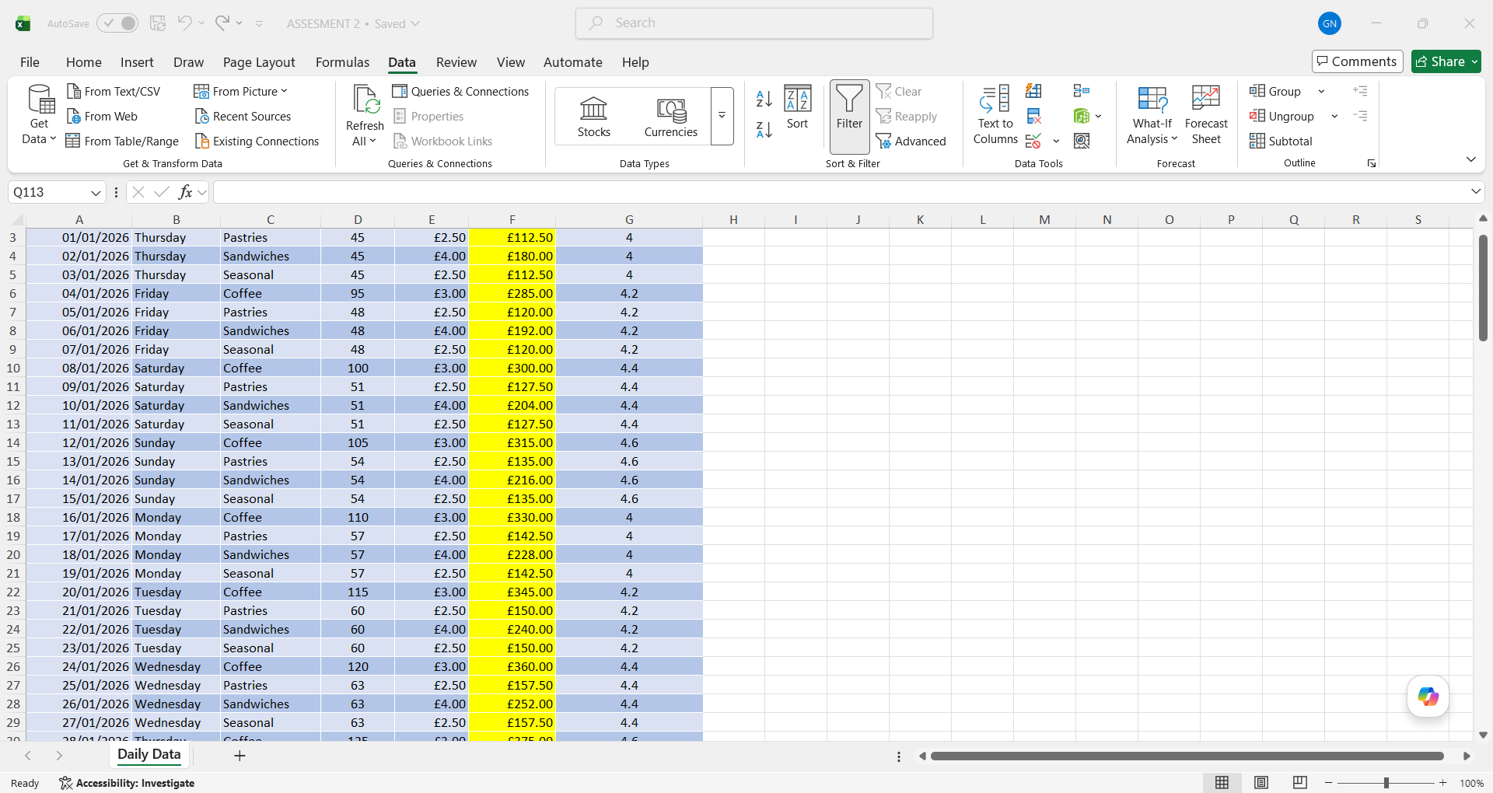
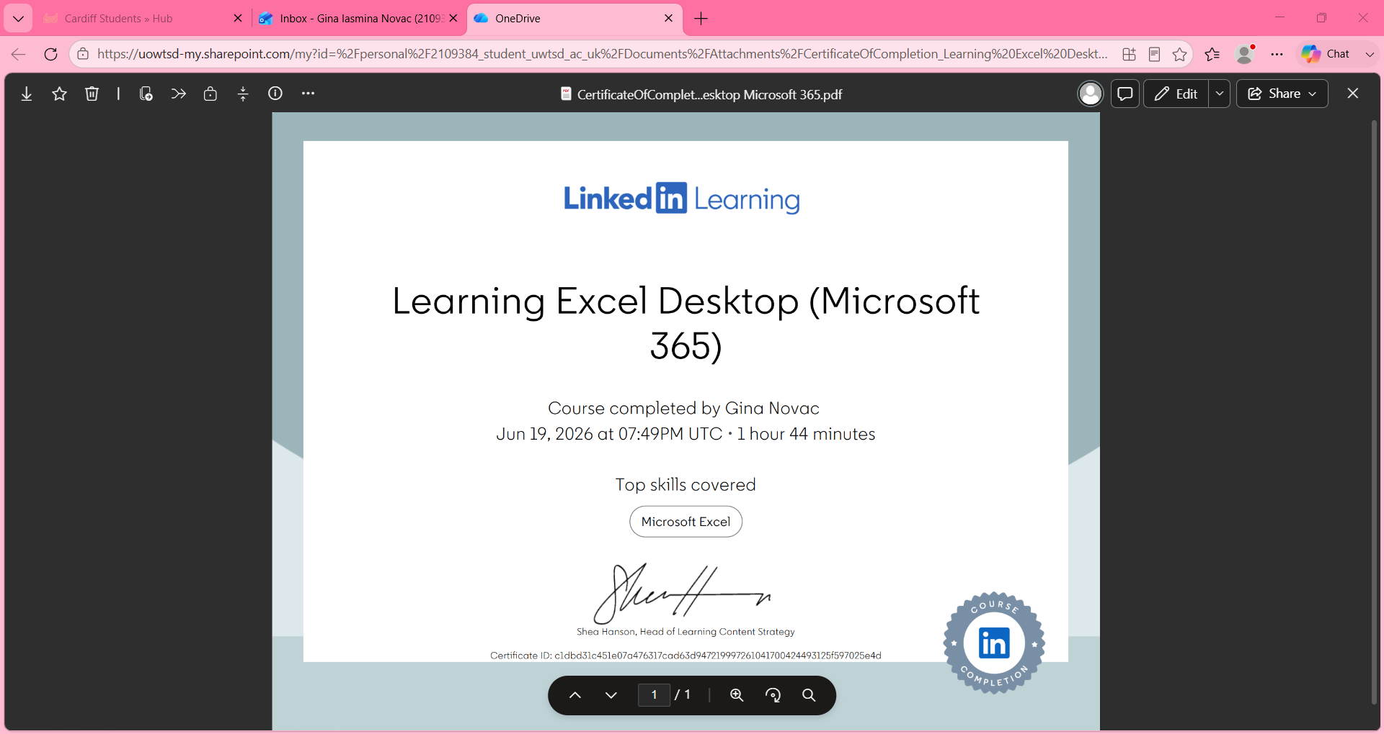
Excel spread sheet analysis!
Learning excel desktop certificate!
Microsoft excel was quite challenging but in the end it gave me the experience for the future.

Slide 7

AI technology and ChatGPT!
Digital Skills helped me to understand the use of AI and its benefits.
What is ChatGPT?
ChatGPT is a tool to help and improve your skills to a formal and professional level.
It sharpens your skills and make it easier for your knowledge.

Slide 8
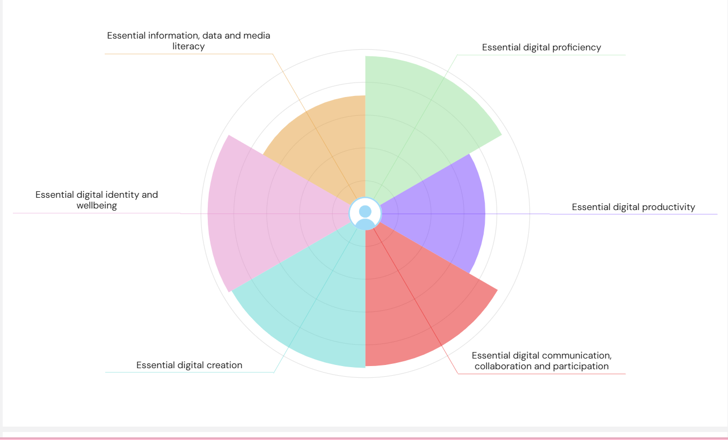
MY JISC TOOLS GRAPH !
The Jisc tool chart shows how much progress I have achieved during my course from my first day till now. It shows the areas that I have improved. This graph it shows the key points of how much this course helped me.
https://uwtsd.potential.ly/playlists/question-bank-for-students/assessments/essential-digital-set/report .Accessed at 17/06/26.

Slide 9
References
https://uwtsd.potential.ly/playlists/question-bank-for-students/assessments/essential-digital-set/report Accessed at 17/06/26.
https://www.Linkedin.com/ Accessed at 19/05/26
I knowledge that I have read the book called Cybersecurity for Dummies written by Steinberg. J. publisher . Wiley-Blackweel. Published in 16/03/22. in online library resource on the date of 10/05/26.
I knowledge that I have used the Copilot to generate image on date of 20/06/26.

Slide 10
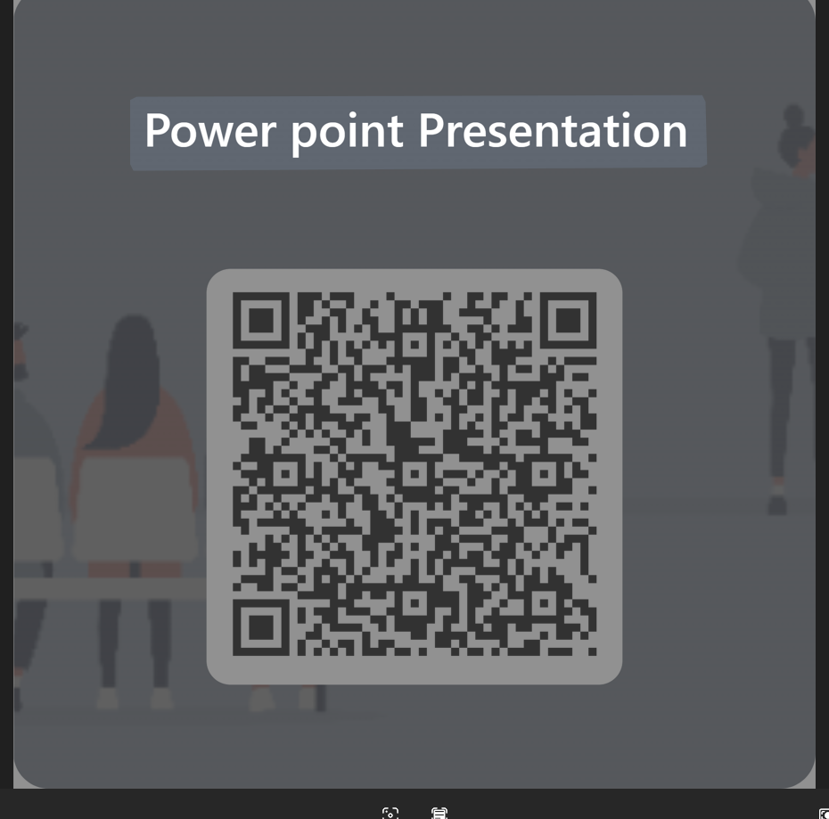
Feedback time! If you would like to leave some feedback for this presentation that would be great! Thank you very much! Please scan this QR code to answer a few questions!

