Slide 1
Electromagnetic
Radiation
(ACDC5009)
Lecture - 4

Slide 2
Content
Electromagnetic Waveguides
Metal waveguide
  Rectangular
  Cylindrical
Dielectric waveguide
  Dielectric slab
  Optic fiber
Transverse modes

Slide 3
Learning Outcome
The student upon completion of the lecture will be able to:
Define the uses of Electromagnetic waveguide.
Describe the types of Electromagnetic waveguide.

Slide 4
Electromagnetic waveguides
A waveguide is a structure that guides waves, such as electromagnetic waves or sound, with minimal loss of energy by restricting the transmission of energy to one direction.
Waveguide helps in the propagation of high frequency Electromagnetic waves like Microwaves, Radio waves, and Infrared Rays.
For low frequency waves which are less than 1 MHz, parallel transmission lines or co-axial cables are used.
There are different types of waveguides for different types of waves.
George C Southworth demonstrated the first Waveguide in the early nineteenth century.

Slide 5
Electromagnetic waveguides
A hollow conductive metal pipe used to carry high frequency radio waves, particularly microwaves.
Dielectric waveguides are used at higher radio frequencies, and transparent dielectric waveguides and optical fibers serve as waveguides for light.
In acoustics, air ducts and horns are used as waveguides for sound in musical instruments and loudspeakers, and specially-shaped metal rods conduct ultrasonic waves in ultrasonic machining.
Sound waves guided through through a hollow pipe such as a cave or medical stethoscope.
Other uses of waveguides are in transmitting power between the components of a system such as radio, radar or optical devices.

Slide 6
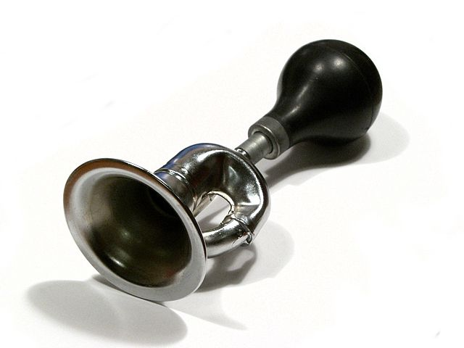
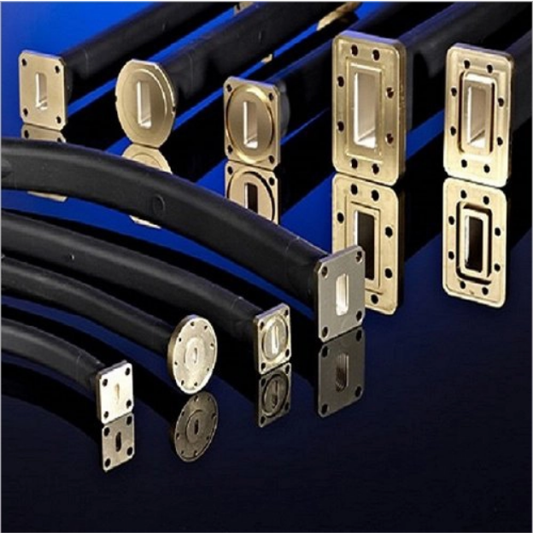
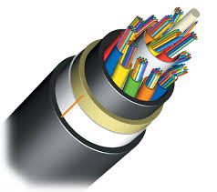
Electromagnetic waveguides

Slide 7
Electromagnetic waveguides
Wave-guide is represented by its dispersion characteristics that has a certain cut-off frequency.
The signals having frequencies above this cut-off frequency are allowed to propagate through the Wave-guide and the signals having frequencies below this frequency will face a high reflection.
A Waveguide acts like a high pass filter due to this characteristics.
The dispersion characteristics can be altered by loading the Wave-guide with metal or di-electric medium

Slide 8
Electromagnetic waveguides
Transverse modes occur in radio waves and microwaves confined to a waveguide, and in light waves in an optical fiber.
Modes in waveguides can be classified as follows:
Transverse electromagnetic (TEM) modes
Transverse electric (TE) modes
Transverse magnetic (TM) modes
Hybrid modes

Slide 9
Electromagnetic waveguides
Transverse electromagnetic (TEM) modes
  Neither electric nor magnetic field in the direction of propagation.
Transverse electric (TE) modes
  No electric field in the direction of propagation.
  These are sometimes called H modes because there is only a magnetic field along the direction of propagation (H is the conventional symbol for magnetic field).
  Electric Field (E) vector is transverse or perpendicular to the Waveguide’s axis.

Slide 10
Electromagnetic waveguides
Transverse magnetic (TM) modes
  No magnetic field in the direction of propagation.
  These are sometimes called E modes because there is only an electric field along the direction of propagation.
  Magnetic Field (E) vector is transverse or perpendicular to the Waveguide’s axis.
  Hybrid modes
  Non-zero electric and magnetic fields in the direction of propagation.

Slide 11
Electromagnetic waveguides
  Hollow metallic waveguides filled with a homogeneous, isotropic material (usually air) support TE and TM modes but not the TEM mode.
  In coaxial cable energy is normally transported in the fundamental TEM mode. The TEM mode is also usually assumed for most other electrical conductor line formats as well.
  The number of modes in an optical fiber distinguishes multi-mode optical fiber from single-mode optical fiber.

Slide 12
Electromagnetic waveguides
The Wave-guide is considered to be infinitely long, oriented along the z-axis, and uniform along its length.
The Wave-guide is constructed from a perfectly conducting pipe (PEC) and is filled with a perfect insulator (lossless dielectric).
The Electric and Magnetic fields are time-harmonic

Slide 13
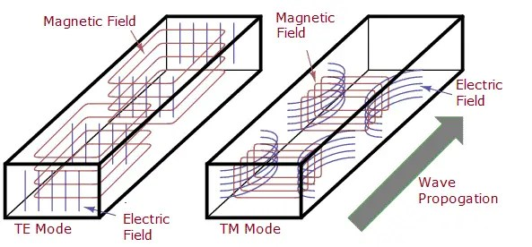
Electromagnetic waveguides

Slide 14
Electromagnetic waveguides
Classification of Waveguide
Waveguides are classified into two types:
Metal Waveguides
Dielectric Waveguides

Slide 15
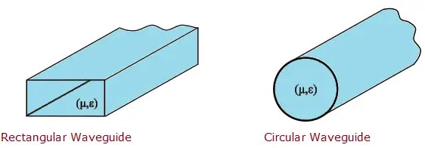
Electromagnetic waveguides
Metal Waveguide
Metal Waveguides consists of an enclosed conducting metal pipe and the wave guiding principle works on the total internal reflection from the conducting walls.
They are of two types:
Rectangular Waveguides
Circular Waveguides

Slide 16
Electromagnetic waveguides
Circular Waveguide
A waveguide with a circular cross-section is called as Circular Waveguide. It supports both transverse electric (TE) and transverse magnetic (TM) modes.
TE11 is the dominant mode in a circular waveguide i.e., a signal in this mode propagates with the minimum degradation.
The circular waveguide is easier to manufacture than rectangular waveguides and is relatively easy to install.
It is usually used to connect a horn antenna with a reflector in tracking radars and for long-distance waveguide transmission above 10 GHz.

Slide 17
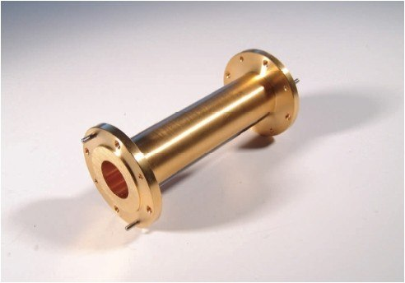
Electromagnetic waveguides

Slide 18
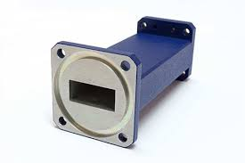
Electromagnetic waveguides
Rectangular waveguides:
A rectangular waveguide supports TM and TE modes but not TEM waves.
A rectangular waveguide cannot propagate below some certain frequency. This frequency is called the cut-off frequency.

Slide 19
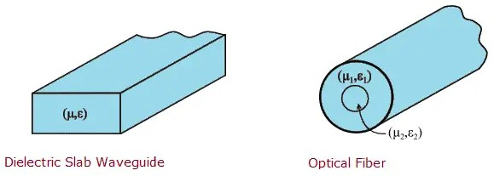
Electromagnetic waveguides
Dielectric Waveguide
Dielectric Waveguides consists of dielectrics and the reflection from dielectric interfaces helps in the propagation of electromagnetic waves along the Waveguide.
They are of two types:
Dielectric Slab Waveguides
Optical Fiber

Slide 20
Electromagnetic waveguides
Optic Fiber:
Optic fiber waveguides are classified as follows
Single mode optic fiber,
Multimode graded index optic fiber,
Multimode step-index optic fiber.

Slide 21
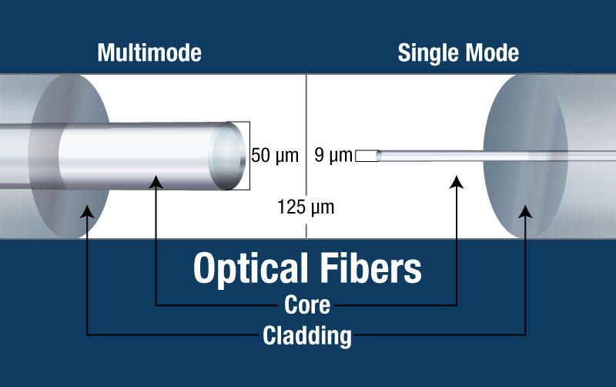
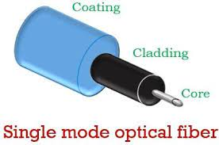
Electromagnetic waveguides
single mode optic fiber,
single-mode optical fiber (SMF), also known as fundamental- or mono-mode is an optical fiber designed to carry only a single mode of light in the transverse mode.

Slide 22
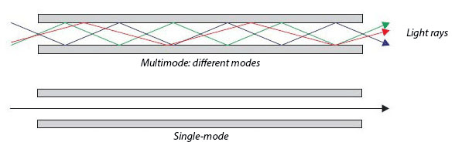
Electromagnetic waveguides

Slide 23
Electromagnetic waveguides
Multimode step index optic fiber :
step-index fiber is a fiber where a uniform refractive index exists within the core and a sharply decreased refractive index exists in the core-cladding interface because of the lower refractive index in cladding.
For step-index multimode fiber, the light propagates in the shape of a zigzag along the fiber/core axis according to the principle of total reflection.
Light entering the fiber at different angles of incidence will go through different paths.
Although the incident lights propagate at the same speed simultaneously at the input, the time to reach the output of the fiber is different, resulting in a temporal dispersion called modal dispersion.

Slide 24
Electromagnetic waveguides
Multimode graded index optic fiber
Graded index multimode fiber is a type of optical fiber where the refractive index is higher at the axis of the core and then it decreases gradually towards the core-cladding interface.
That is to say, the refractive index of a graded-index fiber gradually decreases from its center, and eventually decreases to the same value as the cladding at the core edge.
The change in refractive index causes refraction rather than total internal reflection.
When light passes through a layer with a lower refractive index, the light will fold back to the fiber axis. Total internal reflection does not occur because refraction folds the light back into the fiber axis before it reaches the cladding boundary.

Slide 25
Electromagnetic waveguides
Multimode graded index optic fiber
For graded-index multimode fiber, the light travels forward in the form of sinusoidal oscillation.
Like step-index multimode fibers, different lights in a graded-index multimode fiber travel along different paths.
However, the speed of light propagation in graded-index multimode fibers is different because the speed of guided light varies with the refractive index of the fiber core.
The farther the light goes from the center of the fiber, the faster its speed is.
The speed difference compensates for the longer paths followed by the light rays that go farthest from the center of the fiber.
This equalization of the transmission time of different modes reduces the mode dispersion greatly, making a higher bandwidth in graded-index fiber than step-index fiber.
Therefore, most of the multimode fiber today is graded-index fiber. Compared to step-index fiber, the graded-index fiber is usually used in medium-distance (10~20 km) and relatively higher-speed (34~140 Mb/s)

Slide 26
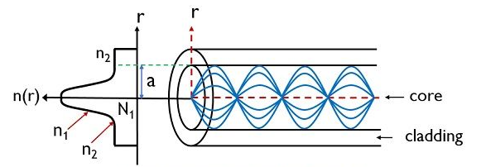
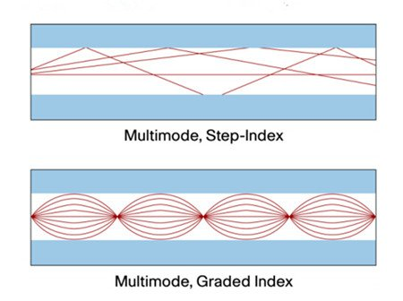
Electromagnetic waveguides

Slide 27
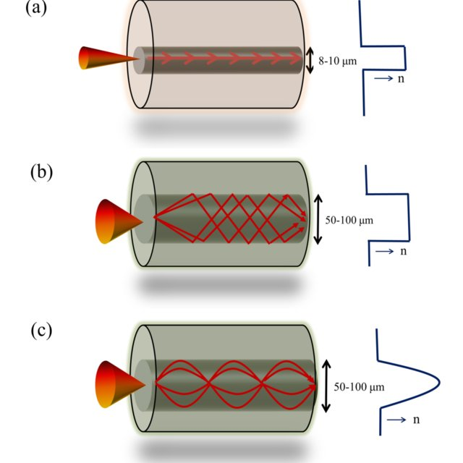
Electromagnetic waveguides

Slide 28

Thank You
Module Descriptor

