Slide 1
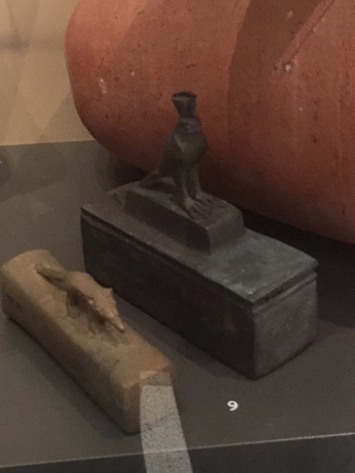
Using post-processualism to compare the nature of falconry in Ancient Egypt to today.
Jess Plunkett (1700273)
Notes:
Using the paradigm of post-processualism in order to show the changing nature of falconry due to its ancient votive nature requiring us to bring in the sub-discipline of religious studies and its modern educational/entertainment nature requiring us to look into the sub discipline of education.

Slide 2
Falconry definition
falconry
Pronunciation /ˈfɒlk(ə)nri//ˈfɔː(l)k(ə)nri/
NOUN
The keeping and training of falcons or other birds of prey; the sport of hunting with such birds.
Notes:
Just as we have previously discussed needing to find our own ways to define the term ‘civilization’ , the Oxford English Dictionary definition of the word falconry is also problematic. However it was the best one I could find. Most dictionaries mearly define it as ‘the act of hunting with falcons’ or something to that extent, which is highly incorrect for modern falconers for two main reasons, the first is that the most common form of falconry these days is not of a hunting nature, but rather one of educational/entertainment value. The second is that ‘falconry’ doesn’t mean just include falcons but rather all birds of prey. I fact, those who do hunt prefer to do so with Hawks- specifically Harris Hawks due to their intelligence and pack instincts.
Because of this, I will define falconry as ‘The act of keeping and/or training birds of prey’

Slide 3
Why Post-Processualism?
Processualism = Draws on Determinism and Logical Positivism
Post-Processualism = Advocates alternative interpretive perspectives
Notes:
Post-Processionalism was born out of the critiques of processionalism. These were that it relied to heavily on ‘scientific fact’ and aimed to prove a ‘unobjective fact, which just isn’t practical when you remember that we are looking at the study of people! Ancient people but people non the less and no two are the same, everyone experiences different thought processes and has different opinions. Considering this, post processionalism was born. It argues that the only way to understand ancient history, is to looks at it through different lenses, such as gender or materiality. Due to my chosen presentation topic containing the word ‘compare’ I thought it wize to use this theory as it allows for closer interpretation and really humanises and helps us understand that the Ancient Egyptians weren’t as different from us as you might expect from Processualism

Slide 4
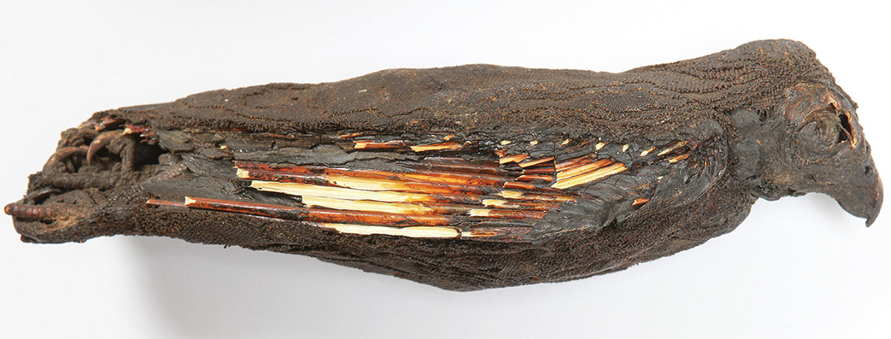
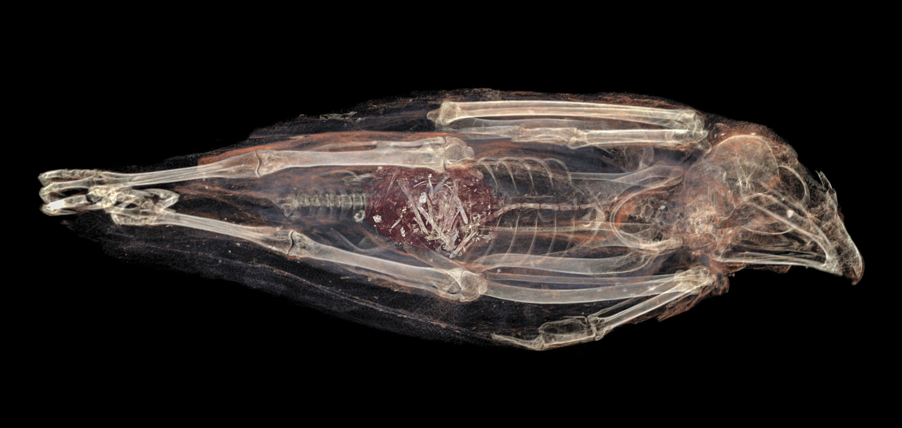
Ancient Falconry
Votive nature
‘Gift to the gods’
Bred to die
Notes:
The votive nature of Ancient falconry is best found in Saqqara where over 100,000 mummies of birds of prey were found in a tomb dedicated to the goddess Isis, mother of Horus the falcon headed god. Most of the birds found here were native breeds such as lanners or kestrals but also found were non native breeds like kites, vultures and even songbirds (suggesting fakes sold to devotees).
But how does this suggest evidence for falconry? The answer comes in the pictures on the slide. This is a mummified kestrel that had been unusually left with its innards intact allowing us to see its last meal. This revealed that it had been force fed showing us that humans must have been involved. The weight of the bird meant that it couldn’t fly, so would have needed to be looked after by humans, (Fed up, flying weight, etc) and due to the fact it is male, we can imply that females were kept around to be bred from.
Therefore, We can postulate that for the ancient Egyptians, The nature of falconry was a religious one, where the were kept and bred to die as sacrifices to appese the gods.

Slide 5
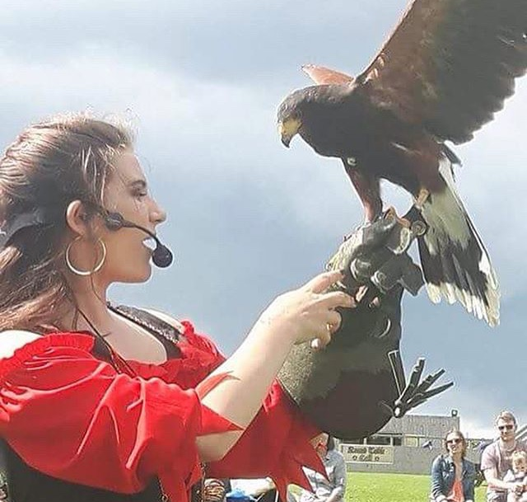
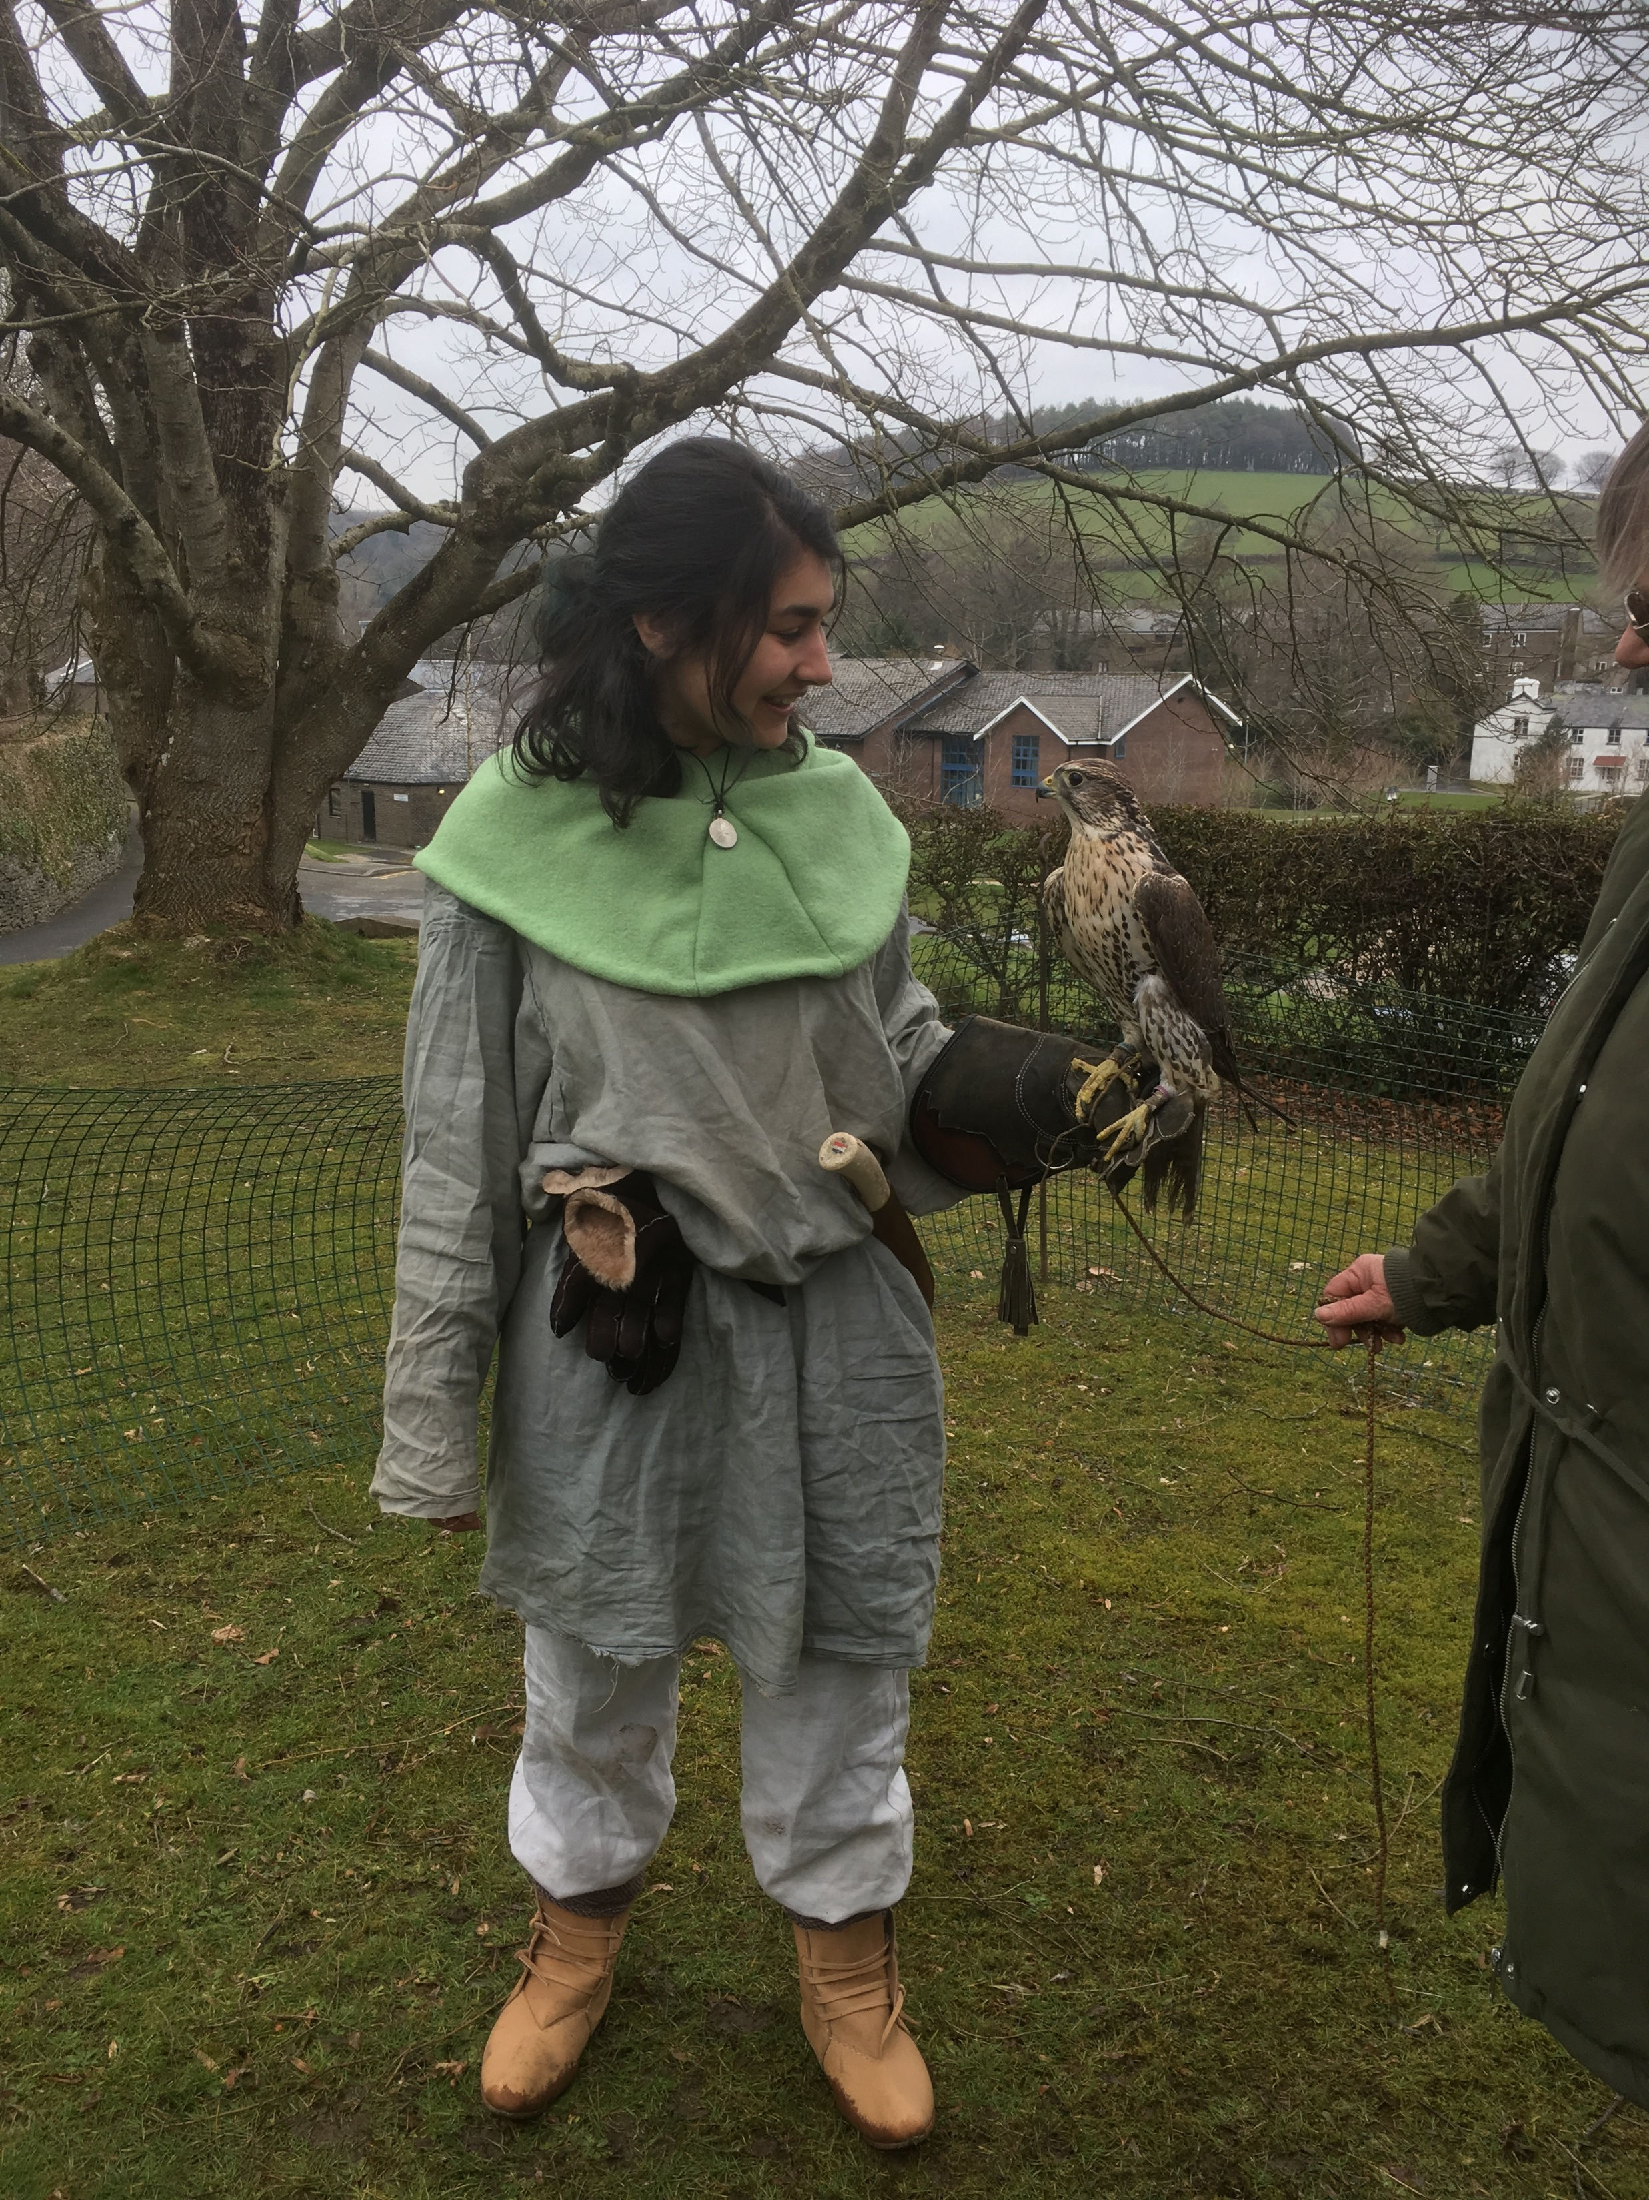
Modern Falconry
Education
Entertainment
Conservation
Notes:
To contrast to this, modern falconry ismostly tailered towards the conservation of birds of prey. There are strict laws in place that states no wild birds can be captured and trained and no captive birds can be released into the wild (for their own safety). Therefore, most falconers tailor their shows to be educational, to give people the chance to have up close experiences with birds of prey and teach you about them in order to stop people attempting to approach wild birds. The act of feeding birds of prey is an exact science, each individual bird (not just breed) has its own ‘fat weight’ and ‘flying weight’ Flying weight is when they are hungry enough to trust you for food, not too hungry to decide theyd be better off hunting their own food – not too full to not want to do anything – this is where the expression ‘fed up’ comes from.

Slide 6
Conclusion
Combining disciplines essential for ‘compare’ questions
Element of food crucial to both Ancient and Modern Falconry.
Notes:
In conclusion, by implementing the Post-Processualist element of combining disciplines, such as science, religious studies, zoology and education I managed to identify the nature of Ancient Egyption Falconry as votive and Modern Falconry as conservationalist, though It is interesting that both ancient and modern falconry woked out the exact same key feature of falconry, the correlation between the amount of food given and the behaviour of the bird, yet used it for nearly opposite purposes. The Egyptions overfed their birds so that they would be docile and couldn’t fly and eventually died and could be used as an offering to the gods, Yet today we use it to entertain the masses and educate people about these magnificent creatures.

