Slide 1
SBPD8001
Preparing for doctoral research
03 Research Design

Slide 2
Topics
Research design
Research onion
research philosophy
Methodological choice
  mono-method; multi-method; mixed-method
Research strategy
  Experimental research; survey; ethnography; phenomenology; narrative research; grounded theory; archival research; case study; action research
Data collection methods
  Interviews; focus groups; observations; document analysis
Data analysis techniques
  Grounded analysis; thematic analysis; content analysis; discourse analysis; narrative analysis; phenomenology analysis

Slide 3
Research Design
Research design is the master plan specifying the approach, methodology, strategies and methods for collecting and analyzing the required information.
It determines how the participants are selected, how variables are manipulated, data are collected and analysed, and how confounding variables are controlled so that the overall research problem can be addressed.
Which research design should I choose?
  Best addresses the research problems
  Ethics
  Cost in time and money
  Validity

Slide 4
Research design
While research design is the plan for a research study, research methodology is the specific methodological choice and strategies used to carry out that plan.
Method refers to the specific techniques or tools used to collect and analyse data in a research study. For example, a researcher might use personal interviews, focus groups or observations as methods to collect data, and content analysis as methods to analyse data.
Methodology is more comprehensive than method and includes the rationale for why a particular method was chosen and how it fits into the overall research design.

Slide 5
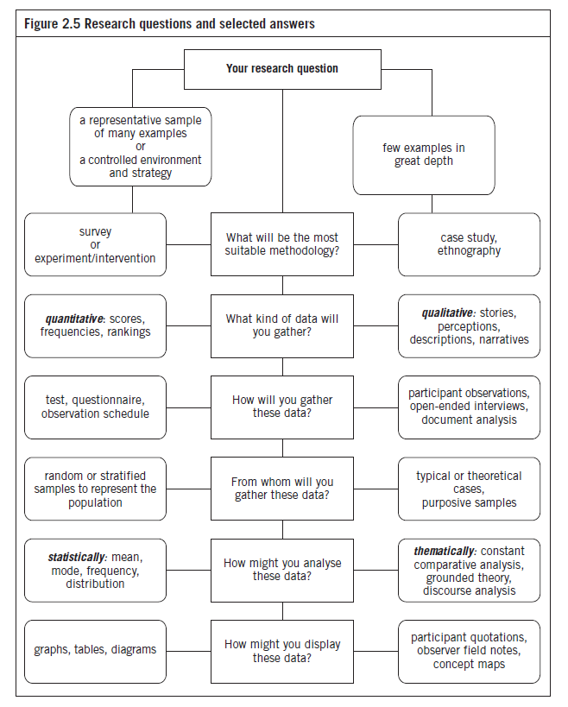

Slide 6
Research onion
Many terms have been used to describe or classify empirical studies which cause confusion. A quantitative study may be described as a positivist research, it may also be described as deductive; if a survey is involved, it may be either cross-sectional or case study.
Saunders et al.’s (2019) research onion offered a comprehensive and structured approach to explain the considerations that underlie the choice of research methodology and methods.

Slide 7
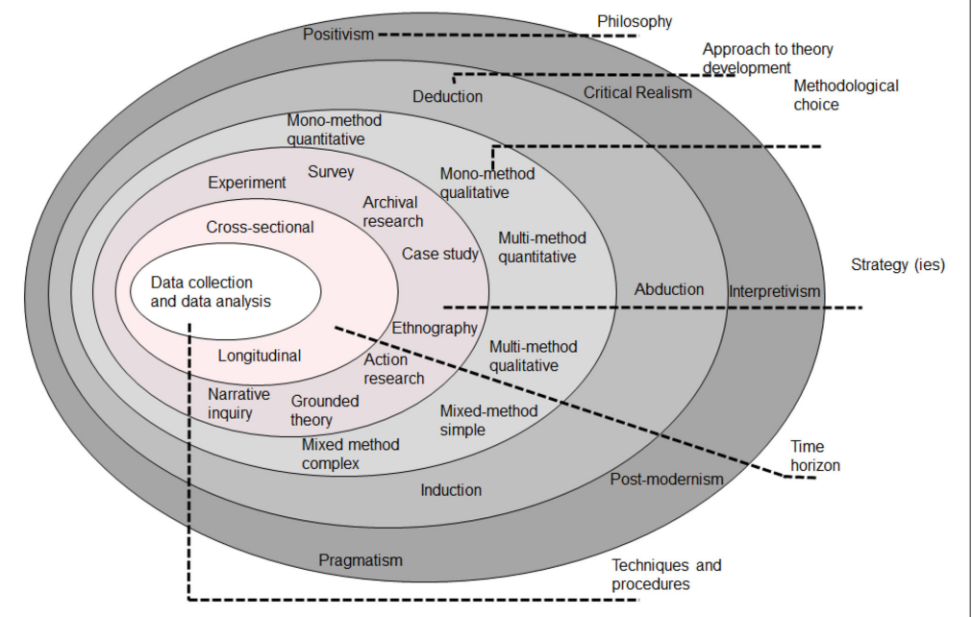
Research Onion

Slide 8
Research onion
Research philosophy: positivism; critical realism; interpretivism; post-modernism; pragmatism
Approach to theory development: deduction; abduction; induction
Methodological choice: mono-method; multi-method; mixed-method
Research strategy: Experimental research; survey; anthography; phenomenology; narrative inquiry; grounded theory; archival research; case study; action research
Time horizon: cross-sectional research; longitudinal research
Techniques and procedures (date collection and analysis methods): primary and secondary data; qualitative and quantitative data

Slide 9
research philosophy
A research philosophy is a belief about the way in which data about a phenomenon should be gathered, analysed and used.
Positivism:
Emphasizes the use of empirical and scientific methods to study the world
Assumes that there is an objective reality that can be observed and measured
Believes that knowledge can be acquired through the scientific method
Goal of research is to discover universal laws and patterns that explain the phenomena being studied
Critical realism:
Seeks to understand the underlying structures and mechanisms that produce the phenomena being studied
Assumes that there is an objective reality that exists independently of our perceptions
Believes that research should aim to uncover the causal processes that produce the phenomena being studied, while also recognizing the role of human agency and interpretation in shaping those phenomena

Slide 10
research philosophy
Interpretivism:
- Emphasizes the subjective and contextual nature of human experience
- Assumes that individuals construct their own meanings and interpretations of the world based on their unique experiences, values, and beliefs
- Believes that research should focus on understanding the meaning and significance of human behaviour
- Goal of research is to develop rich and nuanced descriptions of the phenomena being studied
Post-modernism:
- Challenges the notion of objective reality and truth
- Assumes that reality is socially constructed and that different people and cultures construct reality in different ways
- Believes that research should focus on understanding the ways in which power and language shape our understanding of the world
- Goal of research is to deconstruct dominant narratives and challenge established power structures

Slide 11
research philosophy
Pragmatism:
- Emphasizes the practical application of knowledge
- Assumes that knowledge is constantly evolving and that the validity of knowledge is determined by its usefulness in solving real-world problems
- Believes that research should focus on identifying practical solutions to real-world problems
- Goal of research is to develop actionable recommendations that can improve people's lives
Each research philosophy has its own set of assumptions, beliefs, and values that guide the research process, and the choice of research philosophy depends on the nature of the research question, the research context, and the researcher's own assumptions and beliefs about the world.

Slide 12
Research philosophy and research design
Here are some ways in which the choice of research philosophy affects the research design and methodology:
Research questions: Positivists tend to ask questions that can be answered through empirical observation and measurement, while interpretivists tend to ask questions that explore the subjective and contextual nature of human experience.
Data collection methods: Positivists tend to use quantitative methods such as surveys and experiments, while interpretivists tend to use qualitative methods such as interviews and observation.

Slide 13
Research philosophy and research design
Data analysis methods: Positivists tend to use statistical analysis to test hypotheses and identify patterns, while interpretivists tend to use methods such as content analysis and discourse analysis to explore the meaning and significance of data.
Researcher role: Positivists tend to adopt an objective and neutral stance, while interpretivists tend to acknowledge their own subjectivity and the influence their values and beliefs may have on the research process.
Validity and reliability: Positivists tend to prioritize internal validity (i.e., the extent to which the research design controls for confounding variables), while interpretivists tend to prioritize external validity (i.e., the extent to which research findings are applicable to real-world contexts).

Slide 14
Methodological choice
The research onion suggests mono-method, mixed method and multi-method as possible choices for conducting research.
The mono-method comprises only one method for the study.
The mixed method is based on the use of two or more methods of research and commonly refers to the use of qualitative and quantitative methodology.
The multi-method uses a wider selection of methods.

Slide 15
Research strategy
Experimental research: Experimental research refers to a research process that studies the results of an experiment against the expected outcomes.
Survey: Survey research is a quantitative approach that features the use of self-report measures on carefully selected samples.
Ethnography: Ethnography is a research approach that involves the systematic observation and study of people in their natural settings. Ethnographers aim to understand the culture and social practices of a group or community by immersing themselves in their environment and observing their behaviour.

Slide 16
Research strategy
Phenomenology: Phenomenology is a research approach that focuses on the lived experiences of individuals. Phenomenologists aim to understand how people experience and make sense of the world around them, without making assumptions or imposing preconceived ideas.
Narrative research: Narrative research is a research approach that focuses on the stories that individuals tell about their experiences. Narrative analysts aim to understand how stories are constructed, how they are used to create meaning, and how they shape our understanding of the world.
Grounded theory: Grounded theory is a research approach that focuses on developing theories from data. Grounded theorists collect data first, and then develop concepts, categories, and theories based on the patterns and themes that emerge from the data.

Slide 17
Qualitative research
Archival research: Archival research is a research approach/method that involves the examination of historical records or documents in order to answer research questions or test hypotheses.
Case study: Case study is a research approach that involves the in-depth study of a particular case or situation. Case studies can be used to explore complex phenomena, identify patterns and themes, and develop theories or hypotheses.
Action research: Action research involves collaboration between researchers and participants in the research process. This approach is often used in community-based research, and seeks to empower participants to identify and address issues that are important to them.

Slide 18
Experimental Research
Experimental research examines the cause-and-effect relationships between variables.
  The method involves manipulating one variable to determine if changes in one variable cause changes in another variable.
  It relies on controlled methods, random assignment and the manipulation of variables to test a relationship.
  True experiments: All the important factors that might affect the phenomena of interest are completely controlled.
  Example: An experimental design with two groups was employed. The study was carried out in three phases: pre-test, treatment and post-test.
  Random: Students were randomly assigned to treatment group (with eLearning) and control group (without eLearning).

Slide 19
Experimental research
Quasi-experimental research involves selecting groups, upon which a variable is tested, without any random pre-selection processes.
  It is often used when it is not possible or practical to control all the key factors.
  Example: A quasi-experimental design with two groups was employed. The study was carried out in three phases: pre-test, treatment and post-test.
  Random: Two centres were randomly selected. In turn, one centre was randomly assigned to the experimental condition (with eLearning) and the other to the control condition (without eLearning).

Slide 20
Experimental research
Field experiments are done in a natural setting, whereas laboratory experiments are undertaken in a simulated setting.
  Proves the direct cause-and effect relationship between two variable.
  Advantages: can establish cause and effect relationships; adjustability/flexibility
  Disadvantages: lack of “reality”; unrepresentative samples

Slide 21
Survey Research
Survey research studies samples drawn from populations and from these samples it infers the characteristics of the defined population or universe.
Sample surveys attempt to determine the incidence, distribution, and interrelations among sociological and psychological variables, and in so doing, usually focus on people, the vital facts of people, and their beliefs, opinions, and attitudes.

Slide 22
Survey Research
Advantages
Disadvantages
Less expensive
Collected and processed quickly
Uniformity in questioning and response sets
Objective epistemological position (neutral or unbiased position)
Wider geographical distribution
Closed response sets restricts choice
In-depth data not collected
Passive activity
May generate expectations among the participants
Intrusive form of data collection
Lack of reciprocity

Slide 23
Types of Surveys
Surveys can be undertaken through oral or written questioning.
  Oral questioning is known as interviewing
  Written questioning is accomplished through questionnaires
Five types of surveys
  Mail surveys
  Telephone surveys
  Self-completion surveys
  Interviewer-completed questionnaires
  Online surveys

Slide 24
Online Surveys
Advantages
Disadvantages
Respondents enter the data directly
The cost of conduct is minimal
Faster than mail, telephone or intercept surveys
Real-time responses
Lack of sampling frames
Not knowing who completed the surveys
Many paid survey panels are not reliable
Difficulties in gaining access to some e-lists

Slide 25
Case Study Research
Case study is an in-depth analysis of a single case or a small number of cases
A large number of aspects of a single case (individual, organization or team) was investigated in depth over a long period within the case’s own context.
It involves collecting in depth, descriptive data which is then interpreted, analysed and evaluated.
The method is particularly appropriate when little in known about a topic
Multiple sources of data
Triangulation (the use of two or more methods of data collection or sources of data in the study of some aspect of human behaviour)

Slide 26
Case Study Research
According to Robert Yin (1994), a case study is an empirical inquiry that investigates a contemporary phenomenon within its real-life context
“The case study method allows investigators to retain the holistic and meaningful characteristics of real-life events – such as individual life cycles, small group behaviour, organizational and managerial processes, neighbourhood change, school performance, international relations, and the maturation of industries”. (Yin, 2009)

Slide 27
Case study research
Advantages
disadvantages
In-depth data is collected on a single case or multiple cases
Evidence is grounded in the social setting being studied
Study members can check the data for accuracy
Member checking may remove researcher bias
Methodological triangulation is used
The case study focus is emergent.
The research process is subjective as opposed to objective.
Evidence may be denied for reproduction based on the use of member checking.
Data collection, analysis and findings may contain bias.
Findings are not able to be generalized to other cases.

Slide 28
Single- versus Multiple-case Design
Single-case
Multiple-case
Context
Context
Context
Holistic
(single
unit
analysis
Case
Case
Case
Context
Context
Case
Case
Context
Context
Context
Embedded
(multiple
unit
analysis
Embedded unit of analysis 1
Embedded unit of analysis 1
Embedded unit of analysis 1
Embedded unit of analysis 2
Embedded unit of analysis 2
Embedded unit of analysis 2

Slide 29
Single- versus Multiple-case Design
Rationales for single case study
Rationales for multiple case study
The case selected is a/an
critical case*
extreme/unique case
typical/representative case
revelatory case (phenomenon previously inaccessible; involving a novel situation)
longitudinal case
Provides intra- and inter-case comparisons
Predicts similar results (literal replication); cases are designed to corroborate each other
Predicts contrasting results (theoretical replication); cases are designed to cover different theoretical conditions and different results are expected.
*A case is critical if it “meets all conditions for testing the theory, can confirm, challenge or extend the theory.” (Yin, 2009, 99). For example, if you wish to study how CSR can be implemented successfully, it is important to identify such organisations that claim to be successful in CSR and have established credible standing among the industry.

Slide 30
Action Research
Action research aims at an understanding of a complex situation rather than prescribing a universal social law.
Unlike academic researchers who remain “neutral”, action researchers attempt to intervene the problem setting. Their goal is to foster improvement via a defined research framework.
Action research assists in organizational change. It empowers stakeholders (e.g., employees, residents, etc.) to contribute to the research and decision making process.
It involves planning, implementing, monitoring and reflecting.

Slide 31
Action Research - Example
Abstract: “Ecologically sound tourism planning and policy require an empowering community participation. The participatory action research model helps a community gain understanding of its social reality, learn how to learn, initiate dialog, and discover new possibilities for addressing its situation.”
Guevara, J., & Roberto, Q. (1996). Learning through Participatory Action Research for Community Ecotourism Planning, Convergence, 29(3), 24-40.

Slide 32
Advantages and Disadvantages
Advantages:
It is participatory in nature (e.g., residents representatives are encouraged to undertake research projects that address the needs of the community
Process and outcomes are owned by the participants
It aims to empower participants to lead their own community/unit rather than being directed by professionals.
It focuses on improving organizational practices, conditions and processes.
Disadvantages:
The outcomes being site or organization specific
Time-consuming
Self-fulfilling prophecy (when we expect something to happen, it is more likely to happen).

Slide 33
Data collection methods
Qualitative research typically involves collecting data through a variety of methods, depending on the research question and the nature of the phenomenon being studied.
Personal Interviews: This is a commonly used method where the researcher asks open-ended questions to participants to elicit their experiences, thoughts, and perspectives on the research topic.
Focus groups: This method involves bringing together a small group of participants to discuss a specific topic or issue. The researcher moderates the discussion, and participants are encouraged to share their thoughts and experiences with each other.
Observations: This method involves observing participants in their natural setting to gain insight into their behaviour and experiences. The researcher may use field notes or audio/video recordings to document observations.
Document analysis: This method involves analysing documents such as diaries, letters, and other written materials to gain insight into people's experiences, beliefs, and attitudes.

Slide 34
Data Analysis techniques
Positivism
Content Analysis (focuses on identifying and determining the “objective” content of texts; frequency and distribution of the themes can be relevant)
Thematic Analysis (focuses on themes or patterns emerge from data; deductive approach can be used)
Interpretivism
Grounded Theory/Analysis (bottom up approach; constant comparison)
Discourse Analysis (focuses on verbal and nonverbal language used in social interactions)
Narrative Analysis (tell a story and retell the story)
Phenomenology Analysis (subjective experiences)

Slide 35
Grounded analysis
Grounded analysis is part of the wider grounded theory methodology (Glaser & Strauss, 1967).
Grounded theory is an inductive methodology that provides systematic guidelines for gathering, synthesising, analysing, and conceptualizing qualitative data for the purpose of theory construction. It aims to develop theories (patterns) grounded in data.
Grounded theory may mean many things: It may refer to the research strategy, the methods of data collection and data analysis technique used in a study.
Some researchers believe that grounded analysis differs from either content analysis or thematic analysis because it has its own distinctive set of procedures, including theoretical sampling and open coding. Others believe that thematic analysis can be used across a range of epistemologies including grounded theory studies.

Slide 36
Grounded analysis - Example
In a study on the experiences of employees who work remotely, the researchers used grounded analysis to develop a theory of how remote employees manage their work-life balance. They collected data through interviews with remote employees and analysed the data using a systematic and iterative process.
Through their analysis, the researchers identified several themes related to work-life balance, including time management, boundary management, and support from supervisors and colleagues. They found that remote employees often use a combination of these strategies to manage their work and personal lives, and that the effectiveness of these strategies can depend on individual factors such as personality and family responsibilities.
Based on their analysis, the researchers developed a theory of how remote employees manage their work-life balance, which emphasized the importance of a flexible and boundaryless approach to work that allows remote employees to manage their work and personal lives in a way that works for them. This theory has been used to inform organizational policies and practices related to remote work and has helped to advance our understanding of the experiences of remote employees.

Slide 37
Thematic analysis (Braun & Clarke, 2006)
Thematic analysis is a method for identifying, analysing, organizing, describing, and reporting themes found within a data set (Braun & Clarke, 2006).
In grounded theory research, data collection and data analysis proceed together. In contrast, thematic analysis waits until all the data has been collected before any coding begins.
There are various approaches to conducting thematic analysis, but the most common form follows a six-step process: familiarization, coding, generating themes, reviewing themes, defining and naming themes, and writing up.
  An inductive approach involves allowing the data to determine your themes.
  A deductive approach involves coming to the data with some preconceived themes you expect to find, based on theory or existing knowledge.

Slide 38
Online resources
Five Types of Qualitative Research Design
https://www.youtube.com/watch?v=H45UCgcfLC8
Types of Qualitative Data Analysis [Purposes, Steps, Example]
https://youtu.be/dxxES6YYwMs

