Slide 1
M5X01572
Entrepreneurship for Film
Why you? Why now?

Slide 2
Entrepreneurship for Film
Introduction to module
Module handbook
Scheme of work
Assessment
Lectures, seminars & workshops

Slide 3
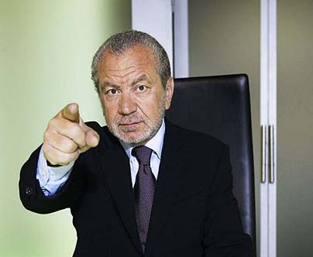
What is an entrepreneur?
Notes:
https://www.youtube.com/watch?v=FoqF2GmbmeQ&list=PL5A4nPQbUF8CJSYgQD17hKmRb15mhibaB&index=1

Slide 4
The Filmmaker as Entrepreneur
What is an entrepreneur?

Slide 5
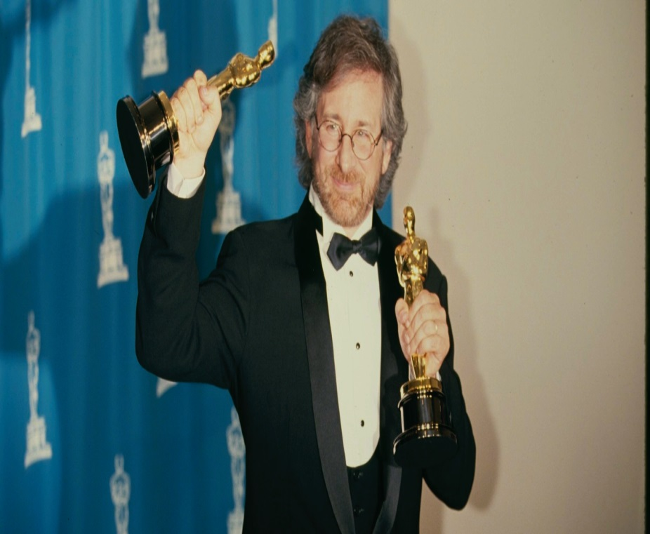
What is an entrepreneur?

Slide 6
Steven Spielberg
Started making short films, then TV episodes, then TV movie, then movies
Started two different production companies

Slide 7
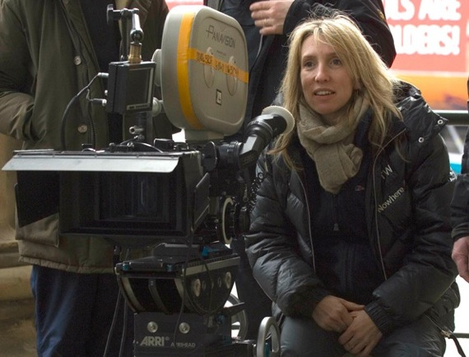
What is an entrepreneur?

Slide 8
Sam Taylor-Johnson
Studied fine art at Goldsmiths
Worked as fine art photography
Moved in to moving image work – David Beckham Sleeping for NPG
Directed Nowhere Boy (2009), Fifty Shades Of Grey (2015)

Slide 9
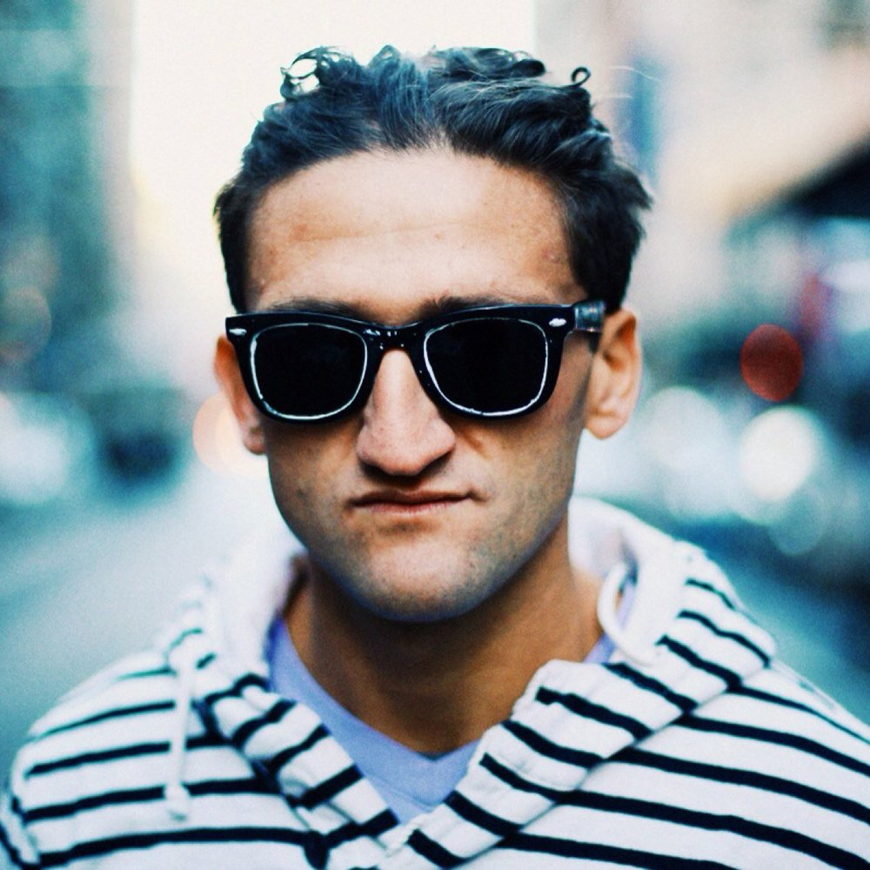
What is an entrepreneur?

Slide 10
Casey Neistat
High school dropout, lived in a trailer park.
Worked in studio of artist Tom Sachs, for whom he made short videos
Made a 3-minute video in 2003, criticizing Apple’s iPod battery
Makes short films, vlogs, TV series
Notes:
iPod’s Dirty Little Secret
https://www.youtube.com/watch?v=SuTcavAzopg
Make It Count
https://www.youtube.com/watch?v=WxfZkMm3wcg

Slide 11
The Filmmaker as Entrepreneur
What is an entrepreneur?

Slide 12
What does an entrepreneur do?
Have ideas
Communicate ideas

Slide 13
Seminar
How do find your story?
How do you pitch your story?

Slide 14
Seminar
What’s a good pitch?
What’s a good story?

Slide 15
Seminar
Working in teams of three
Research newspapers for a story idea
Brainstorm the key points of the story
Deliver a one minute pitch

Slide 16
Seminar
Clear communication of the story
Don’t explain the whole story
What’s it about?
Is your concept intriguing?
Does it pose a question?

Slide 17
Seminar
Rehearse (know your material)
Relax (deep breaths, posture, look ahead)
Remember (your first line)

Slide 18
Two Key Questions
Why you?
Why now?

Slide 19
Why you?
What personal connection do you have to this story?
How does the material speak to your life?
This is NOT about adapting events of your life

Slide 20
Why now?
Why is this story relevant today?
What themes will connect with a contemporary audience?

