Slide 1
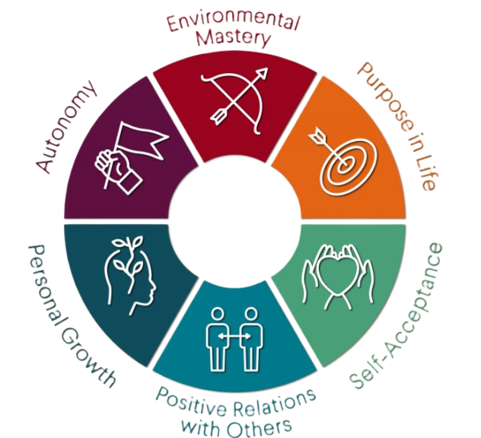
Health, well-being and lifestyles
2403683 ECEY 5009 Words: 1911
Introduction
The key concepts that this poster will be exploring in detail are health, well-being and lifestyles, this will include the importance of these concepts, how people and theorists have different views and understandings of them. The poster will also explore how the concepts link to current legislation and curriculum, including the links to early years practice and how practitioners can support children and their families to adopt healthier lifestyles. As stated by the Department of Health (2014) health and well-being are connected as they influence each other, well-being can affect both physical and mental health and good health will have an impact on a person’s overall well-being. Children and young people's well-being can be more complex, it is linked not only to their physical health and a healthy lifestyle, but it can also depend on their resilience and there is a stronger association with their environment that includes the quality of their relationships and financial aspects. (Public Health England, 2013).
Health
Many professionals view health as subjective and as being multidimensional such as The World Health Organisation believing that it should not only be considered as the absence of illness or disease but also, as a state of complete physical, mental and social well-being. (WHO, 2025). However, there are some professionals who do not view health as being subjective, Balog (2013) proposes that it should be considered as an objective and natural phenomenon, he believes that people should not confuse a good life with good health and suggests that people often fail to distinguish between what affects health and what health is, suggesting that it ultimately comes down to how well the body is functioning.
Hjelm (2010) suggests, present culture has the tendency to consider health as how a person appears physically and maintaining a healthy body, as opposed to taking the whole person into consideration, he believes that health should be viewed holistically but he claims that it can be complicated to do so as there are so many different aspects to consider. Many professionals believe that health is not only dependent on a person's physical capabilities, but they also consider it to be a state of well-being that includes having the ability to cope with changing circumstances and that is also dependent on personal and social aspects. (Durch, Bailey, Stoto, 1997).
Cowley (2021) highlights the importance of social health in terms of quality relationships, as children grow, they form attachments, and those early attachments can influence the quality of their relationships throughout their lives, relationships at home, school and within the community can influence their character and affect their wellbeing as it can provide them with a sense of belonging. Wilkinson, Marmot (2003) reiterate this as they stress the importance of positive social experiences and how feeling socially excluded can be detrimental to mental health as it can lead to anxiety and depression which can affect physical health and possibly shorten life expectancy. According to Saunders et al. (2017) a person's socioeconomic status can also impact on both physical and mental health, inequities such as poor living and working conditions, inability to access quality and inclusive education, they also propose that working to improve inequalities in early child development has the greatest and most cost-effective impact.
Wellbeing
Bautista et al. (2023) suggest that, similarly to health, wellbeing also has many sides, and many factors contribute to a person feeling a sense of wellbeing and although there is no singular definition, they would define it as being in a positive mood and having no negative emotions, feeling content with life and a sense of fulfilment.
Berlinski, Schady (2015) define wellbeing as being happy, healthy and prosperous and suggest that good early year's experiences can enable children to flourish and similarly to what has been previously mentioned, investing in a child's wellbeing can lead to them becoming more productive and lead to a more prosperous society.
(Source:AMeaningOfLife,2024)

Slide 2
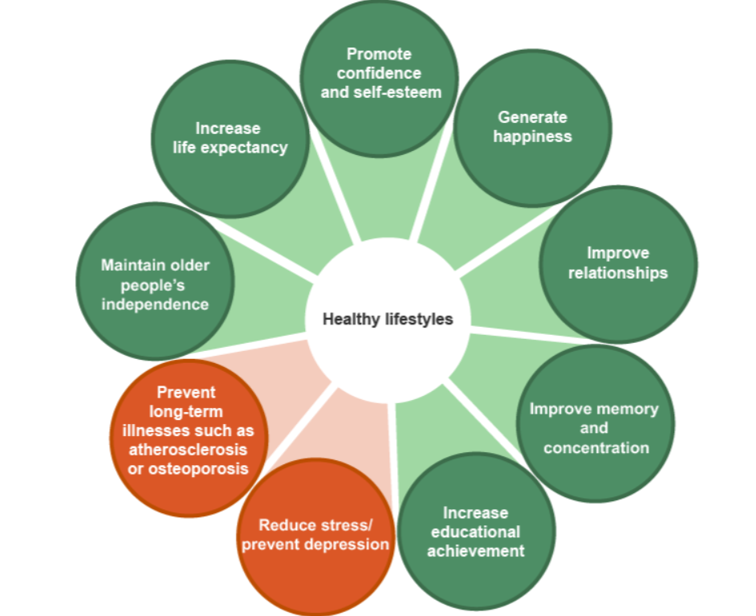
Similarly to Saunders et al. (2017) The Mormot Review found that the higher the socioeconomic position, the greater the opportunities, more possibility of a flourishing life and better health and wellbeing, which is why he believed we should aim to give children the best start in life by reducing inequalities in early child development as it will have lasting affects throughout life and reduce the chances of ill health such as disease and mental health issues (Marmot, 2010).
Felton (2015) believes that health, physical activity and social interaction are essential for mental wellbeing and wellbeing is something that most people strive for, however, wellbeing is subjective and measuring it can be challenging as it can be dependent on how resilient and optimistic a person is and it could also be dependent on their socioeconomic status. Derbyshire Healthcare NHS Foundation Trust (2013) state that building resilience allows a person to cope with adversity and overcome challenges and it can help protect them from mental health issues and maintain their wellbeing, they also highlight those at greater risk of low wellbeing as groups who have lower socioeconomic status such as families from low income and minority groups.
Gallagher, Lopez, Preacher (2013) examine models of wellbeing, one being Ryffs eudaimonic model of wellbeing that focuses on six components; personal growth, a purpose in life, environmental mastery, positive relationships, self-autonomy and self-acceptance. The component ‘self-acceptance’ is considered an essential component to mental health and wellbeing, and it is compared to Maslow’s ‘self-actualisation’ and as his hierarchy of needs theory suggests that all the needs need to be met to achieve this, similarly to how health and wellbeing are intertwined and need to be considered holistically as they cannot exist alone. (Ryff, Singer, 2006).
Another component of Ryffs eudaimonic model is positive relationships and as previously mentioned and as Holmes (2014) highlights Bowlby’s attachment theory that suggests that positive relationships contribute to emotional development and emotional support, it can boost self-esteem and confidence which can also affect a person's mental health and coping mechanisms.
Lifestyles
According to Jensen (2008) lifestyle should not only be taken as a way persons way of living but also their values and attitudes. Blaxter (2003) suggests that how a person lives is closely linked to their health, such as if a person is living in poverty or wealth, the type of environment they live in, if they work or are unemployed, if they feel content or stressed, all those factors can impact a person's health and wellbeing. A healthy lifestyle is considered important as health and wellbeing have a significant impact on a person's quality of life and adopting good habits early on in a person's life can have an influence throughout life, good habits such as healthy eating, being active, ensuring own safety and also acknowledging the importance of mental health can determine a personals overall health and wellbeing. (Thornton, Brunton, 2009). Thomas et al. (2020) agree with this as they claim that lack of exercise and an unhealthy diet can contribute to health issues such as obesity and cardiovascular problems, a unhealthy lifestyle can lead to a poor quality of life and have a negative impact on mental health, highlighting the significance of establishing good mental health in childhood.
Yu, Zou (2023) highlight the importance of having sufficient sleep and how it can also lower the risk of diseases and impact a person's life expectancy. Lack of sufficient sleep can also have other implications. As stated by Ernstmeyer, Christman (2021) Maslow includes sleep as a physiological need and having a good quality sleep can protect physical and mental health and a lack of sufficient sleep can lead to a weakened immune system. Lack of sleep also affects cognitive function, for children this could affect their ability to concentrate in school which would affect their academic performance, this could have a lasting effect throughout their life and determine their future lifestyle. (Buckhalt, 2011).
(Source: BBC, 2025)

Slide 3
Application to early years practice
According to Kay (2012) early years practitioners can provide children with opportunities to help achieve a healthier lifestyle and support their overall wellbeing by implementing good practice and following government policies and guidelines.
The Welsh Government (2020) outlines in The Curriculum for Wales their aim for schools to enable their learners to work towards the four purposes, one of those purposes involves promoting wellbeing and involves gaining a holistic view of the child which requires partnership working and it also embeds the rights laid out by the UNCRC. The articles of the UNCRC state the child's right to an education and one that should develop the child’s individual personality and abilities, and they also state their right to the best possible health which includes nutrition and sanitation and being educated on wellbeing to enable to maintain a healthy lifestyle. (UNICEF UK, 2019).
DFE (2024) highlight the importance of practitioners working in partnership with parents enables children to do well as parents can provide knowledge about their child’s background and interests which will allow them to plan the best way to support their learning and lead to better outcomes for the child in all aspects of development. Vygotsky’s theory highlighted the importance of providing learning environments that value the child as a whole and that respect cultural differences and different lifestyles. (Mahn, 2003). Vygotsky also introduced the concept of the zone of proximal development (ZPD) that practitioners can use to support children’s development and make a positive impact on their health and wellbeing as it allows them to tailor their support to suit each individual child and that support can lead to children feeling more confident and being more self-sufficient. (Moll, 1990).
Welsh Government (2015) outline the foundation phase and its seven areas of learning, one of those being physical development that requires practitioners to promote physical activity both indoors and outdoors, this not only develops a wide range of gross and fine motor skills but can also have a positive impact on overall health and wellbeing if the children enjoy being active, it can enable them to adopt healthy behaviours throughout life.
As the work of Bronfenbrenner (1979) suggested, as a child’s environment plays an important role in their development it can also affect their health, wellbeing and lifestyle. A child’s immediate environment includes their family; their parenting skills and their socioeconomic status will affect the child’s health and lifestyle which will continue to affect them into later life as it helps to shape their identity and as previously mentioned, it can affect many aspects of their health. (Mollburn, Lawrence, 2018).
Conclusion
As shown in this poster, health, wellbeing and lifestyles are all interlinked as they influence each other, although, how they are viewed and understood can be varied as they can have a different meaning depending on the individual and their circumstances or background.
Some people consider being free of illness or disease as having good health whereas others look at it on a broader scale and take into consideration a person’s health and overall wellbeing. There are many factors that can affect a person’s wellbeing and as it varies from each person it can be difficult to measure but it is important to look health and wellbeing holistically.
As foundations for good health and wellbeing are established in early childhood, this poster shows the importance of reducing detriments to health as much and as early on as possible and how parents and early years practitioners play an important role as they have an impact on children’s health, wellbeing and lifestyle, that can have a lasting impact throughout their life.

Slide 4
Reference list
A Meaning Of Life (2024) Carol Ryff’s Six Factors of Psychological Well-being. Available at: https://ameaningoflife.org/happiness/positive-psychology/ (Accessed: 5 June 2025)
Balog, J, E. (2013) The Meaning of Health. Available at: https://doi.org/10.1080/19325037.2005.10608195
Bautista, T. G., Roman, G., Khan, M., Lee, M., Sahbaz, S., Duthely, L. M., Knippenberg, A., Macias-Burgos, M. A., Davidson, A., Scaramutti, C., Gabrilove, J., Pusek, S., Mehta, D., & Bredella, M. A. (2023). What is well-being? A scoping review of the conceptual and operational definitions of occupational well-being. Journal of clinical and translational science, 7(1), e227. Available at: https://doi.org/10.1017/cts.2023.648
BBC (2025) Health and Wellbeing – WJEC. Positive lifestyle choices- the benefits. Available at: https://www.bbc.co.uk/bitesize/guides/z3shycw/revision/2#:~:text=taking%20part%20regularly%20in%20physical,be%20immediate%20and%20long%2Dterm (Accessed: 7 June 2025)
Berlinski, S., Schady, N. (2015). The Early Years: Child Well-Being and the Role of Public Policy. Palgrave Macmillan US. Available at: https://doi.org/10.1057/9781137536495
Blaxter, M. (1990). Health and Lifestyles (1st ed.). London: Routledge.
Bronfenbrenner, U. (1979). The Ecology of Human Development: Experiments by Nature and Design. United Kingdom: Harvard University Press.
Buckhalt (2011) Insufficient Sleep and the Socioeconomic Status Achievement Gap. Available at: https://doi.org/10.1111/j.1750-8606.2010.00151.x
Cowley, A. (2021). The Wellbeing Curriculum: Embedding Children's Wellbeing in Primary Schools. India: Bloomsbury Publishing Plc.
Department of Education (DFE) (2024) Working in Partnership with parents and carers. Available at: https://help-for-early-years-providers.education.gov.uk/support-for-practitioners/working-in-partnership-with-parents-and-carers (Accessed: 8 June 2025)
Department of Health (2014) The relationship between well-being and health. Available at: https://assets.publishing.service.gov.uk/media/5a7baa00ed915d4147621d62/The_relationship_between_wellbeing_and_health.pdf (Accessed: 02 June 2025)

Slide 5
Derbyshire Healthcare NHS Foundation Trust (2013) Building resilience, promoting wellbeing. Available at: https://www.derbyshirehealthcareft.nhs.uk/application/files/3915/4685/7171/building-resilient-communities-training-resource.pdf (Accessed: 5 June 2025)
Durch, J. S., Bailey, L. A., Stoto, M. A. (1997). Improving Health in the Community: A Role for Performance Monitoring. United States: National Academies Press.
Ernstmeyer, K., Christman, E. (2021) Nursing Fundamentals: Chapter 12 Sleep and Rest. Available from: https://www.ncbi.nlm.nih.gov/books/NBK591812/
Felton, L. (2015) Mental Health Foundation. What is well-being, how can we measure it and how can we support people to improve it? Available at: https://www.mentalhealth.org.uk/explore-mental-health/blogs/what-well-being-how-can-we-measure-it-and-how-can-we-support-people-improve- (accessed: 5 June 2015)
Gallagher, M, W., Lopez, S, J., Preacher, K, J. (2017) The Hierarchical Structure of Well-being. Available at: https://doi.org/10.1111/j.1467-6494.2009.00573.x
Hjelm, J. (2010). The Dimensions of Health: Conceptual Models. United Sttes: Jones & Bartlett Learning.
Holmes, J. (2014). John Bowlby and Attachment Theory (2nd ed.). London: Routledge.
Jensen, M. (2007). Defining lifestyle. Environmental Sciences, 4(2), 63–73. Available at: https://doi.org/10.1080/15693430701472747
Kay, J. (2012) Good Practice in the Early Years. United Kingdom: Continuum International Publishing.
Mahn, H. (2003). Periods in child development: Vygotsky’s perspective. Available at: https://www.researchgate.net/profile/Holbrook-Mahn/publication/233858612_Periods_in_Child_Development/links/09e4150c3d2f6d5d26000000/Periods-in-Child-Development.pdf (Accessed 8 June 2025)
Marmot, M. (2010) Fair society, healthy lives: The Marmot Review. London: Marmot Review. Available at: https://www.instituteofhealthequity.org/resources-reports/fair-society-healthy-lives-the-marmot-review/fair-society-healthy-lives-full-report-pdf.pdf (Accessed: 5 June 2025)
Moll, L. (1990) Vygotsky and Education: Instructional Implications and Applications of Sociohistorical Psychology. Cambridge: University Press.

Slide 6
Mollborn, S., & Lawrence, E. (2018). Family, Peer, and School Influences on Children’s Developing Health Lifestyles. Journal of Health and Social Behavior, 59(1), 133-150. Available at: https://doi.org/10.1177/0022146517750637
Public Health England (2013) How Healthy Behaviour Supports Children's Wellbeing. Available at: https://assets.publishing.service.gov.uk/media/5a7c72c5e5274a5255bceb73/Smart_Restart_280813_web.pdf (Accessed: 02 June 2025)
Ryff, C.D., Singer, B.H. (2008) Know Thyself and Become What You Are: A Eudaimonic Approach to Psychological Well-Being. Available at: https://doi.org/10.1007/s10902-006-9019-0
Saunders, M., Barr, B., McHale, P., Hamelmann, C. (2017) Key Policies for Addressing the Social Determinants of Health and Health Inequities. Philippines: World Health Organisation.
Thomas, M. M., Gugusheff, J., Baldwin, H. J., Gale, J., Boylan, S., & Mihrshahi, S. (2020). Healthy Lifestyle Behaviours Are Associated with Children’s Psychological Health: A Cross-Sectional Study. International Journal of Environmental Research and Public Health, 17(20), 7509. Available at: https://doi.org/10.3390/ijerph17207509
Thornton, Brunton (2009) Healthy Living in the Early Years Foundation Stage. Available at: https://www.google.co.uk/books/edition/Healthy_Living_in_the_Early_Years_Founda/RJqmo8OUGvsC?hl=en&gbpv=1 (Accessed: 7 June 2025)
UNICEF UK (2019) A Summary on the UN Convention on the Rights of the Child. Available at: https://www.unicef.org.uk/wp-content/uploads/2019/10/UNCRC_summary-1_1.pdf (Accessed: 8 June 2025)
Welsh Government (2015) Foundation Phase Framework. Available at: https://hwb.gov.wales/storage/d5d8e39c-b534-40cb-a3f5-7e2e126d8077/foundation-phase-framework.pdf (Accessed: 8 June 2025)
Welsh Government (2020) The New Curriculum for Wales. Available at: https://hwb.gov.wales/curriculum-for-wales (Accessed: 8 June 2025)
Wilkinson, R, Marmot, M. (2003) Social Detriments of Health: The Solid Facts. 2nd Edition. Switzerland: World Health Organization, Regional Office for Europe.
World Health Organisation (2025) Health and Wellbeing. Available at: https://www.who.int/data/gho/data/major-themes/health-and-well-being (Accessed: 02 June 2025)
Yu, X., & Zou, Z. (2023). Dietary, Lifestyle, and Children Health. Nutrients, 15(10), 2242. Available at: https://doi.org/10.3390/nu15102242

