Slide 1
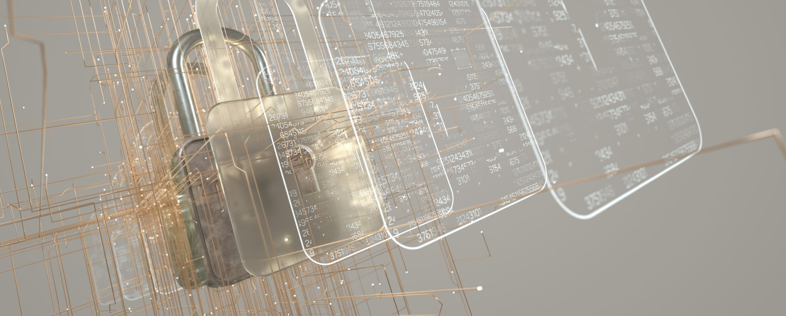
Networks and Cyber Security Essentials
Kayleigh Davies
Student Number: 2316137

Slide 2
Introduction
Our aim is to demonstrate the development of FinSecure Ltd (FSL) security policies and procedures to improve security awareness across the organisation and to reduce the risks of security incidents occuring.
Identification of cyber threats and trends
Security policies and procedures
Mitigation measures
Monitoring and Responses
Training and awareness

Slide 3
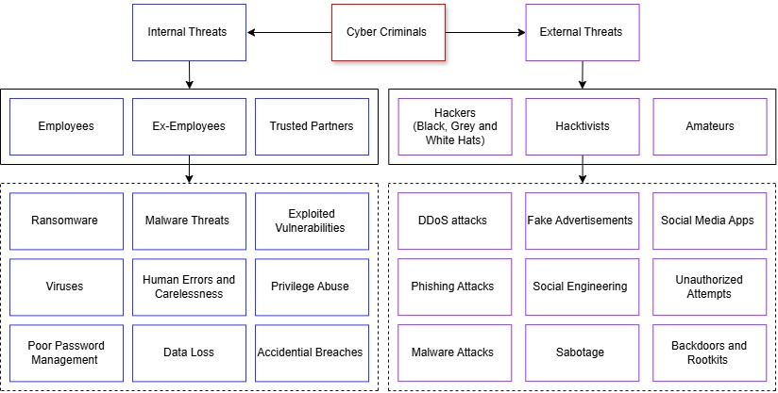
Identification of Threats
There are several cyber threats that can affect an organisation including phishing, social engineering, ransomware, software attacks, human errors and unauthorized access. These examples can be categorized into two parts which are internal threats and external threats as shown in the diagram below
Internal threats
Human Error and Carelessness
Privilege Abuse
Accidentally Downloading Malware
External threats
Unauthorized Access
Phishing and Social Engineering
Malware and Virus Attacks
Figure 1. Internal and External Threats

Slide 4
Security Policies and Procedures
“Examining the effectiveness of current cybersecurity strategies and policies” is a key part of addressing vulnerabilities of an organisation [5]. Plus, it can identify gaps in the support available for tackling future cyberattacks.
The aim of the new security policies is to achieve compliance by using the guidance outlined in international standards such as ISO 27001, NIST Cybersecurity Framework, CIS Controls and GDPR to support FinSecure Ltd in creating stronger security policies allowing them to protect their data and employees from further cyberattacks.
Access Control Policy | Data Protection and Classification Policy
Acceptable Use Policy | Email and Communication Policy
Incident Response Policy | Remote Working and Bring Your Own Device (BYOD) policy
Figure 2. Policies and Procedures
After reviewing previous security incidents and FSL’s existing policies, vulnerabilities in access control, remote working, security measures and incident response have been identified

Slide 5
Mitigation Measures
Phishing and Social Engineering
Unauthorised Access Controls
Software Management Schedule
Implementation of Firewalls and Antivirus Software
Technical and Physical Security Controls
Above are examples of the mitigation measures that will improve the security across the FSL organization through “strengthening the efforts to prevent, detect and respond to cyber-attacks” [16].

Slide 6
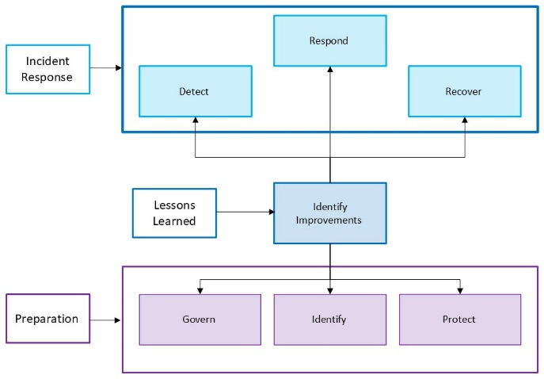


Monitoring and Responses
To ensure FSL have an effective system in place for monitoring and responding to incidents, the NIST Cybersecurity Framework will be used to make sure incidents are handled efficiently [13].
The framework can also “improve efficiency and effectiveness of detection, response and recovery times” [13]. This is because it encourages organizations to work towards continuous development by using past experiences to understand how incident response and risk management processes can be improved.
Figure 3. Monitoring and Responses

Slide 7
Training and Awareness
Training Topics:
Phishing and Social Engineering
Ransomware
Password Management
Two factor authentication
Software Management
Working Remotely
Safe Internet Topic
To improve the knowledge and awareness of security throughout the organization a mixture or mandatory training, monthly meetings, learning burst and phishing simulations will be used.
Mandatory training will be completed every 6-12 months
Training resources will be updated to reflect changes to FSL policies, procedures and cybersecurity trends
Reminding staff that simple things such as wearing identification cards around the office, locking laptop screens, clearing desks of sensitive information and keeping software and operating systems up to date with the latest versions are all examples of security precautions [4].

Slide 8
Conclusion
Cyberthreats and trends that impact finsecure ltd have been identified and addressed in new security policies and mitigation measures
Security policies and procedures have been revised to comply with international security standards with the aim of creating a safer working environment
New Mitigation Measures have been developed to strengthen the current controls in place to reduce vulnerabilities and prevent future cyber-attacks
Monitoring and Responses will be regularly assessed to update security controls and procedures to address new cyber security trends
Training materials will be renewed to improve the understanding and awareness of cybersecurity for fsl employees

