Slide 1
Social Trends Impacting Transportation
By Bence Tary

Slide 2

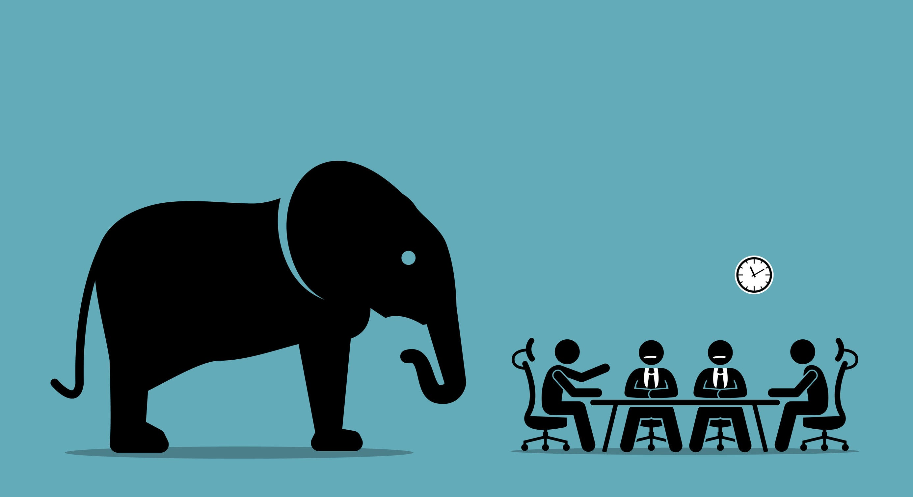
Lets Get the Elephant In the room…
Covid-19
It’s the Thing…
It’s the Plague…
It’s the Curse…
The end of All that we love…

Slide 3
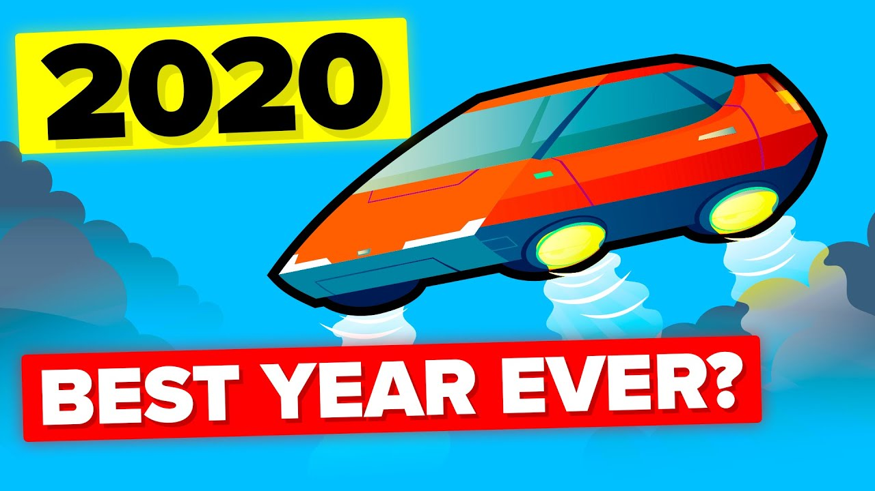
How Did Covid-19 Affect transportation?
Social Distancing…
No meetups…
No travel…
No holidays…
Cancelled Events…
Overall, destroyed plans.
Worst

Slide 4


Slide 5
How was Transportation impacted?
In short…. Not well
Urban Travel took the largest hit.
In some places Public Transport use was 70% down (for the rich folk)
Washing DC metro ridership dropped 80%!

Slide 6
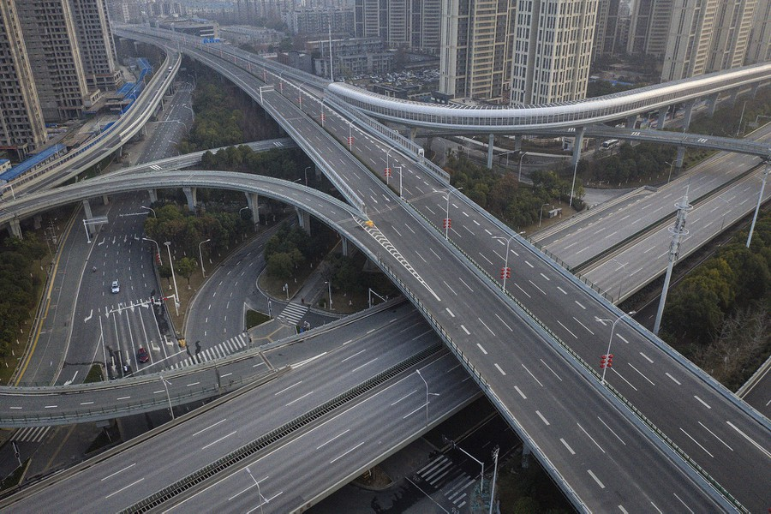
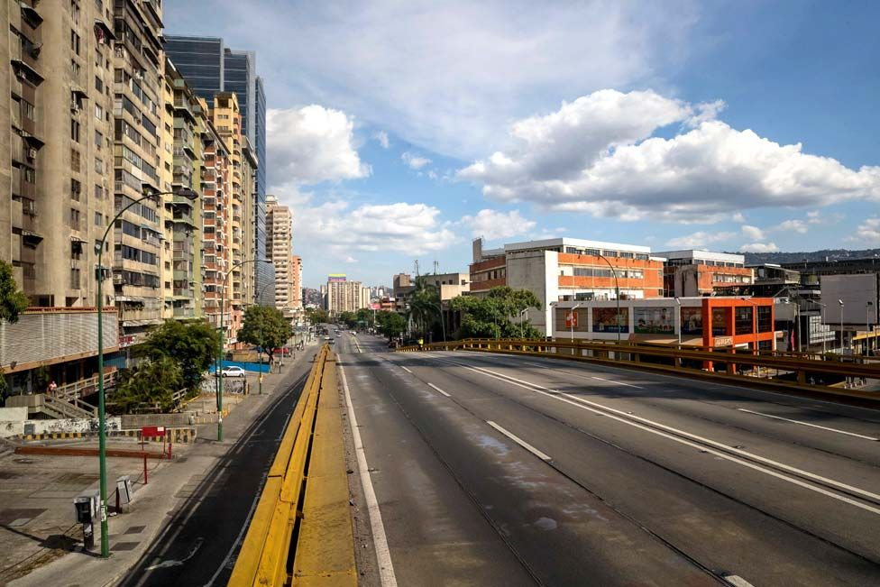

Slide 7


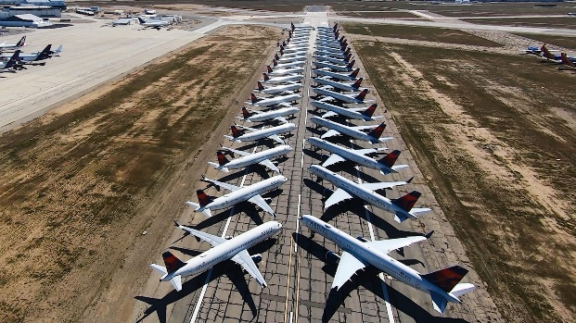
Why was this?
Travel Restriction
Closing of not-essential services
Border closes meant no holidays
And most importantly…

Slide 8
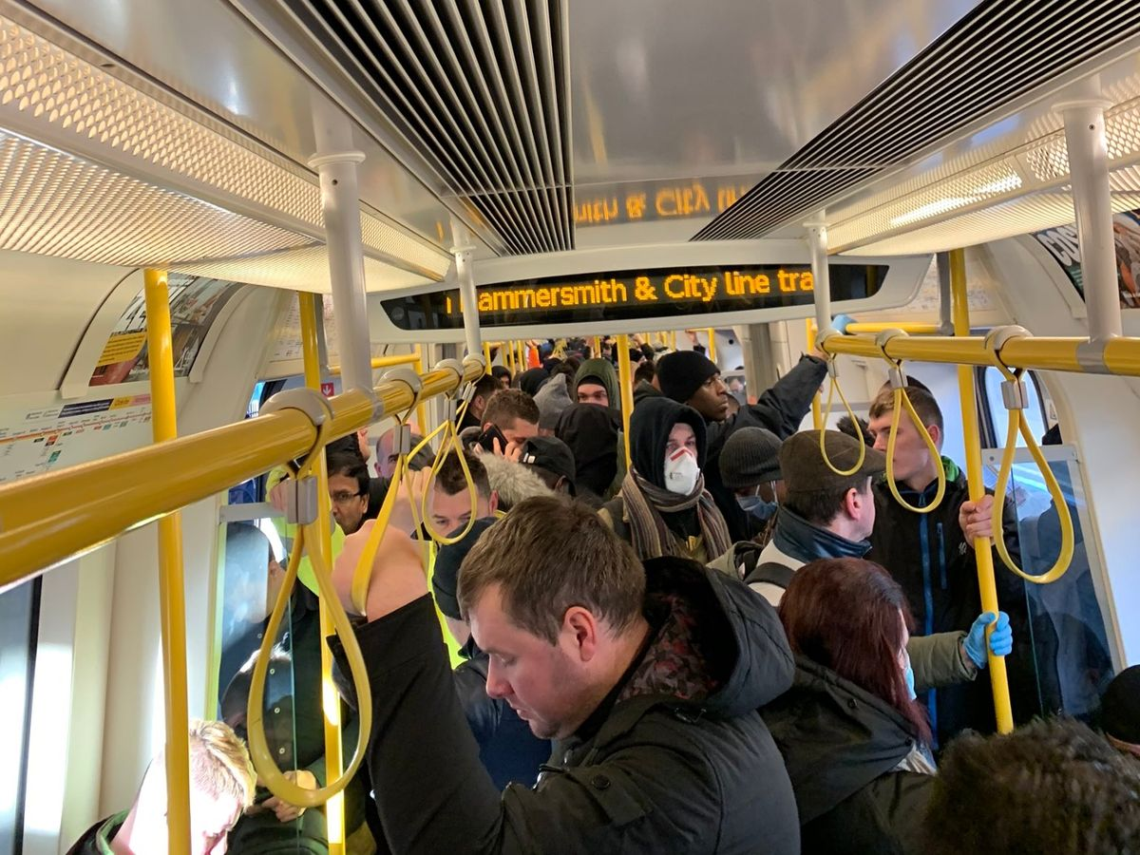
Fear of the Virus
Undesired to be in a tightly packed place…
(…Unless it’s a pub)
Public Transportation is, by design, packed.

Slide 9

The other great Changer
Sustainability

Slide 10

Sustainability on Transportation?
Desire for less emissions
Desire for green vehicles
Support for Public Transport
(Then Covid-19 ruined that…)
Cycle, walk (or teleport?)

Slide 11
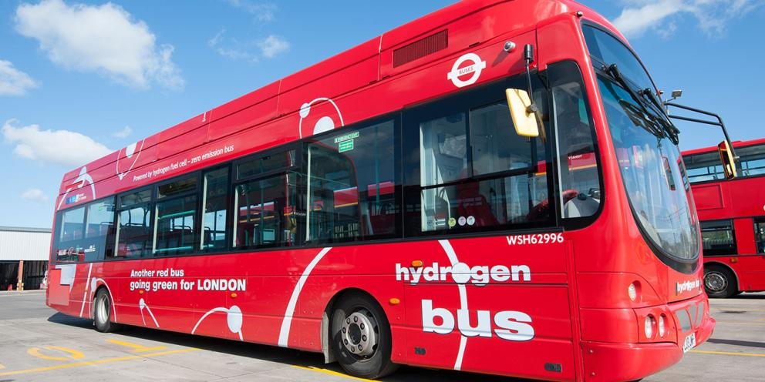
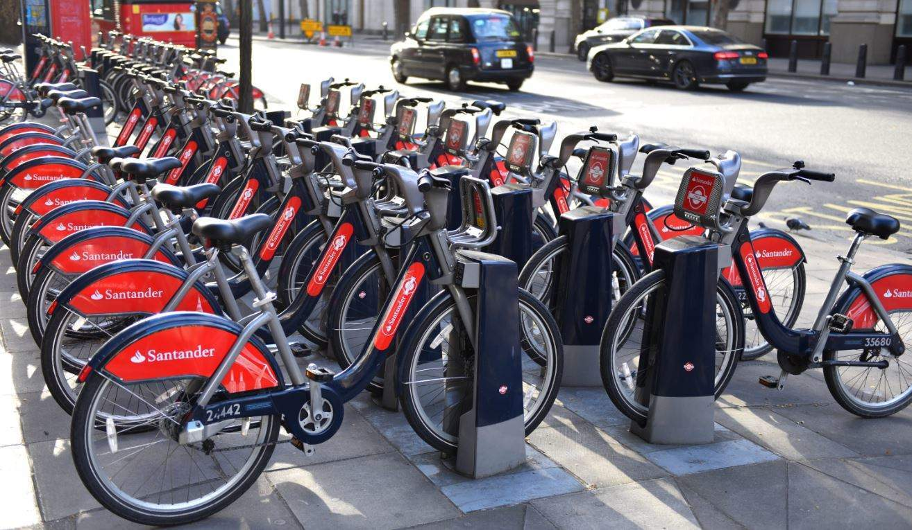

Slide 12
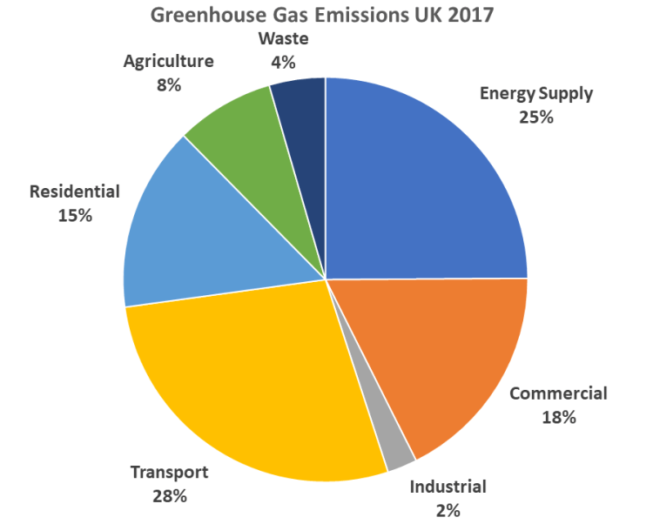
Why transportation?
Size of the pollution – largest emitter of greenhouse gases in 2017
Existing green(er) technology
Easier to reduce then others

Slide 13
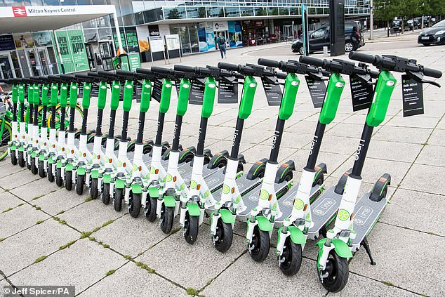
What is the change?
More people cycling
Less people driving
Cities introducing greener alternatives – MK
More people using Public Transport
Greener cars

Slide 14
So – Conclusions
Covid-19 is bad and makes people miserable
Also, it makes people avoid Public Transport
Sustainability is a growing concern
Also attainable – and we are doing good

Slide 15


