Slide 1
TITLE PAGE
Name of Student - Madona Igbinovia
Student ID Card - 1815861
Module name – BMSW4001_ACEGROUP3
Lecturer name – Barbara chinyany

Slide 2

Introduction
Learning is a gradual process that improves skills with time.
To improve learning, it is important to be a part of an effective educational institution.
That is the reason I choose “University of Wales”.
As currently, I am proceeding with the program “CerHE Skills for the Workplace”.
  Very effective
  Increase my knowledge
  Enhance my professional Skills
  Help me to grasp the leading industry knowledge
  Make a strong understanding of the software and programs

Slide 3
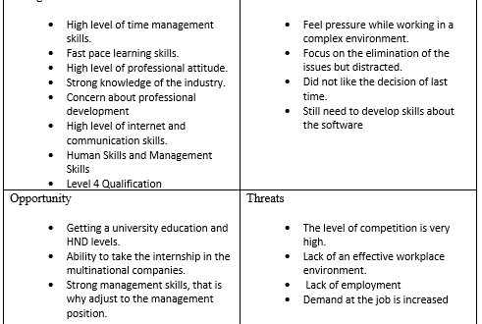
SWOT Analysis for Self-Assessment

Slide 4
Academic Analysis
Currently, I consider my academic skills and progression path very effective.
This degree will be very effective to build up a professional.
HND level program will increase my academic skills.
CertHE Skills for the Workplace enhance my academic skills as this course cover several important topics, theories, etc.
Along with the theoretical knowledge, I also learn about the software which will be very effective in my professional career.

Slide 5
Employability Skills
I have done an internship which helps me to understand the professional job scenario.
I used to strongly focus on the professional skills needed on the job.
For that purpose, the internship helps me to understand the workplace.
I strongly focus on the skills which improve the job position.
I strongly focus on management skills, human skills, and interpersonal skills.
I believe that communication skills are also important for professional growth.

Slide 6
Conclusion
It is concluded that I have academic skills and employability skills.
But a good education is very important.
That is why I strongly focus on my academic career.
I believe that it will lead to an effective professional career.
Self-assessment through SWOT analysis is very effective for a strong understanding of academic and professional skills.
Self-analysis is also very effective for future progression.

