Slide 1
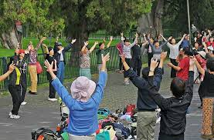
Chinese Park Life Culture.
http://www.thedailychina.org/differences-between-public-parks-in-china-and-america/
By Megan Genevieve Pearson
1900634
HPCH6010 Chinese Wellbeing: from Philosophy and Religion to Culture!

Slide 2
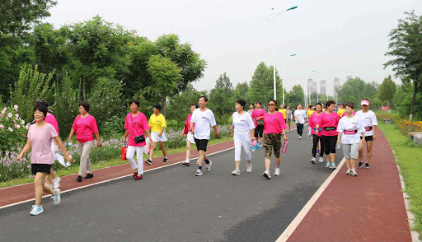
饭后百步走 ( fàn hòu bǎi bù zǒu )，活到九十九 ( húo dào jǐu shí jǐu ): If you wish to live long, take a walk after the meal.
Chinese believe walking is one of the best ways to keep the body healthy.
http://en.people.cn/n3/2017/0831/c90000-9262906.html

Slide 3
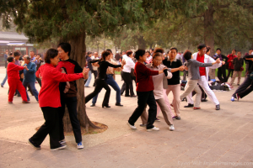
Chinese Parks:
For a variety of reasons, Chinese public parks are often large and active. As China is a densely populated country, most individuals lack access to private gardens or parks. They generally go to the park since it is similar to their "garden" and has a wide range of activities.
There are several activities that primarily appeal to older folks. Partly due to their amount of spare time. Ping pong, tai chi, fitness dance, and traditional fan dances are some examples of these exercises.
Many Chinese people take their exercise in free public parks, where they may also enjoy nature and relaxation.
http://www.thedailychina.org/differences-between-public-parks-in-china-and-america/
http://www.thedailychina.org/differences-between-public-parks-in-china-and-america/

Slide 4
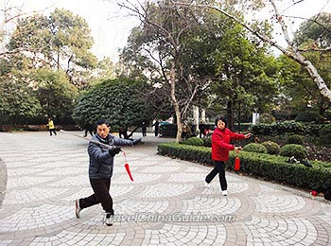
Parks in China operate similarly to outdoor community centres, although they have a more organic feel than chair yoga for elders. Isolation, which is a major concern for the elderly in other cities, appears to be less of a problem in Chinese cities, with parks providing a refuge.
Every morning, thousands of senior people congregate in public parks for their regular exercise regimen, which may include dancing, QiGong, or even mild gymnastics. Many people use exercise equipment such as ellipticals and pulldown machines for mild cardio workouts and gentle strength training. These brightly coloured exercise machines may look like they belong at a children's playground, but they are designed for elders.
(Limited, n.d.)
https://earth.org/how-urban-green-spaces-are-impacting-on-chinas-environmental-and-public-health/

Slide 5
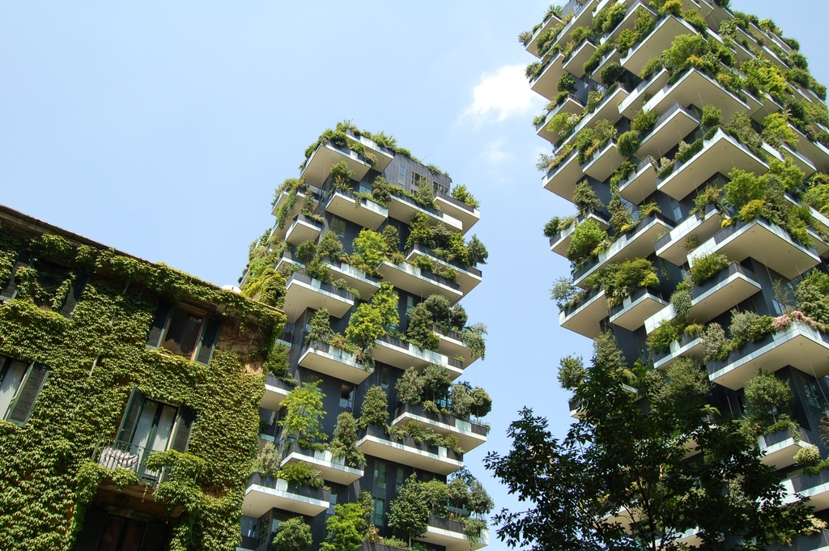
Why are Parks and Green Spaces important?
Reduces the urban heat island effect and severe localised weather events by improving air quality, reducing and regulating rainfall run-off, and reducing both the urban heat island effect and severe localised weather occurrences.
https://earth.org/how-urban-green-spaces-are-impacting-on-chinas-environmental-and-public-health/

Slide 6
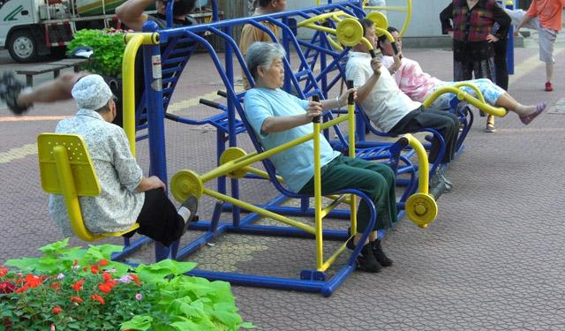
Why are China's parks so well used?
The fact that the public parks are free for all is the primary reason for their popularity and use.
Another reason for the high population is that housing does not include a garden, therefore the parks are considered as people's gardens. The government maintains them, which provides employment for some.
Popular With the Disabled community.
Free Gym, equipment provided in parks.
(www.chinahighlights.com, n.d.)
https://www.chinosity.com/2020/12/18/get-swole-with-chinese-exercise-equipment-the-mystery-behind-these-unique-parks/

Slide 7
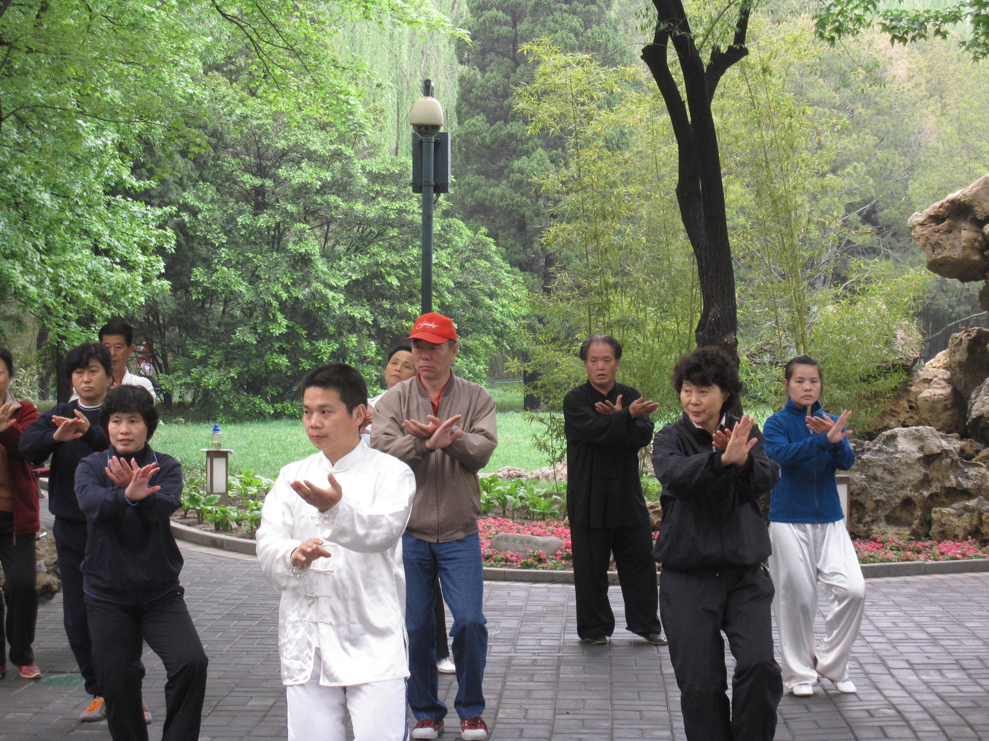
What activities happen in the parks?

Slide 8
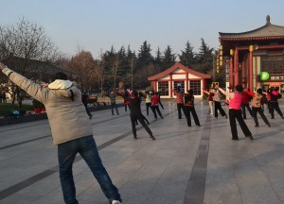
TIAO WU (DANCING)

Slide 9
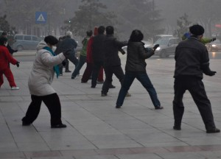
TAI CHI

Slide 10
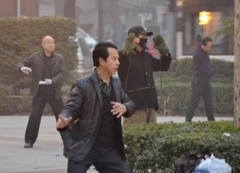
WUSHU

Slide 11
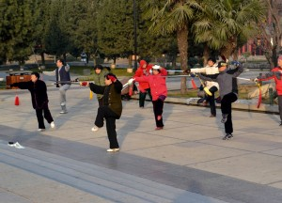
JIAN WU (SWORD DANCE)

Slide 12
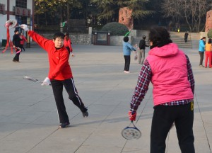
TAIJI ROULIQIU (TAI CHI TENNIS)

Slide 13
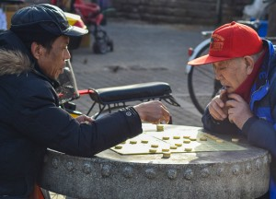
XIANGQI (CHINESE CHESS)

Slide 14
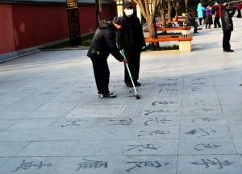
SHUFA (CALLIGRAPHY)

Slide 15
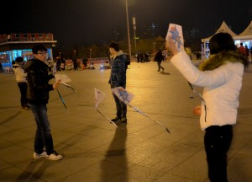
FENGZHENG (KITES)

Slide 16
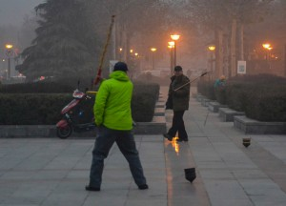
TSA LIN (SPINNING TOPS)

Slide 17
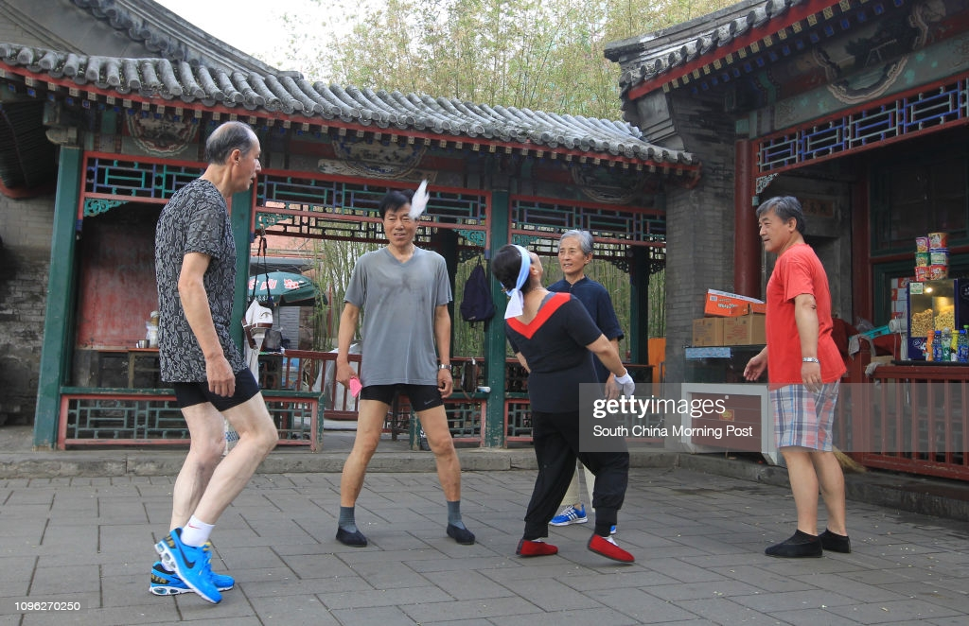
Why do we think our parks to not get used the way China’s Park do?

Slide 18
Reference List:
Sources:
China Incidentals.. 2021. The Cultural Landscape of China’s Urban Parks.. [ONLINE] Available at: https://chinaincidentals.com/2017/12/16/the-cultural-landscape-of-chinas-urban-parks/#:~:text=China%E2%80%99s%20parks%20function%20a%20lot%20like%20outdoor%20community,for%20banishing%20the%20loneliness%20that%20comes%20from%20aging.. [Accessed 5 October 2021].
www.youtube.com/watch?v=RnCCY2YtVX0
https://www.youtube.com/watch?v=84rXHqjltjs
https://www.youtube.com/watch?v=DJzhxU6fNxM
www.chinahighlights.com. (n.d.). China’s Park Life — no better way to see all things Chinese. [online] Available at: https://www.chinahighlights.com/travelguide/article-park-life.htm [Accessed 7 Oct. 2021].
Limited, A. (n.d.). Group of Chinese ladies singing in Chengdu People’s Park China Stock Photo - Alamy. [online] www.alamy.com. Available at: https://www.alamy.com/group-of-chinese-ladies-singing-in-chengdu-peoples-park-china-image344957936.html [Accessed 7 Oct. 2021].
Images:
http://www.thedailychina.org/differences-between-public-parks-in-china-and-america/

