Slide 1
Crusading in the Middle Ages
Military Orders

Slide 2
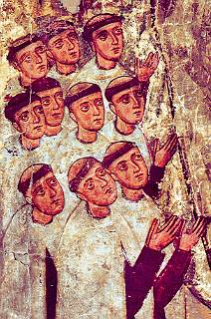
Carmelites
Mount Carmel
Eremetical
Cenobitic
Pater noster
1229 official recognition by Pope Gregory IX
The White Friars

Slide 3
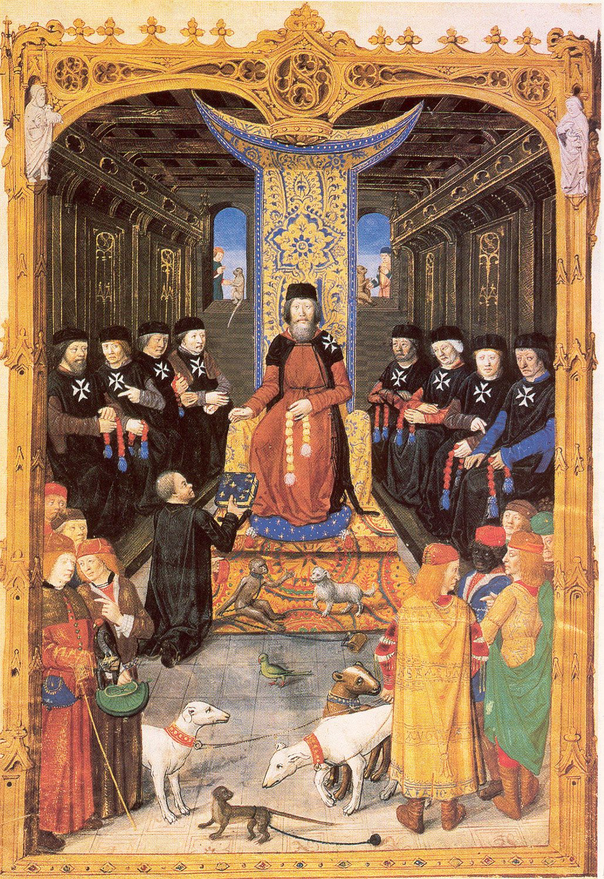
Hospitallers
Order of the Hospital of St John of Jerusalem
Officially recognised in 1113
Foreshadowed Franciscans
First proper hospitals
Then developed military arm

Slide 4
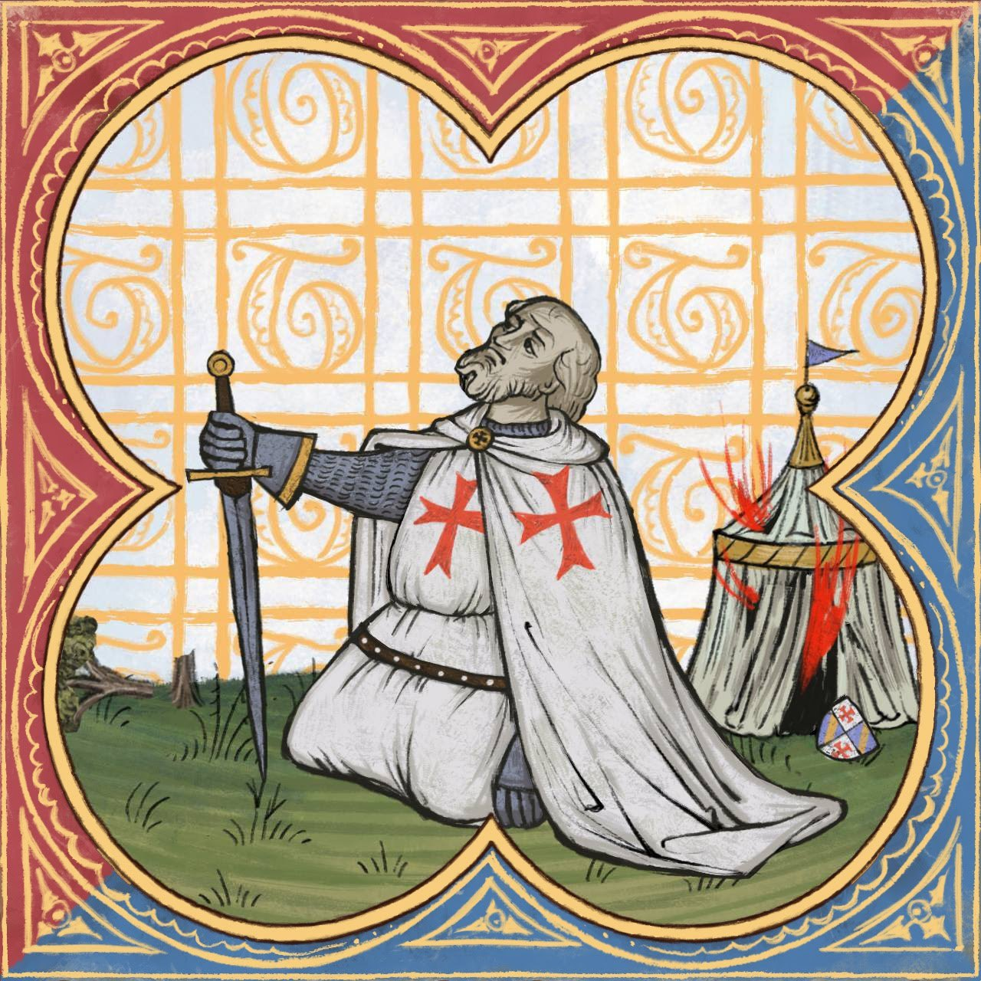
Templars
Originated 1118/9
Hugh of Paynes from Champagne
Supported by Baldwin II and Bernard of Clairvaux
Rule written for them in 1139

Slide 5
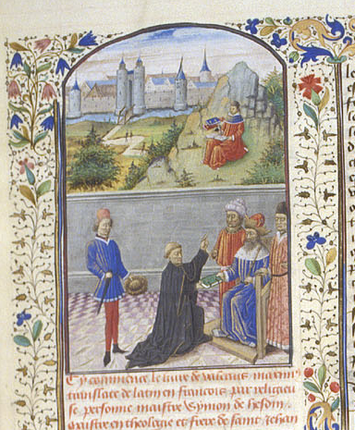
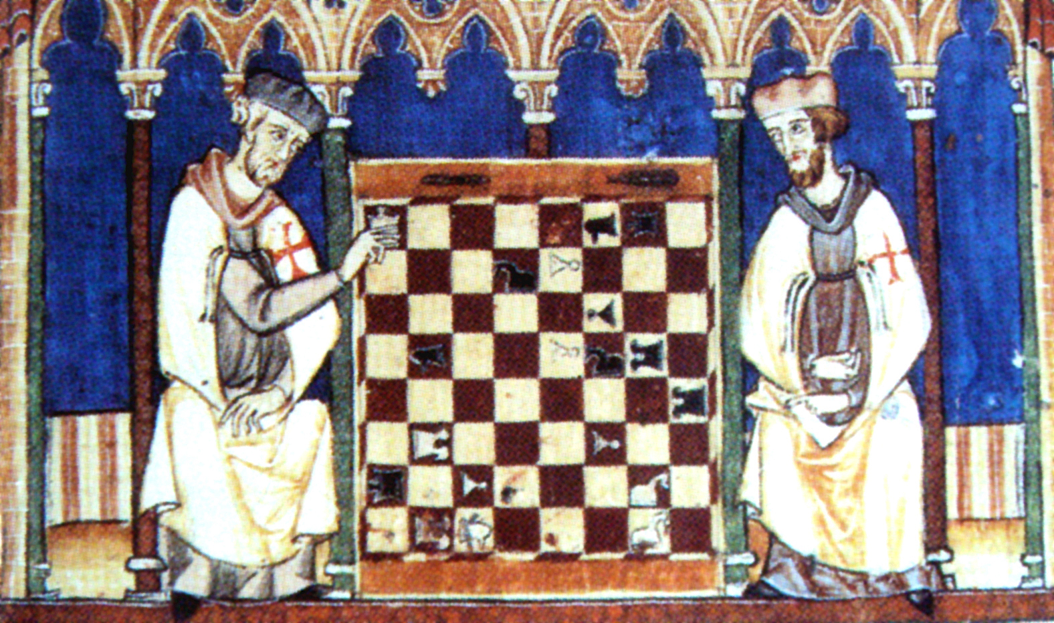
Templars and Hospitallers

Slide 6
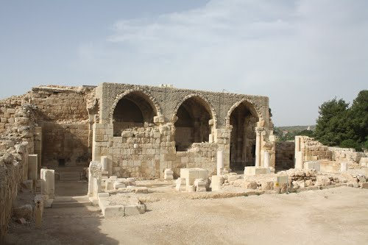
Bet Guvrin

Slide 7
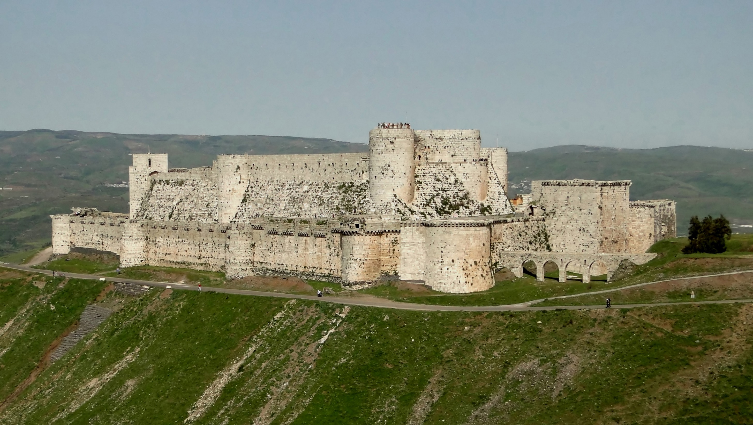

Slide 8
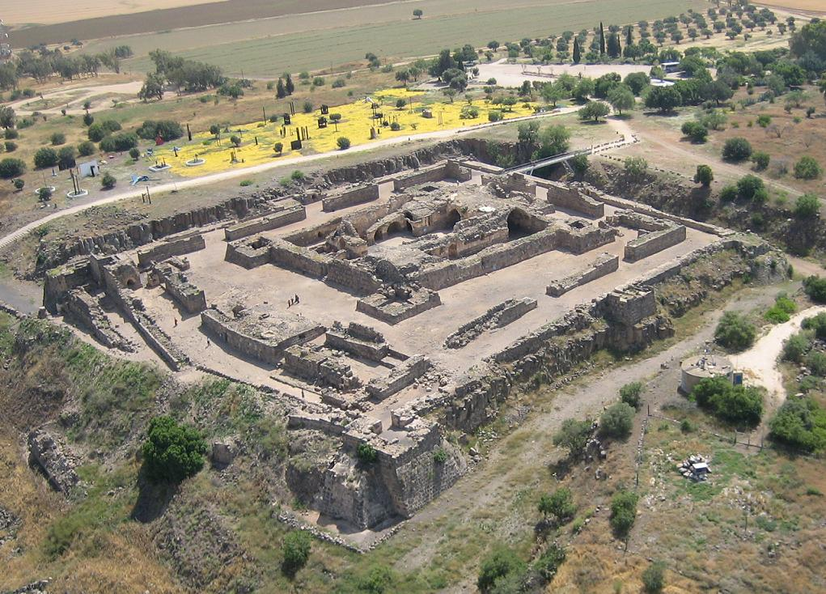
Belvoir

Slide 9
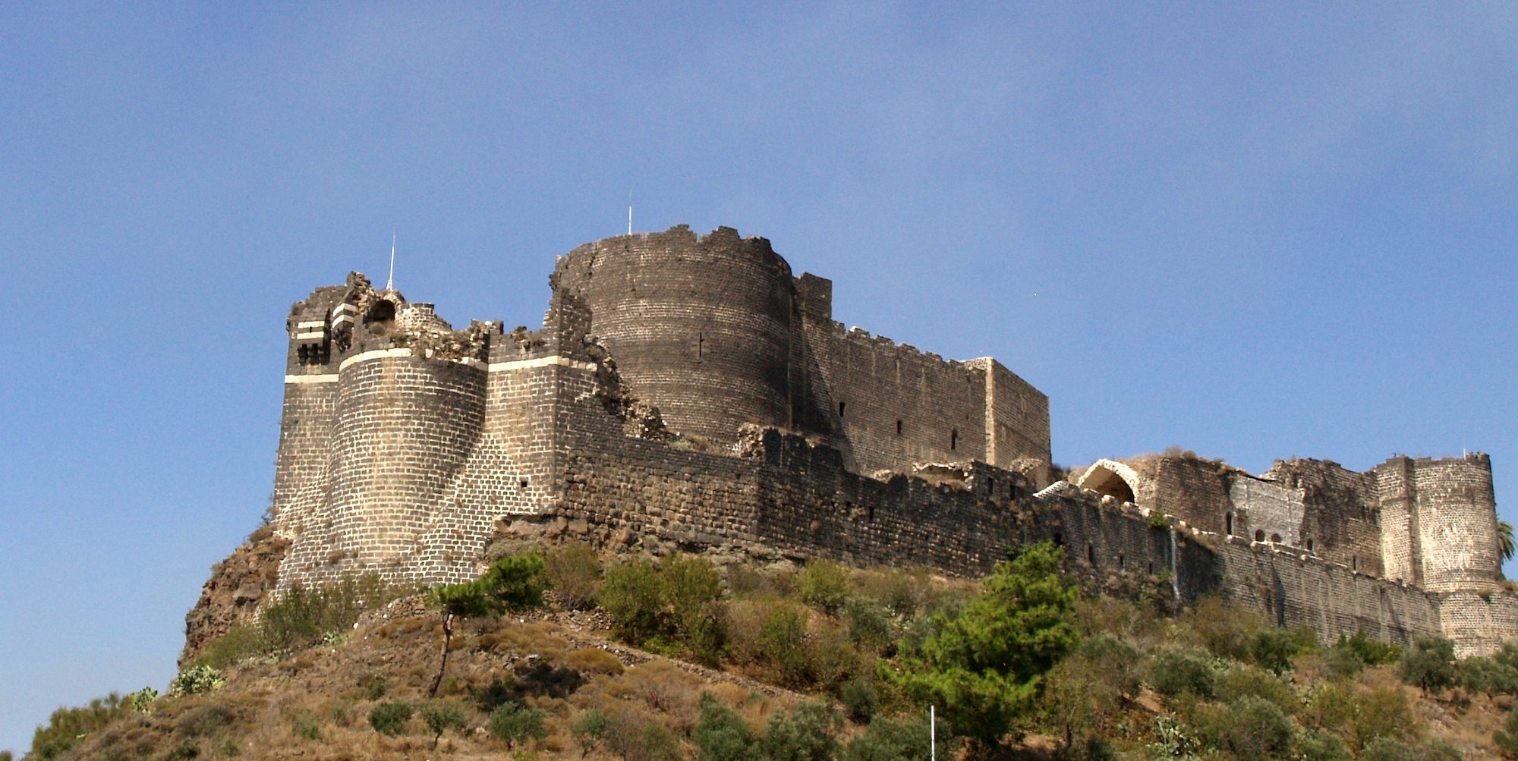
Marqab

Slide 10


