Slide 1
CertHE Skills for the Workplace
Module: BMSW4002
Effective Team Working and Communication
Week 3

Slide 2

Overview of Workshop
Belbin’s Team Roles
Adair’s action centred Leadership
Reward & Recognition
Herzberg Motivational theory

Slide 3
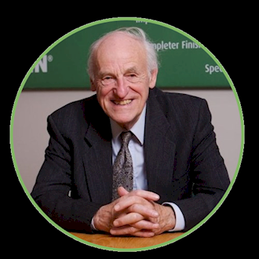
Group/Team Development
R. Meredith Belbin
Father of Team Role Theory
Management Teams: Why They Succeed or Fail (1981), The Job Promoters: A Journey to a New Profession (1990), Team Roles at Work (1993), The Coming Shape of Organization (1996), Changing the Way We Work (1997), Beyond the Team (2000), Managing without Power (2002)

Slide 4
Belbin’s Team Roles
Belbin considered that any individual’s potential contribution to a team could be assessed according to the following traits:
Intelligence
Dominance
Extroversion / Introversion
Stability / Anxiety
Based on these traits he identified 9 distinct team roles:

Slide 5
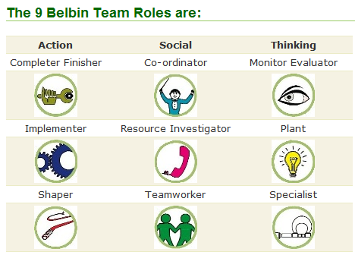
Notes:
Ask the group for a rough poll of how many of each role are present in the room – how many shapers? Coordinators? And so on. Make a mental note, so that you can ask them about whether they recognise the traits for each role as they are discussed.

Slide 6

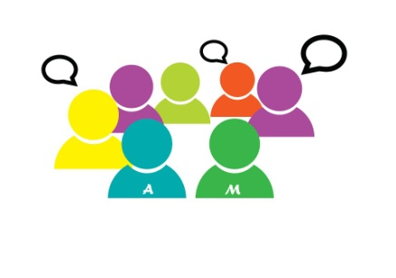
Coordinator (CO)
Presides over the team and coordinates efforts to meet targets.
Intelligent rather than brilliant; not really an ‘ideas’ person.
Establishes roles/work boundaries according to individual abilities and focuses people on what they do best.
A good two-way communicator and self-disciplined in approach.
If a decision is necessary, it is taken firmly after everyone has had a say.
Notes:
Who is a Coordinator? Draw out examples of how they behave in work or in groups – can they see this in themselves? Is there a down-side to this preferred role? Discuss with the whole group. Pull out the learning…..these are summarised ina later slide.
Now, go through each role and take the same approach.

Slide 7

Implementer (IMP)
The practical organiser, concerned with what is feasible.
Turns decisions into defined and manageable tasks that people can actually get on with.
Not easily discouraged, though will not do so well in unstable, quickly changing situations.
Efficient, systematic, methodical, but can be inflexible.
If you need to know what was decided, or what needs to be done, the implementer is the one to see.

Slide 8

Plant (PL)
The ‘ideas’ person.
Most imaginative and intelligent member of the team and the one most likely to look for a new approach to a problem if the team gets bogged down.
Can cause offence when criticising other people’s ideas, usually counter-proposing own ideas.
Can sulk if own ideas are dissected or rejected.
Needs careful handling by the coordinator to ensure that vital spark is provided.

Slide 9

Monitor/Evaluator (ME)
Measured, dispassionate, analysis is his/her forte.
Critic rather than creator – but only if he/she can see a flaw in the argument.
The most objective mind in the team, likes time to mull things over.
Most likely to stop the team from committing itself to a misguided project.
One quality makes him / her indispensable – judgement is hardly ever wrong.

Slide 10

Resource Investigator (RI)
Sociable, gregarious, positive, enthusiastic.
Goes outside the group and brings back information, ideas etc.
The diplomat, the liaison officer, always looking for new possibilities in the wider world outside.
Needs the stimulus of others, gets bored in solitary work.
Within the team, though, a good improviser, active under pressure.
Prevents the team from losing touch with reality.

Slide 11

Team Worker (TW)
Most aware of individual needs and emotional undercurrents within the team. Most active internal communicator.
Likeable, popular, unassertive: the cement of the team.
Loyal to the team unit, builds on ideas rather than demolishes them. Dislikes confrontation, avoids it, and helps cool it down in others.
Exemplary team member, particularly in times of stress.

Slide 12

Shaper (SH)
The task leader, where the Coordinator is a sociable leader.
If no Coordinator is present, the Shaper will lead and give shape to the application of the team’s efforts.
Seeks to convert ideas into decisions and action.
Impulsive and impatient, people outside the team regard him/ her as arrogant.
Can even make the team feel uncomfortable, but makes things happen.

Slide 13

Completer/Finisher (CF)
Worries about what might go wrong.
Checks every detail, this obsession being an expression of anxiety.
Preoccupied with order, compulsive in meeting deadlines, maintains a permanent sense of urgency.
Although an asset to the team, can be a morale-lowering worrier, and be side-tracked by trivia.

Slide 14
Now let’s see what you are!

Slide 15
Team Roles
Team Role | Strengths | Weaknesses
Plant | Creative, imaginative, unorthodox, solves difficult problems. | Poor in communication and in managing ordinary people.
Resource Investigator | Extrovert, enthusiastic, communicative. Explores opportunities and develops contacts. | Loses interest once initial enthusiasm has passed.
Coordinator | Mature, confident and trusting. A good chairperson. Clarifies goals, promotes decision-making. | Not necessarily the most clever or creative member of the group.
Shaper | Dynamic, outgoing and highly strung. Challenges, pressurises, finds ways around obstacles. | Prone to provocation and short-lived bursts of temper

Slide 16
Team Roles (cont.)
Monitor/Evaluator | Sober, strategic and discerning. Sees all options. Judges. | Lacks drive and ability to inspire others
Team Worker | Social, mild, perceptive and accommodating. Listens, builds, averts friction | Indecisive in crunch situations.
Implementer | Disciplined, reliable, conservative and efficient. Turns ideas into plans/actions. | Somewhat inflexible. Slow to respond to new possibilities.
Completer/Finisher | Painstakingly conscientious. Searches out errors and omissions. Delivers on time. | Inclined to worry unduly. Reluctant to delegate
Specialist | Single-minded, self-starting and dedicated. Provides knowledge. | Contributes only on a narrow front.

Slide 17
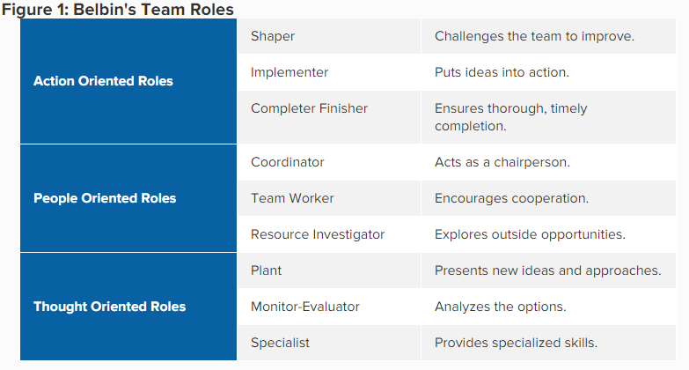
Balancing the team
Notes:
Team leaders and team development practitioners often use the Belbin model to help create more balanced teams.
Teams can become unbalanced if all team members have similar styles of behavior or team roles. If team members have similar weaknesses, the team as a whole may tend to have that weakness. If team members have similar team-work strengths, they may tend to compete (rather than cooperate) for the team tasks and responsibilities that best suit their natural styles.
Knowing this, you can use the model with your team to help ensure that necessary team roles are covered, and that potential behavioral tensions or weaknesses among the team member are addressed.

Slide 18
Activity in your teams!

Slide 19

When looking at team Roles
Everyone working within a team acquires a role (whether consciously or not)
Some people like to lead
Others prefer to be more passive participants
Defining roles, along with a clear goal, is an important strategy for creating a successful teamwork environment
Clearly defined goals, matched with specific tasks, will help team members decide which role is best suited to their personality and abilities

Slide 20

In a nutshell, using Belbin Team Roles will give you:
Balanced teams based on behavioural contributions rather than job titles
Self-aware individuals who can adapt their behaviours according to the situation and business need
The right people doing the right tasks, leading to better-performing teams
Informed, impartial decision-making, based on fact rather than a 'gut-feel' which may be subject to unconscious bias
Confidence when making decisions involving people
Insight into behavioural strengths and weaknesses which aren't necessarily revealed by a CV

Slide 21
Adair’s Action Centred Leadership
Achieving the Task, Developing the Team and Developing Individuals - are mutually dependent, as well as being separately essential to the overall leadership role.
The model helps to get the right balance gets results, builds morale, improves quality, develops teams and productivity and is the mark of a successful manager and leader.
Task
(achieving tasks)
Team (Managing team)
Individual
(Managing Individuals)
Notes:
John Adair, born in 1934, British, developed his Action Centred Leadership model while lecturing at Sandhurst Royal Military Academy and as assistant director and head of leadership department at The Industrial Society. This would have been during the 1960s and 70s, so in terms of management theories, Adair's work is relatively recent.
His work certainly encompasses and endorses much of the previous thinking on human needs and motivation by Maslow, Herzberg and Fayol, and his theory adds an elegant and simple additional organisational dimension to these earlier works.
Very importantly, Adair was probably the first to demonstrate that leadership is a trainable, transferable skill, rather than it being an exclusively inborn ability.
Task – identifying aims/ purpose/ direction/ activity
Identify resources/ people/ systems
Create plans (measurable)
Establish responsibilities
Set standards/ quality
Monitor and manage performance
Report on progress
Review/ adjust plans
Teams- establish team members (Belbin)/ culture/ communications
Monitor and maintain discipline/ ethics/ focus/ objectives
Resolve conflicts/ disagreements
Develop teamworking (TUCKMAN)
Facilitate/ lead
Identify training needs
Give feedback
Individual – understand personalities (identify each individual skills stregnths (Belbin role)
Assist and support
Give recognition and praise
Reward
Train and develop

Slide 22
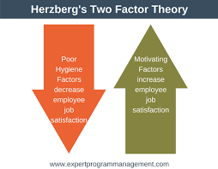
Herzberg’s Motivation Theory – Two Factor Theory
Herzberg’s Motivation Theory model, or Two Factor Theory, argues that there are two factors that an organisation can adjust to influence motivation in the workplace.
Hygiene factors: These won’t encourage employees to work harder but they will cause them to become unmotivated if they are not present
Motivators: Which can encourage employees to work harder.

Slide 23
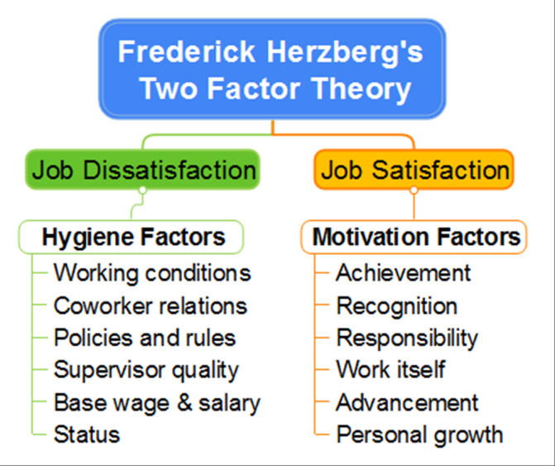

Slide 24
How did Pandemic effect hygiene factors & Motivation in companies
How did working conditions change
Did employee relations get effected
Did supervision quality get effected
Did people continue to grow in their careers
What else could have been done to improve effective team working in those circumstances?

Slide 25

Hygiene factors include:
Company policies: These should be fair and clear to every employee. They must also be equivalent to those of competitors.
Supervision: Supervision must be fair and appropriate. The employee should be given as much autonomy as is reasonable.
Relationships: There should be no tolerance for bullying or cliques. A healthy, amiable, and appropriate relationship should exist between peers, superiors, and subordinates.
Work conditions: Equipment and the working environment should be safe, fit for purpose, and hygienic.
Salary: The pay structure should be fair and reasonable. It should also be competitive with other organizations in the same industry.
Status: The organization should maintain the status of all employees within the organization. Performing meaningful work can provide a sense of status.
Security: It is important that employees feel that their job is secure and they are not under the constant threat of being laid-off.

Slide 26

Motivating factors include:
Achievement: A job must give an employee a sense of achievement. This will provide a proud feeling of having done something difficult but worthwhile.
Recognition: A job must provide an employee with praise and recognition of their successes. This recognition should come from both their superiors and their peers.
The work itself: The job itself must be interesting, varied, and provide enough of a challenge to keep employees motivated.
Responsibility: Employees should “own” their work. They should hold themselves responsible for this completion and not feel as though they are being micromanaged.
Advancement: Promotion opportunities should exist for the employee.
Growth: The job should give employees the opportunity to learn new skills. This can happen either on the job or through more formal training.

Slide 27

How to Use The Model
1. Eliminate Job Hygiene Stressors by:
Rectify petty and bureaucratic company policies.
Ensure each team member feels supported without feeling micromanaged.
Ensure the day to day working culture is supportive. No bullying. No cliques. Everyone treated with equal respect.
Ensure that salaries are competitive within the industry. Ensure there are no major salary disparities between employees doing similar jobs.
To increase job satisfaction and status, aim to construct jobs in such a way that each team member finds their job meaningful.

Slide 28

2. Boost Job Satisfaction through-
Job enrichment : enriching a team member’s job by giving them more challenging or complex tasks to perform.
Job enlargement: giving a team member a greater variety of tasks to perform..
Employee empowerment: delegating increasing responsibility to each team member. This can be done by slowly increasing the amount of responsibility you delegate to an employee. Rewarding and recognising efforts, praising employees.

