Slide 1

Student name: Dajou Kateka
Student ID: 2317142
Student Module name: Empowering The Older Person
Module code: BMHP6027
Lecturer’s name: Arif Ahmed
ID: 2317142
Acknowledgement of the use of AI tools
I confirm that I have not used any AI tools in the research and creation of this assignment. I confirm that I have not presented any AI generated materials as my own work. I confirm I have copies of my drafts, notes, and other resources I used, which I may be asked to provide in evidence

Slide 2
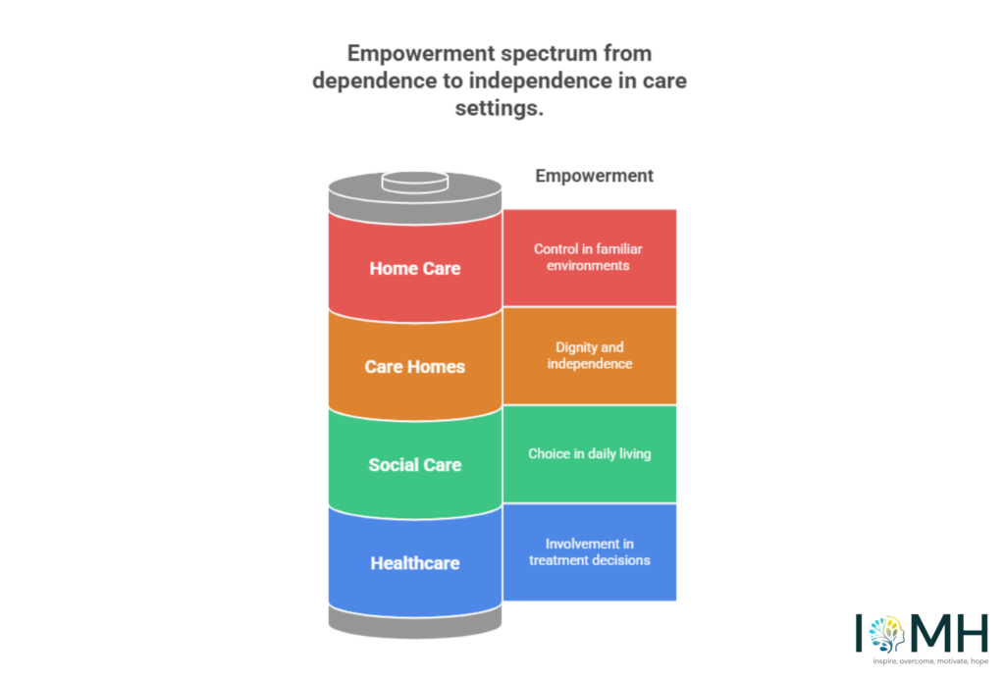

Empowering The Older Person
Information, digital exclusion and advocacy: (Department of Health and Social Care, 2014).:
Comprehensive Geriatric Assessment (CGA): medication problems, or mobility limitations early. (British Geriatrics Society, 2024)
The Equality Act 2010 protection from discrimination based such as age, disability, gender, race and religion.
The NHS Long Term Plan (2019): focuses on enhancing care for older individuals, especially those with long-term conditions and complex health requirements (NHS England, 2019)
Theory
Person-Centred Care Theory: Respecting the individual’s values, preferences and life experiences (Moilanen, T., et al, 2021)
Empowerment Theory: involved in decisions about their care and support (CAREY, M., 2019).
Effectiveness and benefit approach
(IOMH, 2025),
Effectiveness
Physical Activity and Rehabilitation Programmes:
Social Participation, Community Interventions and social interventions
Health Promotion and Preventive Care:.
Technology and Digital Health Interventions (NHS England, 2019).
Introduction
According to The IOMH (2025), that empowerment in health and social care is a fundamental principle that prioritise individuals in managing their own care and support.
Mental Health
Physical
Social
(Age UK, 2023).
Expanding Community-Based Support Services (Age UK, 2022)
Enhancing Workforce Training and Staffing Levels
Promoting Digital Inclusion and Assistive Technology (NHS England, 2019).
Challenges
Benefit
Reduced hospital readmissions
Increased independence in daily activities
Reduced loneliness and social isolation
Better physical health
Improved access to services and information (Khan, A., et al, 2019).
Physical Health Decline and Chronic Illness (NHS, 2023).
Social Isolation and Loneliness (Age UK, 2022).
Limited Access to Health and Social Care Services (Department of Health and Social Care, 2021).
Financial difficulties: Some elderly individuals may encounter financial difficulties after retiring because of decreased income or increasing living expenses.
Conclusions
According to Age UK (2023) that statistically in 2023 there are 11 million people aged over 65 in England. This is projected to increase by 10% in the next five years and by 32% by 2043 (1.1 and 3.5 million people respectively) (Age UK, 2023).
Elderly individuals in the UK have various care requirements. It is important to offer suitable support, encouraging independence, to improve their wellbeing and quality of life, Policies such as the Care Act 2014 and initiatives like the NHS Long Term Plan aim to address these needs by promoting effective integration of services. Challenges like limited resources and a shortage of workers still impact on the provision of services. Innovations in health and social care services are essential to assist the increasing elderly population in the UK.
The care, empowerment and support needs of older people
Person-centred care customised to individual needs (NICE, 2015)
Opportunities to participate in decision-making (Khan, A., et al (2019), (GOV UK, 2025)
Community and social engagement to combat isolation (Age UK, 2025)
Policies and Theory
Policies
The Care Act 2014: wellbeing of individuals at the centre of care and support services(Department of Health and Social Care, 2014).
Recommendations
Strengthening Person-Centred Care by following the Care Act 2014 (Department of Health, 2014).

Slide 3
References
Age UK (2023) The State of Health and Care of Older People, 2023 Available at: https://www.ageuk.org.uk/siteassets/documents/reports-and-publications/reports-and-briefings/health--wellbeing/age-uk-briefing-state-of-health-and-care-july-2023-abridged-version.pdf (Accessed: 9 March 2026)
Age UK (2025) The State of Health and Care of Older People in England 2025 Available at: https://www.ageuk.org.uk/siteassets/documents/reports-and-publications/reports-and-briefings/health--wellbeing/state-of-health-and-care/state-of-health-care-of-older-people-in-england-2025.pdf?utm_source=copilot.com (Accessed:16 March 2026)
Ashikali, E.-M., Ludwig, C., Graf, C., Ionita, I., & Busnel, C. (2024). Application of the Medical Research Council guidance for complex interventions in the development of VIeSA, an intervention to support healthy ageing among community-dwelling older adults. BMC Geriatrics, 24(1), Article 830. https://doi.org/10.1186/s12877-024-05399-y
British Geriatrics Society (2024) Evidence Synthesis for Older Adults Available at: https://www.bgs.org.uk/resources/evidence-synthesis-for-older-adults?utm_source=chatgpt.com
CAREY, M. (2019). Some limits and political implications of participation within health and social care for older adults. Ageing and Society, 39(8), 1691–1708. https://doi.org/10.1017/S0144686X18000193
Care Learning (2024) Explain the importance of empowering individuals. Available at:https://carelearning.org.uk/qualifications/level-3-extended-hsc/hsc-dm1/1-1-explain-the-importance-of-empowering-individuals/?utm_source=chatgpt.com (Accessed: 9 March 2026)
Department of Health (2014) Care and Support Statutory Guidance Available at: https://assets.publishing.service.gov.uk/media/5a7f6122e5274a2e87db57f9/23902777_Care_Act_Book.pdf
Dong, Y., & Dong, H. (2023). Design Empowering Active Aging: A Resource-Based Design Toolkit. International Journal of Human-Computer Interaction, 39(3), 601–611. https://doi.org/10.1080/10447318.2022.2041908
Halamová, L., Locock, L., Maclaren, A., Makin, S., & Phillips, L. (2025). Involvement of older adults in shared decision-making on care transitions in the UK: an interpretative qualitative systematic review. Ageing and Society, 45(11), 2500–2525. https://doi.org/10.1017/S0144686X25100123
GOV UK (2025) Care and support statutory guidance Available at: https://www.gov.uk/government/publications/care-act-statutory-guidance/care-and-support-statutory-guidance?utm_source=copilot.com (Accessed:16 March 2026)
IOMH (2025) Empowerment in health and social care: definition and examples. Available at: https://iomh.co.uk/what-is-empowerment-in-health-and-social-care-definition-importance-examples-practice/?utm_source=chatgpt.com (Accessed: 9 March 2026)
Khan, A., Newman, A., Mann, M., & Nelson, A. (2019). 51 The unmet health and social care needs of older caregivers: a systematic review. BMJ Supportive & Palliative Care, 9(Suppl 3), A20. https://doi.org/10.1136/spcare-2019-mariecuriepalliativecare.51
Office for National Statistics (2021) Ageing Available at: https://www.ons.gov.uk/peoplepopulationandcommunity/birthsdeathsandmarriages/ageing (Accessed: 08/03/2026)
Office for National Statistics (2023) Older people living in care homes and changes over time, England and Wales, Census 2021 Available at: https://www.ons.gov.uk/peoplepopulationandcommunity/birthsdeathsandmarriages/ageing/datasets/olderpeoplelivingincarehomesandchangesovertimeenglandandwalescensus2021 (06/03/2026)
Moilanen, T., Kangasniemi, M., Papinaho, O., Mynttinen, M., Siipi, H., Suominen, S., & Suhonen, R. (2021). Older people’s perceived autonomy in residential care: An integrative review. Nursing Ethics, 28(3), 414–434. https://doi.org/10.1177/0969733020948115
Mc Grath, M., Clancy, K., & Kenny, A. (2016). An exploration of strategies used by older people to obtain information about health‐ and social care services in the community. Health Expectations: An International Journal of Public Participation in Health Care and Health Policy, 19(5), 1150–1159. https://doi.org/10.1111/hex.12408
NICE (2015) Older people with social care needs and multiple long-term conditions Available at: https://www.nice.org.uk/guidance/ng22?utm_source=copilot.com (16/03/2026)
NHS England (2019) The NHS Long Term Plan Available at: https://www.england.nhs.uk/2019/01/long-term-plan/ (Accessed: 08/03/2026)
Sadler, E., Khadjesari, Z., Ziemann, A., Sheehan, K. J., Whitney, J., Wilson, D., Bakolis, I., Sevdalis, N., Sandall, J., Soukup, T., Corbett, T., Gonçalves-Bradley, D. C., & Walker, D.-M. (2023). Case management for integrated care of older people with frailty in community settings. Cochrane Database of Systematic Reviews, 2023(5), CD013088. https://doi.org/10.1002/14651858.CD013088.pub2

