Slide 1

Managing Projects in the Organisation
Louise Hall (2126231)
Charlene Johnson (2131892)
Everisto Friete de Melo (2129710)
Waqar Ali (2027054)
BMSK5104_BIRM
Bente Fatema
October 2023

Slide 2
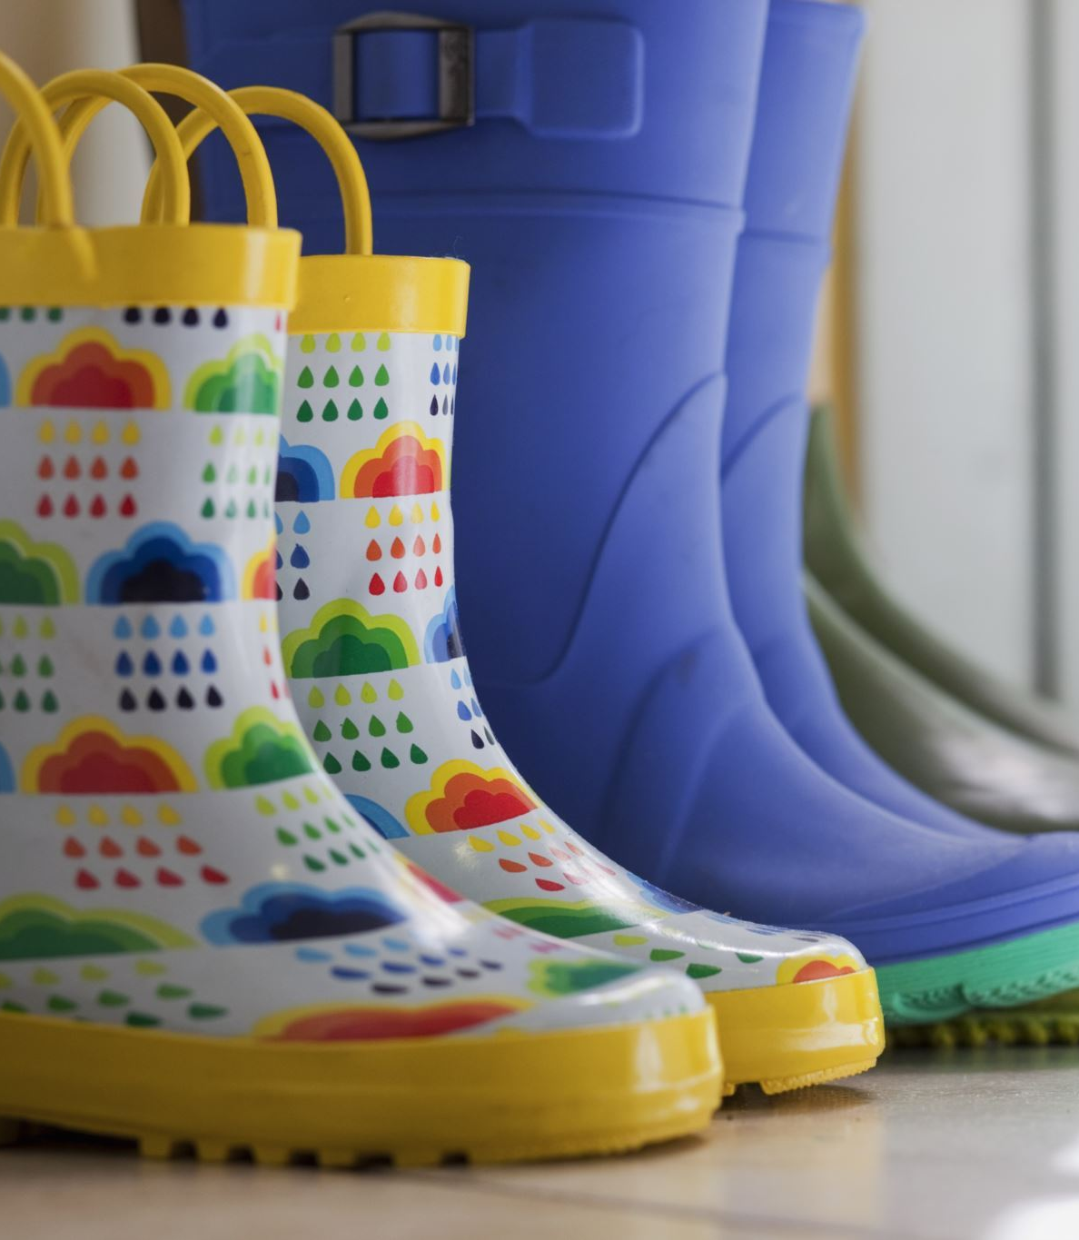
Table of Content
Title page................................................................................................................................Slide 1
Table of contents.................................................................................................................Slide 2
Introduction...........................................................................................................................Slide 3
Project Vision …..................................................................................................................Slide 4
POP app …...........................................................................................................................Slide 5
Solutions….............................................................................................................................Slide 6
Transport …...........................................................................................................................Slide 7
EYSF …...................................................................................................................................Slide 8
Funding …...............................................................................................................................Slide 9
Conclusion.............................................................................................................................Slide 10
References.............................................................................................................................Slide 11

Slide 3
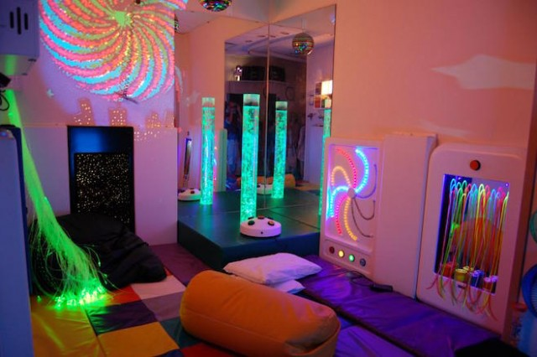
Introduction
My name is Charlene Johnson and today I am happy to introduce to you a project called Little Wonders Nursery. During this presentation we will be discussing the project plan and the vision for Little Wonders Nursery, the scope and breakdown structure for project.
Little Wonders has a unique goal and that is to provide freedom of creativity for all children, the nursey will provide unique playrooms for each child.
Sensory rooms for children with disabilities
Themed and adventure rooms
This Photo by Unknown author is licensed under CC BY-NC-ND.

Slide 4
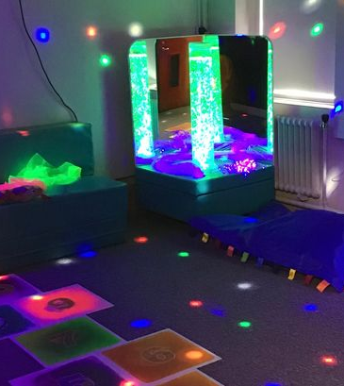
vision
My name is Louise Hall and today I will introduce the vision of Little Wonders nursey.
Little Wonders will provide Pantomime and shows which consist of French and English educational sing along,
Little wonders also has an app called (POP) which is the parents online platform.
Multi-Sensory Environments are spaces with tools that can provide experiences with touch, sound, and light. Children with autism are frequently exposed to multisensory environments. (Unwin, Powell and Jones, 2021)

Slide 5

The app includes Picture app for accidents and emergency this is also linked to the NHS for advice or assistance.
Pop also has disappearing features which enable photos or information to disappeared within 24hrs of usage for confidentiality. The app can also be used for updates, ordering school meal, Pop is also a gateway for communication for parents. Real-time information updates are provided by the school's parent portal in a secure setting. It effectively arranges crucial student information that parents should regularly watch and keep up with. (Okumu, 2023)

Slide 6

Solutions
Little Wonders provides a two-story building which consist of:
ten rooms on each floor
Four toilets and two changing rooms on each floor
Liberty on ech floor
Two main offices and one reception area
Fire point
Fire alarm
Emergency Exit
Toddlers require more staff per class and Little Wonders provide three staff for each of the creativity rooms designed for their age group.
Little Wonders will employ up to fifty staff in total for this project.

Slide 7

Little Wonders will provide four minibuses to pick up children in the morning, including children with disabilities this enables parents to be more flexible with their jobs.
Little Wonders minibuses will cover large areas including the city this also includes travel for our daycare center, making it easier for children to get around safely. We will also have flexible schedules so that parents can balance their work schedule with the time their children spend at Little Wonders.
Buses are the safest form of transportation for students, so parents don't have to stress about their children's safety. (M Keshavadas 2019)

Slide 8
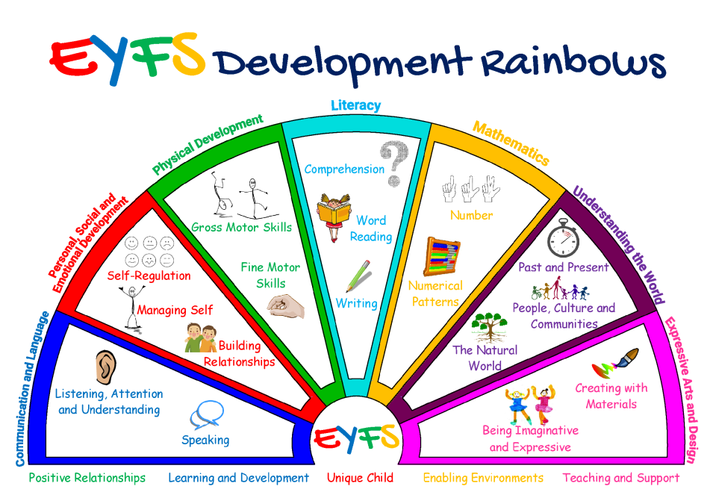
Statutory Framework for the early year's foundation stage requirements
The (EYFS) requires
Communication and language.
Personal, social and emotional development.
Mathematics
Physical development
Expressive arts and design
Understanding the world
Literacy
The Early Years Foundation Stage (EYFS) establishes guidelines for the education, growth, and care of children from birth to age five. (Pascal, Bertram and Rouse, 2019)

Slide 9


Funding
Little wonders is supported by funding from local investors and Birmingham city council. The funders will have no role in the business or any preparation of the company. Tell potential investors why they should invest in you in your business plan since it will be their first exposure to your company. One of the most difficult aspects of launching and operating a business is finding investors. It's ideal to start modest and transition to larger funding alternatives later.(Dublino 2023)
This Photo by Unknown author is licensed under CC BY-SA.

Slide 10
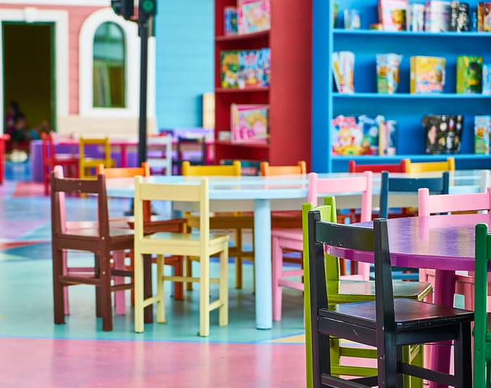
Conclusion
The issues parent's endured after the covid19 restrictions was lifted is the minimal amount of suitable nursey spaces or places.
Little Wonders purposes to build a two-story building with over 20 rooms and over fifty staff members. Little Wonders provides four minibuses for parent's, with funding from Birmingham city council and privet investors.
Little wonders has created a parents app called Pop which is linked to the NHS and parents for communication. Little Wonders will also abide by The Early Years Foundation Stage (EYFS) guild lines and requirement.
In closing Little Wonders aims to provide larger spaces more staff and travel, Little Wonders believes in providing the best care for every parent and their children's needs.

Slide 11
References
Unwin, K.L., Powell, G. and Jones, C.R. (2021). The use of Multi-Sensory Environments with autistic children: Exploring the effect of having control of sensory changes. Autism, 26(6), p.136236132110501. doi:https://doi.org/10.1177/13623613211050176.
M, keshavdas (2019) ‘Top 17 Important Benefits Of Choosing School Buses For Students’, 17 June. Available at: https://www.fleetroot.com/blog/top-17-important-benefits-of-choosing-school-buses-for-students/#:~:text=A%20school%20bus%20can%20accommodate,positively%20to%20reducing%20the%20traffic. (Accessed: 17 October 2023).
..
https://mindingkids.co.uk/wp-content/uploads/edd/2021/10/EYFS-Development-Rainbows-Advert-IMAGE.png
Pascal, C., Bertram, T. and Rouse, L. (2019) Getting it right in the Early Years Foundation Stage: a review of the evidence. Available at: http://www.earlychildhoodforum.org/uploads/Getting_it_right_in_the_EYFS_Literature_Review.pdf.
Okumu, R. (2023) School ERP Software: Benefits of the Parent Portal, SchoolTry. Available at: https://blog.schooltry.com/2023/07/12/benefits-of-the-parent-portal-in-school-erp-software/ (Accessed: 19 October 2023).
dublino, jennifer (2023) How to Find Investors for Your Business, business.com. Available at: https://www.business.com/articles/how-to-find-business-investors/.

