Slide 1

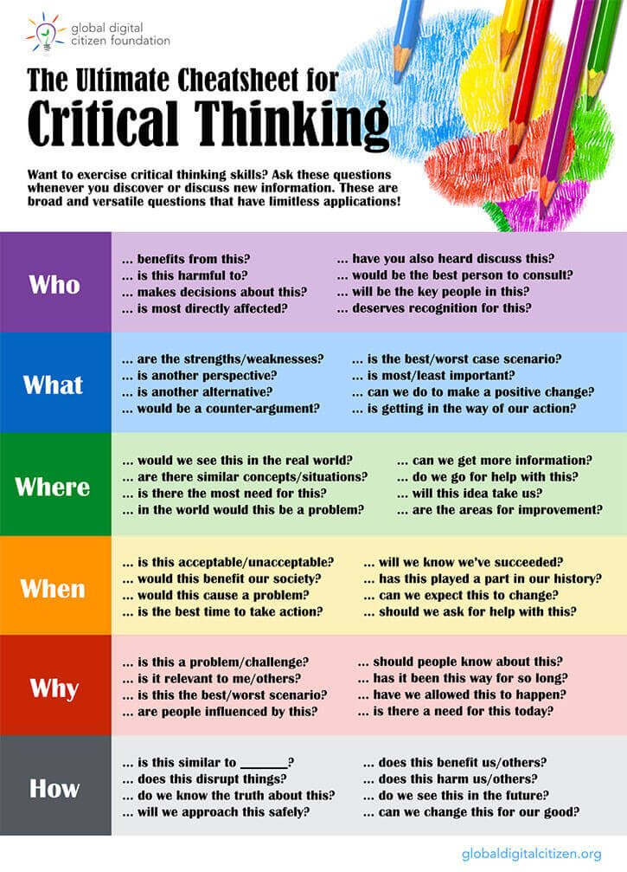
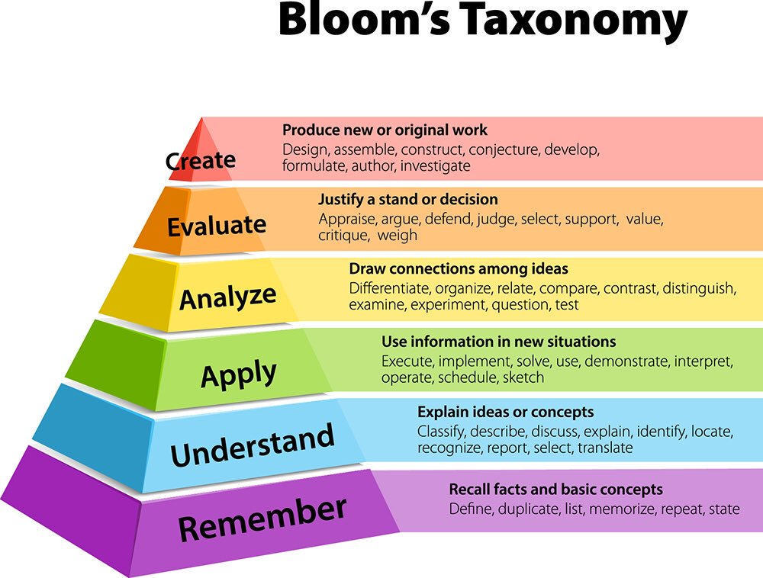
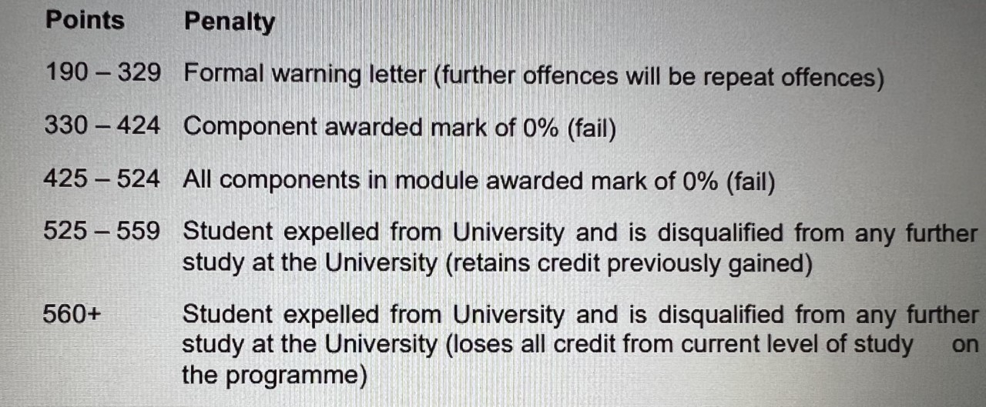
Critical Thinking
Rebecca Thomas Student Number – 2209334 Module code - ECGE4005PC
Skill 2 – Time Management
Cottrell (2019) believes that time management is an important skill to develop when completing a degree. Each individual needs to ensure they find time to study and that they are using that time effectively. Procrastination would have a negative impact on a students progression as it stops them from showing their full academic potential and can result in un-necessary anxiety and cause stress. Some ways to avoid this are:
Set achievable goals.
Use a timetable or purchase a planner – put it somewhere easily accessible and ensure that you persist with it.
Remove distractions by finding a quiet space to work.
Time circles are also a good tool to use filling the first one out with how time is used now and the second with how time should be used.
Moore et al. (2010) points out that if students are perfectionists that can cause poor time management and result in work accumulating. If they are adamant their work has to be perfect, it results in setting unattainable goals. Some people experience this because they want to impress other people, are afraid to make mistakes and cannot deal with criticism. Time management has an impact on critical thinking because if time is not being managed effectively students will not have done enough research to enable them to analyse, problem solve and therefore think critically. Time management is a vital skill for everyday life due to home and work commitments. It is essential for a childcare practitioner as children need set routines and to cover everything in the curriculum time needs to be managed proficiently. Wilson (2009) claims that to work effectively you need to think about what time of day you would be able to concentrate the most and produce your best academic work for example in the morning or evening.
Introduction – What is Critical thinking?
According to Cottrell (2011) research is vital when thinking critically, it is important to look at evidence and arguments for different points of view. To think critically effectively people need to have the ability to question, reflect and draw conclusions logically based on skilled research.
Cottrell (2019) maintains that to think critically students need to be self aware and creative. This is important because without self awareness they will not be able to identify what they have excelled at and what they need to develop when thinking critically. Also creativity enables people to improve their problem solving skills and view things in a different light in an un-biased way. There are many critical questions that need to be thought about. (Source: globaldigitalcitizen.org, no date)
According to …....(global digital citizen.org- blog) Bloom's Taxonomy is a useful technique for thinking critically, it involves six levels of thinking skills ranked in order of importance. When applying Bloom's Taxonomy a good technique to use is the 'Question Daisy' which includes simple, clarifying, practical, explanatory, creative and evaluative questions. (Source: Google images,
Bloom's Taxonomy, 1956)
Skill 3 – Plagiarism
According to Kettel (2018) plagiarism is copying someone else's work and failing to provide a reference proving what source you got the information from. It can sometimes be difficult to avoid this, especially when at the beginning of a degree because students do not always have the skills and experience to paraphrase suitably. Paraphrasing entails re-wording a short section of what you have read but a reference must be cited in the text and added to the reference list also. Summarising is providing an overview of the whole text stating the key points linking to the argument. Plagiarism impacts critical thinking because if it takes place then the student may not have a true understanding of the information included and may not be able to question, reflect and interpret it building up an unreliable argument. As a childcare practitioner plagiarism is discouraged as they ensure the children are creating their own work rather than copying.
Day (2018) maintains that there are many ways to avoid plagiarism:
Summarise, paraphrase and quote efficiently, also citing and referencing appropriately.
Creating their own argument in a piece of work.
Recording a reliable source list.
Effective research and note taking immediately re-wording what you have read but keeping the same meaning.
Turnitin is an electronic programme and crucial tool to use to ensure work is not plagiarised, it flags up parts of the assignment that is not paraphrased well and classed as plagiarised. Therefore students have the opportunity to edit their work before submitting it. Plagiarism has serious consequences. As stated by the University of Wales Trinity Saint David the level the student is studying at and the amount of points received is how the penalty is decided.
Source: University of Wales Trinity Saint
David, Academic Misconduct Policy, (YEAR)
Skill 1 – Citing and Referencing
Day (2018) suggests that citing and referencing are essential in academic writing. When citing and referencing it involves recording where the source of information was found for the reader to refer to. Students create reference lists and include them at the end of their assignments along with full publication details of the source. Citing and referencing is linked to critical thinking because it proves that the information is from reliable sources and helps to build up an argument based on information written by different authors. Reading varying information can support students when applying Bloom's Taxomony. When using the Harvard style it is essential to take note of the author and the date the information was published, the references must be in alphabetical order. The University of Wales Trinity Saint David use the Harvard style and provide their students with a handbook which is an invaluable resource. Citing and referencing helps to provide evidence to back up arguments stated in the writing therefore enabling the reader to think critically. Another way of citing is the numerical style which is when numbers are used. When referencing at the end of the assignment the references go in order of the citations in the subject matter.
Cottrell (2019) points out that referencing is important because it prevents plagiarism, it makes it easier to find the original source of information and it gives the reader evidence that it has come from a reliable source. Some useful referencing management softwares available are Mendeley, Zotero, Endnote and RefMe which support students in producing reference lists. …......maintains that some useful tips to consider when referencing are:
Keep notes of the sources visited straight away.
Consistency in notes taken and referencing is key.
Time management and proof reading is essential.
Consider if the reader would be able to easily find the source of information using the reference list.
Several sources are referenced slightly differently ranging from books, websites, journals, reports and others. The method of referencing is stated in the handbook.
As stated by Godfrey (2013) there are several other referencing styles which are the American Psychological Association, Modern Language Association, Vancouver referencing style and Chicago/Turabian. Vancouver and Chicago are numeric systems, Medicine students often use the Vancouver referencing style. The American Psychological Association is used in social sciences and the author, date and year should be included. The Modern Language Association is promoted in humanities and liberal arts and the author and page must be included.
Conclusion
In conclusion citing and referencing, time management and plagiarism are essential skills to develop critical thinking and as a higher education student everyone needs a broad awareness of these. These skills enable students to research skilfully and analyse, problem solve and evaluate resulting in their own conclusion based on the evidence. A critical approach is needed when it comes to reading and writing. Also objective thinking is vital ensuring there is no bias. Cottrell (2019). If these skills are used students will excel in their studies.

Slide 2
Reference List
Cottrell, S. (2011) Critical Thinking Skills: developing effective analysis and argument. 2nd edn. Basingstoke: Palgrave Macmillan.
Day, T. (2018) Success in Academic Writing. 2nd edn. Basingstoke, Hampshire: Palgrave Macmillan.
Cottrell S. (2019) The Study Skills Handbook. 5th edn. London: Red Globe Press.
Critical Thinking Tools: Bloom’s Taxonomy – Global Digital (globaldigitalcitizen.org)
Images
Godfrey, J (2013) How To Use Your Reading In Your Essays. 2nd edn. Palgrave Macmillan.
Moore, S. et al. (2010) The Ultimate Study Skills Handbook. Open University Press.
Kettel, R.P. and DeFauw, D.L. (2018) 'Paraphrase Without Plagiarism: Use RRLC (Read, Reread, List, Compose)' ….............
Wilson, E. and Bedford, D. (2009) Study Skills For Part-time Students. Harlow: Pearson Education UK.

