Slide 1

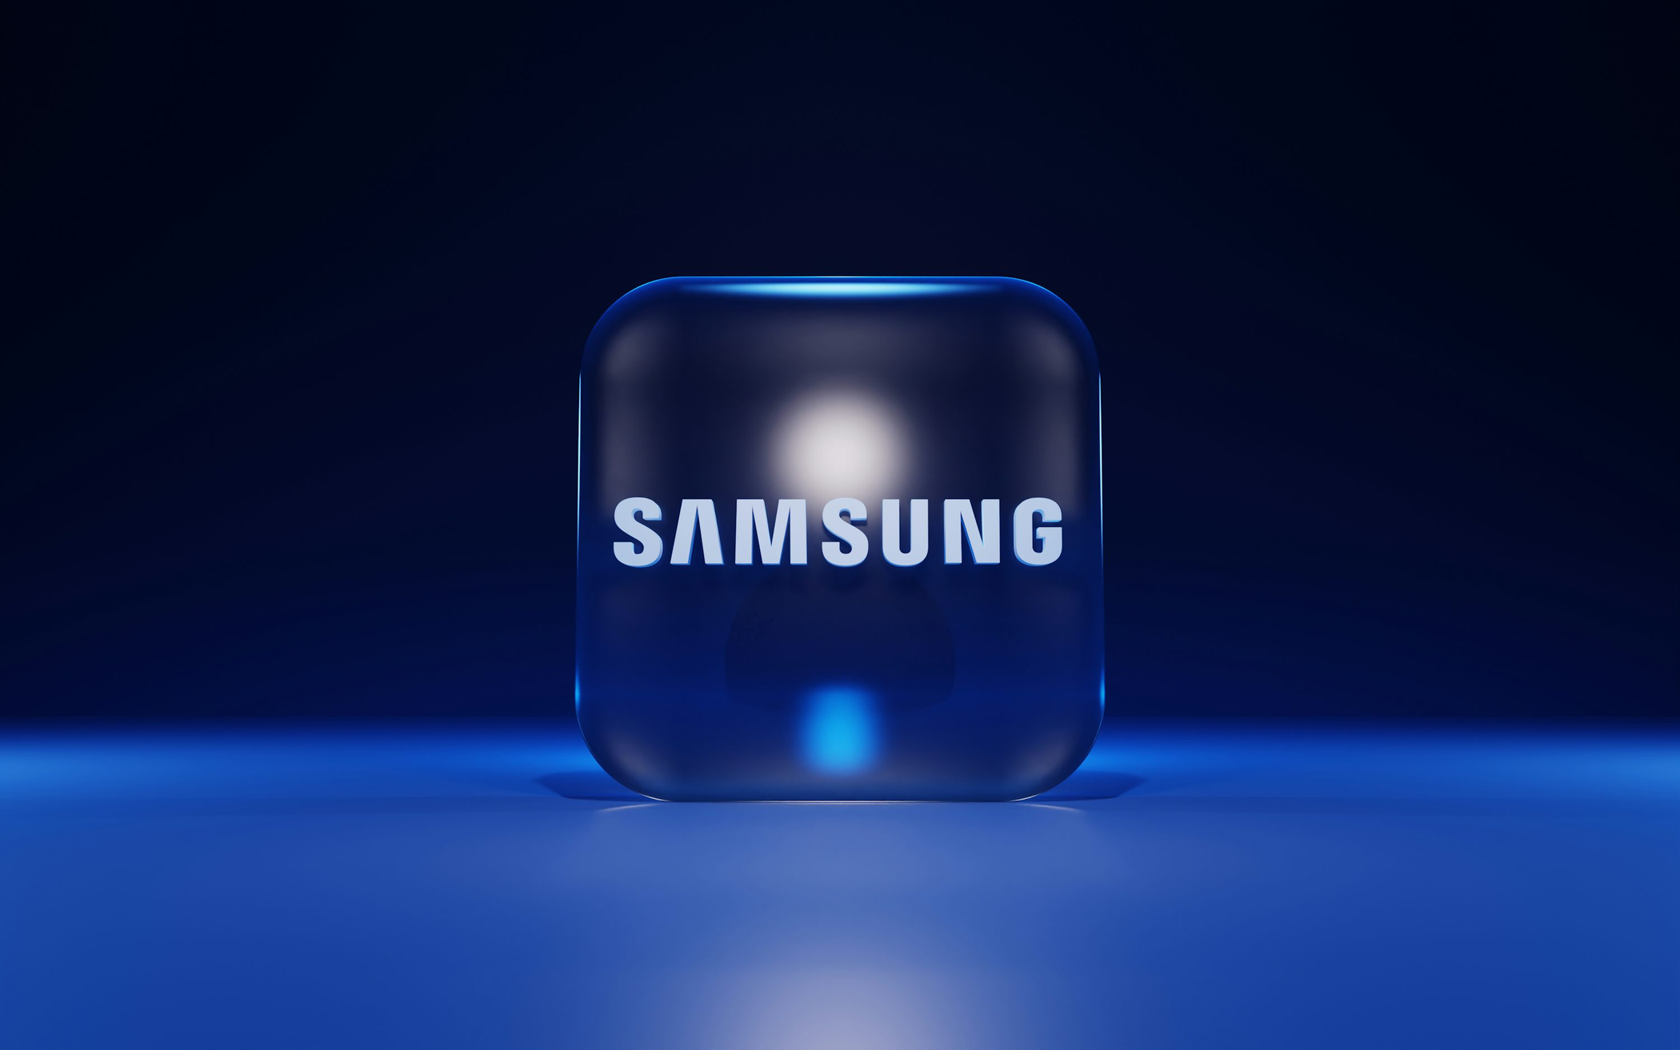
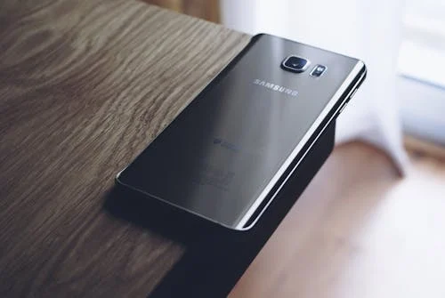

LCBB6023
INTERNATIONAL BUSINESS COMMUNICATIONS
Intercultural Communication in Business: A Comparative Analysis of Samsung UK and South Korea
Student Name | Daniela Voda
Id number :2246662

Slide 2
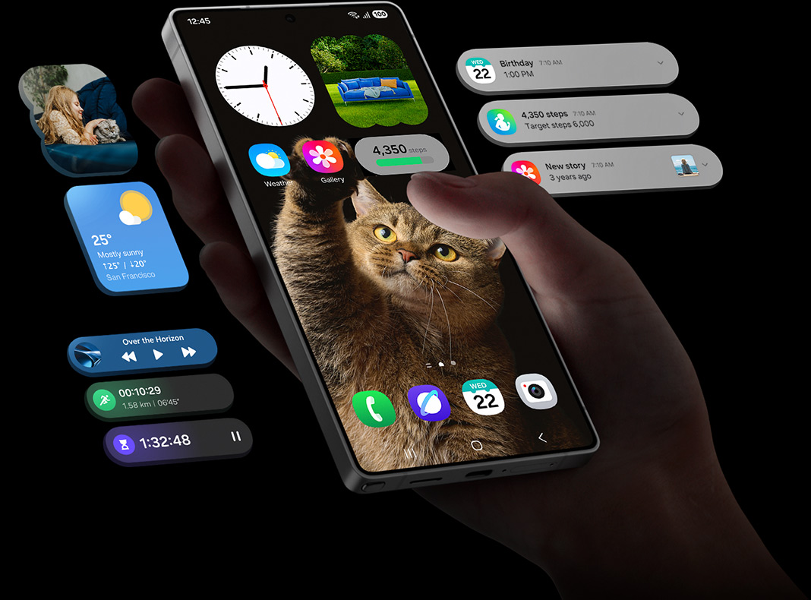
INTRODUCTION & PURPOSE
  The significance of effective intercultural communication has grown in multinational companies due to globalisation (Deresky, 2017).
  Samsung is a South Korean technology conglomerate that runs operations in various global markets, including the United Kingdom.
  This cross-cultural environment is an eye-opener to the importance of national cultural values in management, communication, and teamwork.
  This presentation will critically examine the communication practices between Samsung's UK subsidiary and its Korean headquarters.
  The discussion uses the Cultural Dimensions Theory by Hofstede as a reference to establish some similarities, differences, challenges, and opportunities (The Culture Factor, 2020).

Slide 3
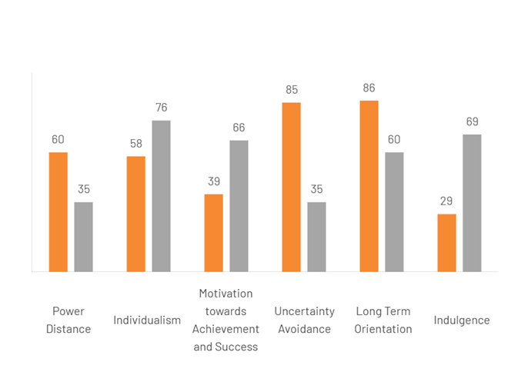
HOFSTEDE’S CULTURAL DIMENSIONS
The Cultural Dimensions Theory by Geert Hofstede describes the impact of national values on workplace communication and management behaviour (Greene, 2024).
  Power Distance: Korea – 60 | UK – 35 → Korea values hierarchy; the UK prefers equality.
  Individualism: Korea – 18 | UK – 89 → Korea is collectivist; the UK is individualistic.
  Uncertainty Avoidance: Korea – 85 | UK – 35 → Koreans prefer structure; Britons accept ambiguity.
  Long-Term Orientation: Korea – 100 | UK – 51 → Korea emphasises long-term stability.
These differences influence Samsung's intercultural communication practices.

Slide 4
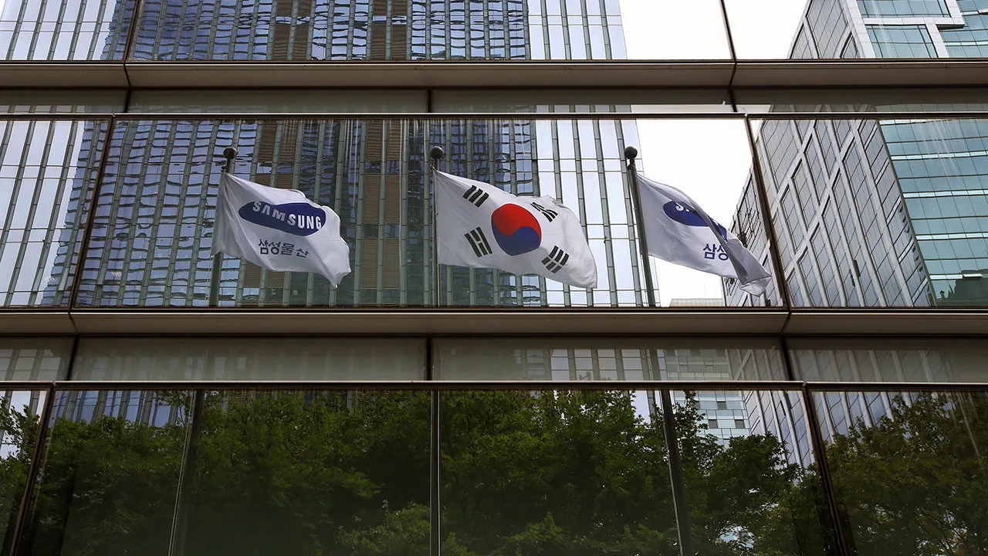
SAMSUNG IN SOUTH KOREA
  Traditional communication in Samsung Korea is top-down, formal, indirect, and has the Confucian notion of harmony (inhwa).
  Authority, seniority, and hierarchy are respected, hence the basis of workplace behaviour.
  Superiors are rarely challenged by employees because unity and saving face are valued more than an open confrontation (OECD, 2023).
  Decision-making is based on a consensus style, where unity in decision-making is achieved at the cost of speed of innovation and dynamism (Kim, 2023).
  The managers’ focus on loyalty, hard work, and communal attainment, which fits the high Power Distance (60) and low Individualism (18) scores (The Culture Factor, 2020).
  Such a system builds a cohesive and stable team, but may stifle creativity and bottom-up feedback.
  Regardless of these limitations, a hierarchical culture has played a significant role in long-term consistency and quality at Samsung (Chu, 2024).

Slide 5
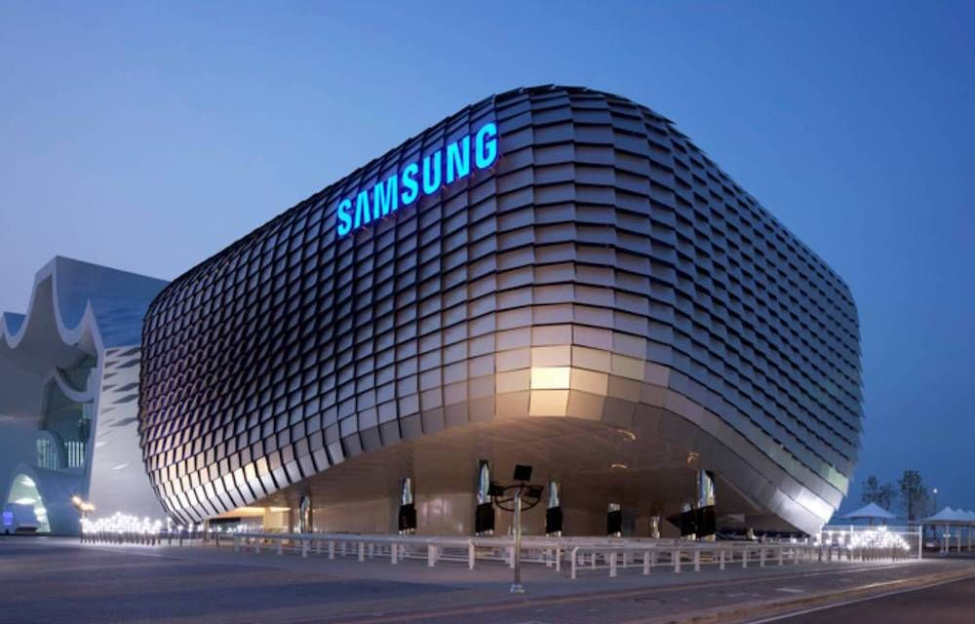
SAMSUNG IN THE UNITED KINGDOM
  Samsung UK has a low power distance culture, which places open and direct communication and transparency (Samsung Electronics, 2023).
  Trojan workers are also allowed to express their opinions openly and criticize the management ideas without fear of retribution (Saunders, 2025).
  The meetings are informal, which encourages work together, equality, and innovative suggestions.
  The process of decision-making is swift and personalistic, and it is results-focused rather than being reached through long-term agreements (McGregor, 2024).
  It is participative leadership where accountability and quantifiable results are given emphasis.
  The emphasis is put on work-life balance and the welfare of workers, which corresponds to moderate uncertainty avoidance and high individualism of the UK.
  Such culture promotes creativity and motivation, which can cause tension with the headquarters of Samsung that favour structure, seniority, and group decision-making.

Slide 6
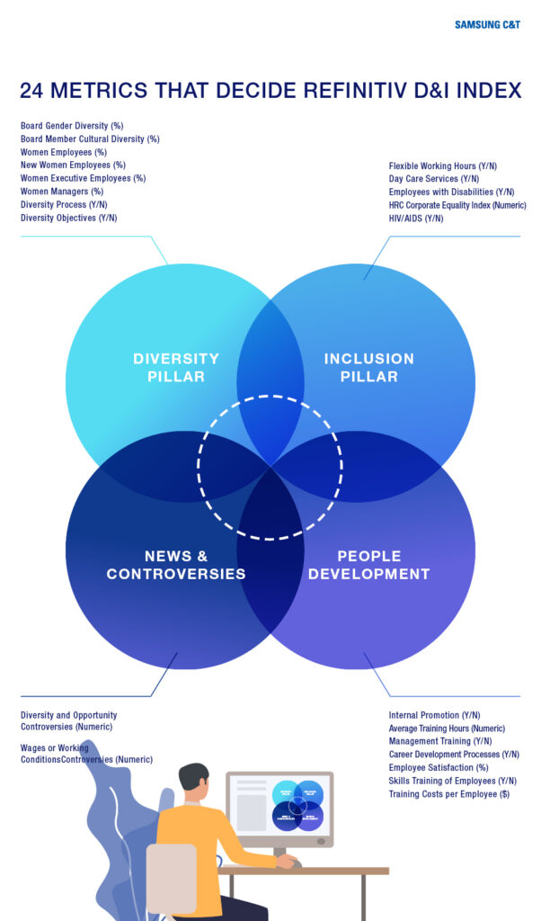
KEY INTERCULTURAL CHALLENGES
Hierarchy vs Egalitarianism: South Korean employees prefer seniority and formality over British employees, who value equality and free communication. It may be a source of confusion when Korean managers seem detached or too formal (Richter, 2023).
Indirect vs Direct Communication: Korean employees use non-verbal communication and minor signals, and British people use straightforward and open communication. This usually results in misunderstanding at meetings or feedback.
Consensus vs Speed: In Korea, the decision-making process implies mutual agreeableness, whereas UK teams appreciate fast decision-making and independence. A combination of the two styles is capable of postponing projects.
Work–Life Expectations: Koreans believe in loyalty and excessive hours, British employees demand work-life balance as it influences retention and motivation (Kang, 2020).
Result: Miscommunication, lower morale, and inefficiencies if not properly managed.

Slide 7
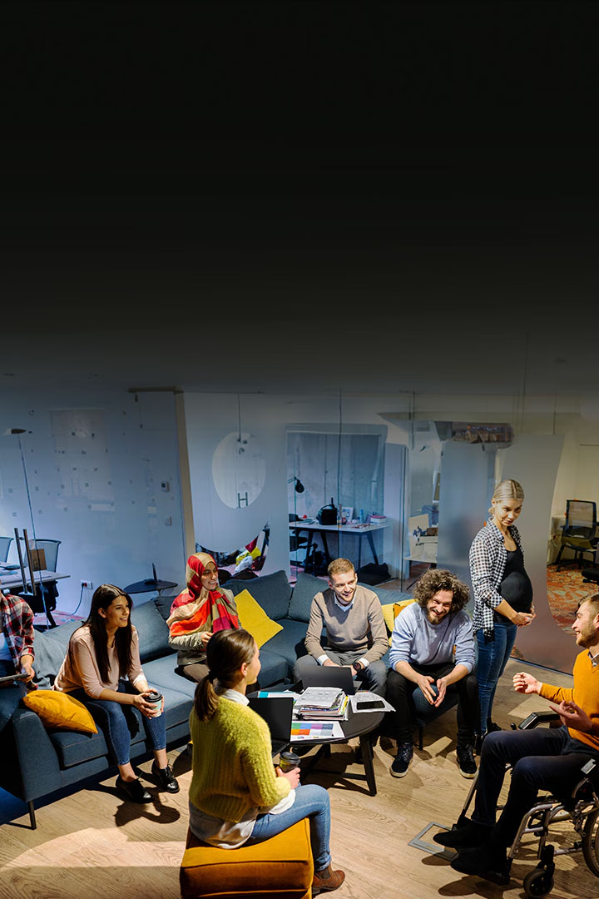
OPPORTUNITIES FOR SYNERGY
  Korean structure and British innovation create creativity and organisational power.
  Flexibility and adaptability in different teams are promoted through hybrid leadership.
  The exposure to the two cultures positively influences problem-solving and innovation because of a wide range of perspectives.
  The integration of the Korean precision and the British openness enhances the effectiveness and choice.
  Cultural awareness campaigns will increase the goodwill and human resource image of Samsung internationally (Lee, 2025).
  The cross-cultural synergy enables Samsung to be competitive and agile in the dynamic global technology market.

Slide 8
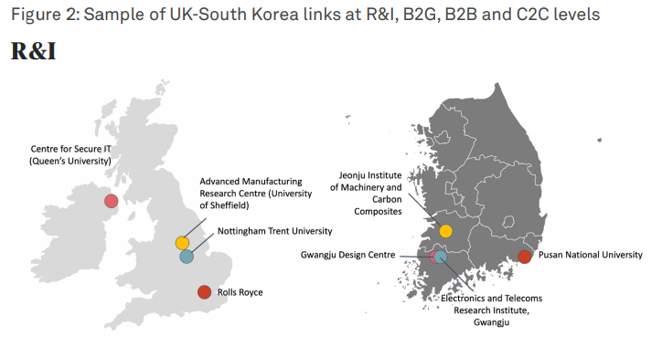
PRIMARY
RECOMMENDATIONS
Cross-Cultural Training:
Implement managed intercultural managerial and employee training in South Korea and the UK. This will facilitate the culture, empathy, and communication to reduce misunderstandings and strengthen teamwork (Samsung Electronics, 2023).
Hybrid Leadership Approach:
Encourage the combination of the Korean respect-based hierarchy and British openness and equality amongst the leaders. This will help Samsung to develop a more agile management culture and contribute to trust, resourcefulness, and efficiency (Samsung, 2024).
Feedback and Dialogue Mechanisms:
Implement periodic feedback and open forums so that employees from both countries can express their opinions freely, which will also contribute to a sense of inclusion, eliminating cultural tension (Kang, 2020).

Slide 9
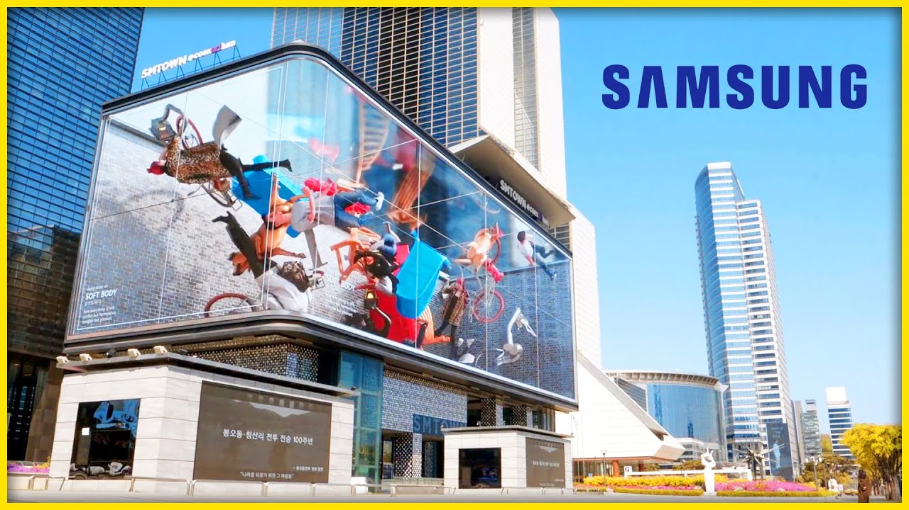
CONCLUSION & IMPLICATIONS
  The Cultural Dimensions Theory by Hofstede can be used to describe the communication and leadership differences between Samsung Korea and Samsung UK.
  These cultural differences can be used by managers to adjust communication, promote inclusiveness, and improve cooperation.
  Intercultural awareness enhances trust, minimizes misunderstanding, and enhances performance globally.
  Successful international leaders are also empathetic and flexible.
  Cultural intelligence can help Samsung transform diversity into innovation, competitive edge, and sustainable global expansion.

Slide 10
REFERENCES
  Chu, A. (2024). As South Korean Investment grows, so Do ‘Koreatowns’. [online] @FinancialTimes. Available at: https://www.ft.com/content/d03d7de9-9b79-4c87-91f7-faab9ba3a245.
  Deresky, H. (2017). International Management: Managing across Borders and Cultures. 9th ed. Pearson.
  Greene, J. (2024). Hofstede’s Cultural Dimensions Theory | EBSCO. [online] EBSCO Information Services, Inc. | www.ebsco.com. Available at: https://www.ebsco.com/research-starters/business-and-management/hofstedes-cultural-dimensions-theory.
  Kang, S. (2020). Workaholism in Korea: Prevalence and Socio-Demographic Differences. Frontiers in Psychology, 11. doi:https://doi.org/10.3389/fpsyg.2020.569744.
  Lee, Y. (2025). Samsung Rides Global AI Boom to Its Biggest Profit since 2022. [online] Bloomberg.com. Available at: https://www.bloomberg.com/news/articles/2025-10-13/samsung-rides-global-ai-boom-to-its-biggest-profit-since-2022.
  McGregor, J. (2024). Samsung Is Giving a New Feature Boost to Millions of Galaxy Phones. [online] Forbes. Available at: https://www.forbes.com/sites/jaymcgregor/2024/02/28/samsung-galaxy-ai-s23-s24-ultra-features-one-ui-61-update/.
  OECD (2023). OECD Reviews of Innovation Policy. [online] Available at: https://www.oecd.org/content/dam/oecd/en/publications/reports/2023/07/oecd-reviews-of-innovation-policy-korea-2023_6517d469/bdcf9685-en.pdf.
www.reallygreatsite.com

