Slide 1
Assignment support

Slide 2
A reflective review of your learning journey through personal development

Slide 3
Your Reflective Assignment
Is specifically about what you have learned from the process of undertaking this module

Slide 4
Assignment Guidance
• Conduct a SWOT analysis on yourself, highlighting your strengths, weaknesses and threats and how you can turn them into your opportunities by looking at appropriate conversion strategies
• At least 2 learning styles questionnaires applied to you
• Applying the GO MAD frame work for yourself
o This would help you identify where you are starting out from – self-awareness!

Slide 5
Assignment Guidance
You would: -
Identify any barriers to your learning and development and…
How you would overcome them! What support is available?
This would demonstrate awareness and planning!

Slide 6
Assignment Guidance
Now, how would you develop you, and address the development needs?
What learning & development options and interventions are available? (consider learning preferences here!)
What support mechanisms are available to you?
Prepare a PDP to achieve at least one (3) key learning objective for yourself How would you monitor development

Slide 7

How

Slide 8
A Definition
Reid (1993) noted that reflection is an active, rather than passive, process, claiming that:
Reflection is a process of reviewing an experience of practice in order to describe, analyse, evaluate, and so inform learning about practice.
Reid, B. (1993) ‘But we’re doing it already’ Exploring a response the concept of reflective practice in order to improve its facilitation.’ Nurse Education Today 13: 305-309.

Slide 9
Why Reflect?
‘It is not sufficient simply to have an experience in order to learn. Without reflecting upon this experience it may quickly be forgotten, or its learning potential lost. It is from the feelings and thoughts emerging from this reflection that generalisations or concepts can be generated.
And it is generalisations that allow new situations to be tackled effectively.’
(Gibbs, 1988)

Slide 10
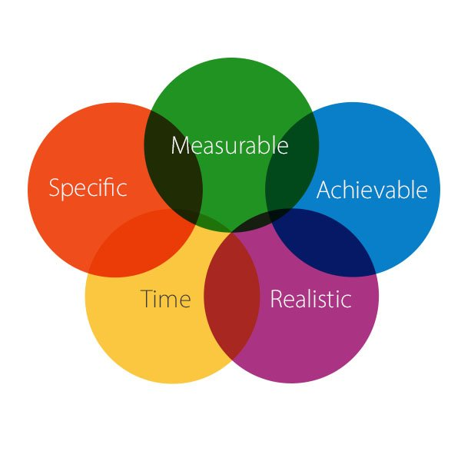
Setting Personal/Business Goals
SMART OBJECTIVES
S = Specific
M = Measurable
A = Achievable (Agreed)
R = Realistic (Relevant)
T = Time bound

Slide 11
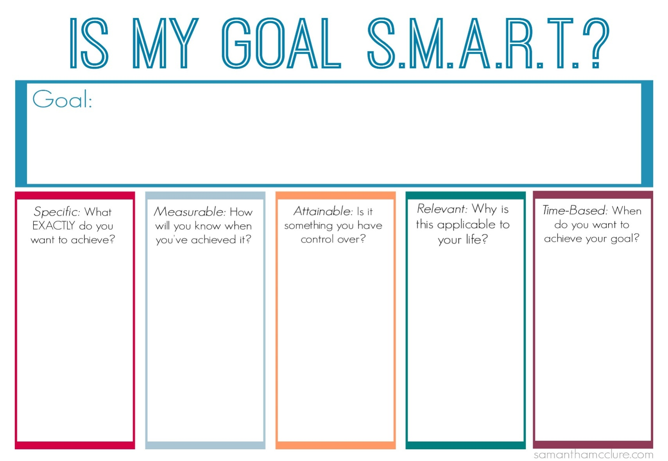

Slide 12
Learning Logs
The log helps you record your learning experience - it is the Learning Cycle put into practice!
Write a running summary of what you have learned in the session
Reflect and draw conclusions on what you have learned - list learning points
Plan how to implement the point you have learned and when you expect to do it (Remember to set a SMART objective)

Slide 13
Self assessment – Skills Audit
Organisational developments
competencies
Work itself
Demands of current post
Reflection
Aspiration/ dreams
Feedback form others
Notes:
Developing ‘extraordinarily realistic self-image (ERSI)’ – Inglis 1994 – so you know where you are at the beginning of the journey
Refelction – in our view crucial skills required for our development through refection of own abilities
Feedback – useful to check our capacity and might prvide us with food for thought – another means of feed back is psychometric & Self diagnostic questrionnres about ourselves and can leed to a slef insight and compare ourselves to others.
Organisational – its about functional or leadership competencies are an attempt to influence us by our employers with a view to working according to their strategic direction.
Work Itself – is an immediate emergency that encourages us to take action – a pressing problem that needs us to take an immediate action or we might not achieve our target.

Slide 14
SWOT Analysis
STRENGTHS
What advantages do you have that others don't have ?
What do you do better than anyone else?
What personal resources can you access?
What do other people (and your boss, in particular) see as your strengths?
Which of your achievements are you most proud of?
What values do you believe in that others fail to exhibit?
Are you part of a network that no one else is involved in?
Do you have connections with influential people?
Notes:
STRENGTHS
What advantages do you have that others don't have (for example, skills, certifications, education, or connections)?
What do you do better than anyone else?
What personal resources can you access?
What do other people (and your boss, in particular) see as your strengths?
Which of your achievements are you most proud of?
What values do you believe in that others fail to exhibit?
Are you part of a network that no one else is involved in? If so, what connections do you have with influential people?
Consider this from your own perspective, and from the point of view of the people around you. And don't be modest or shy – be as objective as you can.
And if you have any difficulty with this, write down a list of your personal characteristics. Some of these will hopefully be strengths!
Tip:
Think about your strengths in relation to the people around you. For example, if you're a great mathematician and the people around you are also great at math, then this is not likely to be a strength in your current role – it may be a necessity

Slide 15
SWOT Analysis
WEAKNESS
What tasks do you usually avoid?
What do you and the people around you see as your weaknesses?
Are you completely confident in your education and skills training? If not, where are you weakest?
What are your negative work habits?
Do you have personality traits that hold you back in your field?
Are you restricted in how far you can travel to work?
Notes:
WEAKNESSES
Again, consider this from a personal/internal perspective and an external perspective. Do other people see weaknesses that you don't see? Do co-workers consistently outperform you in key areas? Be realistic – it's best to face any unpleasant truths as soon as possible.

Slide 16
SWOT Analysis
OPPORTUNITIES
Is your industry/sector growing?
Do you have a network of strategic contacts to help you, or offer good advice?
What trends do you see and how can you take advantage of them?
What new technology can help you?
Are any of your competitors failing to do something important?
Is there a need in your company, industry or sector that no one is filling?
Do your customers, internal or external, complain about something in your company? If so, could you create an opportunity by offering a solution?
Notes:
OPPORTUNITIES
Also, importantly, look at your strengths, and ask yourself whether these open up any opportunities – and look at your weaknesses, and ask yourself whether you could open up opportunities by eliminating those weaknesses.
THREATS
Performing this analysis will often provide key information – it can point out what needs to be done and put problems into perspective

Slide 17
SWOT Analysis
THREATS
What obstacles do you currently face at work?
Are any of your colleagues competing with you for projects or roles?
Is your job (or the demand for the things you do) changing?
Does changing technology threaten your position?
Could any of your weaknesses lead to threats?

Slide 18
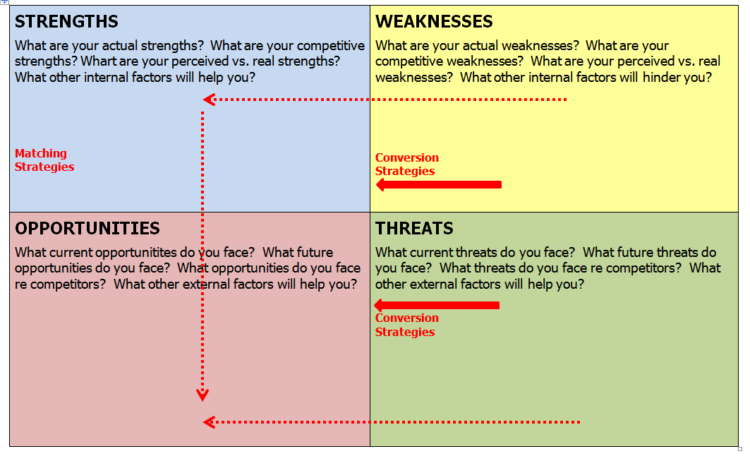
Next Steps – conversion strategies
Notes:
Turn your weaknesses into strengths, build upon your strengths. Negate or reduce your threats, turning them into opportunities. Match your strengths to the opportunities.

Slide 19
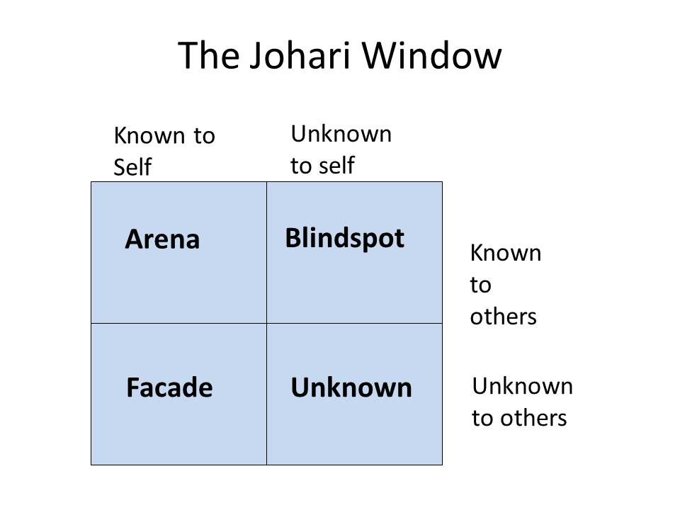
The Johari Window (Luft and Ingham, 1955)

Slide 20

Go Mad
Gilbert, A. and Chackrovaity, I. (2001) “Go Mad: about coaching”. Bath. Bath Press
Notes:
Andy Gilbert and Ian Chakrvorty developed the Go Mad Thinking model System with the book originally published in 1999
Andy is managing director of Go Mad research and consultancy company – works to help businesses improve by helping them to transform their leadership thinking.
Ian a maths teacher – took leave to help develop this thinking model – and is now also working on designing an delivering this programme in coaching and leadership.

Slide 21
Take Action Measure Results & Personal Responsibility
Involve Others
Self Belief
Self Belief
Pp
Personal Responsibility
Check
Achievability
Buy-in
Task
Reasons Why
Define Goals
Plans & Priorities
Strengths
Importance
Notes:
SITBAC
Strength – strong reason (Goal)
Importance – Important to Plan and prioritise
Tasks – Possible tasks to undertake and people to involve with assisting in completing tasks
Buy in – convincing people to buy into your plan – so they also buy into your goal
Achievability – how achievable do you believe your goal is, with time scales in mind, the knowledge you currently posses along with confidence and resources available to you.
Check – Maintain high level of self belief an why – without either it wont work

Slide 22

Myer Briggs Personality Profiling
VARK
Honey & Mumford
Implications for learning& for training
Overview of learning styles

Slide 23
Honey & Mumford (1992)
Activist/ Experience
Reflector/ Reflection and review of experience
Theorist/ conclusions
Pragmatist/ planning
Honey & Mumford (1986) suggest
that there are 4 types of learners:
Activist
Reflector
Theorist
Pragmatist
http://www.peterhoney.org/articles/who-are-honeymumford
Notes:
Honey and Mumpherd (1992) identified that people have different innate learning preferences closely related to Kolb's thinking/ reflective cycle.
Research conducted by Honey and Mumpherd Suggest that some people are better at learning experience (activist) other learn better by reflection (Reflectors), others by developing own ideas preferring theoretical input (theorist) and others like take information and plan for the future and asks ‘what ifs’ (Pragmatists).

Slide 24
Application of learning styles to University
Activist (Active learning, workshops, exercises, Presentations, Group Works, Exams, Practice Assignments, Case Studies)
Reflector (Feedback lecturer/ Peers/ Work)
Theorist( Lectures, books, Tutorial, Discussions, Assignments, Journals, Mind-maps, research)
Pragmatist (Action Planning, Group Discussions, Project Assignments)

Slide 25
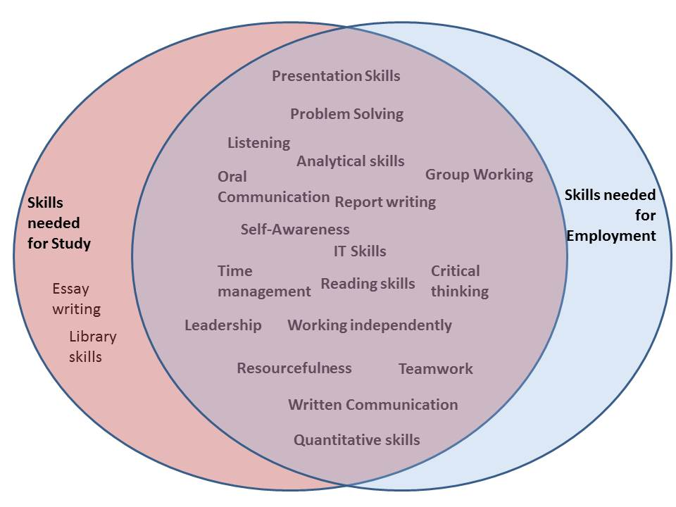
Overlap of ‘Study Skills’ & ‘Employability Skills’

Slide 26

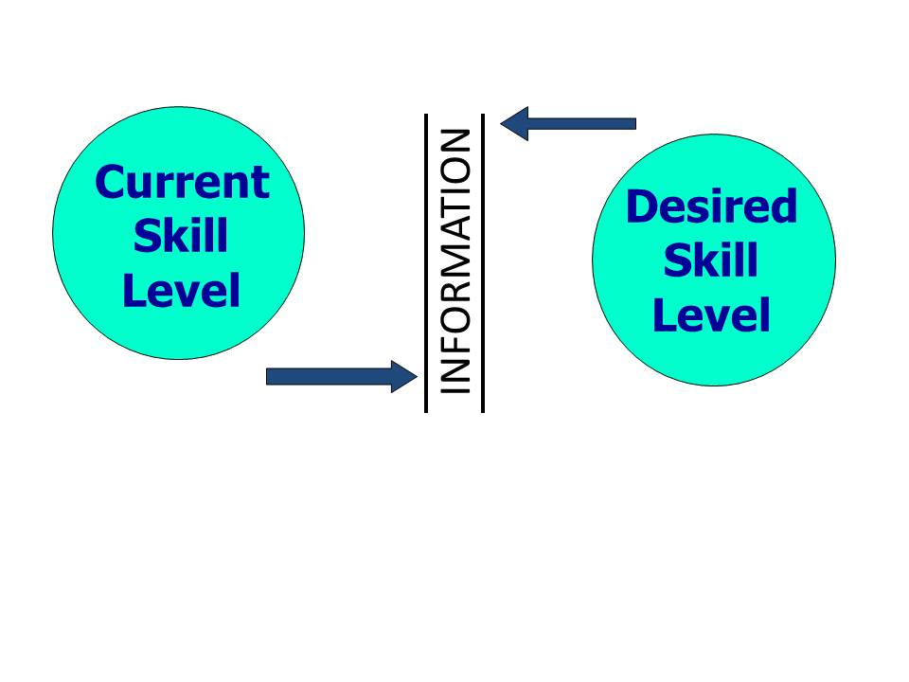
Identifying the gap between your current skills and your desired skill level:

Slide 27
Steps in the Development of Personal Skills (Cont.)
STEP 1: Decide what you need to develop
  Subjective Information
  Johari Window
  Gathering Objective Information
STEP 2: Decide how to develop these skills
Model 1: The Kolb Learning Cycle

Slide 28
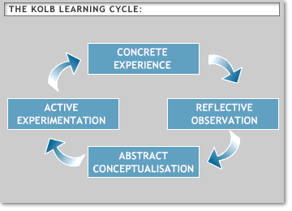
Kolb’s Learning Cycle - Revisited
Notes:
David Kolbs experiential model of learning (KOLB, 1984) related to learning and development programmes.
Its based on individual’s having and thinking about their experience rather than just absorbing theory.
Basic principal is learning a new skill we go through 4 activities in a cycle

Slide 29
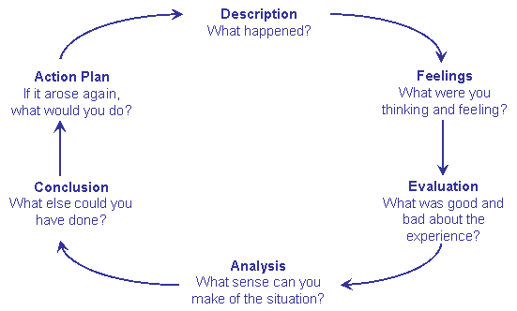
Gibbs Cycle of Reflection (1988)

Slide 30
Stages of Skill Development
Conscious Competence
Conscious Incompetence
Unconscious Competence
Unconscious Incompetence

Slide 31
What is an Objective?
An objective is a clear statement
about what is to be achieved and what the end result will look like.
It contains:
  an active verb (e.g. to plan, to ensure, to prepare, to maintain)
  an outcome (e.g. an increase in sales, a new product, a safe environment)
  success indicators that are SMART (i.e. specific, measurable, achievable, realistic, time-bound)

Slide 33
Assignment guidance
• How would you monitor development (timed progress reviews) – for yourself

