Slide 1

Emerging Trends
By
Steph, Sam, James and Aaron

Slide 2
Team-working & organization
Office 365 - OneDrive Shared Documentation
 | Steph | Sam | James | Aaron
Written Tasks | Methodologies Minute Meetings Change Management Secondary Research Evaluation of Sources Questioning Strategies Critical Evaluation Chatbot Questions | Aims & Objectives Gantt Chartt Research Progress Data Types Secondary Research Reflection | Resources Deliverables Design Secondary Research Questioning Strategies Primary Research Analysing & Presenting Data Development | Scope Risks Stakeholders Quality Management Secondary Research Chatbot Questions
PowerPoint Tasks | Evaluation | Research Progress | Project Planning | Project Inception
Notes:
We all worked on a shared folder
We had our own individual tasks which we worked on a shared word document with each task wrote in detail
We then split the PowerPoint presentation slides between us where we put what was necessary into each slide using the details from the word document

Slide 3
evaluation

Slide 4
Critical evaluation
Chatbots:
Advantages | Disadvantages
Available at all times | Malfunction / downtime
Helps search for information | Sound mechanical, cannot interact as a human
Relevant communication channel for students enrolling | Not able to memorize a conversation already had
Actively provides information | Not personalized or emotive
May reduce the risk of losing potential students | Higher capacity for misunderstanding
Can answer questions | May not be able to answer all questions
Notes:
A: Even in the nights as well as weekends, it is there for the students. A chatbot can handle a large quantity of requests at the same time without being overworked.
A: Students can receive instant answers to their questions, which can solve their problem in a matter of minutes. The chatbot can also assist them in searching internal information and sending them useful content, such as a website link for the different courses available. It saves the student time and gives a stress-free experience when looking for information.
A: A chatbot can provide proactive assistance and guide the user through the enrolling process. According to Stephanie's research "A survey by Intercom came to the conclusion that companies were able to increase their sales by 67 percent with the help of a chatbot." [9]
D: Because chatbots are unable to remember previous conversations, users are forced to repeatedly type the same thing. This can be irritating for the student due to the effort involved. [10]
D: Misunderstanding and not being able to answer all questions makes the chatbot sound robotic. A chatbot's personality has a significant impact on the user experience and is a key aspect in how the user views the conversation. If a discussion deviates from a predetermined course, the bot will be unable to improvise lacking the human touch, which can result in a disappointing experience.
[9, 10 & 11]

Slide 5
Critical evaluation
Chatbot Development:
Advantages | Disadvantages
Allowed for our vision | Time-consuming
Any framework | Little research
Any API | Platform used
Useful tools | Deadline date
Privacy and Security | Flexibility
Notes:
A: The chatbot was able to be developed exactly how it was intended to look and function due to it being built from scratch.
A: It was possible to develop the chatbot using any framework and API, in this case, node.js and discord.js were chosen. Choosing the right platform tools is critical because it can improve the chatbots' efficiency.
A: Because of the various tools included, the discord.js API proved to be extremely useful in making the chatbot sound as human as possible.
A: The privacy and security were able to be managed too in terms of the information that the chatbot would be exposed to. Although, developing the chatbot not to store any data on users due to GDPR reasons made it harder to develop.
D: A lot of time was consumed to develop the chatbot to get it right due to developing it from scratch with little research found to help towards the development.
D: Due to the platform used, it states next to the discord profile that it is a bot, with no option of being able to remove it.
D: With only a few months to complete the chatbot, features had to be simplified or eliminated in order for it to be ready on time, such as allowing the user to select what enrolment section they want to move onto next.
D: Getting the chatbot to read the text files and respond with the correct answer, as well as reading and storing the text files in the intended manner to interact with the message query code that was built, proved challenging. For example, checking to see if the user has asked a question, if the question included a course and if that course was actually known by the bot.
Initially, the usage of chatbots was viewed as a way to reduce human work. Despite the fact that various challenges have occurred in relation to the core idea that robotics would never be able to replace people, misconceptions and a lack of personalization with no emotions have arisen. On the other hand, chatbots can relieve human workload, decrease stress, and assist students in enrolling in a course at any time and day as long as the information is basic enough for the chatbot to comprehend. If chatbots are correctly developed and executed, they can be used to increase user engagement and deliver a positive user experience between humans and the field they serve.
[11, 12 & 13]

Slide 6
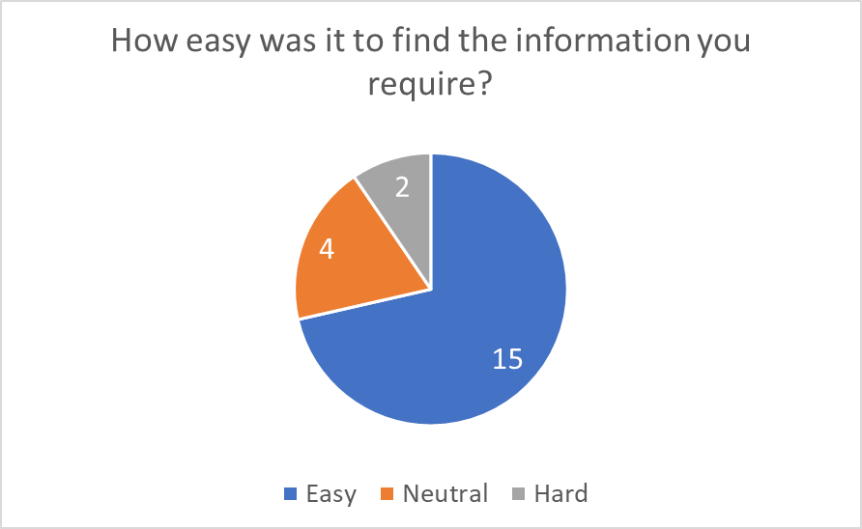
Analyzing and presenting data
Notes:
15 out of 21 found the bot easy to use
4 out of 21 found it neither easy nor difficult
2 out of 21 found it difficult
The most popular response was that some areas of information provided by the bot could provide more detail, such as the steps required to upload an image

Slide 7
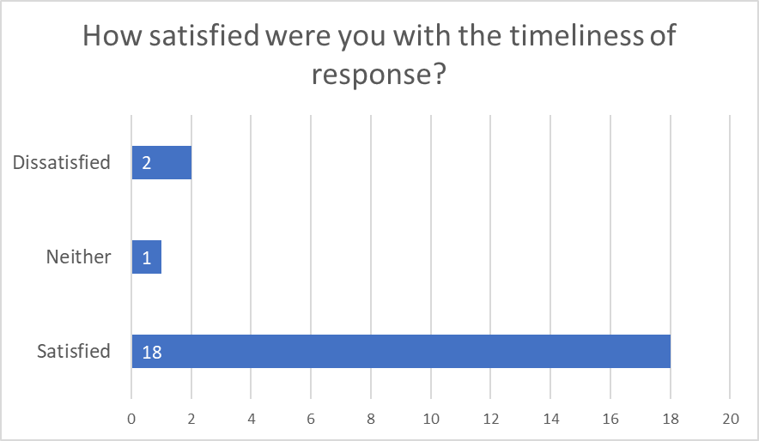
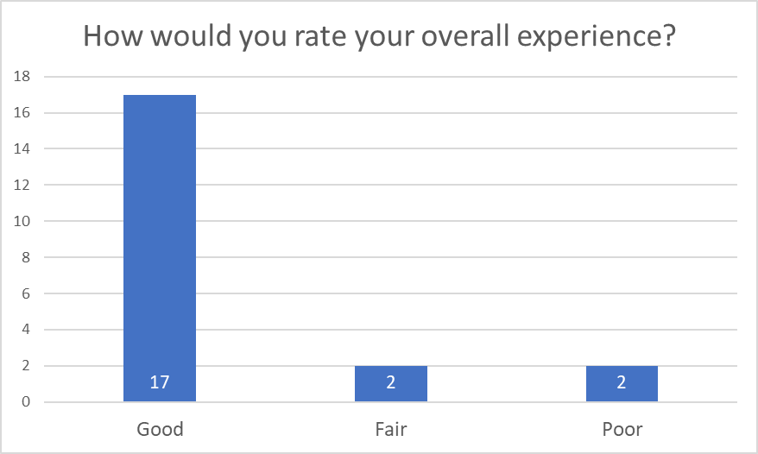
Analyzing and presenting data
Notes:
18 out of 21 were satisfied
1 out of 21 was neither satisfied nor dissatisfied
2 out of 21 were dissatisfied
17 out of 21 had a good experience
2 out of 21 had a fair experience
2 out of 21 had a poor experience
The majority of participants felt that the bot could be improved slightly. However, they did like how the bot acted like a human with the indication of them typing with a response

Slide 8
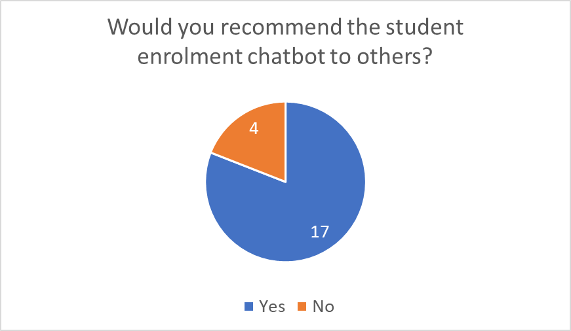
Analyzing and presenting data
Notes:
17 out of 21 would recommend the bot
While 4 out of 21 would not
The bot was considered to be extremely straightforward to use, access, and obtain information by the majority of respondents, although it does require more refinement in areas such as the response details.

Slide 9
Analyzing and presenting data
Slight adjustments needed
Human-like
Notes:
According to the findings, based on the little data, it can be presumed that the bot functions as planned, with slight adjustments needed to have it suitable for deployment, such as providing additional detail in areas where the user must upload documentation.
Also from the findings, the bot appeared human-like to the user due to the dots displayed to indicate that the bot is typing a response.

Slide 10
reflection
Primary and secondary research
Costs
Satisfaction
Team members contribution
Limitations
Notes:
The primary and secondary research conducted, provided vital information on the effectiveness of our proposed technology.
The chatbot designed, implemented and tested has shown evidence of being an effective solution in cost cutting measures for the university due to a lesser strain on resources as students interact with an AI.
There is also evidence suggesting that students at the university were satisfied with the interactions between themselves and the chatbot. Students were also likely to recommend the chatbot to other students.
Fair team member contribution and the implementation of time management tools allowed effective communication between team members when issues occurred throughout the project such as an absence.
Due to limited time constraints, only one form of primary research was conducted throughout the project research (questionnaire). If time permitted, another form of primary research such as interviews or focus groups could have been implemented to provide further detail to either dispute or confirm our previous findings.

Slide 11
references

Slide 12
References Used
9. The 10 Most Important Benefits Of Chatbots For Companies And Users. AI Chatbot Platform from Onlim. 2020. [accessed 1 Jan 2022] Available from: https://onlim.com/en/benefits-of-chatbots-for-companies-and-users/
10. Nation E. Chatbots: Advantages and Disadvantages of these Tools. E-Commerce Nation. 2018. [accessed 1 Jan 2022] Available from: https://www.ecommerce-nation.com/chatbots-advantages-and-disadvantages-of-these-tools/
11. Veglis A. Chatbots on the Rise. Theodora-maniou.com. 2019. [accessed 6 Jan 2022] Available from: http://www.theodora-maniou.com/wp-content/uploads/2019/05/Veglis-Maniou_Chatbot.pdf
12. Ahmad N. Review of Chatbots Design Techniques. researchgate. 2018. [accessed 6 Jan 2022] Available from: https://www.researchgate.net/profile/Nahdatul-Akma-Ahmad/publication/327097910_Review_of_Chatbots_Design_Techniques/links/5b77cf3e4585151fd11cd905/Review-of-Chatbots-Design-Techniques.pdf
13. Feine J. Designing Interactive Chatbot Development Systems. researchgate. 2020. [accessed 6 Jan 2022] Available from: https://www.researchgate.net/profile/Stefan-Morana/publication/344412598_Designing_Interactive_Chatbot_Development_Systems/links/5fb7877092851c933f430590/Designing-Interactive-Chatbot-Development-Systems.pdf

