Slide 1
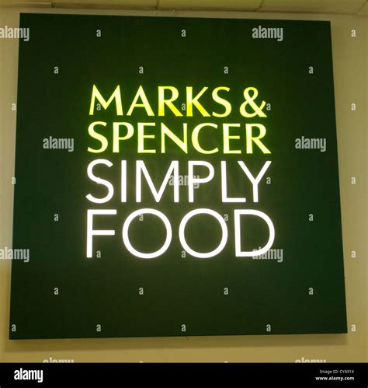
M&S FOOD'S ENGAGMENT WITH DIGITAL AND SOCIAL MEDIA
Iustina Mirela Rusei
01/12/2025
https://sl.bing.net/eWVNWyq2ZZk

Slide 2
Presentation overview
Defining digital marketing in CRM
Benefits and Risks of digital marketing
Social Media in CRM
Digital Marketing Tools used by M&S Food

Slide 3
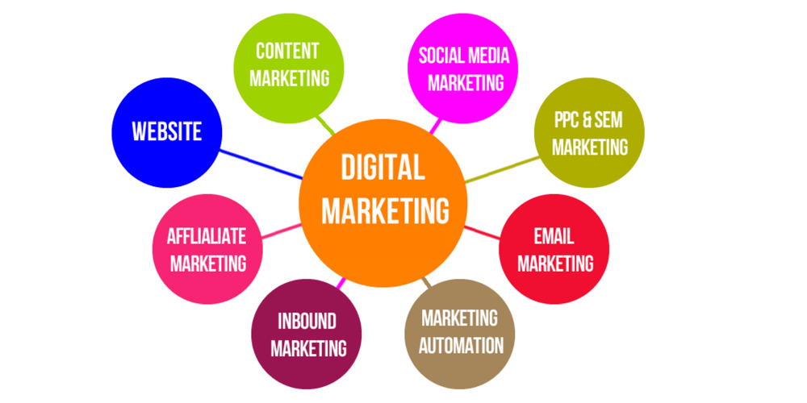
Digital Marketing
“Digital marketing refers to the use of digital technologies to promote and distribute products or services through various channels including websites, social media, mobile applications, and search engines”(Dastane, 2020).
ThePhoto by PhotoAuthor is licensed under CCYYSA.

Slide 4

Customer Relationship Marketing (CRM)
“CRM is a strategic approach that uses people, processes, and technology to build and manage customer relationships for long-term value.”(Buttle, Maklan and Prior,2024)
ThePhoto by PhotoAuthor is licensed under CCYYSA.

Slide 5
The importance of Digital Marketing for CRM
Personalisation & Loyalty - digital marketing enables personalised customer journeys, boosting satisfaction and loyalty.(Hoque & Hasanat, 2019)
Real-Time Engagement - with two-way interactions, it help brands respond quickly to customer needs.(Sheridan, 2019)
Strategic Integration - digital CRM is a business strategy that turns customer data into personalised experiences and informed decisions.(Buttle et al., 2024)
Competitive Advantage - when integrated with CRM, digital tools help create a clear edge in customer engagement.(Ziarani & Janpors, 2023)

Slide 6
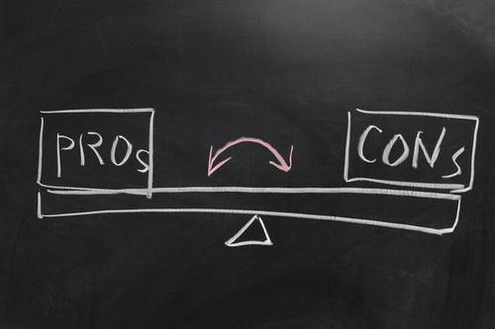
Benefits and Risks of Digital Marketing in Organisations
ThePhoto by PhotoAuthor is licensed under CCYYSA.

Slide 7
The benefits of Digital Marketing
Customer Insight & Personalisation gives businesses access to real-time data and customer behaviour insights, tailored individually.(Chaffey and Ellis-Chadwick, 2019)
Cost Efficiency & ROI better than traditional marketing and allows precise targeting.(Tiago and Veríssimo, 2014)
Global Reach & Speed with digital tools, brands can reach global audiences faster and with less resources.(Ryan, 2016)
Two-Way Interaction & Engagement it enables open dialogue between brands and customers, building stronger relationships and trust over time.(Buttle et al., 2024)

Slide 8
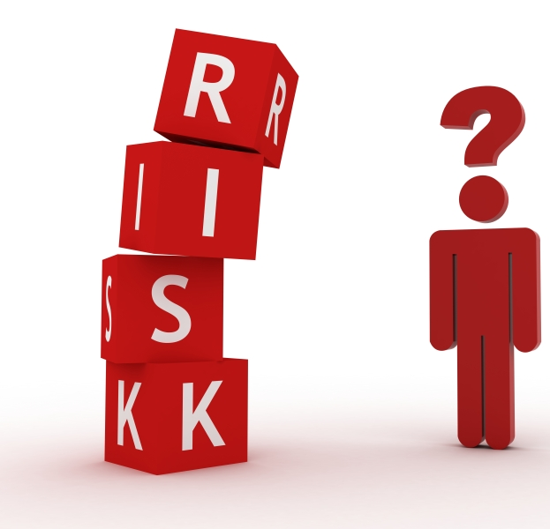
Information Overload
“Digital media magnifies the impact of brand missteps through viral user reactions, forcing companies into damage control”
(Kapoor et al., 2021).
Too much digital content can overwhelm audiences, leading to disengagement and loss of interest.
(Ziarani and Janpors, 2023)
Pepsi’s ad in 2017 featuring Kendall Jenner aimed to align with social justice themes but was widely criticised for appearing to minimize serious issues. After the backlash on social media the company withdraw the ad shortly after being released.
ThePhoto by PhotoAuthor is licensed under CCYYSA.

Slide 9
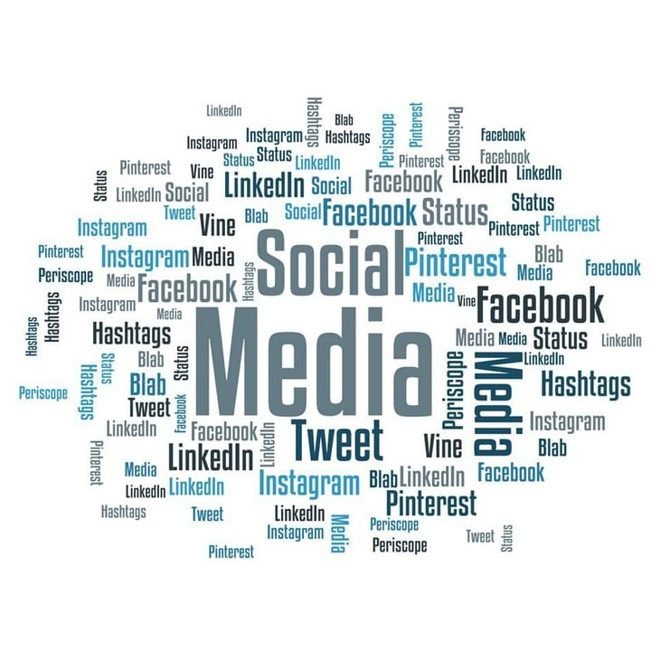
Social Media in CRM
"Social media are interactive platforms that facilitate digital content creation, real-time communication, and community-building between individuals and brands.”(Alalwan et al., 2024)

Slide 10
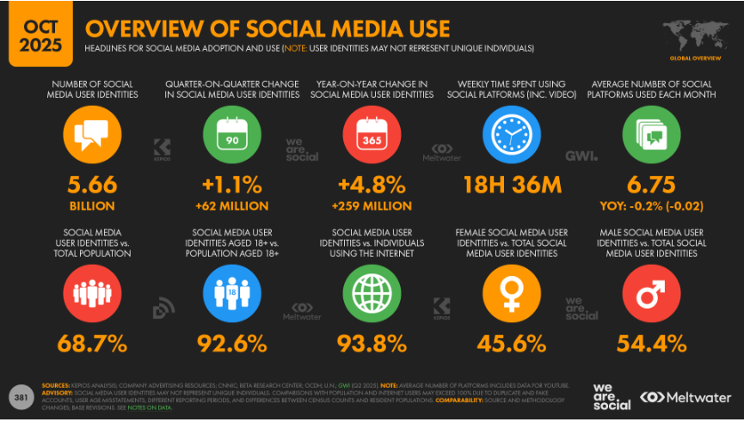
Over 5.6 billion people with nearly 69% of the global population now use social media, with 259 million new users added in the past year.(We Are Social and Meltwater, 2025)

Slide 11
The benefits of Social Marketing
Partnering with Influencers - to reach specific audiences, especially on TikTok and Instagram.
Short form Video - creative videos on platforms like Reels and TikTok are now key tools for brand storytelling.
Content by Customers, for Customers - more brands are encouraging user-generated content, helping build trust and authenticity.
AI for Customer Service - Chatbots are handling DMs on Instagram and Facebook, offering instant answers and product help.
Hashtag Campaigns to Drive Buzz - hashtags are still powerful for getting people involved and spreading brand messages across networks.
(We Are Social andMeltwater, 2025)

Slide 12

Social Media Backfires
ThePhoto by PhotoAuthor is licensed under CCYYSA.
Dolce & Gabbana China campaign 2018 faced a social media backlash by releasing an ad with a Chinese model struggling to eat Italian food with chopsticks. While the ad was meant to be playful, it was seen as culturally insensitive and stereotypical.

Slide 13

ThePhoto by PhotoAuthor is licensed under CCYYSA.
Social media backlash was immediate not only in China but worldwide.
Influencers and celebrities denounced the brand.
Major e-commerce sites in China (e.g., Alibaba, JD.com) removed D&G products.
The brand was forced to cancel its Shanghai show and issue a public apology.
Why it failed?
Lack of cultural awareness, tone-deaf content, and poor crisis handling turned a marketing campaign into a PR disaster.

Slide 14
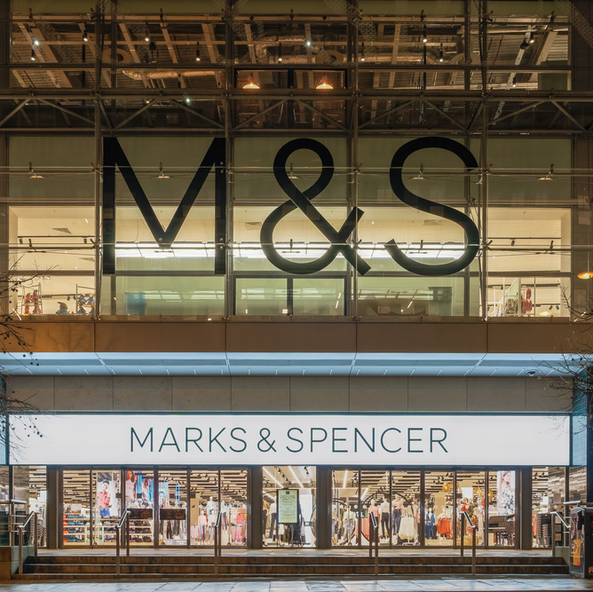
Digital Marketing Strategy at M&S Food

Slide 15
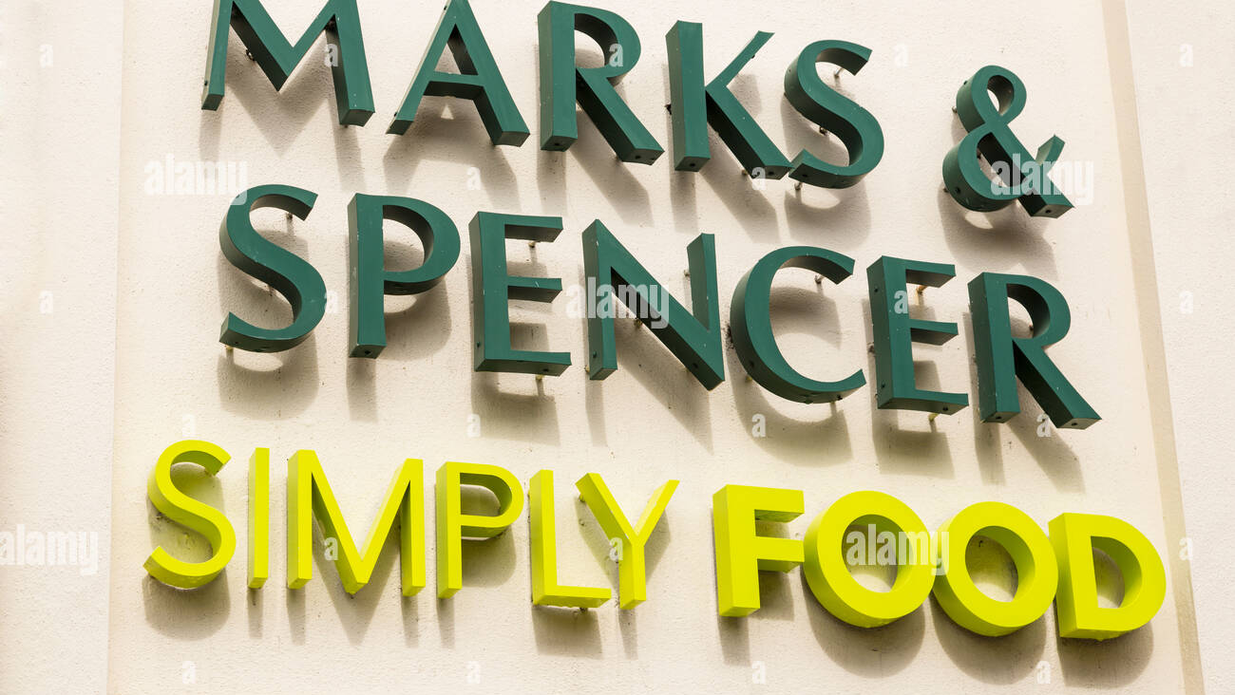
From Data to Loyalty: M&S Food Digital Approach
M&S Food uses digital marketing to boost performance, connect with customers, and build loyalty. It personalises content and offers using data from the Sparks app, social media, and customer behaviour. M&S also uses digital tools to share stories, promote sustainability, and build emotional ties with its audience.

Slide 16
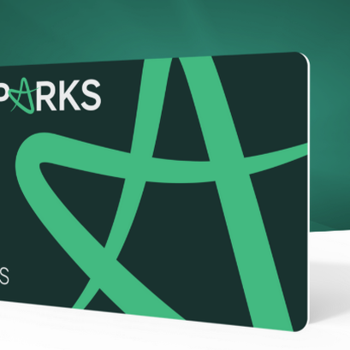
Digital Marketing Tools at M&S
Sparks Loyalty App
Offers personalized discounts and rewards based on past purchases (Marks & Spencer Group, 2025a)
Customer Relationship Impact: Tailors product offers, discounts, and rewards based on customer behavior.
Effectiveness: Over 16 million customers are registered, contributing to a 20% increase in loyalty-led purchases (Marks & Spencer Group, 2025a)

Slide 17
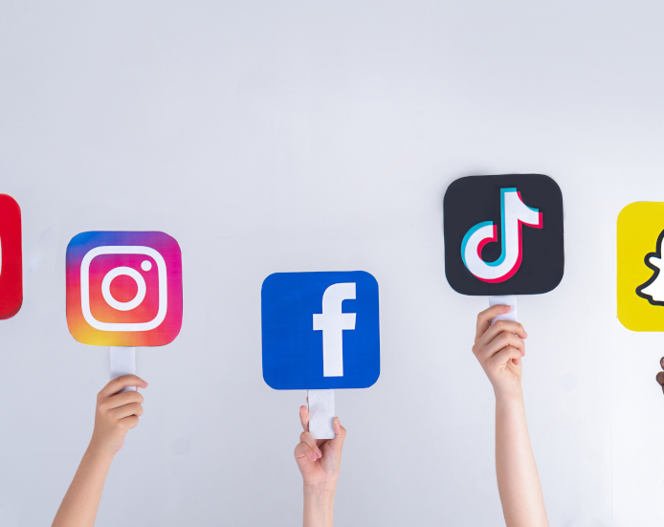
Digital Marketing Tools at M&S
Social Media Platforms
Instagram, Facebook, TikTok used for food trends, behind-the-scenes content, recipes
Campaigns like “#MyMarksFave” invite user participation(Econsultancy, 2023)
What It Does: Encourages users to share their favorite M&S meals.
CRM Benefit: Co-creation deepens customer involvement with the brand.
Effectiveness: High engagement rates on Instagram and TikTok, particularly among Gen Z audiences (Econsultancy, 2023).
Emotional engagement is enhanced, but campaign lacks strong cross-channel follow through.

Slide 18
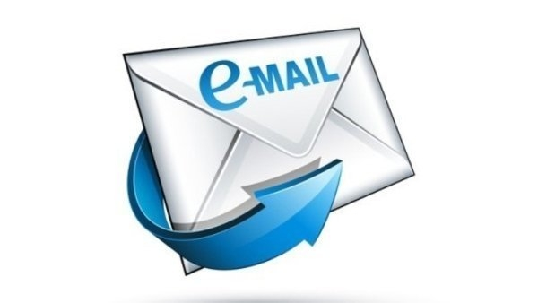
Digital Marketing Tools at M&S
Email Marketing & Push Notifications
Personalised weekly deals and seasonal product launches
Notifications linked to store proximity and shopping habits
What It Does: Sends weekly meal deals and in-store event updates.
CRM Value: Keeps M&S top-of-mind with timely, relevant offers.
Effectiveness: 27% open rates, above retail average (M&S, 2025a).
Still depends heavily on opt-in behaviour, could be enhanced through AI-driven scheduling.

Slide 19
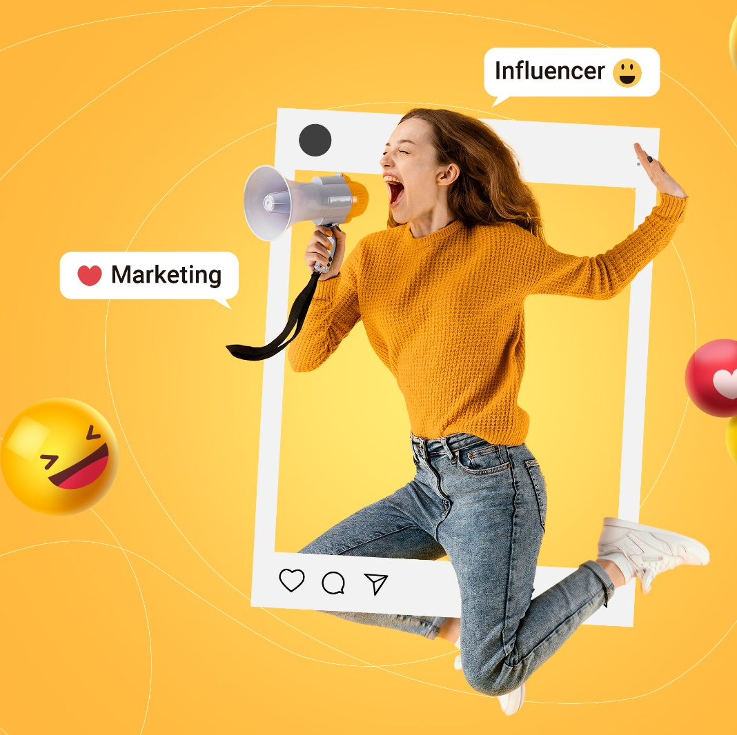
Digital Marketing Tools at M&S
Content Marketing
Offers daily inspiration linked to M&S products.
CRM Role: Reinforces utility-based value beyond purchase.
Effectiveness: Users reportedly spend more time in-app exploring meal solutions (M&S, 2025a).
Influencer Collaborations
Strategic partnerships with food bloggers and lifestyle influencers
Intended for a younger audience that’s active online

Slide 20
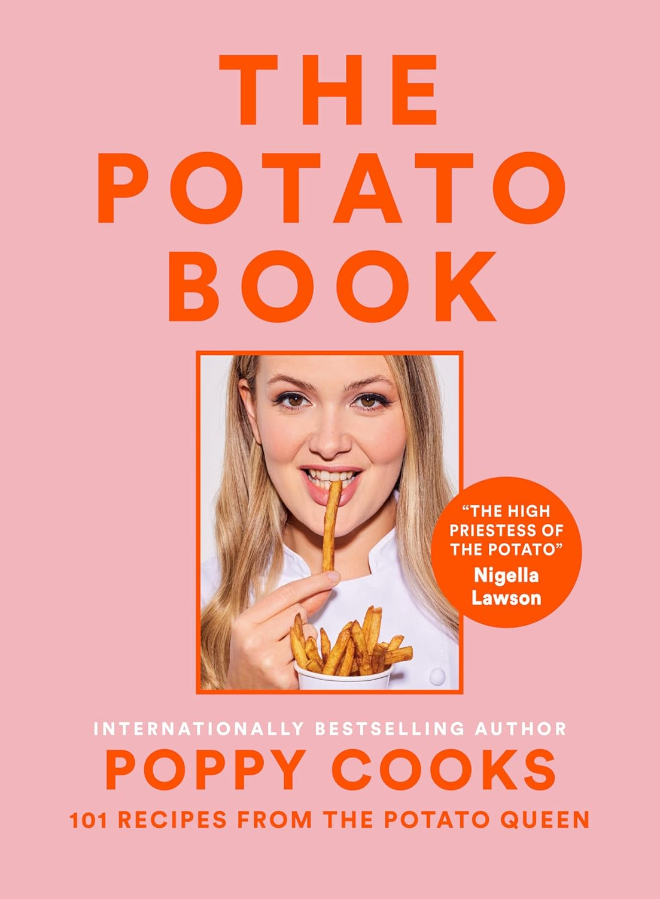


Content Marketing – collabs
1. Poppy O’Toole (@poppycooks)
A Michelin chef and TikTok influencer known for viral potato recipes
Collaborated with M&S to promote seasonal food ranges and air fryer meal inspiration
Campaign featured across Instagram, TikTok, and YouTube
2. Becky Excell (@beckyexcell)
UK’s leading gluten-free food influencer
Partnered with M&S to showcase their expanding gluten-free products
3. The Batch Lady (@thebatchlady)
Known for freezer-friendly meals and meal prepping
Collaborated with M&S to promote family-friendly recipes using M&S ingredients

Slide 21
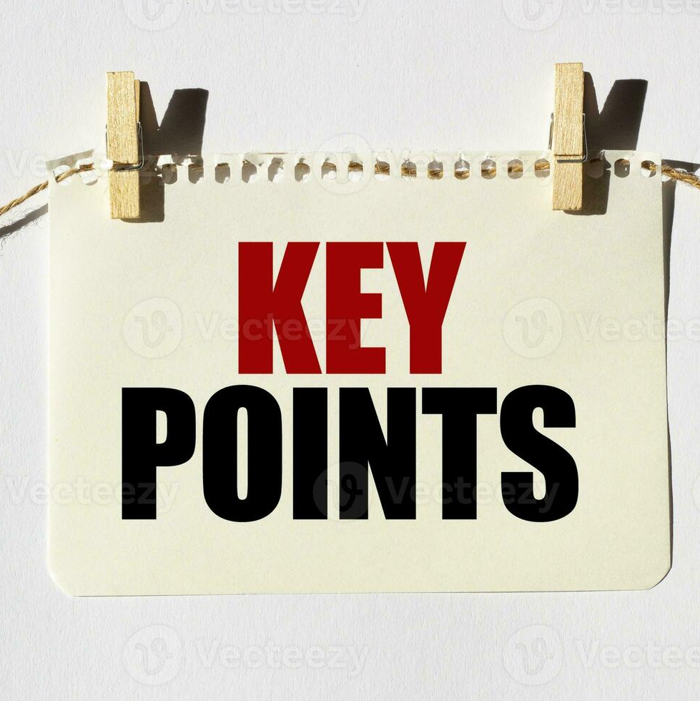
20% increase in app engagement following loyalty upgrades (M&S, 2025a)
Online food orders up by 11% YoY (M&S, 2025a)
High engagement on TikTok and Instagram with seasonal campaigns
“Digital engagement is embedded across all aspects of the M&S Food business from product promotion to post purchase experience” (Marks & Spencer Group, 2025a; 2025b)
While M&S is strong in building loyalty and customer engagement, its digital CRM could do more to actively involve customers in product development and community building (Econsultancy, 2023).
For example, there's no dedicated space like a forum or community hub where customers can share ideas or have ongoing conversations with the brand beyond basic comment sections.

Slide 22
Overall conclusion
Digital marketing plays a key role in CRM, helping M&S deliver personalised, data-driven experiences. (Buttle et al., 2024; Sheridan, 2019)
Social media and mobile tools allow M&S Food to connect emotionally with customers and build loyalty. (Trainor et al., 2014; Econsultancy, 2023)
Tools like the Sparks app, tailored recipes, and promotions boost engagement and enhance the customer journey. (M&S, 2025a) Results show success—from rising online sales to strong social and app engagement.
Still, there are gaps: limited customer co-creation, weak community features, and underused feedback in product development.

Slide 23
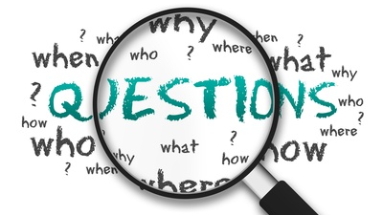
ThePhoto by PhotoAuthor is licensed under CCYYSA.

Slide 24
References list
Alalwan, A.A., Dwivedi, Y.K. and Rana, N.P. (2024) ‘Social media listening and engagement in customer relationship management: A resource-based perspective’, Journal of Business Research, 164, pp. 113125.
Buttle, F., Maklan, S. and Prior, D.D. (2024) Customer Relationship Management: Concepts, Applications and Technologies. 5th edn. London: Routledge.
Chaffey, D. and Ellis-Chadwick, F. (2019) Digital Marketing. 7th edn. Harlow: Pearson.
Dastane, O. (2020) ‘Impact of digital marketing on online purchase intention: Mediation effect of customer relationship management’, Journal of Asian Business Strategy, 10(1), pp. 142–158. Available at: https://www.academia.edu/download/95467619/JABS-2020-101-142-158.pdf
Econsultancy (2023) Marks & Spencer: Inside the brand’s social media innovation. Available at: https://econsultancy.com/marks-spencer-social-media-innovation/ (Accessed: 12 November 2025).
Hoque, A. and Hasanat, M.W. (2019) ‘Effect of customer relationship management in digital marketing for customer satisfaction and loyalty’, International Conference on Business and Economics. Available at: https://www.researchgate.net/publication/336286348
Kapoor, K., Dwivedi, Y.K., Piercy, N.F. and Reynolds, N. (2021) ‘Advancing digital marketing: Theoretical and strategic directions’, Journal of Business Research, 125, pp. 902–912.
Marks & Spencer Group (2025a) Annual Report and Financial Statements 2025. Available at: https://corporate.marksandspencer.com/annualreport2025 (Accessed: 12 November 2025).

Slide 25
Marks & Spencer Group (2025b) ESG Report 2025. Available at: https://corporate.marksandspencer.com/sites/marksandspencer/files/2025-05/Marks-and-Spencer-Group-plc-ESG-Report-2025.pdf (Accessed: 12 November 2025).
Ryan, D. (2016) Understanding Digital Marketing: Marketing Strategies for Engaging the Digital Generation. 4th edn. London: Kogan Page.
Sheridan, M. (2019) They Ask, You Answer: A Revolutionary Approach to Inbound Sales, Content Marketing, and Today’s Digital Consumer. 2nd edn. Hoboken: Wiley.
Tiago, M.T.P.M.B. and Veríssimo, J.M.C. (2014) ‘Digital marketing and social media: Why bother?’, Business Horizons, 57(6), pp. 703–708. https://doi.org/10.1016/j.bushor.2014.07.002
Trainor, K.J., Andzulis, J.M., Rapp, A. and Agnihotri, R. (2014) ‘Social media technology usage and customer relationship performance: A capabilities-based examination of social CRM’, Journal of Business Research, 67(6), pp. 1201–1208.
We Are Social and Meltwater (2025) Digital 2026: Global Overview Report. Available at: https://wearesocial.com/uk/blog/2025/10/digital-2026-global-overview-report/ (Accessed: 25 November 2025).
Ziarani, M.R. and Janpors, N.N. (2023) ‘Effect of digital marketing on customer behavioural intentions with the mediation of CRM’, SSRN Electronic Journal. Available at: https://papers.ssrn.com/sol3/papers.cfm?abstract_id=4320387

