Slide 1

Cultural Beliefs and Attitudes Towards Children with Down Syndrome in the Somali Community in the UK.
Name: Maryan Mohamed (2029256)
Name of Lecturer: Oluwadamilola Tayo
Module: Practice- Based Research.
Module Code: (LCHS7008)
Component 1

Slide 2
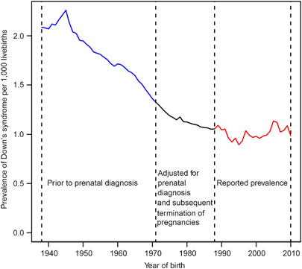
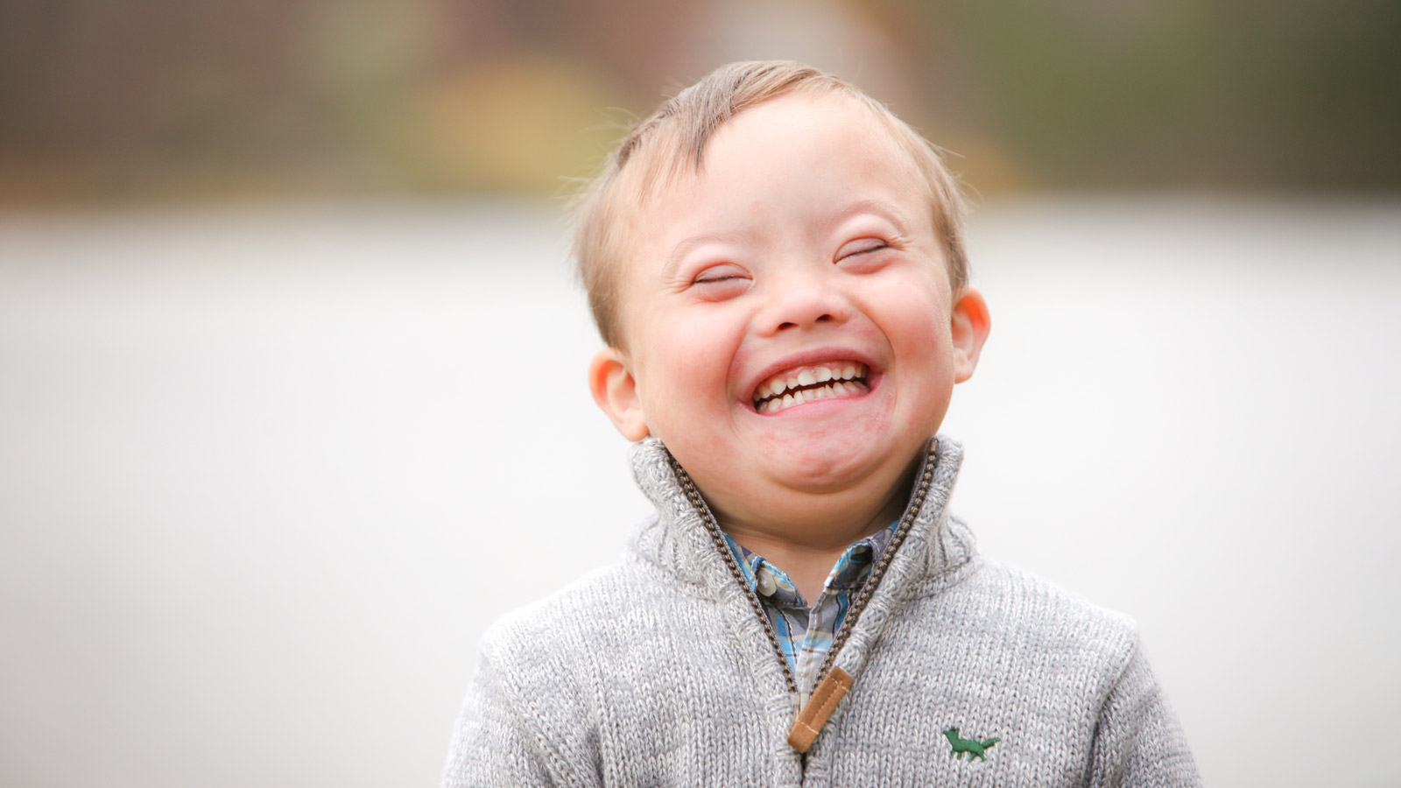
Cultural Beliefs and Attitudes Towards Children with Down Syndrome in the Somali Community in the UK.
Introductions
An extra copy of chromosome 21 causes Down syndrome, a genetic disorder that lasts a lifetime and can result in learning impairments and levels of intellectual and physical development (NHS, 2025).
According to studies shown, cultural beliefs and attitudes can have a significant impact on how disability is perceived and experienced in various cultures (GOV.UK, 2025).
Prevalance
About 1 in every 1000 births in the UK has Down syndrome, the most prevalent chromosomal disorder (NHS, 2023).
Around 700-800 babies are born with Down Syndrome each year in the UK ( PMC, 2023).
There is limited research on Down syndrome, specifically within the UK population. However, research indicates that among ethnic minority communities, diagnosis, access to treatment, and family experiences may be impacted by cultural views, stigma, religious interpretations, and ignorance ( PMC, 2025).
Understanding the prevalence of these perspectives can help the healthcare professionals maintain more culturally sensitive care (PMC, 2023).
Rationale for the Research
Families' and communities' understanding and acceptance of disability may be influenced by cultural and religious beliefs (PMC, 2006).
These ideas may have an impact on family support, education, early intervention, and healthcare access (PMC, 2024).
The cultural beliefs and the religious values may influence how the chosen disability is understood and accepted within the family members and communities (Krahn, Walker, and Corre-De-Araujo, 2015).
Research questions
What are the cultural beliefs and attitudes towards children with Down Syndrome within the Somali Community?
How do religion and culture influence these beliefs?
What barriers do Somali family members experience when accessing healthcare support?
Image from journal of Perinatology, 2026)
Aims
The research aims to explore cultural beliefs about Down Syndrome within the UK Somali community.
Research Impact
Enhance culturally sensitive medical practices (PMC, 2025).
Educate the Somali community about Down Syndrome ( PMC, 2025)
Educate legislators and medical experts (Down Syndrome Association, 2022)
Encourage services for inclusive healthcare and education (NHS, 2023)
Objectives
To determine attitudes towards children with Down Syndrome among the members of the Somali Community (PMC, 2024).
To identify the disadvantages or barriers that Somali families face when accessing healthcare, education, and support services (PMC, 2026).
To give out recommendations about culturally sensitive practices in the healthcare and their support services.
Understand or examine the influence of culture and religion on disability perceptions (NHS, 2023).
References
Down Syndrome Association (2022) Education Project. Available at: https://www.downs-syndrome.org.uk/ accessed on 28th June 2026.
GOV.UK (2025) Public perceptions and attitudes towards disabled people: a thematic report. Available at: https://www.gov.uk/ accessed on 28th June 2026.
Journal of Perinatology (2026) Down syndrome birth rate post-Dobbs decision: has it changed? Available at: https://www.nature.com/jp accessed on 28th June 2026.
NHS (2023): What is Down Syndrome? available at: https://www.nhs.uk/ accessed on 28th June 2026.
NHS (2023) A national framework for NHS – action on inclusion health. Available at: https://www.england.nhs.uk/ accessed on 28th June 2026.
NHS (2025) Down syndrome (trisomy 21) available at: https://www.england.nhs.uk/ accessed on 28th June 2026.
PMC (2023) Protocol for a randomized controlled feasibility trial of parent-delivered early language intervention for children with Down syndrome (PACT-DS) available at: https://pmc.ncbi.nlm.nih.gov/ accessed on 28th June 2026.
PMC (2025) Integration of traditional and modern medicine: a review of Somali healing practices. Available at: https://pmc.ncbi.nlm.nih.gov/ accessed on 28th June 2026.
PMC (2025) Perceptions of and access to occupational therapy services among the Somali community in the UK: cultural barriers and systemic challenges. Available at: https://pmc.ncbi.nlm.nih.gov/ accessed on 28th June 2026.
PMC (2025) Religious Coping in Parents of Children with Down Syndrome: A Systematic Review of the Literature. Available at: https://pmc.ncbi.nlm.nih.gov/ . Accessed on 28th June 2026.
PMC (2006) A qualitative investigation of changes in the belief systems of families of children with autism or Down syndrome. Available at: https://pubmed.ncbi.nlm.nih.gov/ accessed on 29th June 2026.
PMC (2024) Healthcare experiences of patients with Down syndrome who are Black, African American, of African descent, or of mixed race. Available at: https://pmc.ncbi.nlm.nih.gov/ accessed on 29th June 2026.
PMC (2024): Awareness of Down syndrome screening among educated Muslim women is associated with a favourable attitude toward testing. Available at: https://pmc.ncbi.nlm.nih.gov/ Accessed on 29th June 2026.
PMC (2026) Determinants of barriers to accessing healthcare services among married women in Somalia: a multilevel analysis of nationwide survey data. Available at: https://pmc.ncbi.nlm.nih.gov/ accessed on 29th June 2026.

