Slide 1
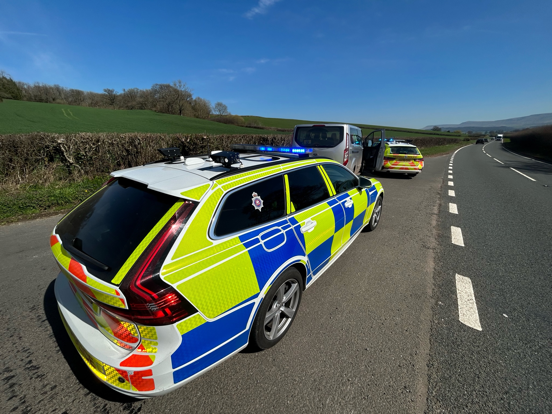
Roads Policing.
Road, Highway and Public Place.
Week 1 Session 2 /3

Slide 2
By the end of the session, students will be able to:
Define what is a road under the Road Traffic Act 1988.
Explain the difference between a Road and a Highway.
Identify what is considered to be a public place for the purposes of the Road Traffic Act 1988
Explain the term mechanically propelled vehicle.
State what a Motor vehicle is
Identify categories of vehicles

Slide 3
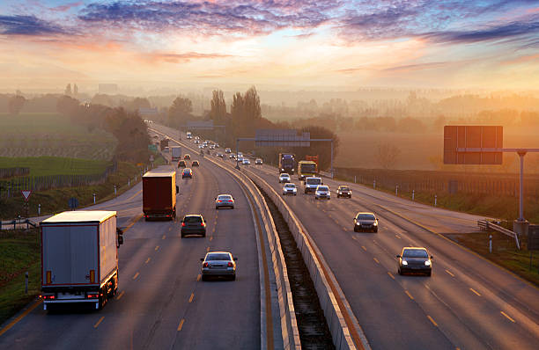
A ‘road’ is any length of highway to which the public have access and includes bridges over which a road passes. S. 192 of the Road Traffic Act 1988.
Limits to the road are hedgerows, fences or building lines.
A footpath running alongside a road would be part of the road.

Slide 4
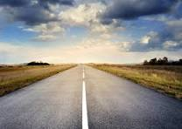
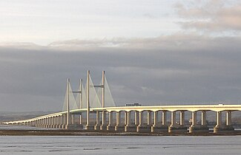
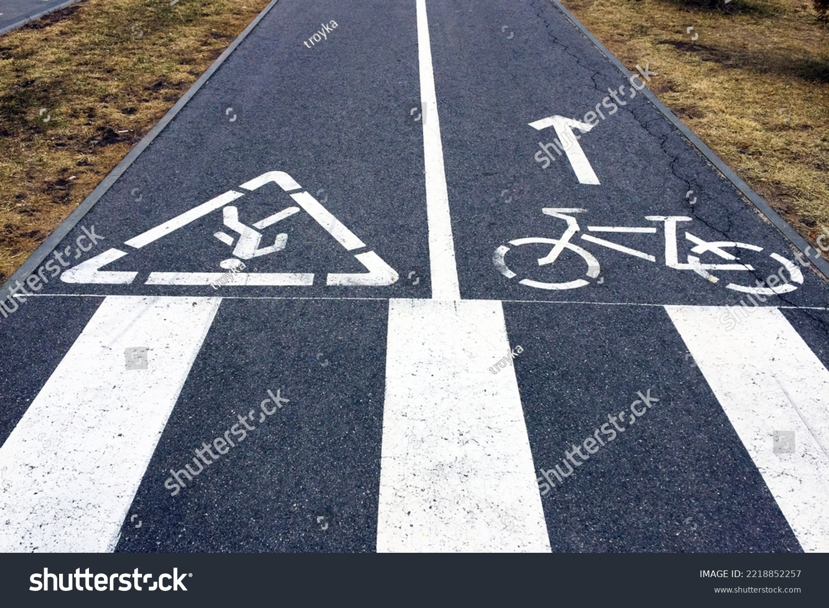
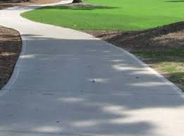
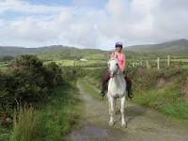
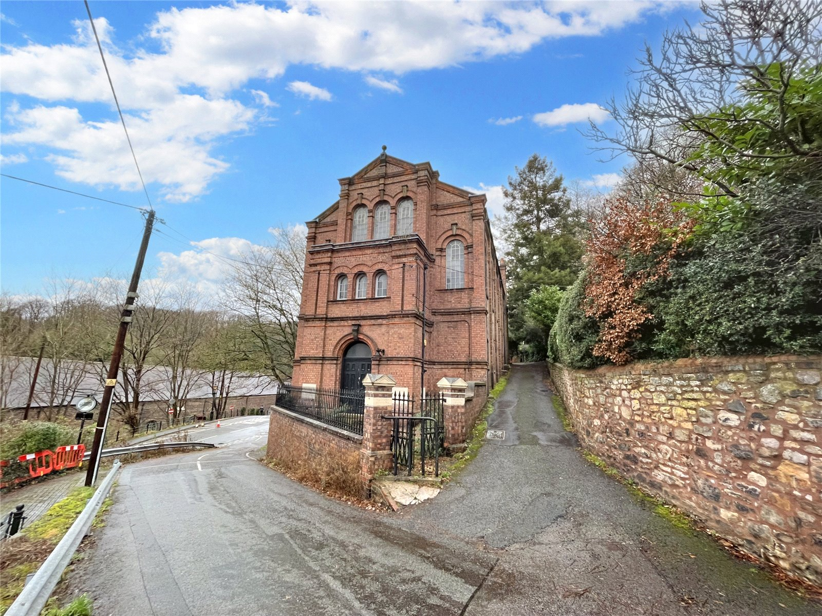
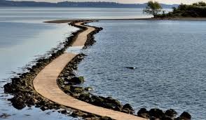
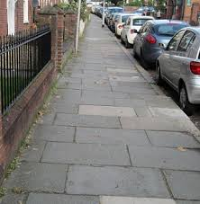
A ‘highway’ is a road, bridge, carriageway, cart-way, horseway; bridle way, footway, causeway, church way or pavement.
S.5 of the Highways Act 1935.

Slide 5
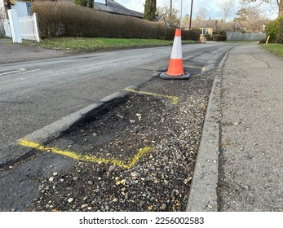
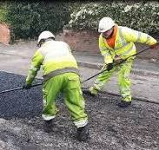
Public road.
This is a road that is maintained at the publics expense.
S.62 Vehicle Excise and Registrations Act 1994.

Slide 6
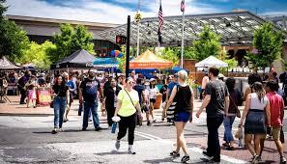
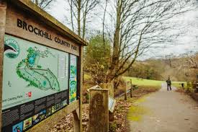
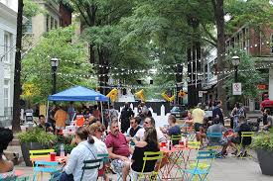
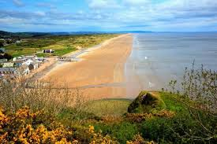
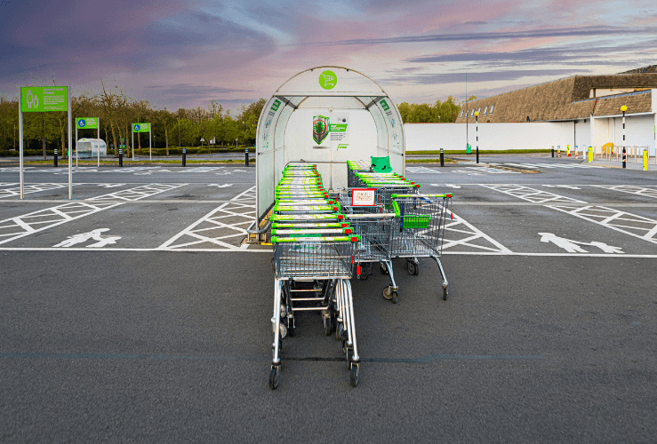
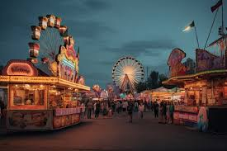
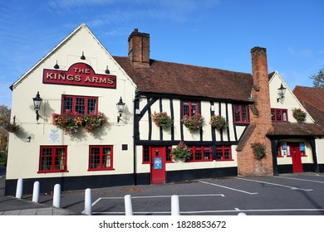
Public Place is a place where the public have access on payment or otherwise.
S.143
(1)(a) Road Traffic Act 1988 (RTA)
(Insurance offences).
S. 170 Road Traffic Act 1988
(Reporting of an Accident).
The same definition is also included in standard of driving offences and drink / drug driving.

Slide 7
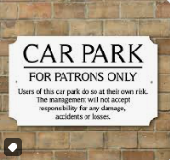

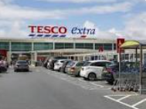
Public place?
Pub car park - Only during open hours and thirty minutes afterwards, not when the pub is closed to the public.
Supermarket car parks enable public access 24/7.

Slide 8
Week 1 Session 3
Mechanically propelled vehicles, motor vehicles and an introduction to categories of vehicles.

Slide 9
By the end of the session, students will be able to:
Define the term mechanically propelled vehicle.
Define the term motor vehicle
Identify a selection of mechanically propelled vehicles identifying which are also motor vehicles (intended for use on the road, and which are not motor vehicles).

Slide 10
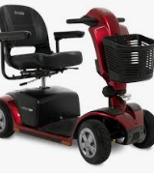
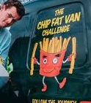
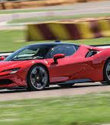
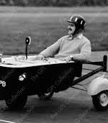
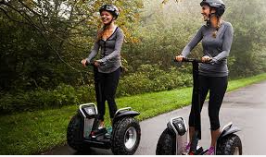
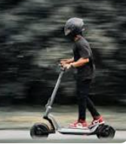
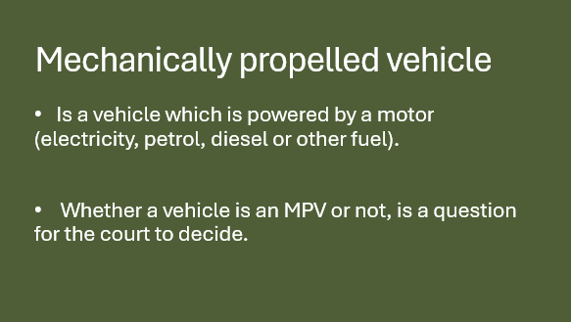
Mechanically propelled vehicle
Is a vehicle which is powered by a motor (electricity, petrol, diesel or other fuel).
Whether a vehicle is an MPV or not, is a question for the court to decide.

Slide 11
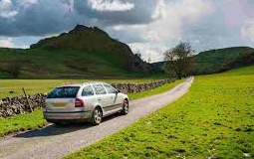
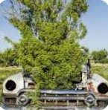
Motor Vehicle:
S 1. Vehicle Excise and Registration Act 1994. (VERA)
Vehicle: “a mechanically propelled vehicle, or anything (whether or not it is a vehicle) that has been, but has ceased to be, a mechanically propelled vehicle”.

Slide 12
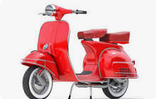
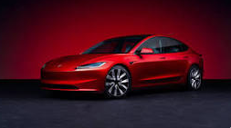
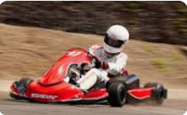




Motor vehicle,
S.185(1) Road Traffic Act 1988
“motor vehicle” means, subject to section 20 of the Chronically Sick and Disabled Persons Act 1970 (which makes special provision about invalid carriages, within the meaning of that Act), a mechanically propelled vehicle intended or adapted for use on roads,

Slide 13

Directed Reading
To conclude Road Traffic Definitions – Please take the time to read over the directed reading power point under week 1 on Moodle.

Slide 14

Any Questions?

