Slide 1
Kings Fish & Chips – Angel Investor Pitch
Name: Gurjit Kaur
ID: 2425352

Slide 2

Business Proposition Overview
Traditional British Fish & Chips shop offering fresh, high-quality meals
Mission: Provide affordable, fresh, and delicious fish & chips with excellent service
Aims: Expand customer base, improve brand presence, increase delivery capacity
    USP: Freshly battered fish daily + eco-friendly packaging

Slide 3

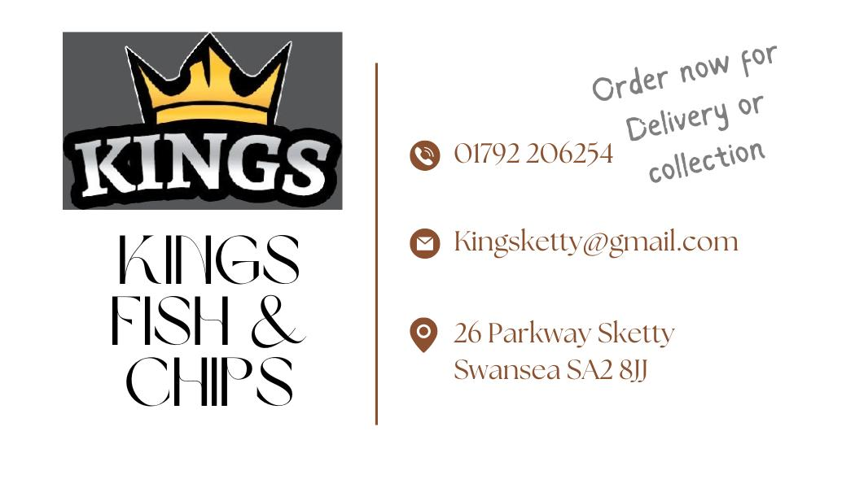
Legal Structure & Location
Legal Structure: Sole Trader
Fast to set up, full control, simple accounting
Location: High footfall area suitable for takeaway & delivery demand
Positioned for local community access + high delivery potential

Slide 4

Human Resource Management
Team Structure:
    Owner/Manager
    2 Kitchen Staff
    Front-of-House Staff
    Delivery & Online Orders Staff
    Recruitment from local job boards and hospitality networks

Slide 5
Financial Overview
Start-up & operating costs controlled for sustainability
Revenue generated through dine-in, takeaway, and delivery
Break-even expected within 12–15 months
Seeking £50,000 for expansion and operational upgrades

Slide 6
SWOT Analysis Summary
Strengths: Quality food, strong local demand, unique recipes
Weaknesses: Limited marketing, small team, rising supply costs
Opportunities: Delivery expansion, social media branding
Threats: Competition & price fluctuations

Slide 7
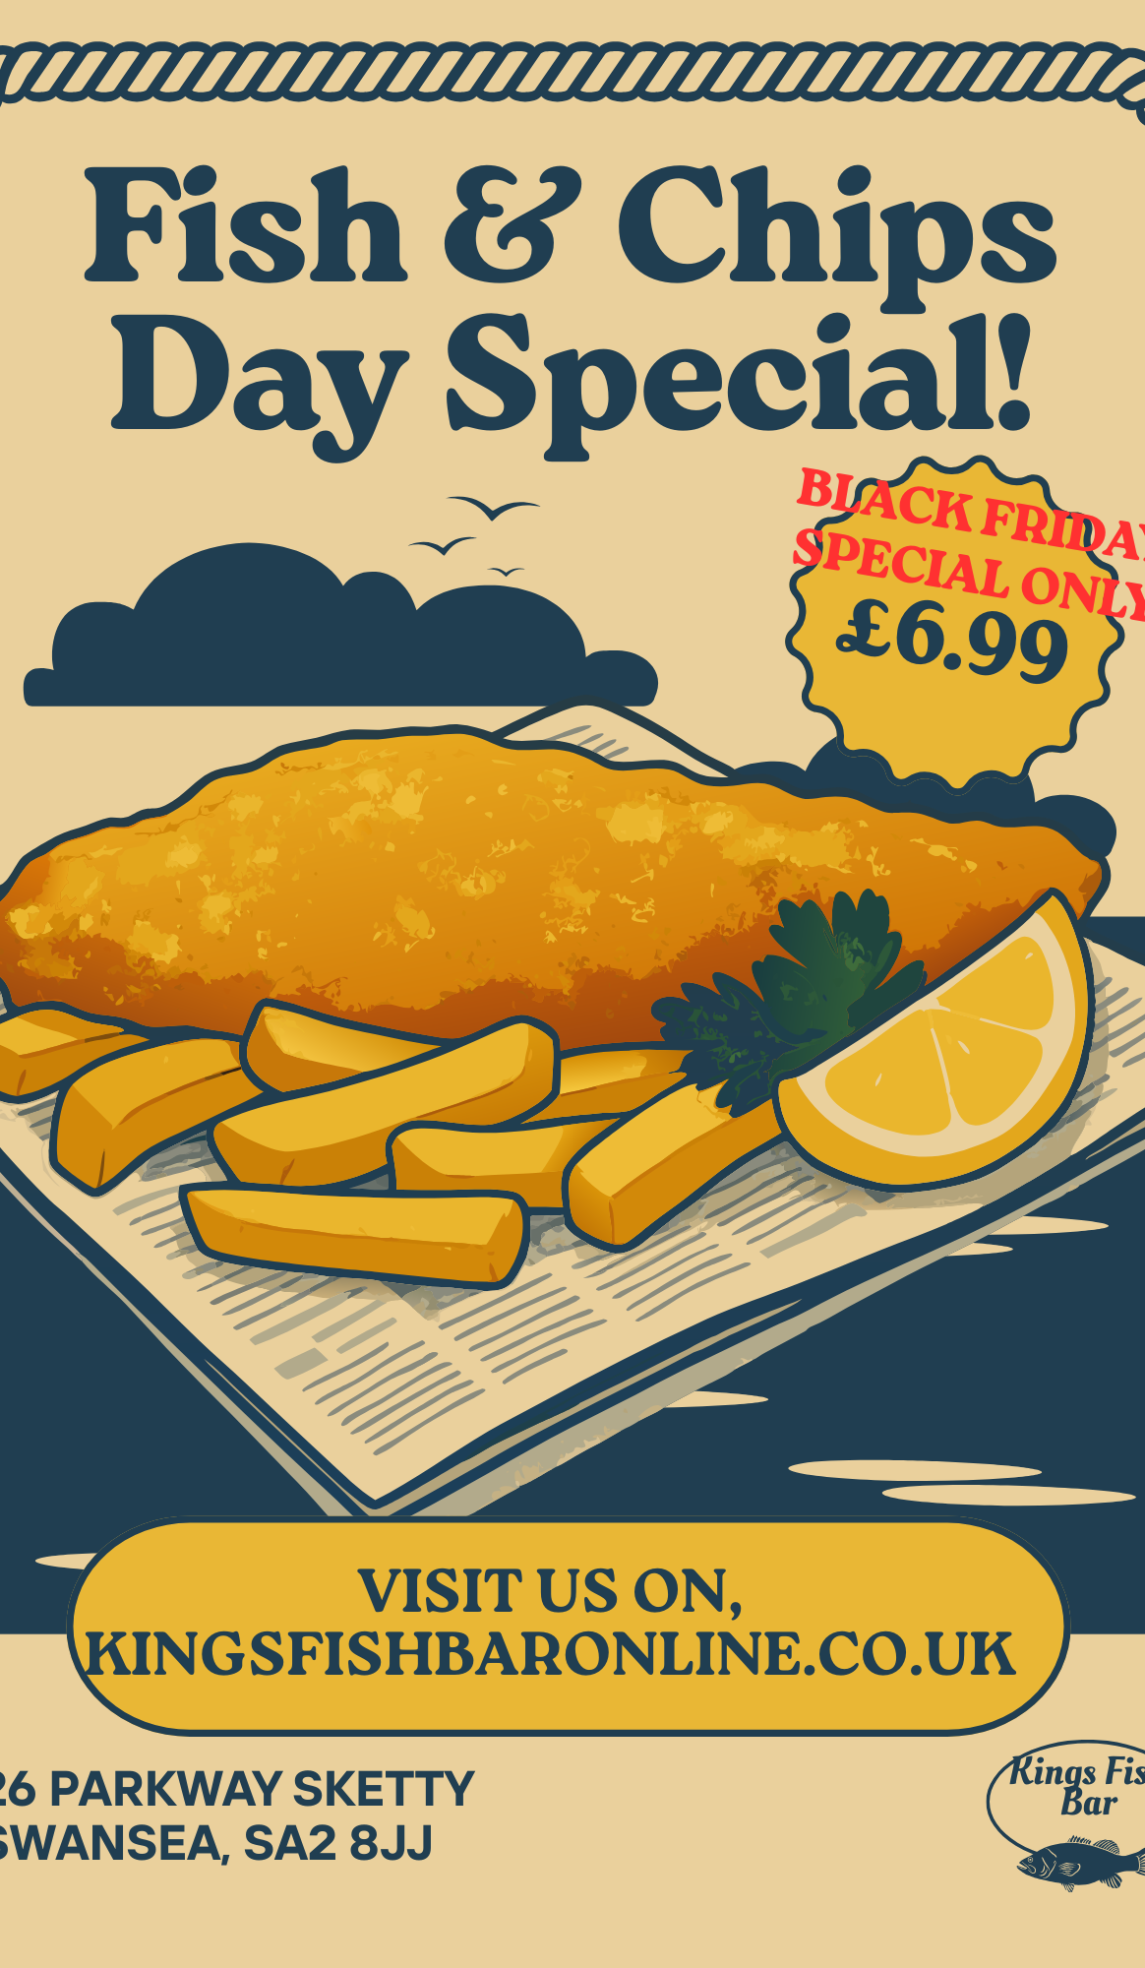
12-Month Marketing Strategy
Launch TikTok & Instagram campaigns
Weekly promotions & meal deals
Loyalty card & student discounts
Flyers, local ads, and boosted Facebook posts

Slide 8
Branding Examples
Business card designs
Flyers for local distribution
Social media post templates
Consistent colour scheme & logo identity

Slide 9

Why Invest in Kings Fish & Chips?
Proven demand & sustainable operations
Strong potential for regional expansion
Opportunities in delivery growth & branding
£50k will accelerate improvements and scaling

Slide 10

How the £50,000 Will Be Used
£15k – New kitchen equipment & upgrades
£10k – Marketing & branding campaigns
£15k – Hiring & staff training
£10k – Delivery expansion + working capital

Slide 11
References
Freeman, A. (2013). ‘Challenging myths about the funding of small businesses...’ [online] Available at: https://demos.co.uk/wp-content/uploads/2013/09/DF_-_Finance_for_Growth_-_web.pdf?utm_source=chatgpt.com [Accessed 21 Nov. 2025].
Kellerton, T.O. (2023). What makes Small and Medium Enterprises successful: A Study. International Journal for Global Academic & Scientific Research, 2(3), pp.61–80. doi:https://doi.org/10.55938/ijgasr.v2i3.54.
Korede, T., Al Mamun, A., Lassalle, P. and Giazitzoglu, A. (2021). Exploring innovation in challenging contexts: The experiences of ethnic minority restaurant owners during COVID-19. The International Journal of Entrepreneurship and Innovation, 24(1), p.146575032110512. doi:https://doi.org/10.1177/14657503211051219.
Miah, S.J. (2022). Impact of Business Analytics and Decision Support Systems on e-commerce in SMEs. [online] arXiv.org. doi:https://doi.org/10.48550/arXiv.2212.00016.
Mohd Noor, H., Imang, U., Foo, J. and Brotosudarmo, T.H. (2022). Strategy used by Small-Scale Food Entrepreneurs against the Impact of the Covid-19 Pandemic. Asian Journal of Environment-Behaviour Studies, 7(22), pp.57–71. doi:https://doi.org/10.21834/aje-bs.v7i22.414.
Morley, A. (2003). Innovation Needs and Outcomes in Food Micro Firms. [online] Available at: https://orca.cardiff.ac.uk/id/eprint/30774/1/AMorleyPhDThesis.pdf?utm_source=chatgpt.com [Accessed 21 Nov. 2025].
Nosratabadi, S., Mosavi, A., Shamshirband, S., Kazimieras Zavadskas, E., Rakotonirainy, A. and Chau, K.W. (2019). Sustainable Business Models: A Review. Sustainability, [online] 11(6), p.1663. doi:https://doi.org/10.3390/su11061663.
Olawunmi, C.A. and Clarke, A.P. (2022). Analysing the marketing strategies that fish farming businesses in the UK can use to gain a competitive advantage. Journal of Enterprising Communities: People and Places in the Global Economy, 17(6). doi:https://doi.org/10.1108/jec-03-2022-0039.
The Business Planning People. (2022). Starting a Fish and Chips Shop? Read This First. [online] Available at: https://www.cbmgroup.co.uk/blog/entrepreneurship/starting-a-fish-and-chips-shop-read-this-first?utm_source=chatgpt.com [Accessed 21 Nov. 2025].

