Slide 1
Lecture 7 & 8
Capital Budgeting

Slide 2
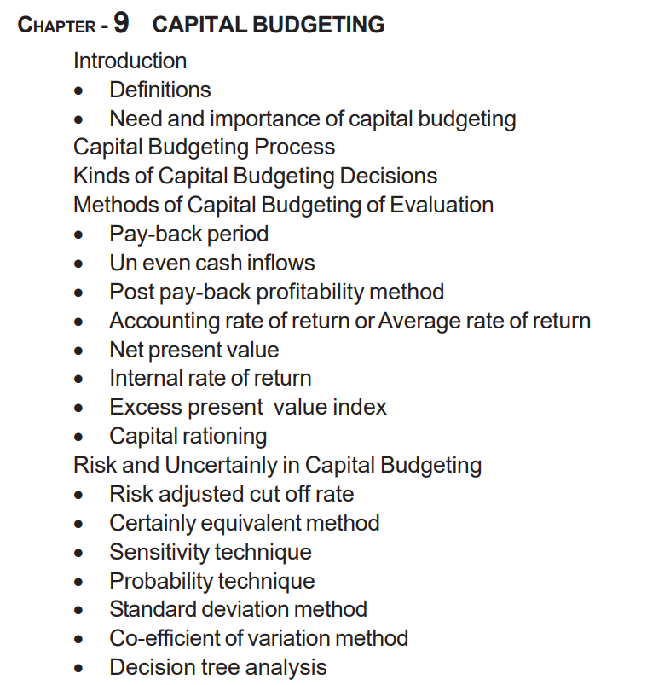

Slide 3
Meaning of Capital
In finance, capital refers to the financial and other assets a business or individual uses to generate value, including money, equipment, and intellectual property. It is used to fund operations, invest in new projects, and cover expenses, and it can be raised through various sources like debt, equity, and retained earnings.
Types of capital
Working capital: Liquid assets like cash and accounts receivable used to cover day-to-day expenses. It is calculated as current assets minus current liabilities.
Debt capital: Funds borrowed through loans or by issuing bonds, which must be repaid with interest.
Share capital: Capital raised by selling company shares to investors.
Equity capital: Represents ownership in a company, often raised through selling shares.

Slide 4
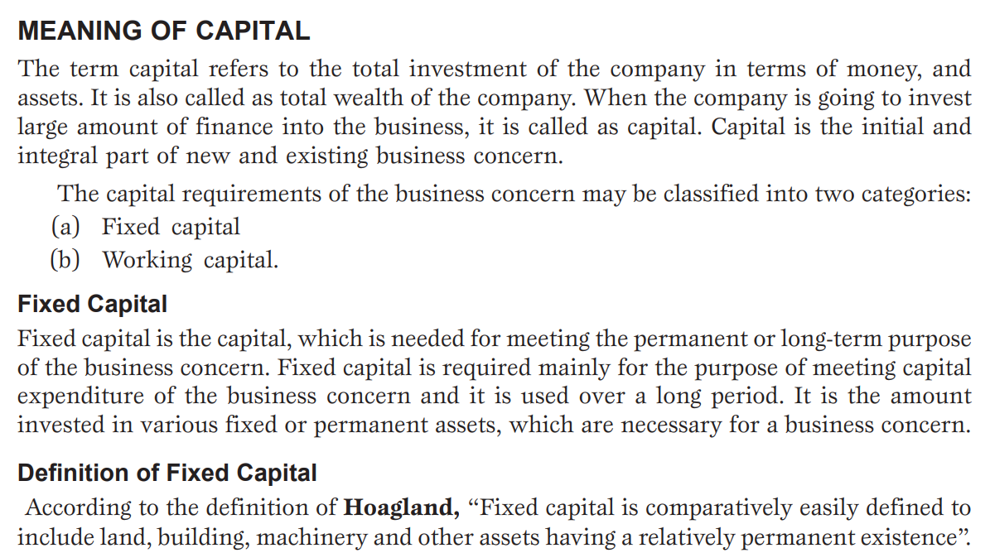

Slide 5
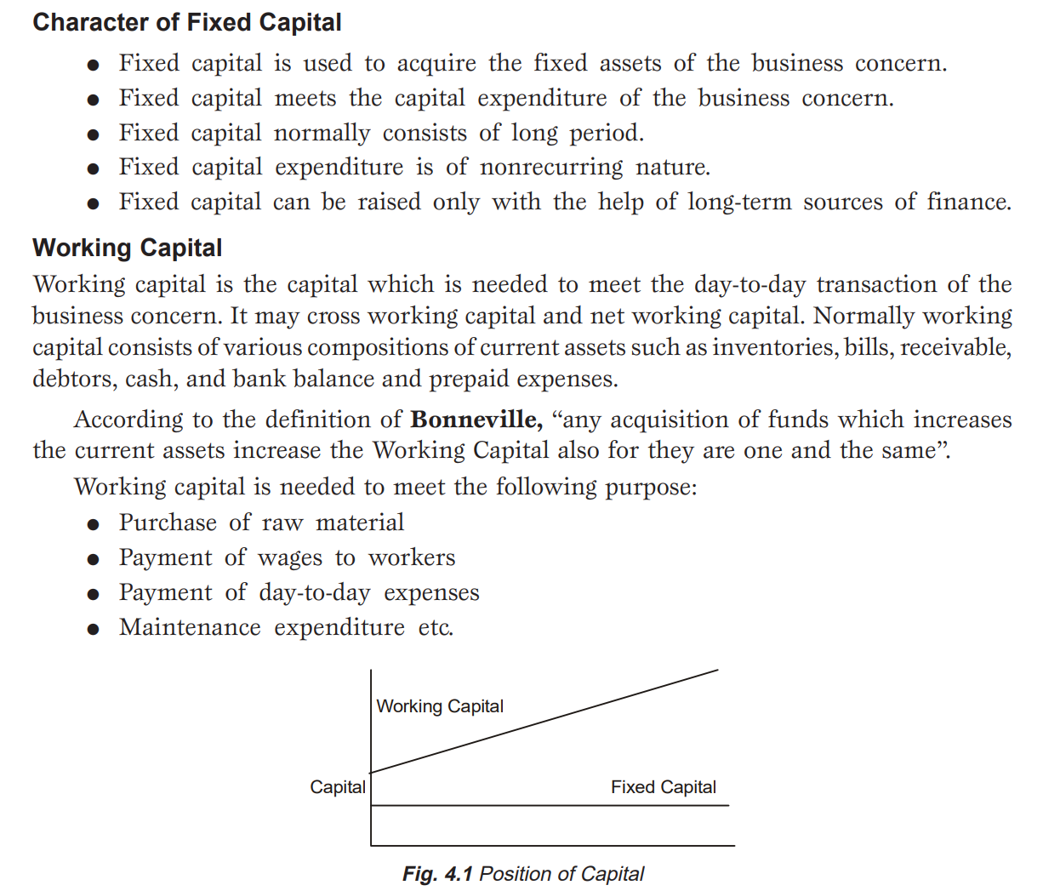

Slide 6

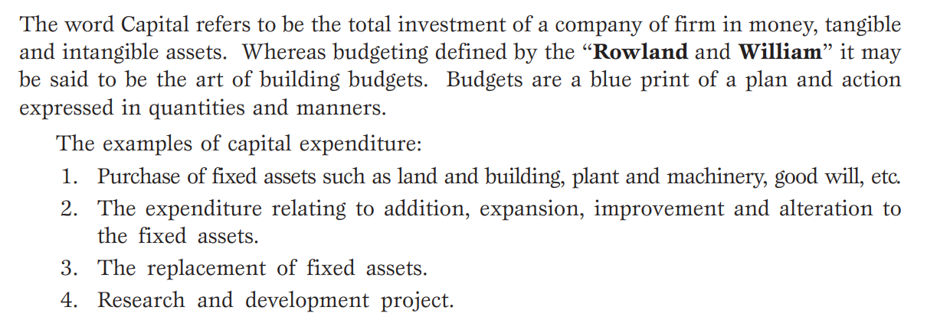

Slide 7
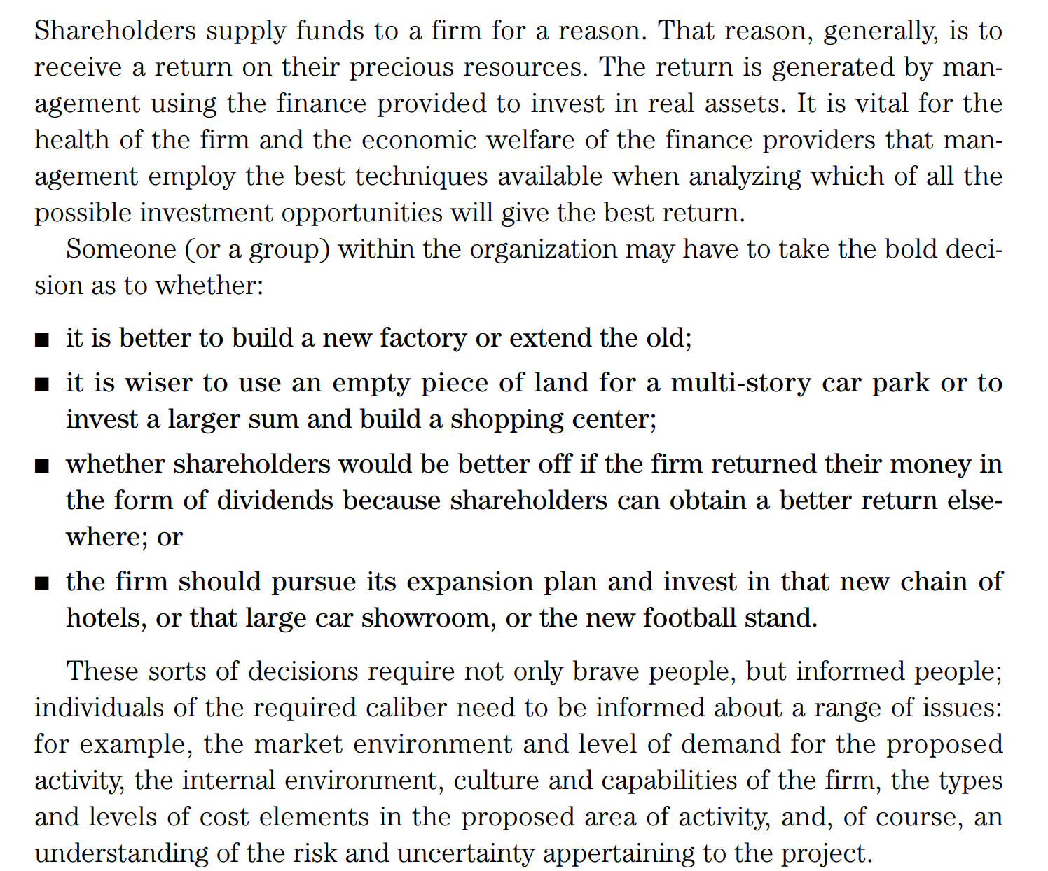

Slide 8
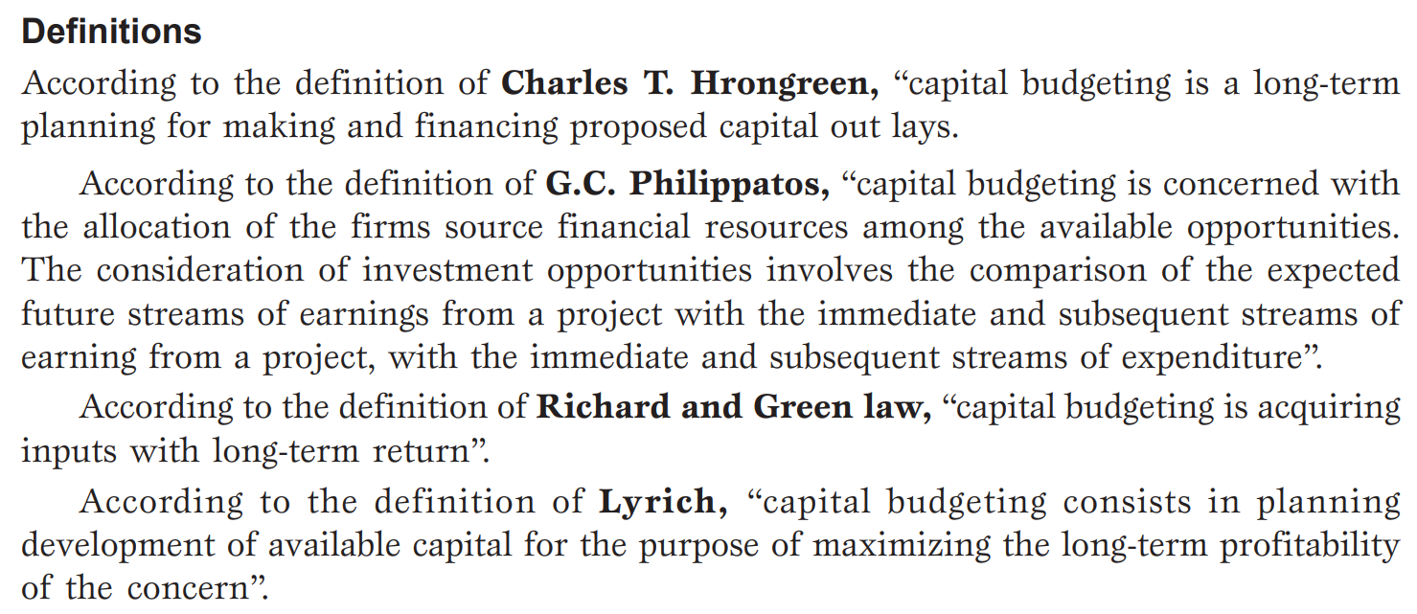

Slide 9
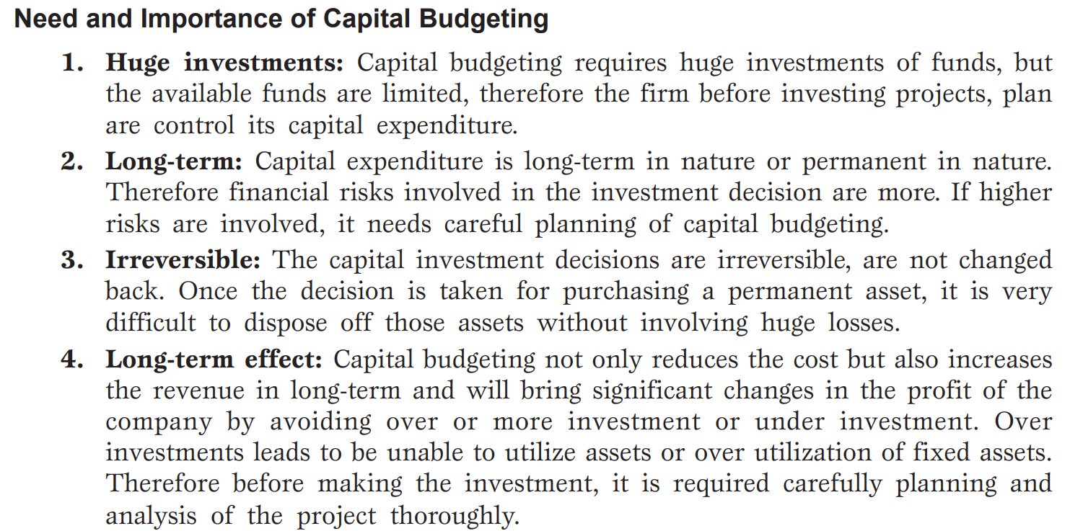

Slide 10
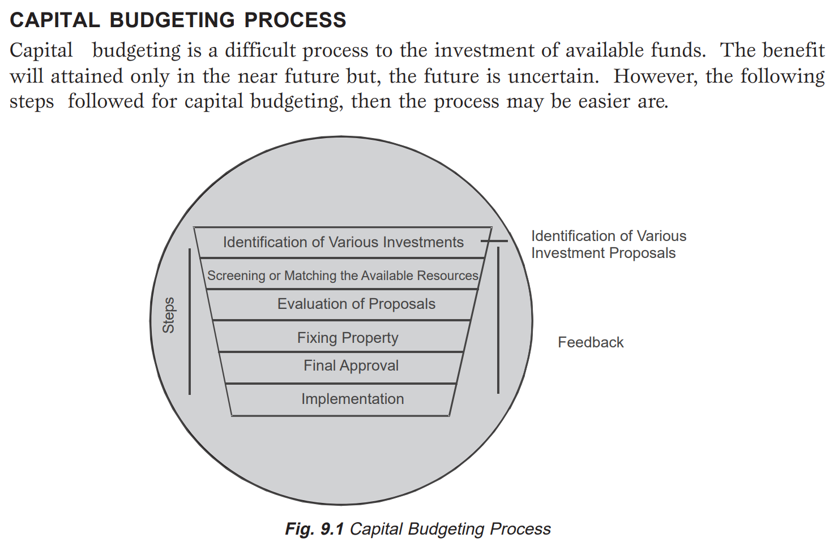

Slide 11
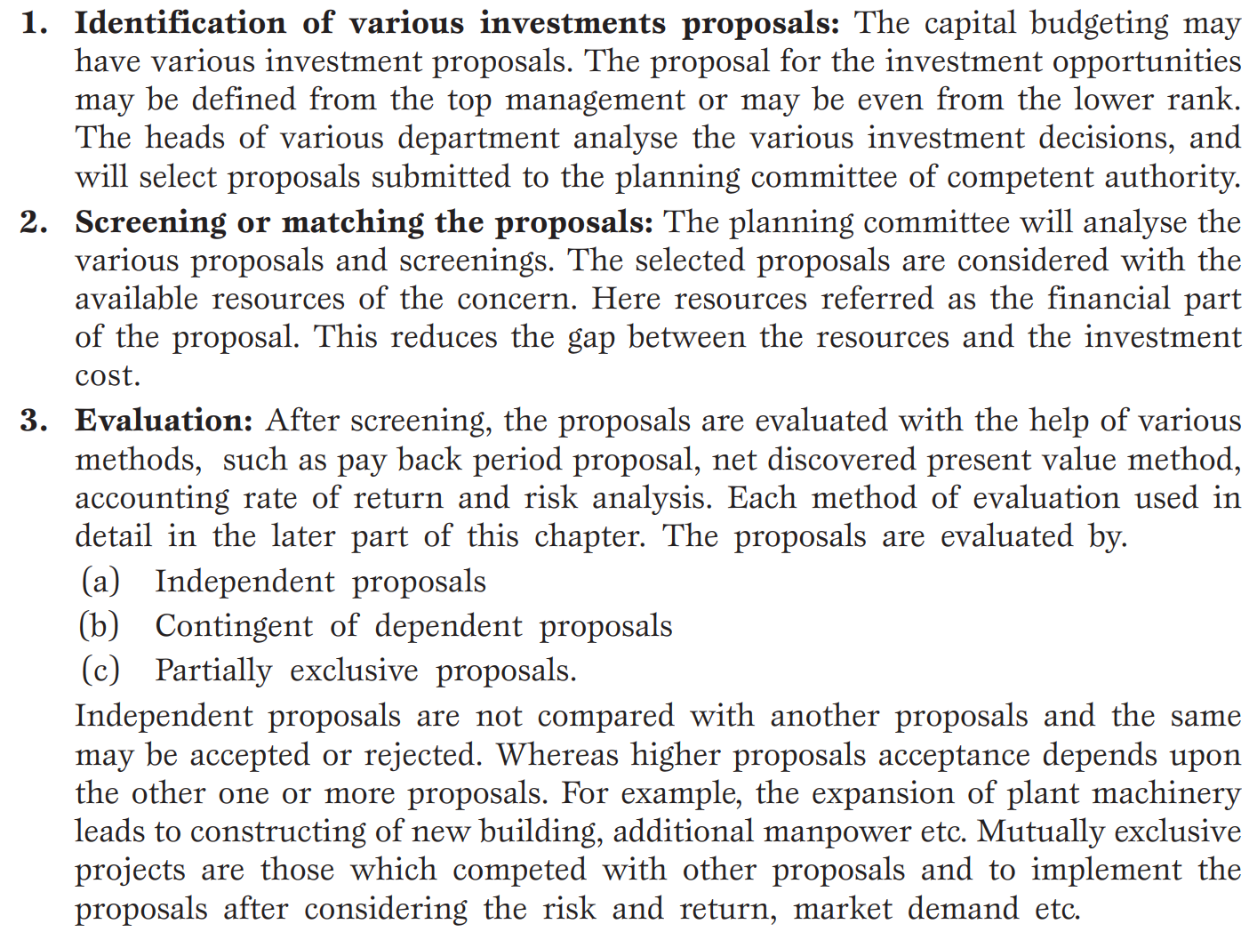

Slide 12
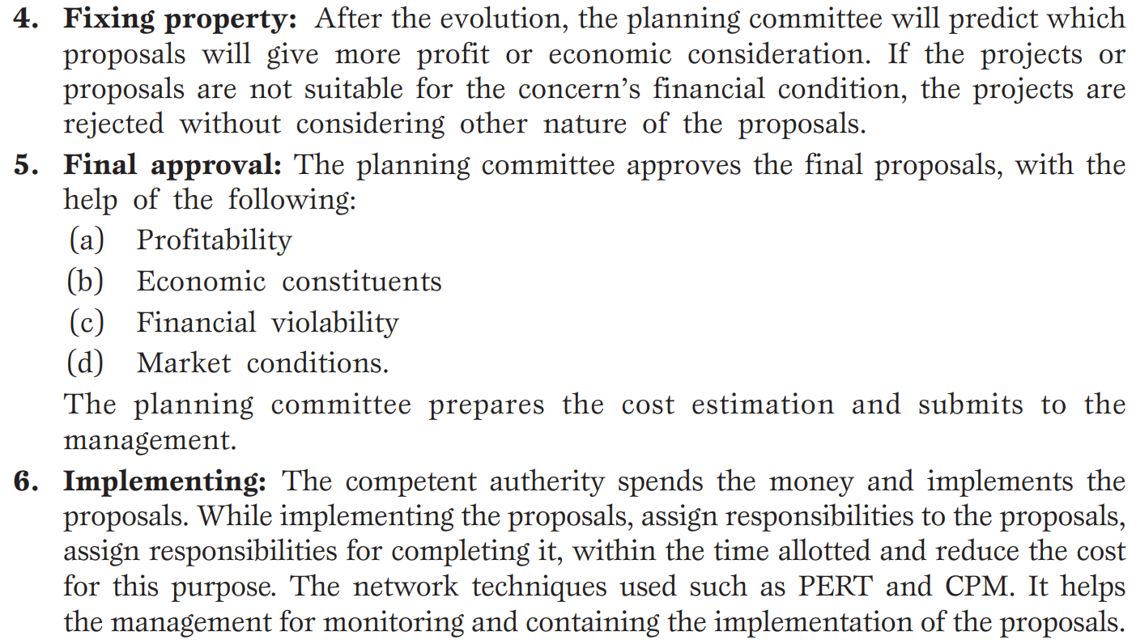
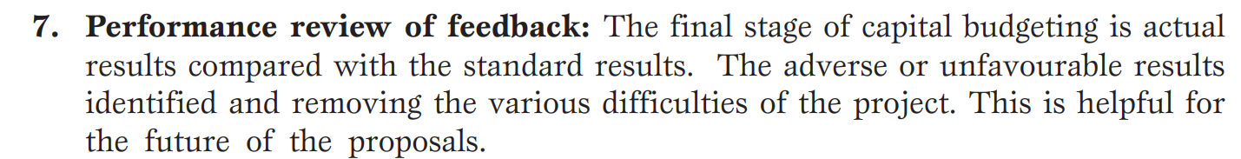

Slide 13
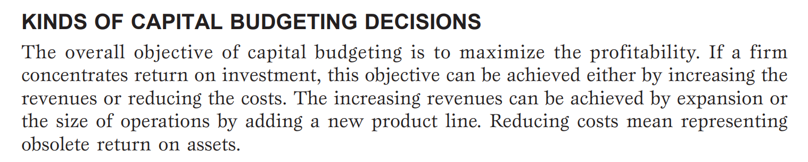

Slide 14
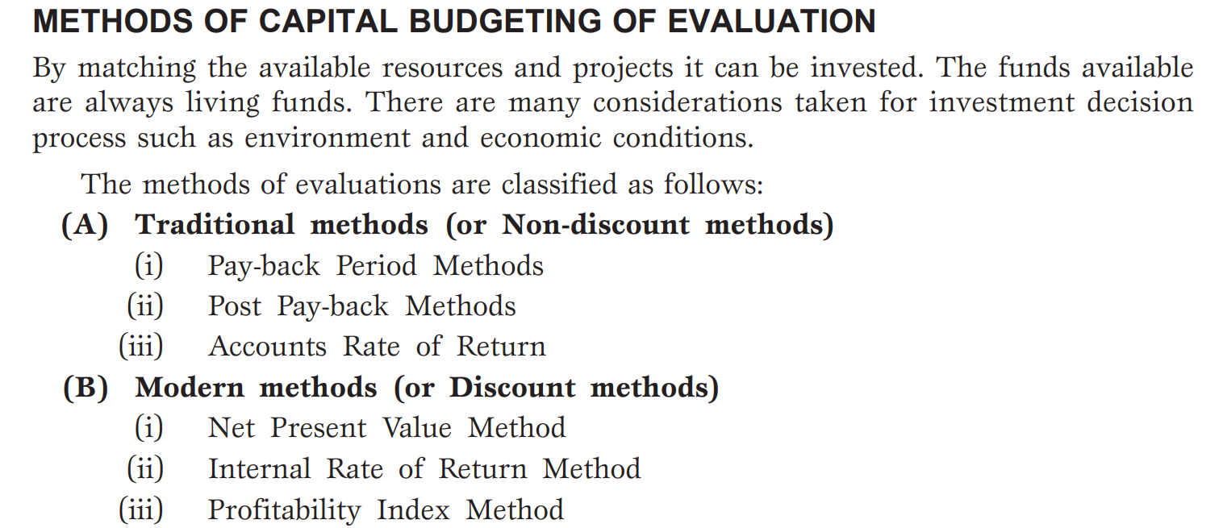

Slide 15
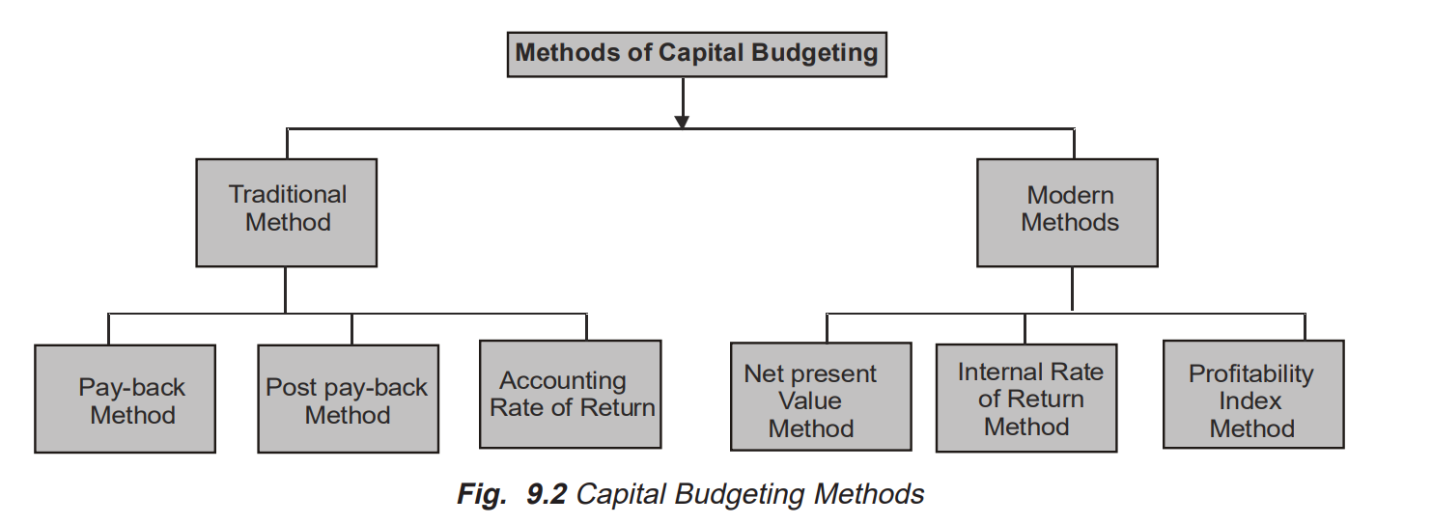

Slide 16
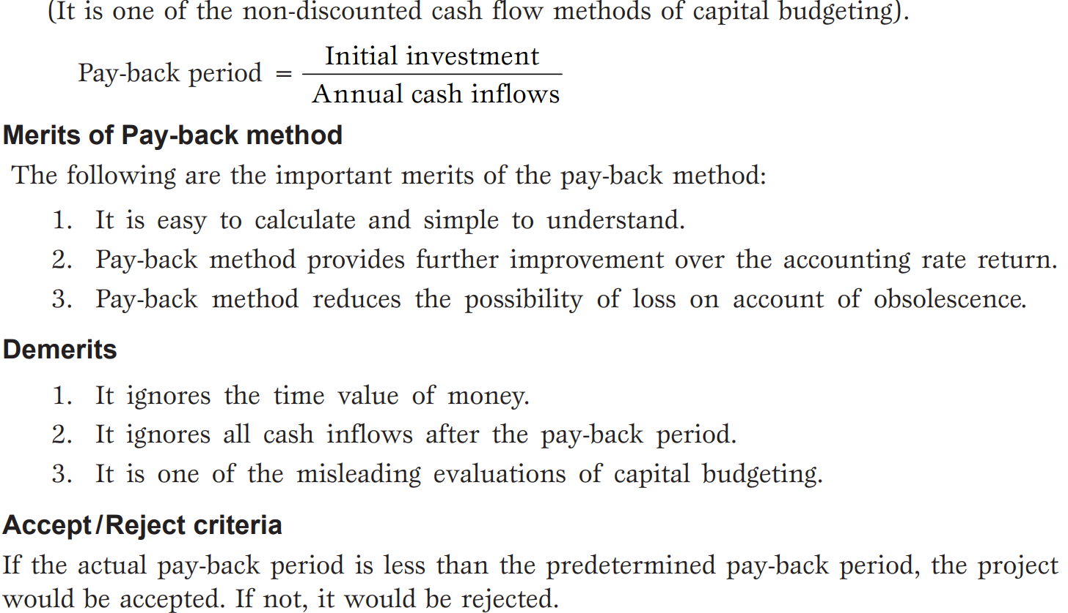

Slide 17
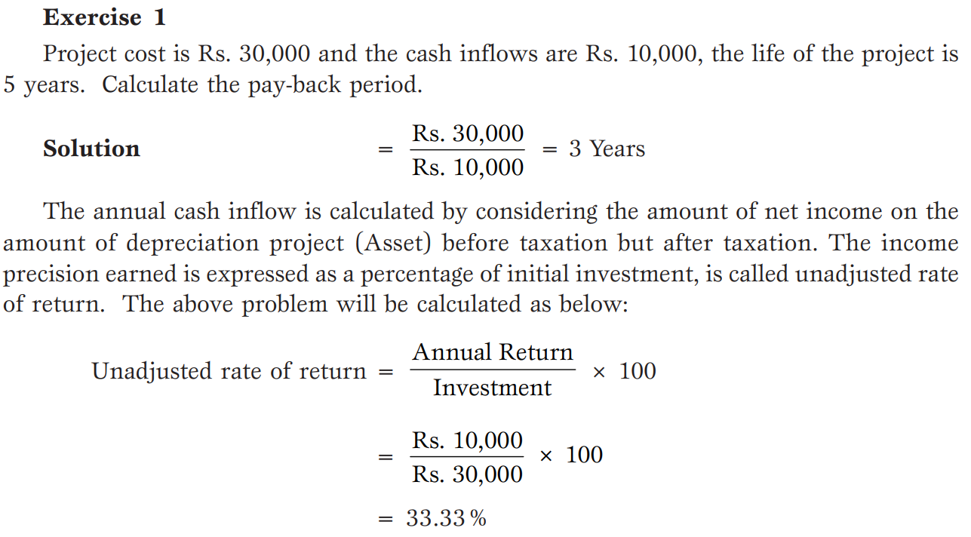

Slide 18
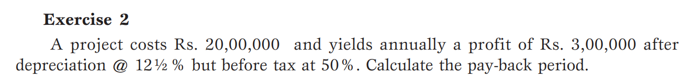
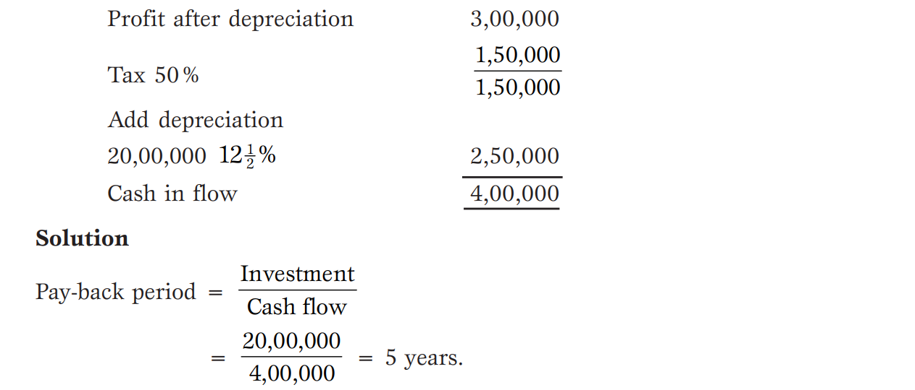

Slide 19
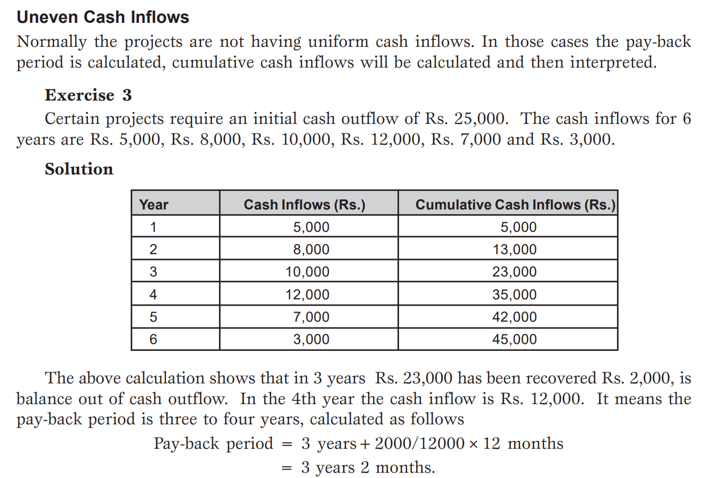

Slide 20
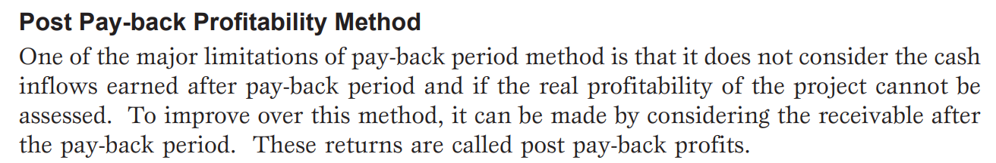
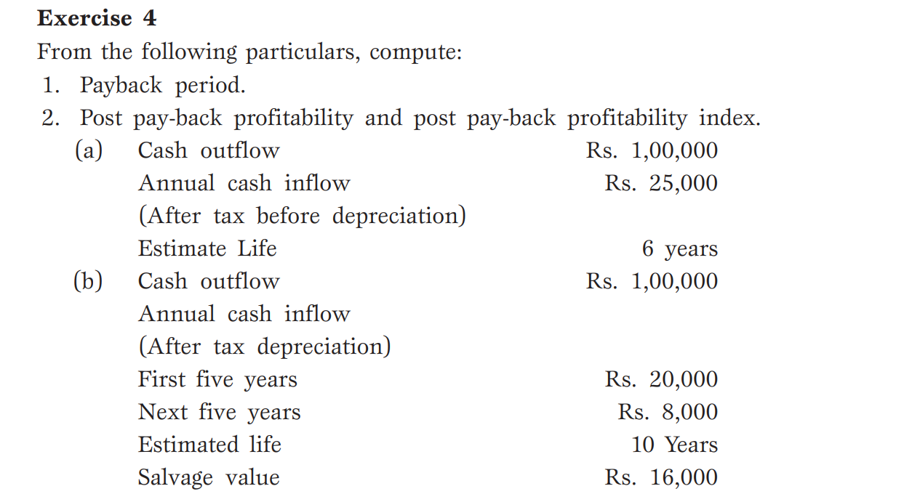

Slide 21
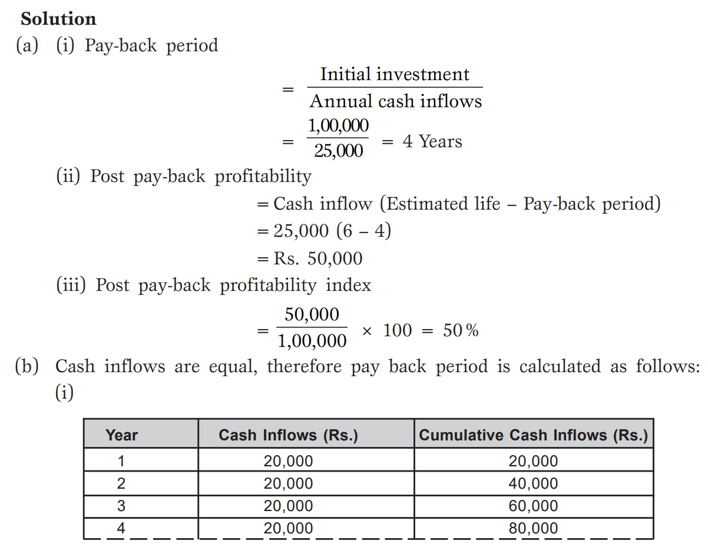
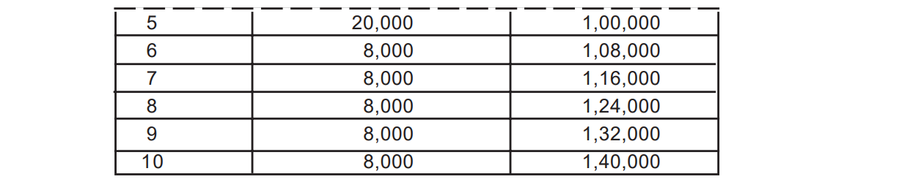

Slide 22
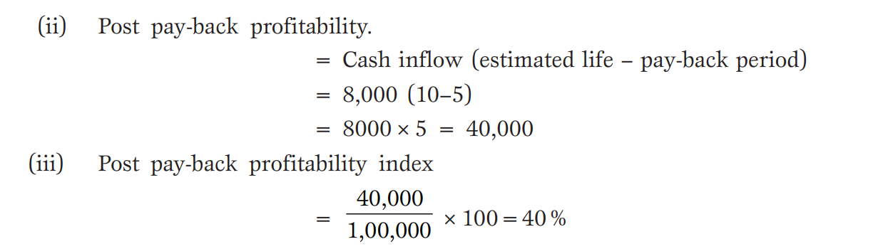

Slide 23
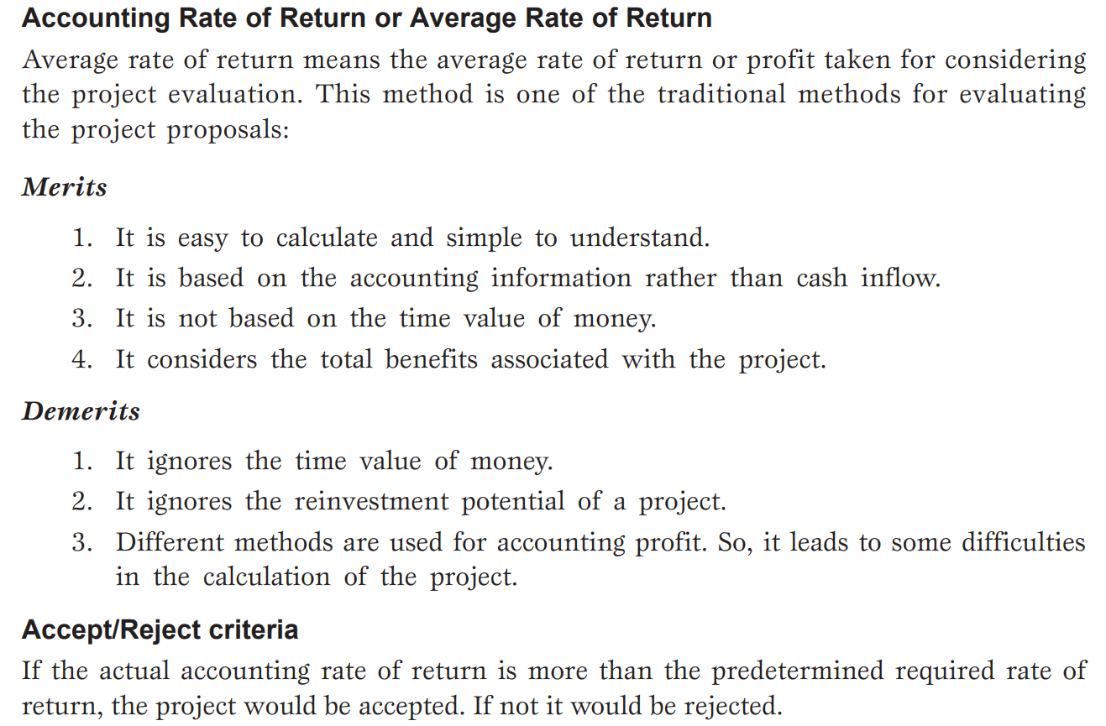

Slide 24
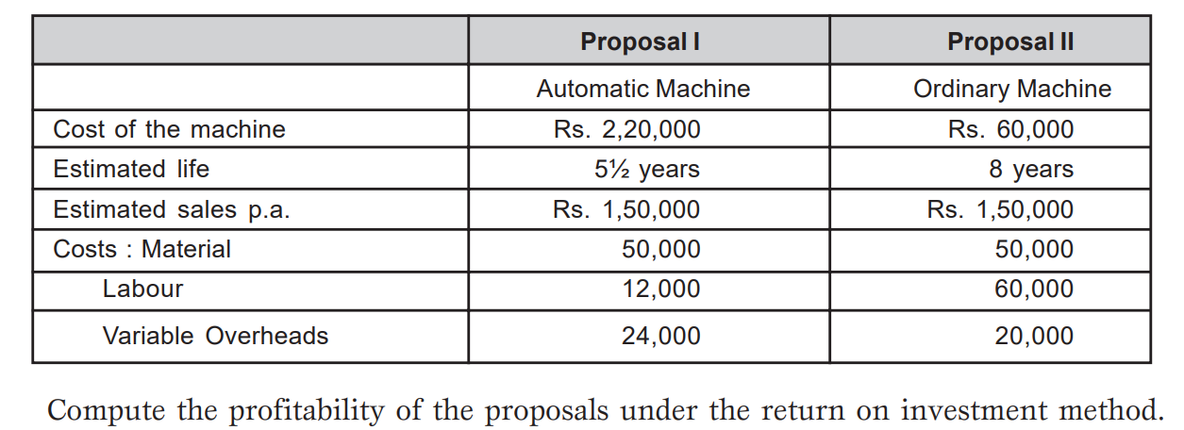

Slide 25
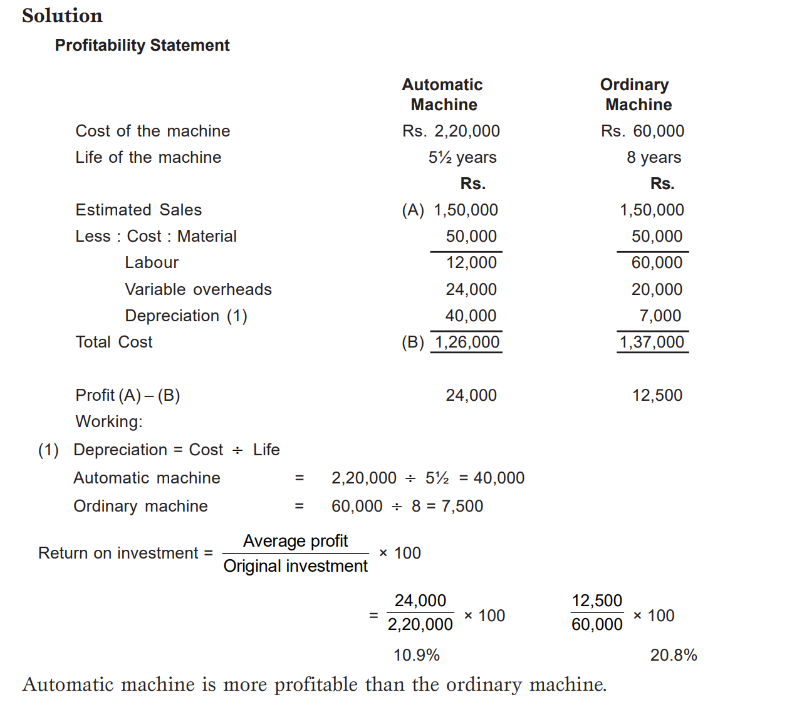

Slide 26
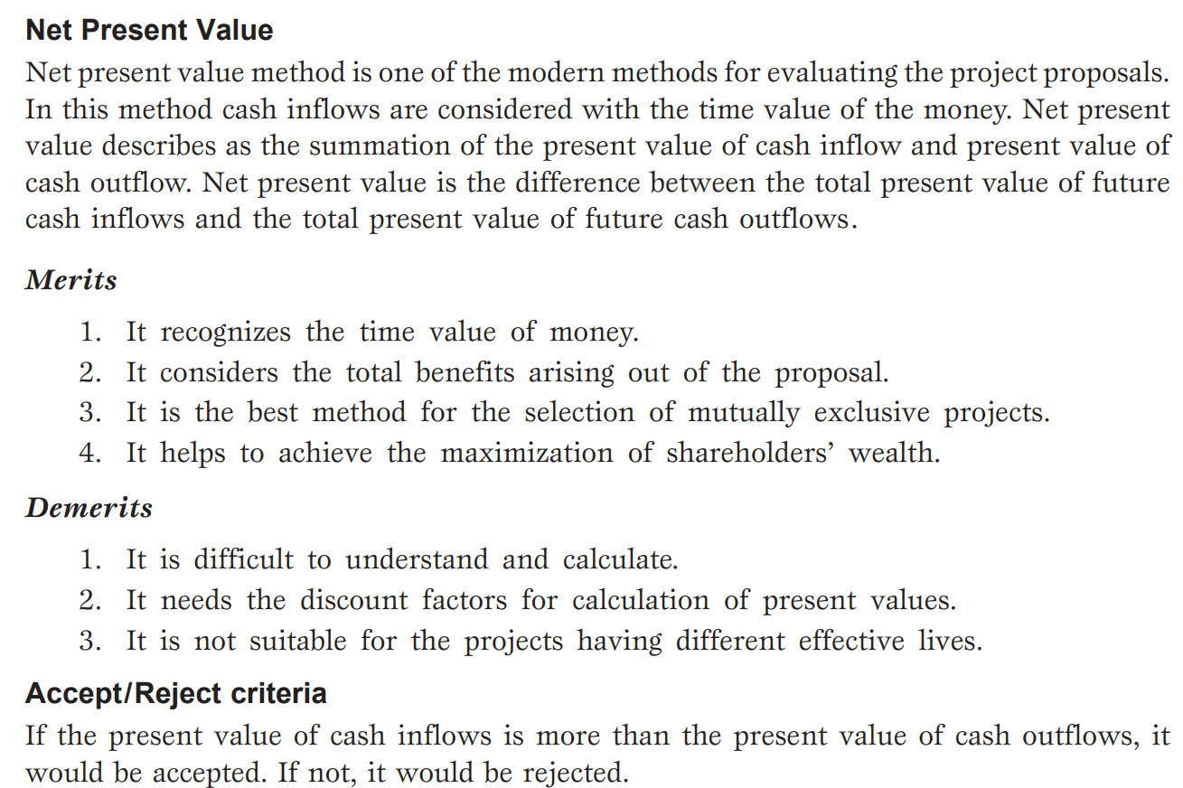

Slide 27
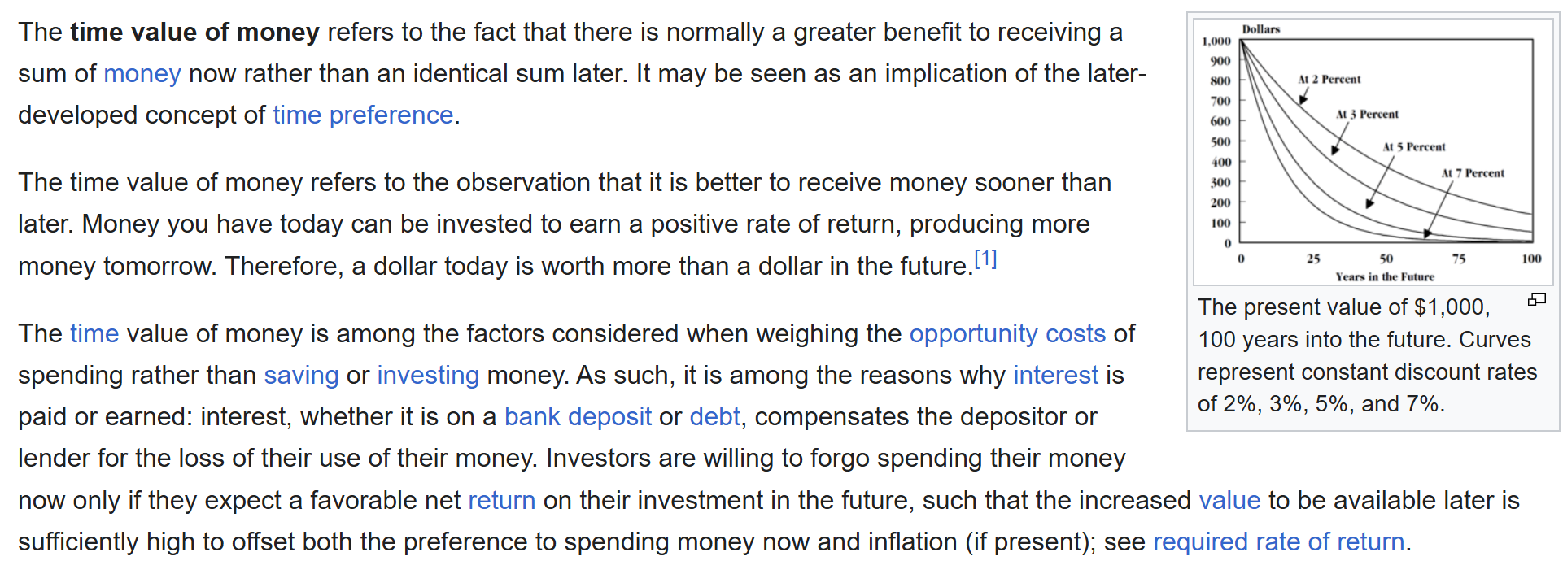

Slide 28
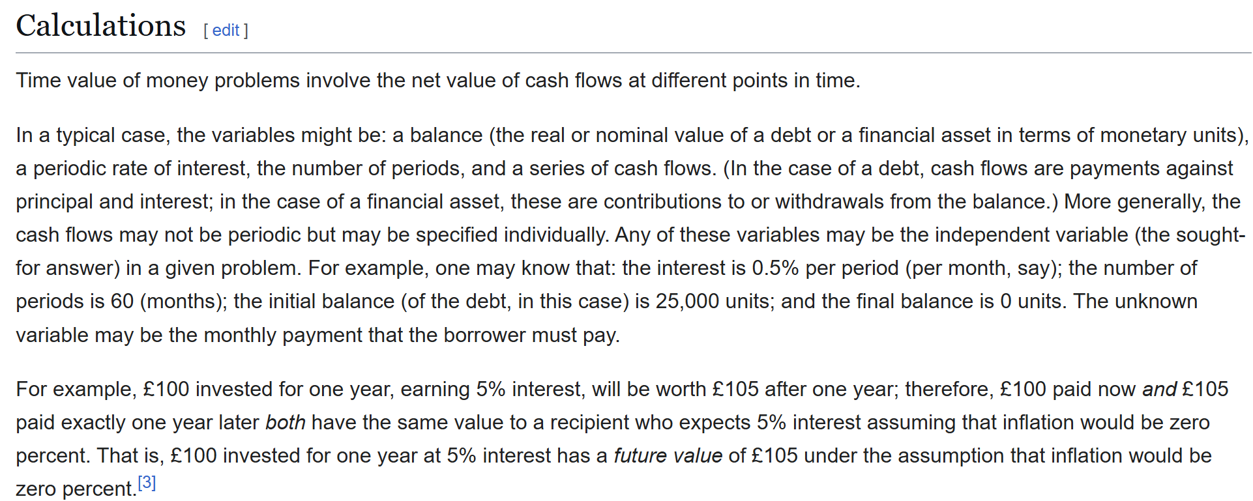

Slide 29
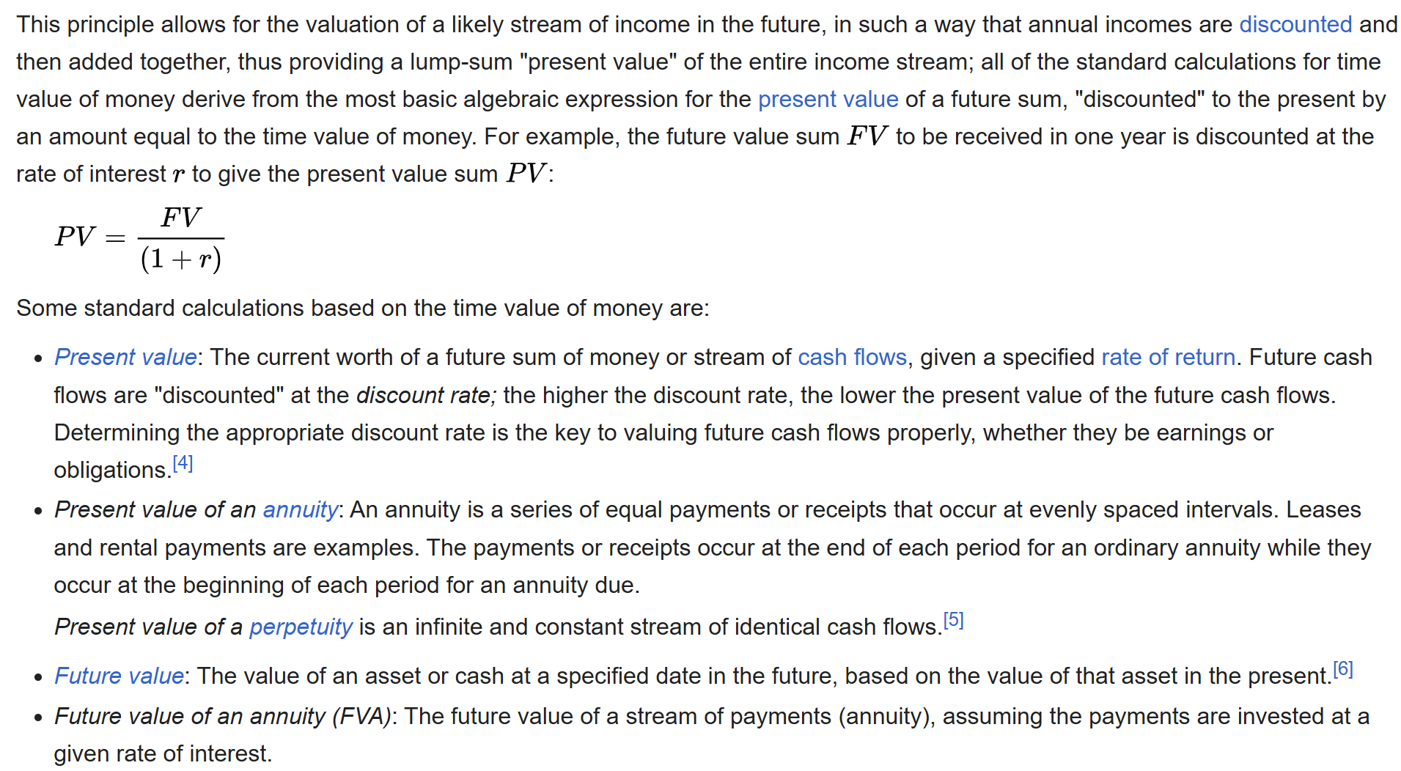

Slide 30
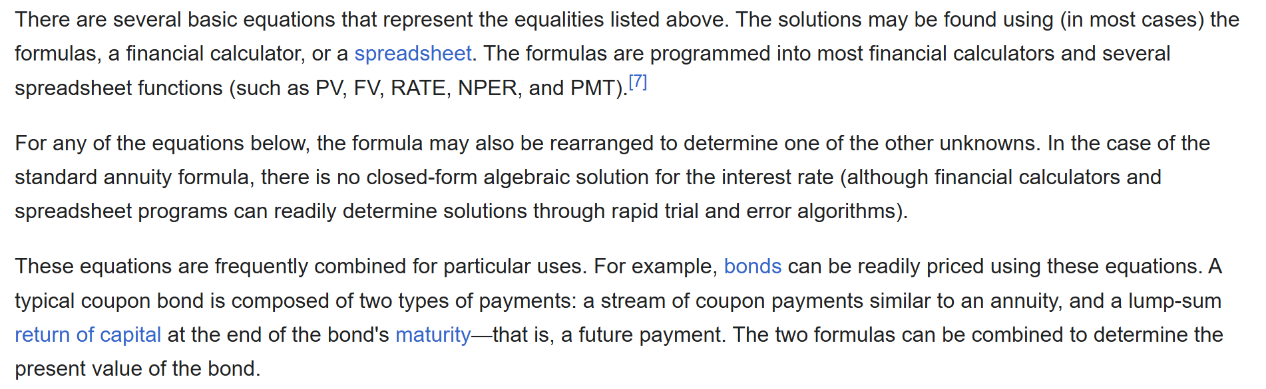

Slide 31
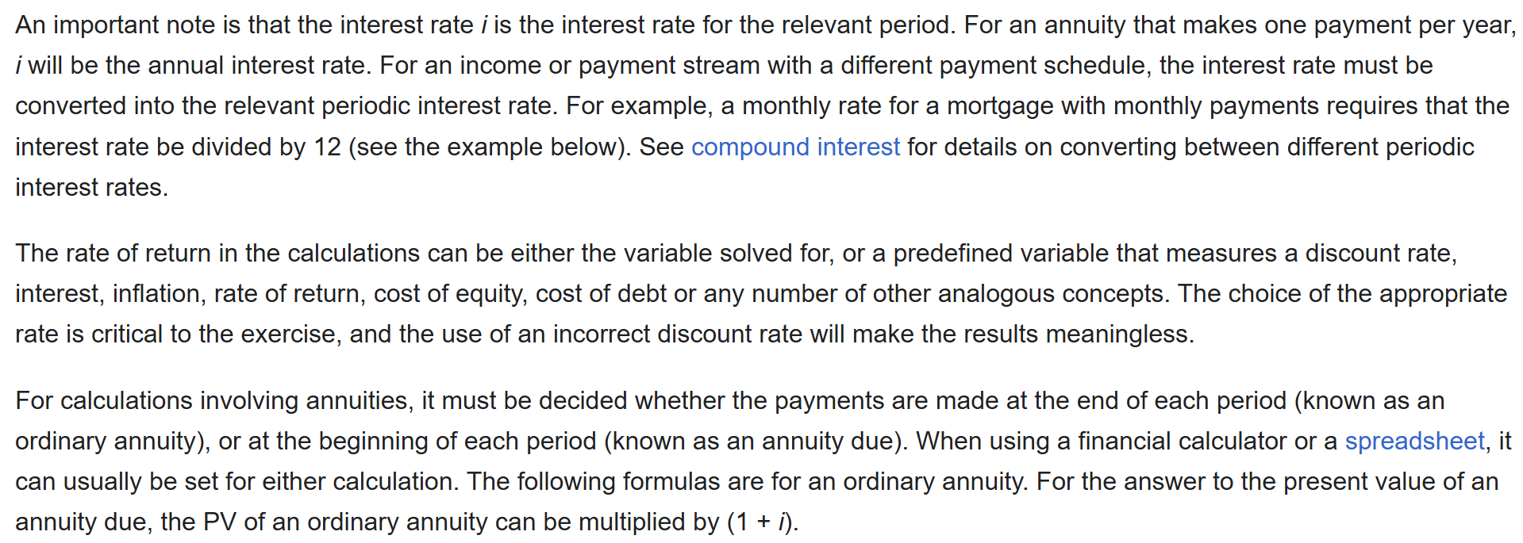

Slide 32
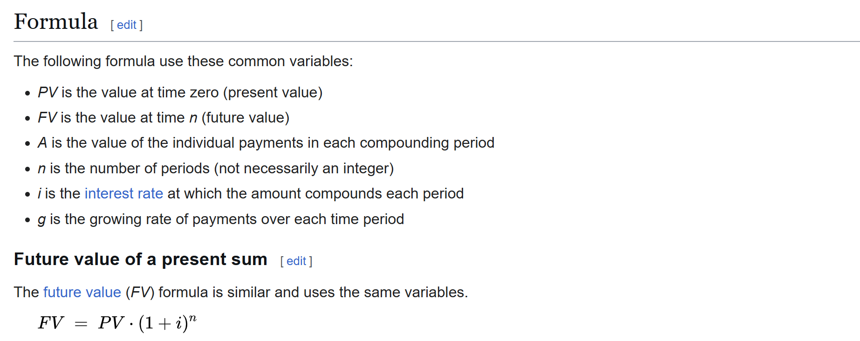

Slide 33
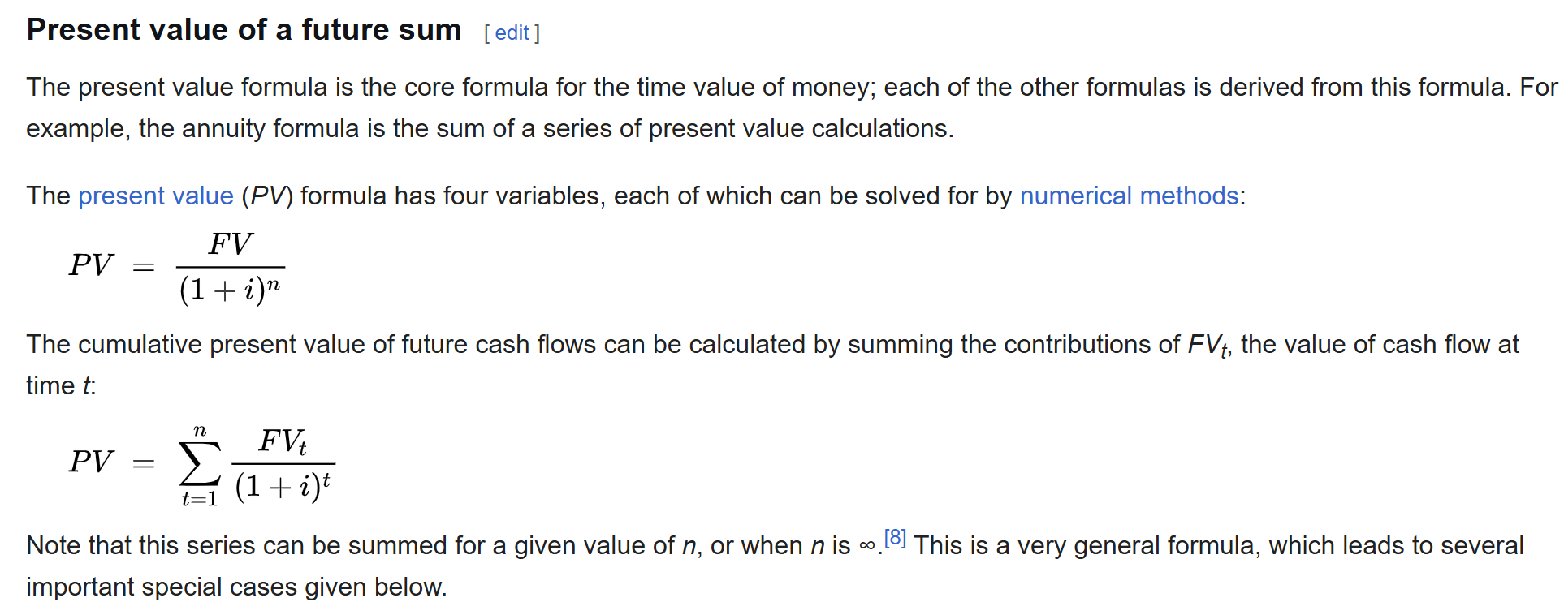

Slide 34
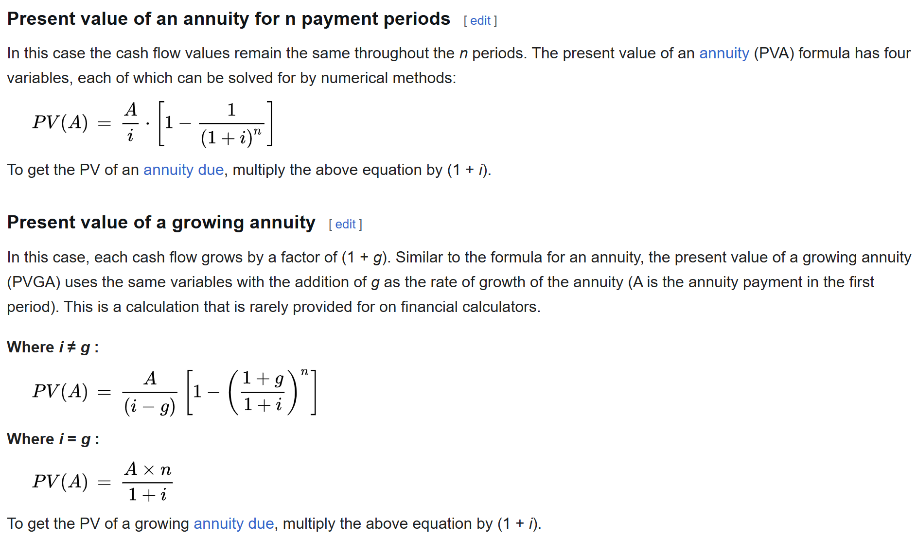

Slide 35
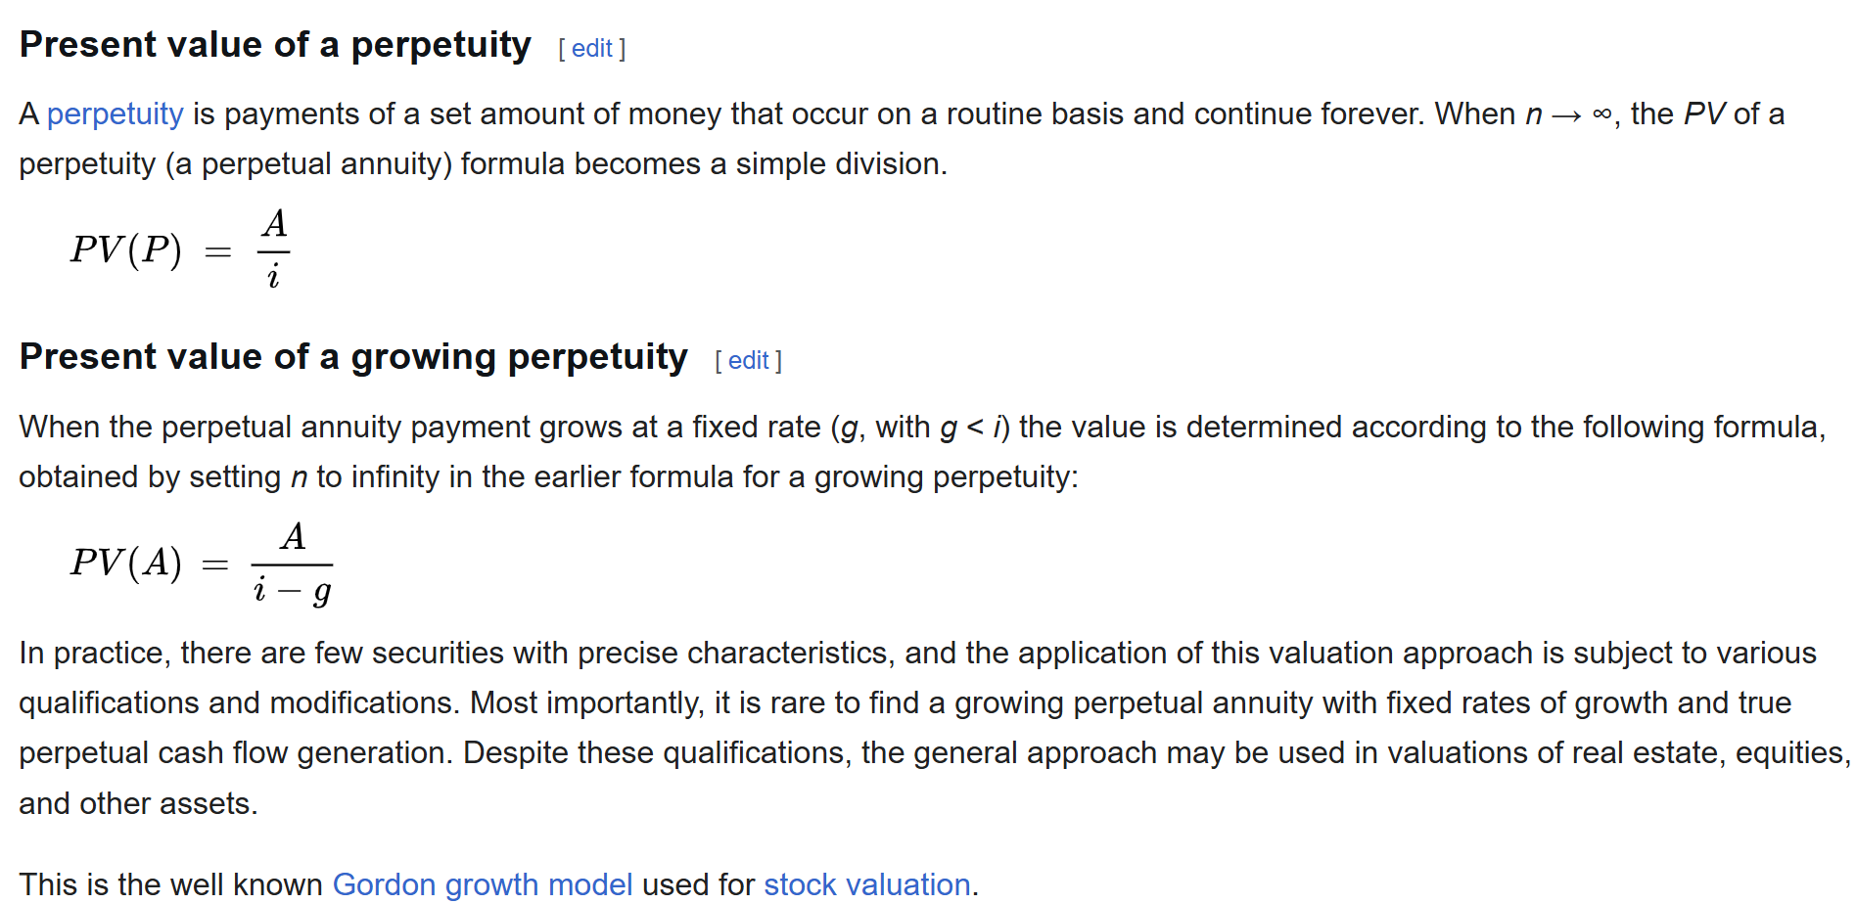

Slide 36
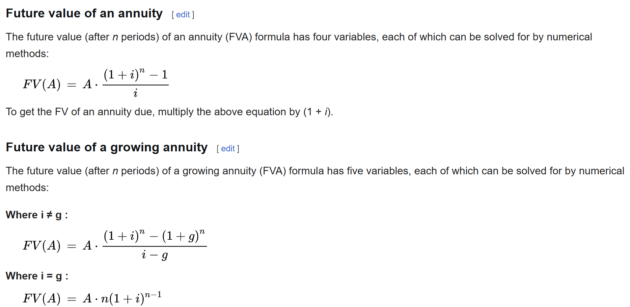

Slide 37
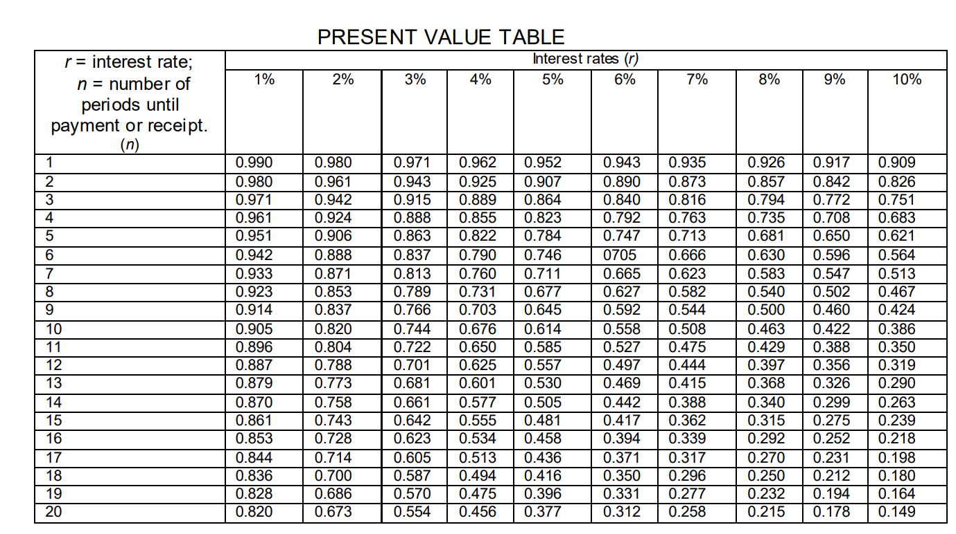

Slide 38
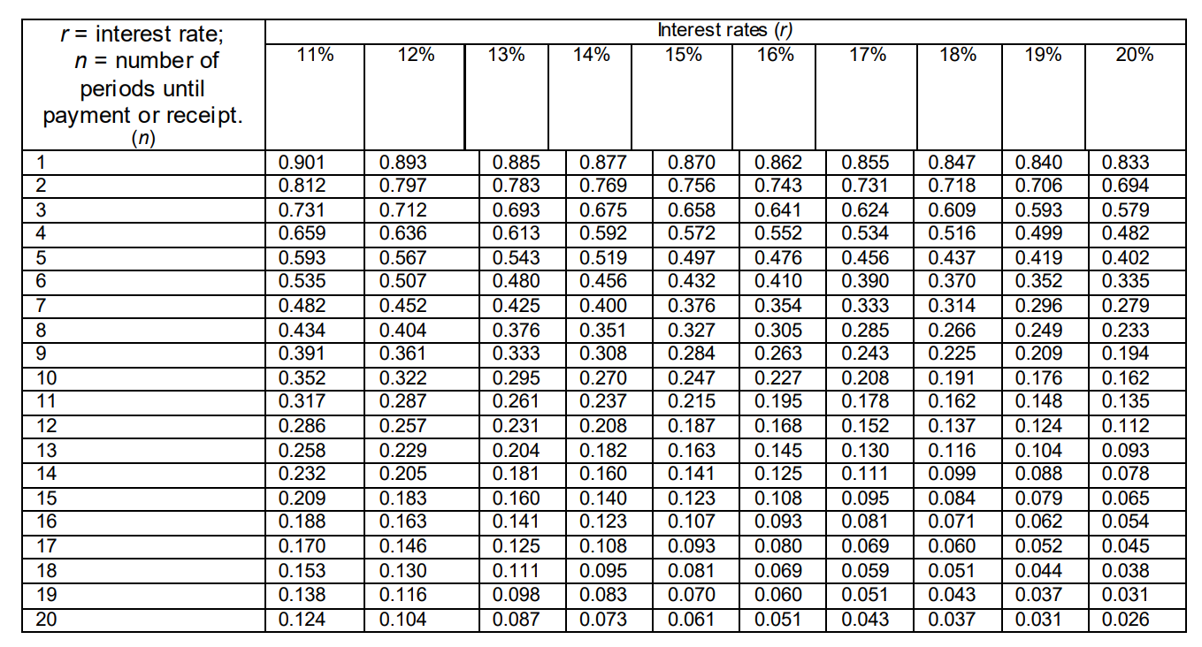

Slide 39
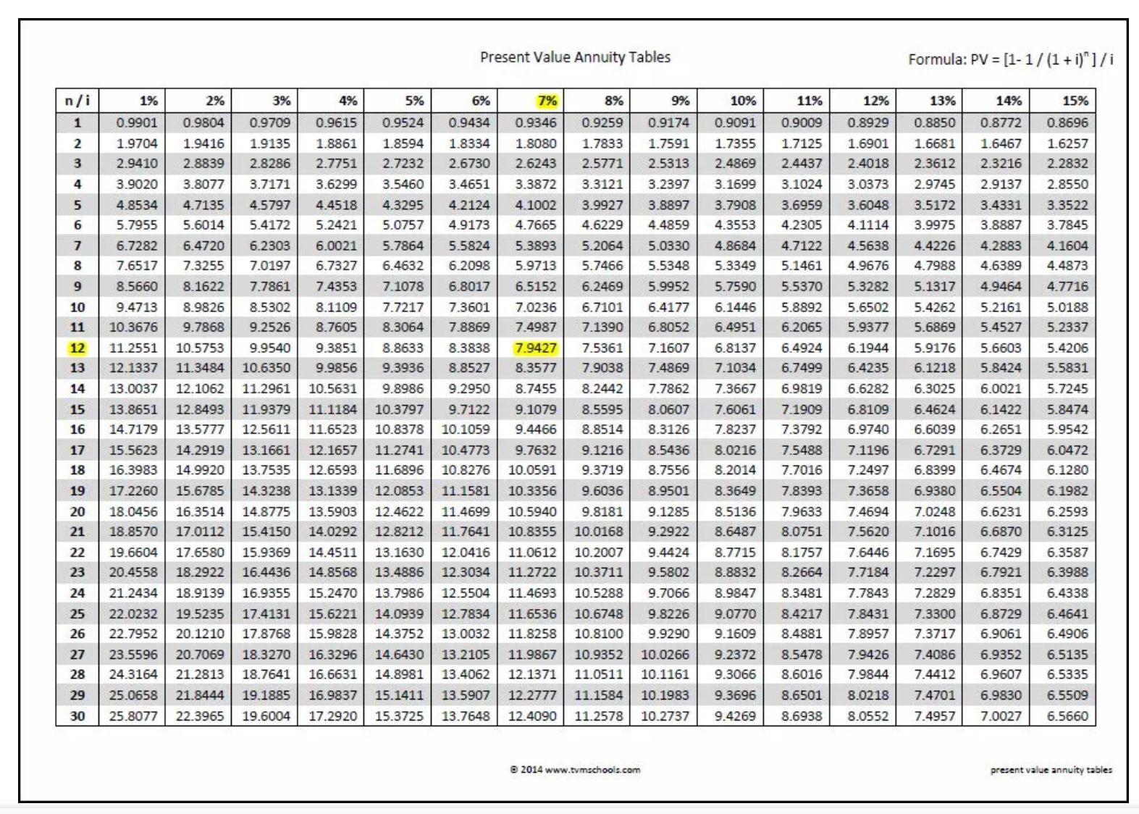

Slide 40
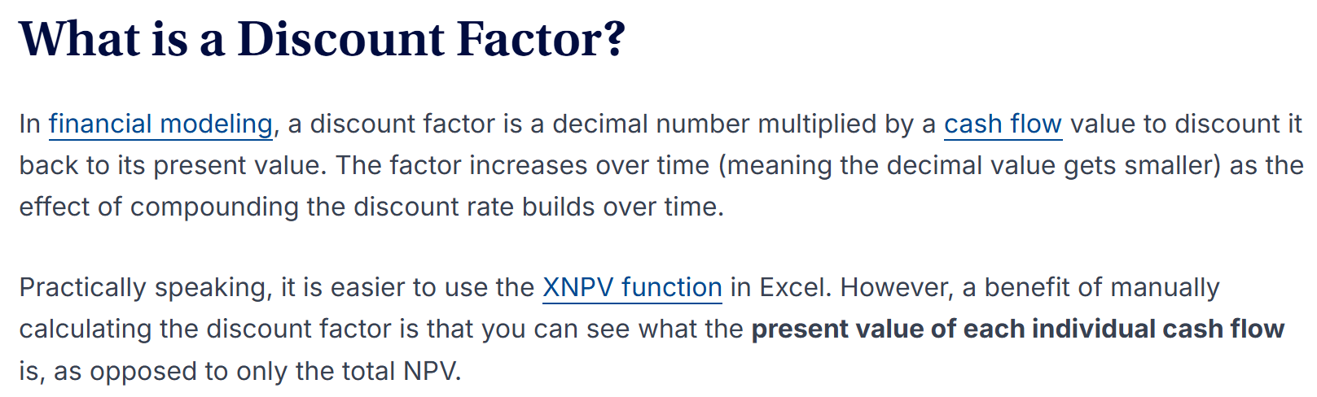

Slide 41
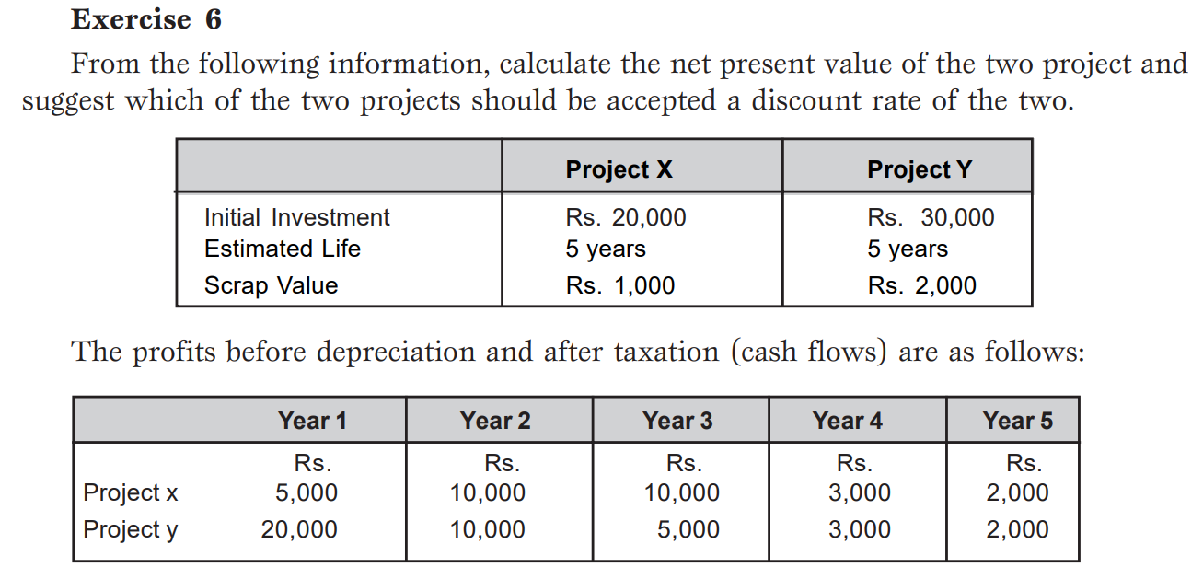
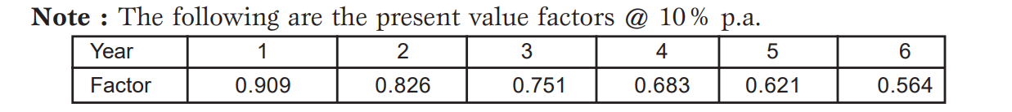

Slide 42
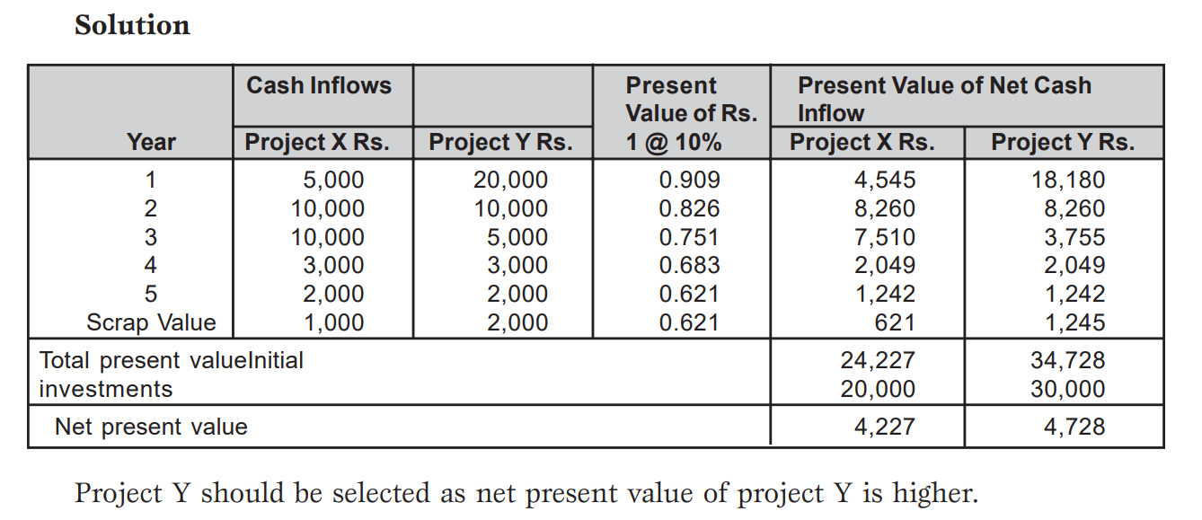

Slide 43
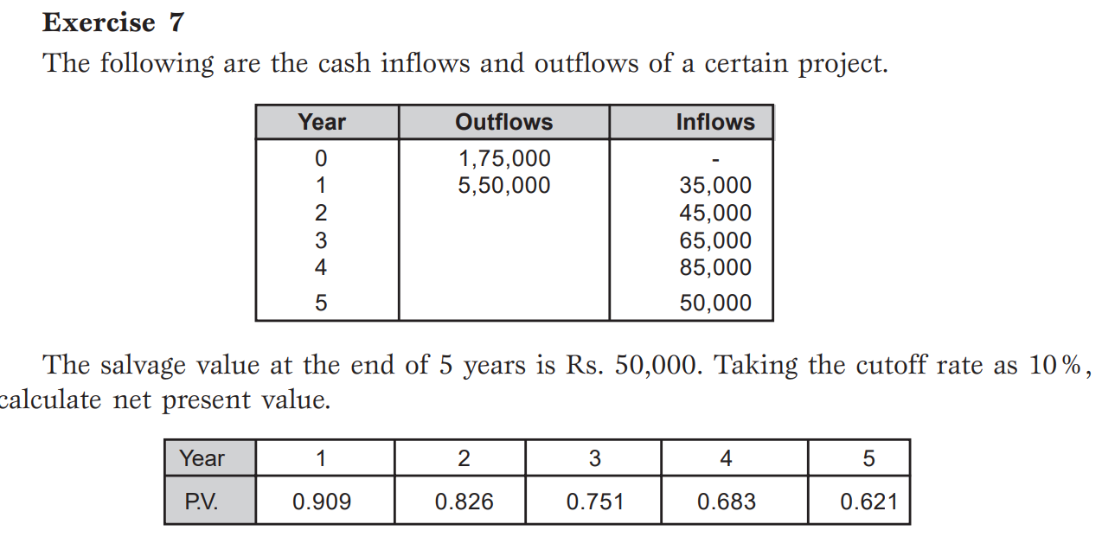

Slide 44
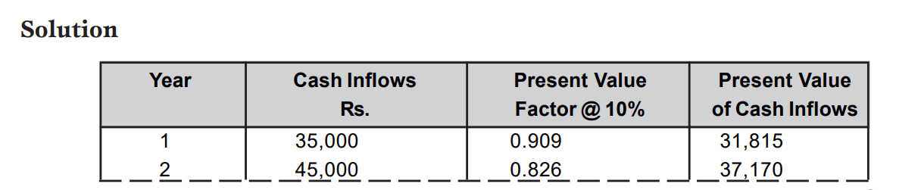
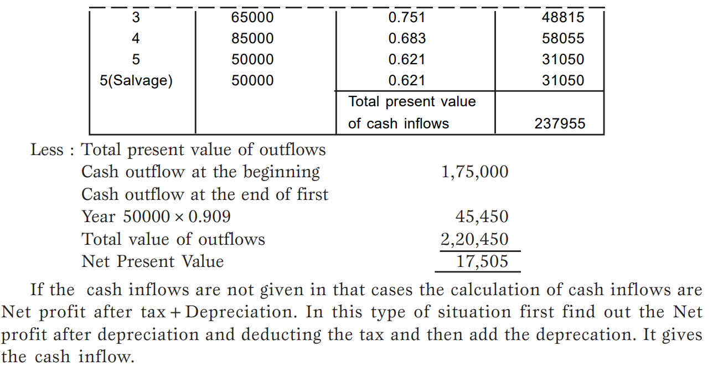

Slide 45
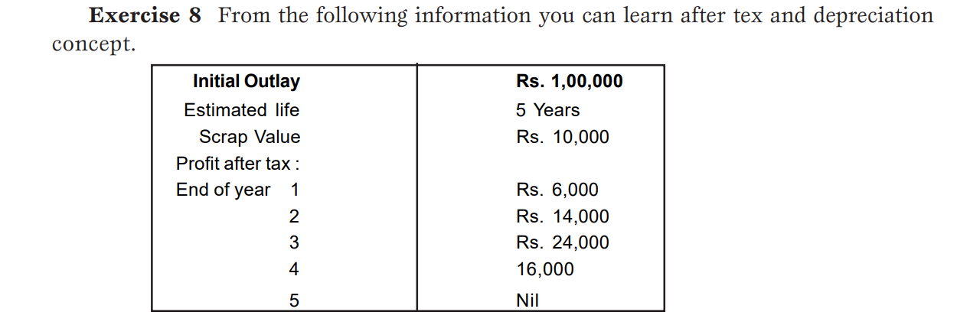

Slide 46
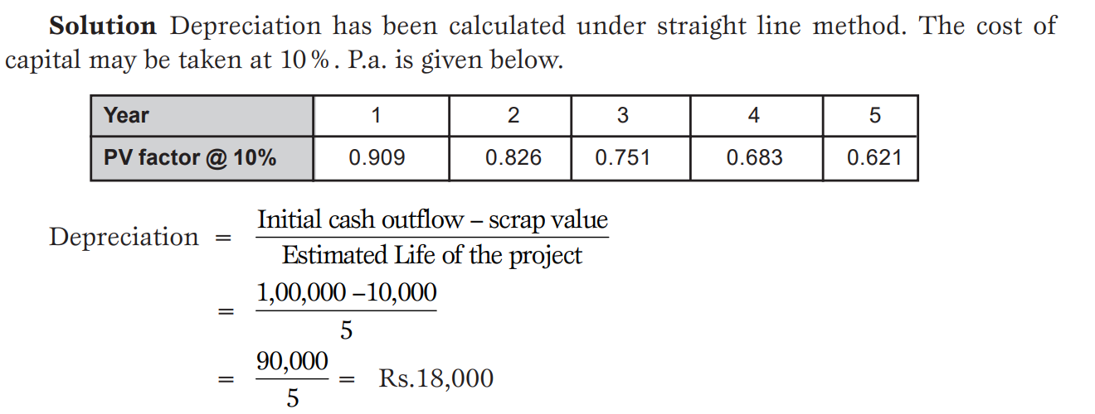

Slide 47


Slide 48


Slide 49


Slide 50


Slide 51


Slide 52



Slide 53


Slide 54



Slide 55


Slide 56


Slide 57


Slide 58


Slide 59


Slide 60


Slide 61


Slide 62


Slide 63



Slide 64


Slide 65



Slide 66


Slide 67



Slide 68



Slide 69


Slide 70


Slide 71


Slide 72


