Slide 1
Why me?
Scott Hayward
1807527

Slide 2
Personal Information
Scott Hayward
25 years old
Plasmarl Primary School – TA
Experience?
4 years working in the education sector and a sporting background related to education, work and hobby.
Goals?
Skills and abilities?
Determined, confident, approachable, flexible, practical, adaptable, observant, growth mind set, professional, patient and resilient.

Slide 3
Vision
Why be a teacher?
Role model, Passion for the job, rewards, experiences, teach children to be empathetic as well as myself, teaching children how to build relationships, teaching children skills to equip them for life and creating an environment to make the children feel safe and excited to learn.
What would my classroom look like?
Clear learning zones, visual, displays, systems and routines, organised, resources, safe, exciting, cater to children of all abilities, nationalities and religions.
What would my learners look like?
Problem solvers, independent, have a growth mind set, confident, healthy, ambitious and not afraid to fail.

Slide 4
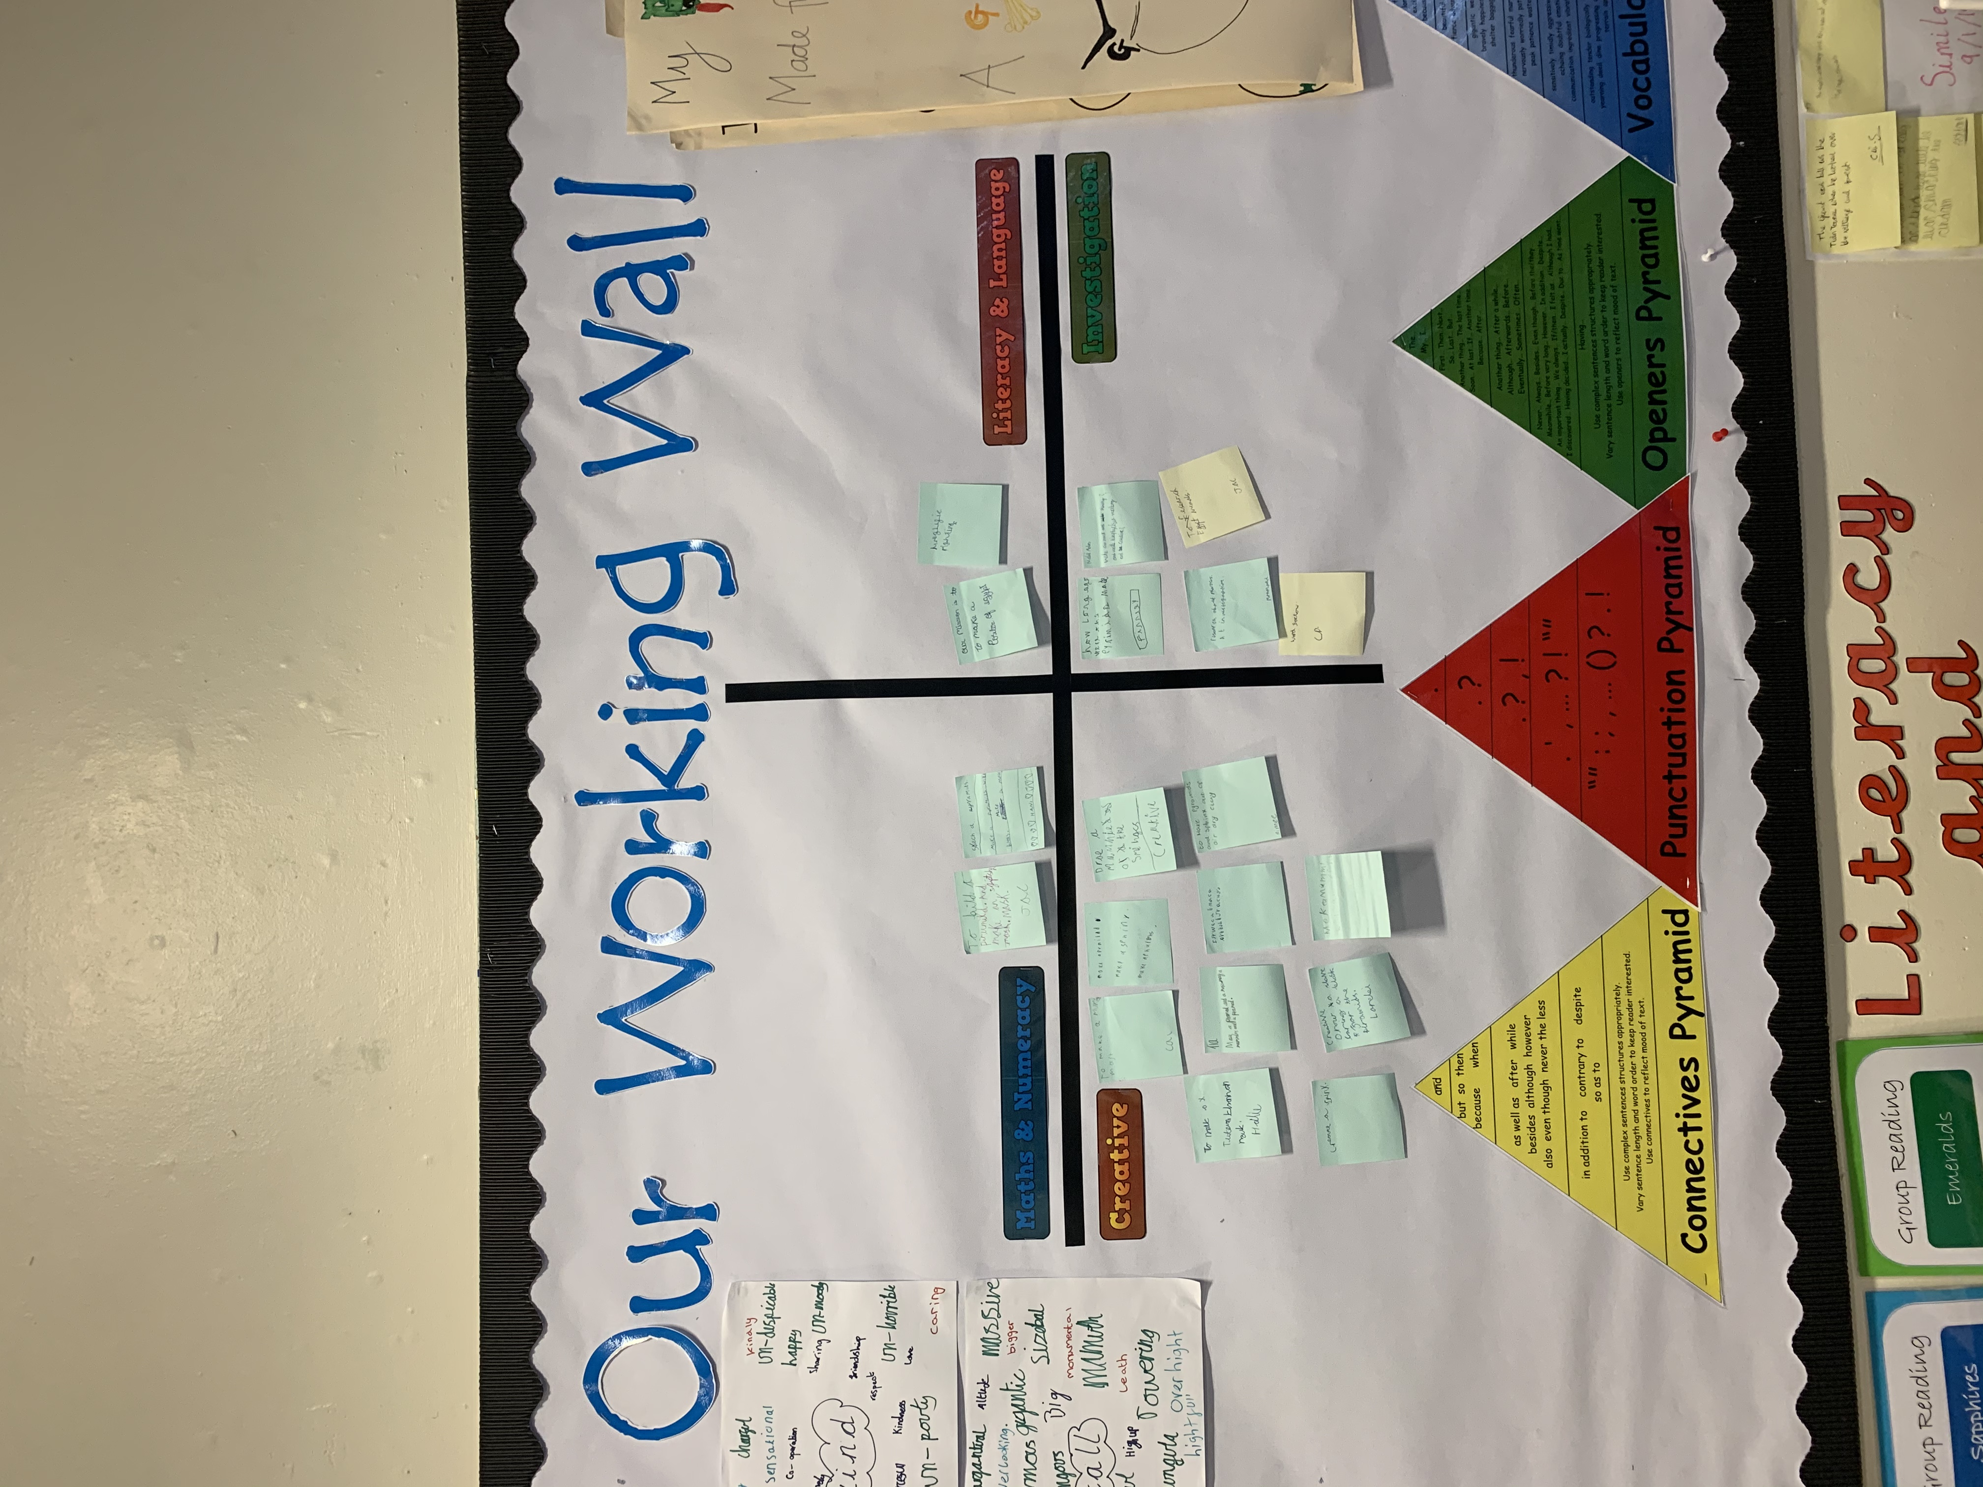
Interactive Display
(Source: Hayward, 2020)

Slide 5
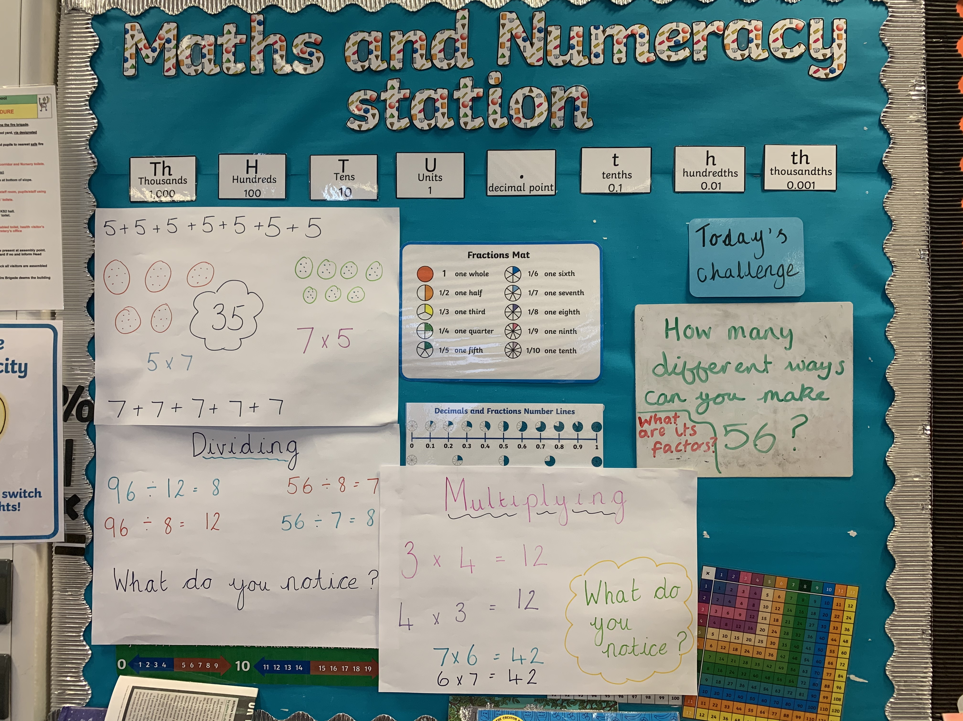
Interactive Display
(Source: Hayward, 2020)

Slide 6
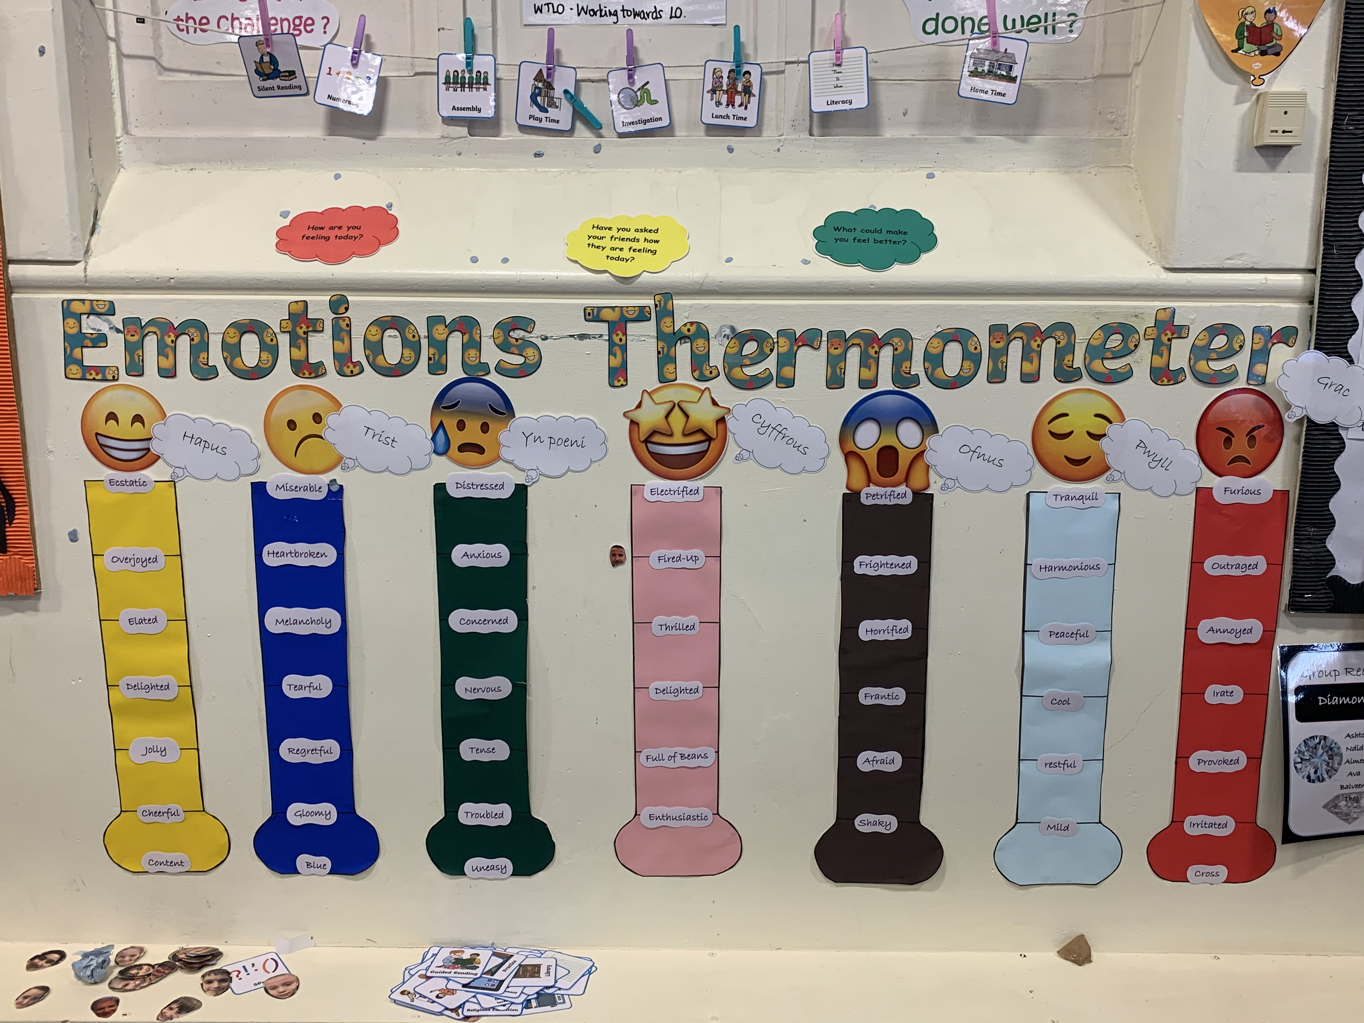
Interactive Display
(Source: Hayward, 2020)

Slide 7
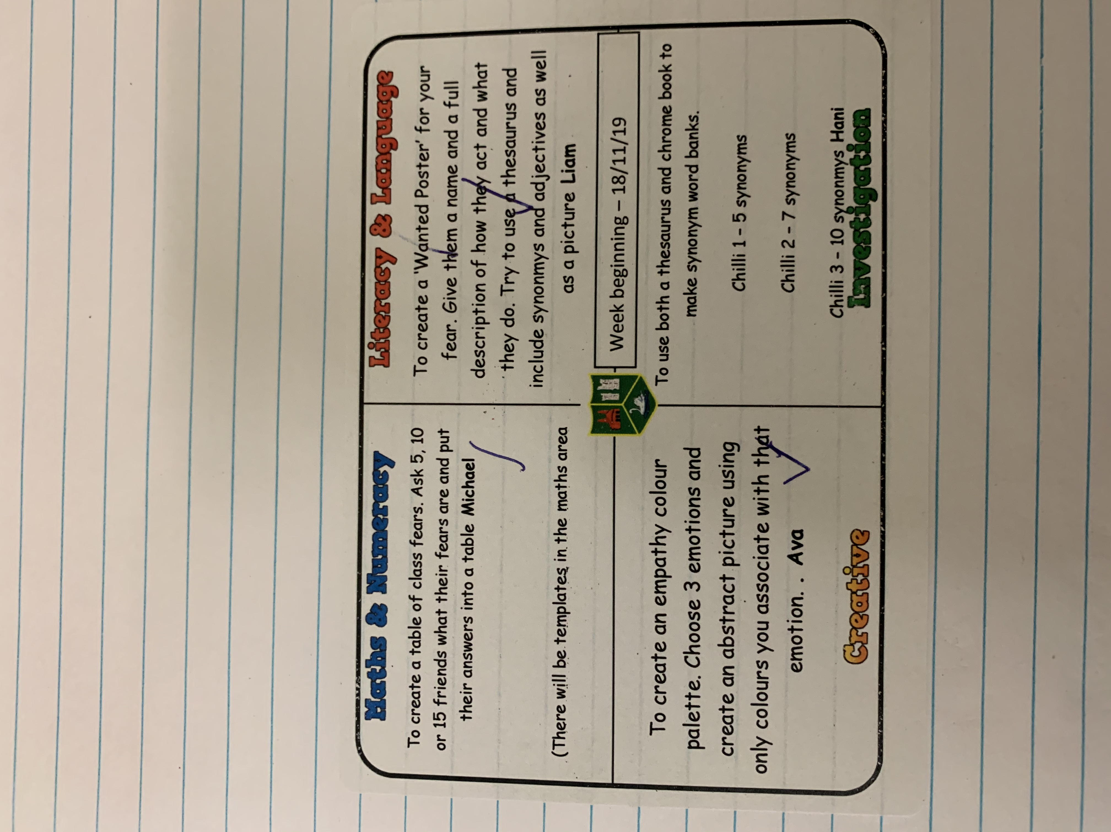
Mission Sticker
(Source: Hayward, 2020)

Slide 8
New Curriculum
The last curriculum was introduced in 1993 and at that time, smart phones and tablets did not exist. However, due to the progression of technology and globalization, the way we live has changed. Every school, teacher and staff within the school must try to be more flexible and react to these changes.
The new curriculum will encourage higher achievement, attract the interest and inspire all children. In hope this will help them to reach their full potential.
To encourage this high achievement and interest of children, learning will become more experienced based with the children learning in a authentic context. All staff within the school will have the flexibility to deliver lessons in a more creative way which will suit the learners that they teach.
With this new curriculum comes a new digital competence framework (DCF). This introduces new digital skills to the children across the curriculum. The purpose of this is to prepare young people for the opportunities and risks that can appear online.
The curriculum should be a child influenced curriculum. The children will have a say but will not dictate.
(GOV.WALES, 2019)

Slide 9
New Curriculum
Ambitious, capable learners
Ready to learn throughout their lives
The New curriculum begins with four purposes that mean the children will be:
The four purposes are a driver, everything we do as professionals needs to reflect the four purposes.
Ethical informed citizens
Ready to be citizens of Wales and the world
Enterprising, creative contributors
Ready to play a full part in life and work
Healthy, confident individuals
Ready to lead fulfilling lives as valued members of society

Slide 10
New Curriculum
It is also suggested that the curriculum should be organised into six ‘Areas of Learning and Experience’ (AoLE). Each of these areas will contribute towards the four purposes.
These AoLEs will run from 3 until 16 years of age.
The six areas will cover all existing subjects and disciplines, they intend to promote collaboration and work together as a holistic curriculum (Hwb.gov.wales, 2019).
EXPRESSIVE ARTS
HEALTH AND WELL-BEING
HUMANITIES
MATHEMATICS AND NUMERACY
LANGUAGES, LITERACY AND COMMUNICATION
SCIENCE AND TECHNOLOGY

Slide 11
New Curriculum
Along with the four purposes and six areas of learning and experience, the new curriculum will have three cross curricular responsibilities which aim to build a solid foundation for learning.
These three responsibilities will be taught through all six of the AoLEs.
This will benefit children as modern society and workplaces already demand high levels of digital skill. With this, the new DCF will develop the ability to establish progression in children’s learning.
In addition, there will be skills embedded across the curriculum which are necessary for modern life and work. These include:
> Critical thinking and problem solving > Creativity and innovation
> Planning and organising > Personal effectiveness
LITERACY
NUMERACY
DIGITAL COMPETENCE

Slide 12
New Curriculum
Descriptions of Learning
Children work through a continuum called descriptions of learning. They should be identified in each AoLE. Designed to allow space to develop skills and knowledge and support for children whose progress is slower.
Descriptions of learning should be at 5, 8, 11, 14 and 16 years of age.
Achievements should be described in child friendly language. Using, ‘I have…’ for experiences and ‘I can…’ for outcomes.

Slide 13
Additional Learning Needs and Education Tribunal (Wales) Bill
Reasons for change
The previous SEN legislation is 30 years old
It was not child-centred
Obstacles for families
Support unclear
(Additional learning needs (ALN) transformation programme, 2017)

Slide 14
Additional Learning Needs and Education Tribunal (Wales) Bill
Main changes
Children and young people will no longer be given statements. Instead, they will be given a ‘Individual Development Plan’ (IDP). The IDP will consist of a profile page, evidence for the action proposed, agreed action plan and names and contact details for everyone involved. The IDP is separate to a ‘Individual Education Plan’ (IEP).
The IDP will remain with that person until the age of 25.
Collaboration increase by involving the child, family, professionals and the school the child attends.
Terminology change with the removal of the term ‘Special Educational Needs’ (SEN) and replaced with ‘Additional Learning Needs’ (ALN). Also, ‘Special Educational Needs Coordinator’ (SENCO) will now be referred to as ‘Additional Learning Needs Coordinator’ (ALNCO).
Child-centred
High aspiration / improved outcomes
Simple system / less adversarial
(SNAP Cymru, 2020)

Slide 15
Reference List
Additional learning needs (ALN) transformation programme. (2017). pp.2-4.
GOV.WALES. (2019). New school curriculum: overview | GOV.WALES. [online] Available at: https://gov.wales/new-school-curriculum-overview [Accessed 15 Jan. 2020].
Hayward, S. (2020) Personal image. [Digital photograph].
Hwb.gov.wales. (2019). A guide to Curriculum for Wales 2022 - Hwb. [online] Available at: https://hwb.gov.wales/draft-curriculum-for-wales-2022/a-guide-to-curriculum-for-wales-2022#areas-of-learning-and-experience [Accessed 16 Jan. 2020].
SNAP Cymru. (2020). ALN/SEN Reform - SNAP Cymru. [online] Available at: http://www.snapcymru.org/help-for-families/aln-reform/ [Accessed 15 Jan. 2020].

