Slide 1


Strategic Management of marine and coast

Slide 2
Lecture Outline
Recap of recent horizon scanning activity in marine and coastal environment.
Large-scale management frameworks for coastal management.
Shoreline Management Plans

Slide 3
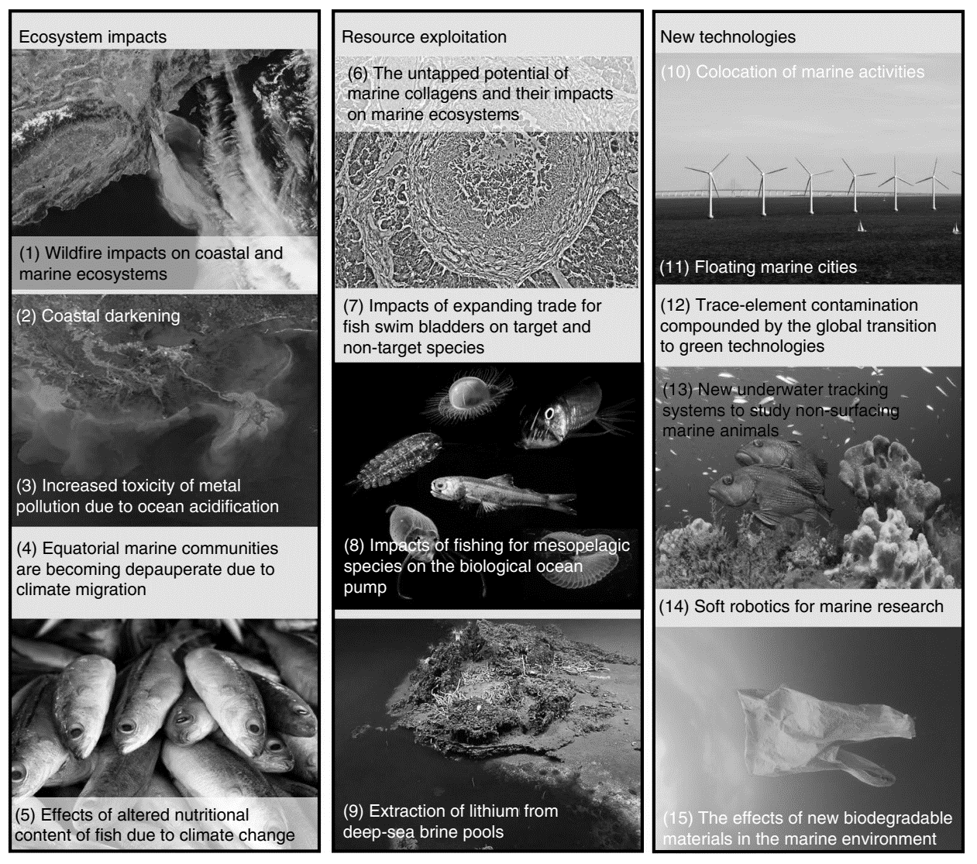
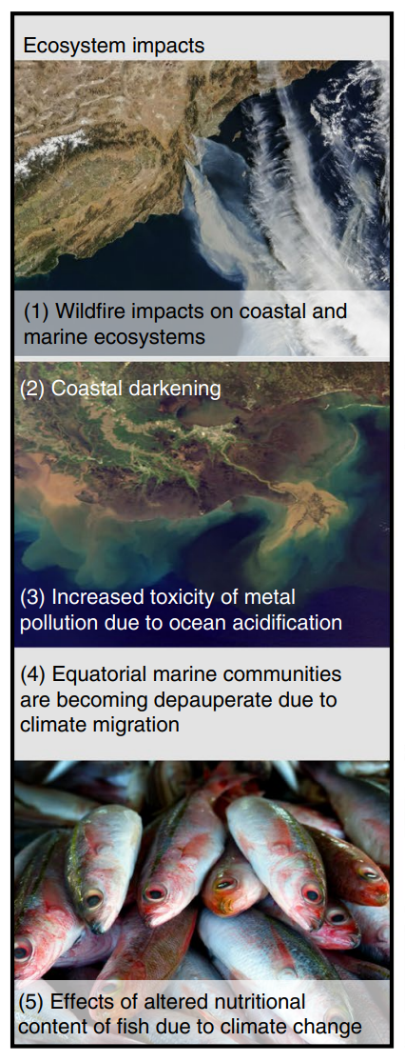
ECOSYSTEM IMPACTS
ECOSYSTEM IMPACTS
A global horizon scan of issues impacting marine and coastal biodiversity conservation | Nature Ecology & Evolution

Slide 4
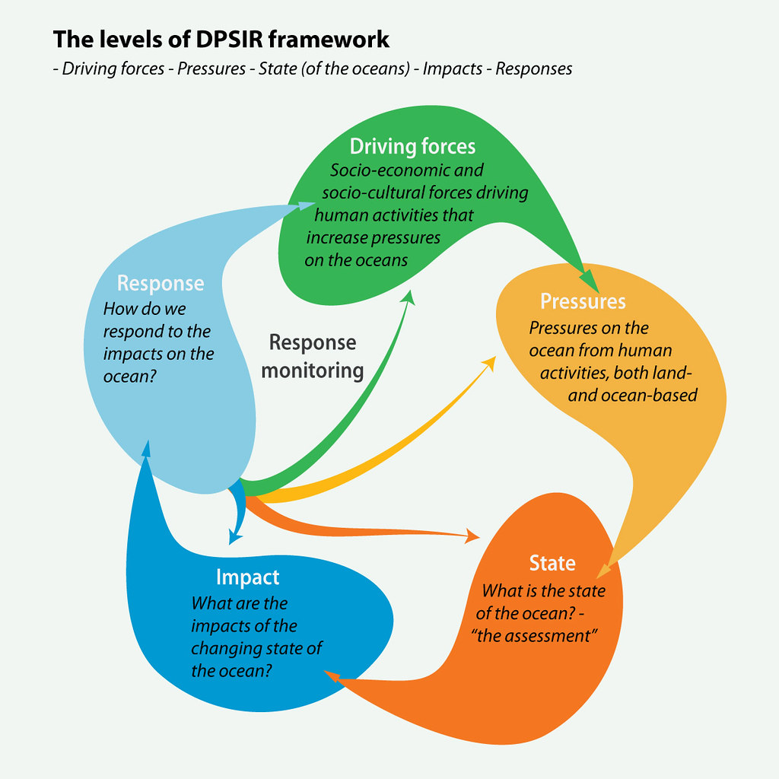
DPSIR Framework
The DPSIR framework (Driving Forces-Pressures-State-Impacts-Responses) is used to assess and manage environmental problems.
The levels of DPSIR framework | GRID-Arendal (grida.no)

Slide 5
DPSIR Framework
Driving forces are the socio-economic and socio-cultural forces driving human activities, which increase or mitigate pressures on the environment.
Pressures are the stresses that human activities place on the environment.
State, or state of the environment, is the condition of the environment.
Impacts are the effects of environmental degradation.
Responses refers to the responses by society to the environmental situation.
The levels of DPSIR framework | GRID-Arendal (grida.no)

Slide 6
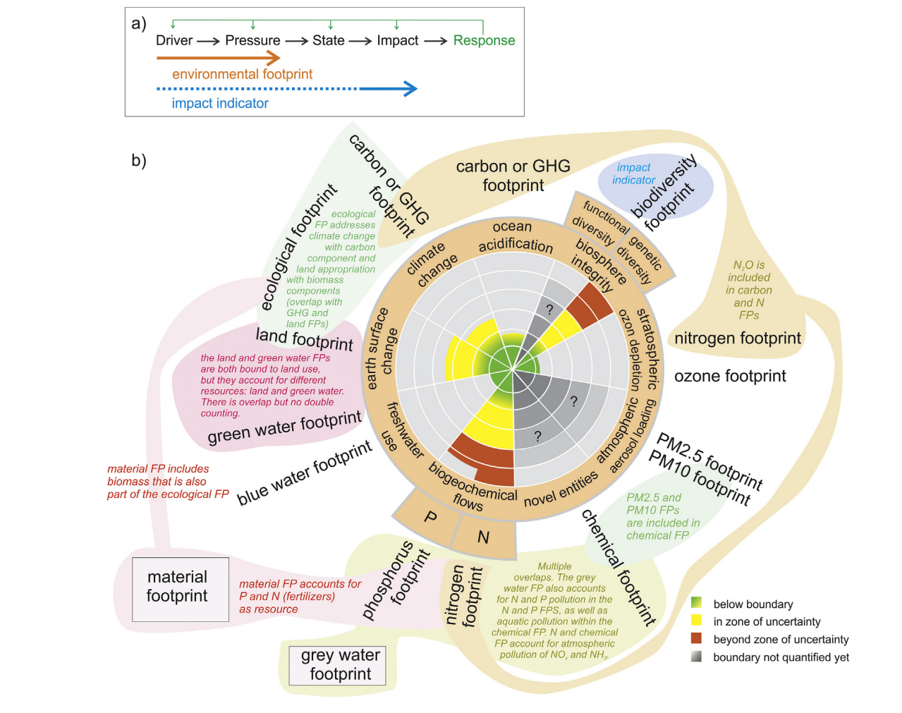
DPSIR Framework
(PDF) Environmental footprint family to address local to planetary sustainability and deliver on the SDGs (researchgate.net)
Linear representation of the DPSIR framework (drivers, pressure, state, impact and response) (OECD, 2003) and its theoretical relationship with environmental footprints and impact indicators.

Slide 7
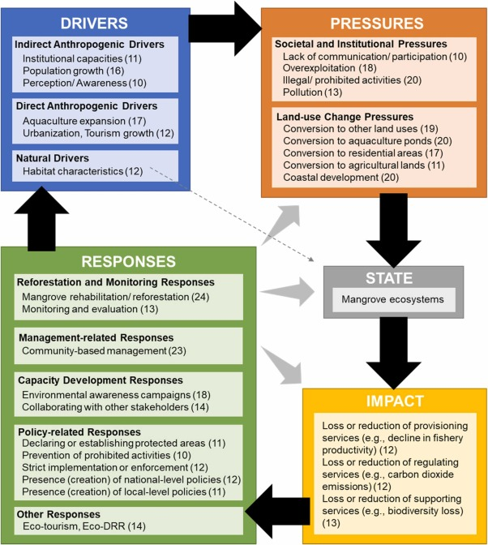
DPSIR Framework
Applying the DPSIR framework to qualitatively assess the globally important mangrove ecosystems of Indonesia: A review towards evidence-based policymaking approaches - ScienceDirect
The DPSIR framework of Indonesia. The number in parenthesis indicates the number of provinces mentioning the component. The D, P, I, and R components with at least 10 provinces are reflected in this figure.

Slide 8
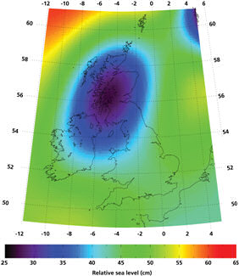
The scale of the challenge – sea level rise
12-76cm sea level rise by 2080. Under UKCP09, the mean estimate sea level rise to 2080 is around 30-40cm, although it could be between 12cm – 76cm – uncertainty is high.
Extreme predictions of up to 1.9m by 2100
Wave height changes unclear: Winter mean -35cm to +5cm, annual maxima -1.5m to +1m
Project Record: UK Climate Projections 2009 (UKCP09) (ceda.ac.uk)
Notes:
Scale of the challenge (1)
Sea level around the UK rose by about 1mm/yr in the 20th Century, corrected for land movement. The rate for the 1990s and 2000s has been higher. All the evidence suggests that sea levels will continue to rise and accelerate globally. We can expect this to continue for centuries. Under UKCP09, the mean estimate sea level rise to 2080 is around 30-40cm, although it could be between 12cm – 76cm – uncertainty is high.
Although extreme sea levels have changes there is no observational evidence for regional trends in either storm surge frequency or magnitude over recent decades.

Slide 9
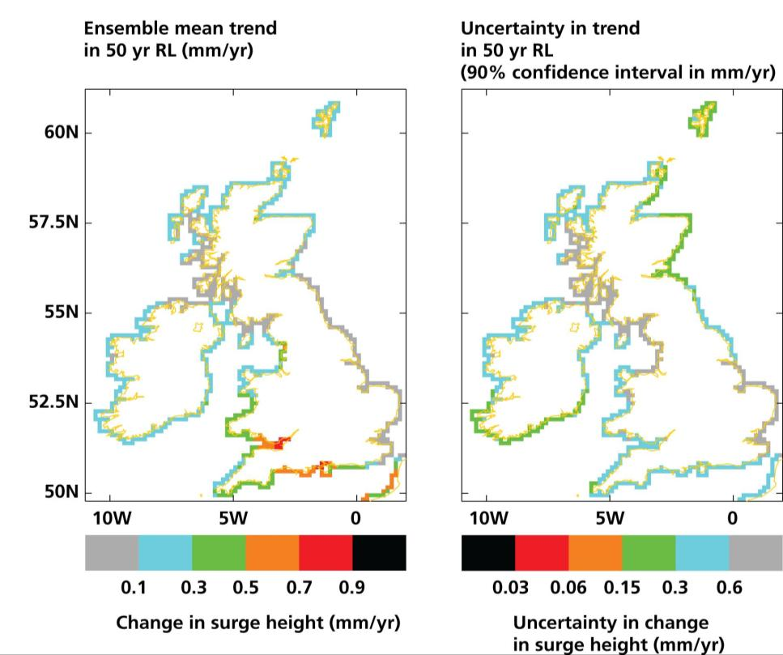
Storm surge
UKCP09 predicts storm surge to be not more than 90mm anywhere in UK, but this is on top of sea-level rise.
It is widely thought that storm surges will increase in frequency and height, but data is inconclusive. The best information we have suggests maximum increases of 90cm, focussed in the south and south east. Storm surge levels are predicted to increase by no more than 9cm by 2100.
Notes:
Scale of the challenge (2)
It is widely thought that storm surges will increase in frequency and height, but data is inconclusive. The best information we have suggests maximum increases of 90cm, focussed in the south and south east. Storm surge levels are predicted to increase by no more than 9cm by 2100.

Slide 10
Rainfall patterns
UKCP02 UKCP09
More intense rainfall
contributing to cliff
erosion?
We can expect increases in precipitation that, together with sea level rise and storm surge changes, might have implications for coastal erosion acting in parallel with groundwater interactions with landslip.
50% probability level, central estimate
Notes:
Scale of the challenge (3)
Finally, we can expect increases in precipitation that, together with sea level rise and storm surge changes, might have implications for coastal erosion acting in parallel with groundwater interactions with landslip.

Slide 11
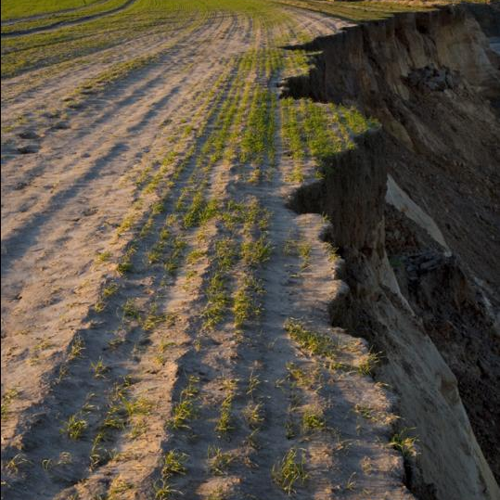
Risk to people and property
Approximately 1.3 million people at coastal flood and erosion risk in England & Wales
About 1 in 25 properties are at risk from sea flooding
About a quarter of the coastline eroding at >10cm/year – but up to almost 2m/yr in some places
740 properties at risk from erosion in next 20 years
Notes:
Scale of the challenge (4)
Defences will become more vulnerable and exposed to the impact of waves if we attempt to maintain the status quo, increasing demands on the national budget for maintenance and improvement. Communities living behind good coastal defences currently protecting them against a flood with a chance of occurrence of 1 in 100 each year would experience a drop in standard of protection by the end of the century to as low as 1 in 5.

Slide 12

Shoreline Management Plans
Shoreline Management Plans (SMPs) set out a shared strategic approach for managing the coastline from coastal flooding and erosion risks. Their aim is to reduce the risks to people, the developed, historic and natural environments over the next century.
A long-term perspective is fundamental to Shoreline Management Plans so that implications of coastal change can be identified.
In some areas there is a need to continue to defend the coastline from flooding and erosion. In other areas, sections of the coast will be allowed to evolve naturally to adapt to changing environmental conditions.

Slide 13

Shoreline Management Policy Plan
The choice of Shoreline Management Plan policy for a section of coast is informed by a review of available evidence and an assessment of:
coastal processes
coastal flood and erosion risks
coastal defence condition
policy development testing and appraisals
environmental impacts informed by Habitat Regulations Assessment, Strategic Environmental Assessment, Water Framework Directive Assessment
social factors
economic appraisal
climate change
local factors
interactions with neighbouring areas

Slide 14

Development of SMP
Shoreline Management Plans have been developed by Coastal Groups, whose members include:
Natural Resources Wales
Maritime local authorities
government bodies
other stakeholders with a responsibility or interest in managing the coast
The Plans have been subject to peer review and public consultation. Coastal Groups then agreed the Plans, which were also approved by local council cabinets before they were signed off by the Welsh Government.
Shoreline Management Plans aren’t statutory documents, but the Welsh Government want to see them considered both in local decision-making and strategic planning, such as Local Development Plans and Local Flood Risk Management Strategies produced by local authorities.
At the coast, local authorities are usually the Local Planning Authority, unless the location is within a National Park such as Eryri or Pembrokeshire Coast National Park which then acts as the Local Planning Authority.

Slide 15
Managing sections of the coast
Shoreline Management Plans split the coastline into small sections (called policy units) and describe how these sections will be managed over the:
short-term (2005-2025)
medium-term (2025-2055)
long-term (2055-2105)
There are four approaches that can be applied to each policy unit, for each period of time, including:

Slide 16
Managing sections of the coast
Managing sections of the coast
Shoreline Management Plans split the coastline into small sections (called policy units) and describe how these sections will be managed over the:
short-term (2005-2025)
medium-term (2025-2055)
long-term (2055-2105)
There are four approaches that can be applied to each policy unit, for each period of time, including:

Slide 17

4 approaches
There are four approaches that can be applied to each policy unit, for each period of time, including:
Hold the line (HTL) by maintaining or changing the existing standard of protection
Advance the line (ATL) by building new defences on the seaward side of the original defences (although none applied in Wales)
Managed realignment (MR) which allows the shoreline to move backwards and forwards, with management to control or limit the movement
No active intervention (NAI) where there is no investment in coastal defences and natural processes are allowed to continue to create an evolving coastline

Slide 18
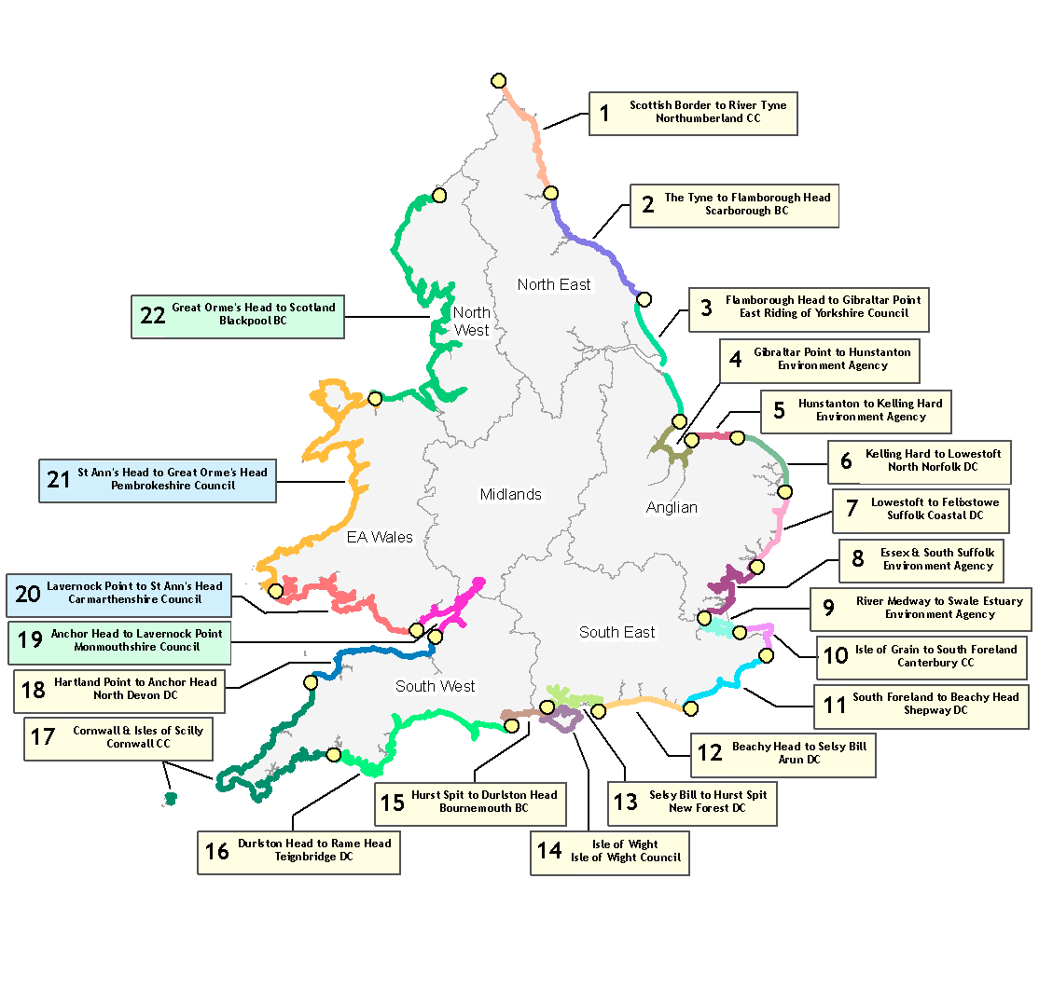

Shoreline Management Plans (1)
Hold the Line
No Active Intervention
Managed Retreat
Advance the Line
Notes:
Managing for uncertainty (2)
First, a little more on the strategic planning approach we use for FCRM in England. Outline of SMPs – boundaries defined by natural geography so local authorities must work together strategically. Four main policy options for each management unit. 22 around E&W.

Slide 19
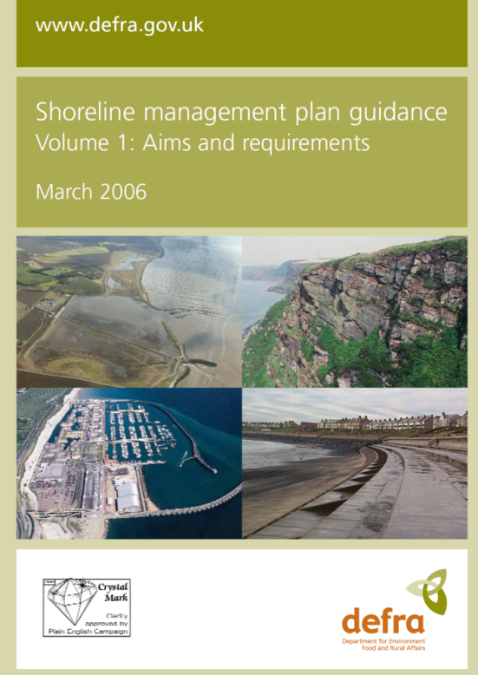
Shoreline Management Plans (2)
Not development plans, and not statutory
Intensive public engagement and consultation
Long-term - set the ‘direction of travel’
Can be challenged, changed and are subject to funding availability
Use consistent data sets informed by local expertise
Notes:
Managing for uncertainty (3)
[as per slide]

Slide 20
Challenges for adaptation
Roll-back:
  Is land available, is it cost-effective, is it technically feasible?
Relocation:
  Homeowners were not always happy with new plots
  …and didn’t always want to move as a ‘community’
  Replacement plots sometimes contested by residents
Buy-and-lease:
  Large initial outlay for local authority, slow unpredictable returns
  Setting fair payments without ‘compensating’ is difficult
Managed re-alignment:
  Working with natural processes vs biodiversity/ecosystem function
  Often seen as a threat by communities – engagement intensive
  Controversy surrounding ‘food security’, budget use, landscape etc

Slide 21

Challenges for the strategic approach
Engaging people about long term risk – 20 years as ‘short term’
01
Empowering people to make decisions on sound but changing evidence
02
Encouraging investment security whilst retaining flexibility
03
Keeping strategic plans ‘living’ and active
04
Communicating uncertainty whilst maintaining authority
05
Giving people options now to change in the future
06

Slide 22
Shoreline Management Plans
Activity: Click on the following link:
Flood and Coastal Erosion Risk Maps (naturalresources.wales)
Apply the DPSIR Framework to a region that has a SMP in Wales. Do you agree with the selected responses?

Slide 23
Shoreline Management Plans
Activity: Click on the following link:
Flood and Coastal Erosion Risk Maps (naturalresources.wales)
Apply the DPSIR Framework to a region that has a SMP in Wales. Do you agree with the selected responses?
Atlantic Ocean circulation nearing ‘devastating’ tipping point, study finds | Oceans | The Guardian

