Slide 1

CHILDREN,YOUNG PEOPLE AND FAMILY

Slide 2
Children, Young Adult, and Family Wellbeing
Malika Ali - 2026355
Omeneke Yusuf - 2009232
Amina Bibi - 1807446
Chantiana Rowe - 1905374
Bushra Khan - 1818384

Slide 3
Introduction
We will discuss:
Children and family perception of wellbeing
The key domains of children and family wellbeing
The policies that are present to help such families
Different multidisciplinary services will help them meet their welfare needs.
Notes:
Hello, my name is -----, and these are my group members, ---------. Our presentation will be focused on the Family A of the case study. We will discuss children and family perception of wellbeing, the key domains of children and family wellbeing, and analyze the policies that are present to help such families. Furthermore, we will also discuss how the different multidisciplinary services will help them meet their welfare needs.

Slide 4

Children and Family Perception of Wellbeing
The wellbeing of an individual is highly dependent on their relationship to their family
Socioeconomic status has a huge impact on the wellbeing of children and family
Ethnicity also plays a role in perception of wellbeing
The sense of wellbeing in children of different ages was linked to different reasons
This Photo by Unknown author is licensed under CC BY-SA-NC.
Notes:
The wellbeing of an individual is highly dependent on their relationship to their family. The social support, that is giving love, taking care, and giving advice, as well as strain, that is being critical and demanding, given by family members can affect the wellbeing of an individual through behavioral, psychosocial, and physiological pathways. The main components of stress process theory are social support and stressors. Stress has a negative impact on mental health, whereas social support has a positive impact on wellbeing. People who receive support from their family usually have high self-esteem which leads to better mental health. Socioeconomic status has a huge impact on the wellbeing of children and family. According to studies, people belonging to lower socioeconomic status are less attached to their siblings, which leads to multiple consequences, such as depression, drug abuse, and depression. A lower socioeconomic class also leads to parents being stressed, which further hampers the wellbeing of the family as a whole. If the basic necessities are not fulfilled, the parents feel inadequate, and the children feel uncared for. Ethnicity also plays a role in sibling relationships, for example black caregivers are more likely to have siblings who also provide care to their parents as compared to white caregivers. The sibling caregiving leads to lower sense of wellbeing among white caregivers as compared to black or another minority caregivers (Thomas, Liu and Umberson, 2017).
According to studies, the sense of wellbeing in children of different ages was linked to different reasons. 8-year-old children were more concerned with relationships with friends and freedom. Whereas 12-year-old children’s wellbeing was linked more to being satisfied with their school marks. 7-year-old children’s wellbeing was less linked to socio-economic, parents, and family-related factors, rather their wellbeing was more dependent on their relationships with family and friends and feeling safe from social exclusion and bullying (Andresen, Bradshaw and Kosher, 2018).

Slide 5
Key Domains of Children and Family Wellbeing
The five main domains of children and family wellbeing are:
Family relationship
Socioeconomic status
Health and Safety
Social Inclusion
Religion/Spirituality
Notes:
Wellbeing can be defined as the continuous existence of positive characteristics or attributes. The five main domains of children and family wellbeing are:
Family relationship
Socioeconomic status
Health and Safety
Social Inclusion
Religion/ spirituality
The issues faced by Family A of the case study were domestic violence, financial instability, non-payment of rent, potential parental, alcohol problems and parenting issues. Their low socioeconomic status contributed to these problems. Domestic violence is found more in the lower socioeconomic class. Financial issues contribute to issues in the relationships of the family members as well. Financial issues also contribute to health problems, and housing issues. By overcoming their financial issues, Family A may significantly benefit (Pannilage Upali, 2017).

Slide 6
POLICIES AND INTERVENTIONS
The Children Act of 2004 does not replace or amend the Children Act of 1989. It adds to it.
It promotes the well-being of every child by fulfilling the five principles:
be healthy
stay safe
enjoy and achieve
make a positive contribution
achieve economic well being
Notes:
To safeguard children, there have been several legislations introduced which protect the rights of children. The “Children Act 1989” was introduced in 1989 which is employed by authorities and gives every child the right to protection and keeps them safe from abuse and exploitation. This act also gives the authorities the right to conduct inquires and investigations if they feel as if any child is at risk of exploitation or their welfare is at risk. This act was amended in 2004 and was thus implemented as the Children Act 2004. The basic principle of the act is that if the welfare of a child is threatened the courts reserve the right to intervene. This intervention is allowed after the relevant authorities such as social workers and health care and legal authorities have conducted a thorough investigation and determined that the welfare of the child is at risk. The courts are then allowed to intervene and bring about a decision concerning the upbringing of the child under this legislation This places a great importance on this legislation since it determines that for a child welfare, the legislation holds more importance than their parents view or the view of any other caretaker or adult within the child's life. The Children Act 2004 was introduced not as an amendment of the Children Act 1989 but rather detail the process of integrity services for the welfare and protection of children in England and created the position of children commissioner of England. It is this legislation that places a duty on regulatory authorities such as the police, health service providers and the youth justice system who come together to promote the welfare of children. It was in 2010 that and independent review of children social work and child protection practice was conducted by the new government to implement new policies and amazing practices to promote the welfare of children. The new findings were accepted, and the new government committed to implementing these findings as well (Evans, 2013).

Slide 7
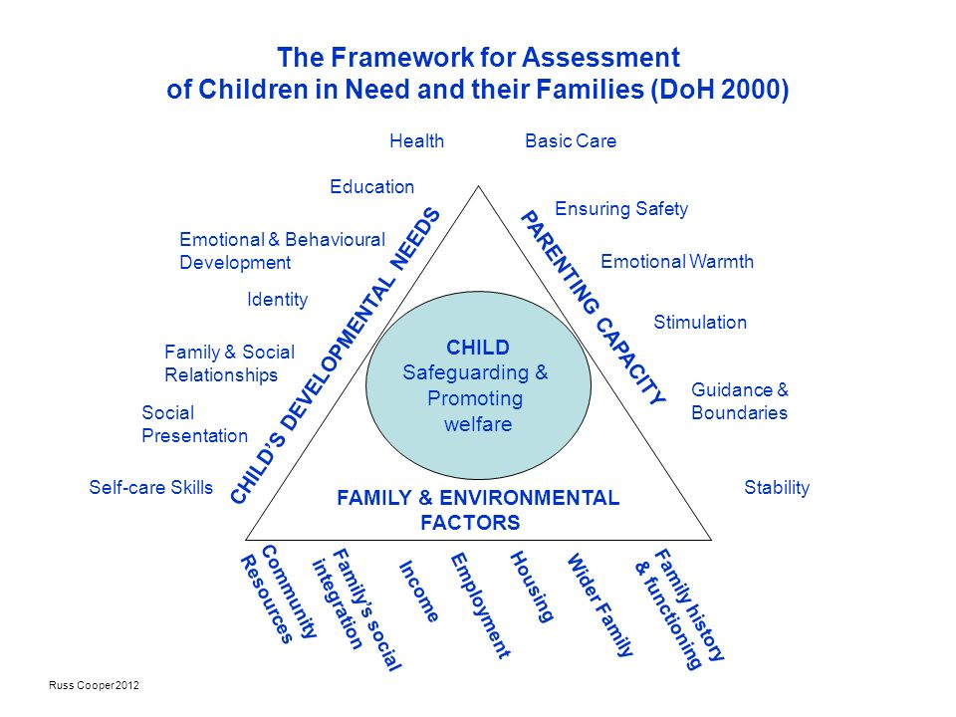
Policies and Professional Intervention
(Blackburn and Dwyer, 2016)
Notes:
Child abuse and maltreatment is a very tragic occurrence within the UK which is why there is a defined intervention process in place that is utilized by health and social care workers in order to act in the best interest of the child. This intervention process can be based upon (CAF). This framework was introduced in order to support early intervention in cases of child maltreatment and improvise multi agency working. The common assessment framework was developed keeping in mind the child's developmental needs, the family and environmental factors that come into play such as family history and functioning, housing, employment and legal issues and finally the parenting capacity of the caretakers which includes basic care, ensuring the safety of the child, ensuring emotional stability, guidance and boundaries and so on.

Slide 8
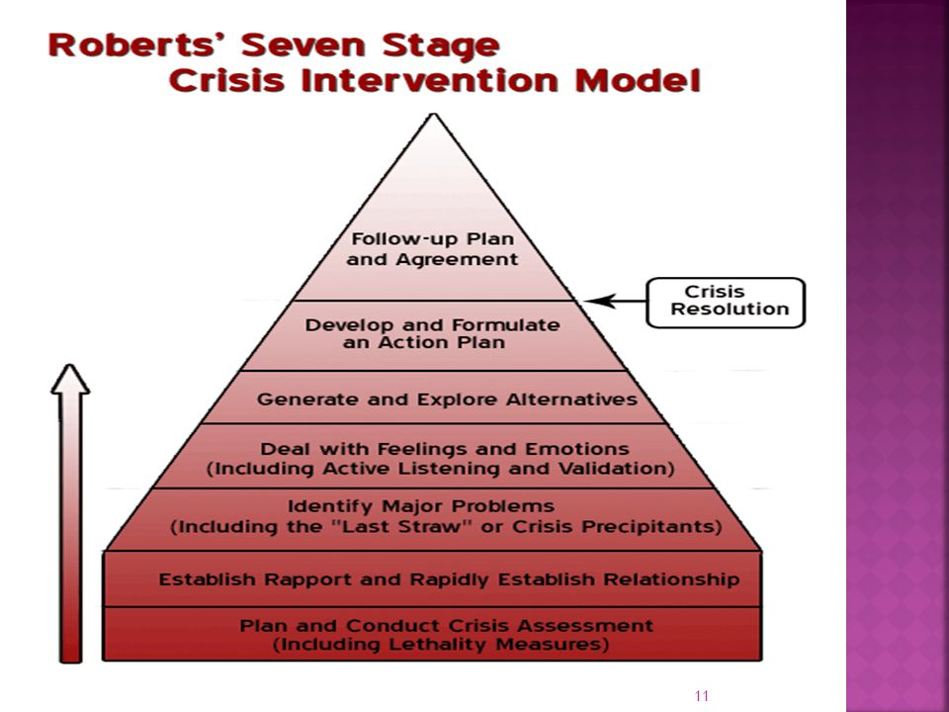
(Roberts and Ottens, 2005)
Notes:
Now based on the information collected from this framework by a social or health care worker, the seven stages of family intervention approach are involved as shown in the slide. the Roberts seven stage crisis intervention model can be implemented which helps assess the crisis and plans intervention by emphasizing on the rapid assessment of the patient’s problem (Lundy, 2011), such as in our case examining and assessing the deteriorating mental health of John as well. The model calls for the social worker to establish an alliance with the patient and then building up on the patient's strengths. The social worker works with the patient to build upon goals and work on how to attain them. Having a crisis intervention protocol proves to be quite helpful for the patient themselves since it focuses on their mental health needs and requirements as well by focusing on the major crisis precipitants affecting the patient’s life.

Slide 9
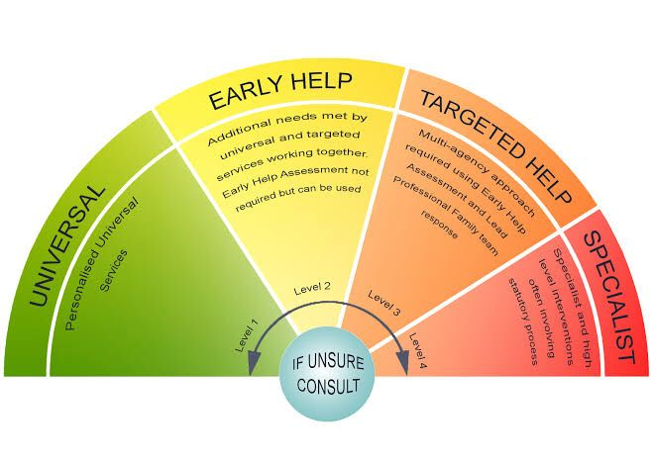
(Gloucestershire’s Levels of Intervention Guidance - Working
Together to Provide Early Help, Targeted and Specialist Support
for Children and Families in Gloucestershire, 2019)
Notes:
Children possess a different range of emotional and physical needs that need to be fulfilled I come across a range of issues as well, which is why and approach that supports care would be appropriate which details the different levels of intervention. Gloucestershire’s Levels of Intervention Guidance has identified 4 levels of need, universal communication, intensive and specialist. Specialist services are those where the need of children is so immense that specialist care is needed to ensure that the needs are met, and the child has continued development. These specialist services include children social care and youth services. Gloucestershire’s Levels of Intervention Guidance is an effective way for agencies to where to get there so that resources are utilized better and positive changes bought into lives of children. The type of support that is required for the child is determined based on their needs and practitioners that need to be involved within offering support for the child and the family. The model depicted in the slide is referred to as the windscreen and is a demonstration of the continuum of need. In order to provide the best possible care for children there needs to be add rest at the lowest possible level so that they can avoid escalation to higher levels of intervention required (Gloucestershire’s Levels of Intervention Guidance - Working Together to Provide Early Help, Targeted and Specialist Support for Children and Families in Gloucestershire, 2019).

Slide 10
Professional Interventions
Job centre plus
Positive Parental trainers.
Youth workers
Antisocial behaviour team
Neigbourhood services
Probation services
Notes:
Some agencies working with this family as a result of all the challenges and troubles facing the family. The intervention of Connexion ,educational services to help with nonattendance and problematic behaviours in school. Problem with Alcoholism can be talked with the intervention of alcohol worker or substance abuse workers.

Slide 11
Respect Action Plan
Anti-Social Behaviour Orders (ASBOs)
injunctions and Dispersal Orders
Respect Agenda
Respect Task Force, 2006
Parenting Orders
Notes:
In England, over 250 initiatives were formed under the Respect Action Plan, Youth Task Force Action Plan, and other initiatives.; Breaking the Cycle’ programme and the early intervention projects initiated by the Scottish government and the Welsh Assembly government respectively. (Ball, Batty and Flint, 2015)

Slide 12
Multidisciplinary Services
The new Yorkshire safeguarding children partnership has resulted in 3 safeguarding partners:
North Yorkshire County Council
The North Yorkshire Police
The North Yorkshire Clinical Commissioning Groups
Notes:
The new Yorkshire safeguarding children partnership has resulted in 3 safeguarding partners which are the North Yorkshire County Council, the North Yorkshire Police, and the North Yorkshire clinical commissioning groups. This was the work of The Children and Social Act 2017 and the Working Together To Safeguarding Children 2018 which is statutory guidance on inter agencies working together two promote the welfare of children. This partnership is responsible for assessing childcare, executing a plan to implement proper childcare and ranging a worker for each child dad will manage all the services and take care of the welfare of the child. This partnership also implements a team that is responsible for monitoring all the goals and work done show that the objectives of the partnership are achieve (North Yorkshire Safeguarding Children, n.d.).

Slide 13
Multidisciplinary team role and duties.
Psychiatrist | They carry out assessments of a child and young person Provide therapies, prescribe any medication needed and investigate for any physical illnesses.
Psychiatric Nurse | Assess any difficulties the individual may have if they need therapies and monitor with medication
Psychologist | They do assessment more in-depth and how the brain functions and different behaviors
Social Worker | They help and support families give advice on housing, finance and any other supports may need.
Occupational Therapist | skills assessments rehabilitation plan this can be individually or in groups

Slide 14

find strategies ,solution and promote the positive
​They will have Opportunities to discuss issues and find ways to deal with their problems​
(What is Multidisciplinary Team?, 2022)

Slide 15

support
Aim
promote good relationship with children and young people with the parents more focused on how to approach and tackles biggest issues that is facing the families.
Decision making skills
Attendance
Improving self-confidence and self esteem
Peer support
Emotional regulation
relationships
therapeutic interventions

Slide 16
Conclusion
Family relationships play a pivotal role in the wellbeing of an individual throughout his life.
Socioeconomic factors play a major role in the wellbeing of a family.
The impact of family on the children is huge.
To safeguard children, there have been several legislations introduced which protect the rights of children
Notes:
Family relationships play a pivotal role in the wellbeing of an individual throughout his life. If these relationships get tainted or dysfunctional, the family suffers as a whole. Socioeconomic factors play a major role in the wellbeing of a family. The impact of family on the children is huge. To safeguard children, there have been several legislations introduced which protect the rights of children. In order for the future generation to prosper, the family has to be functional and focused on the children’s wellbeing. Thankyou so much for your time!

Slide 17

THANK YOU!

Slide 18
Reference list
Andresen, S., Bradshaw, J. and Kosher, H. (2018). Young Children’s Perceptions of their Lives and Well-Being. Child Indicators Research, [online] 12(1), pp.1–7. doi:10.1007/s12187-018-9551-6.
Ball, E., Batty, E. and Flint, J. (2015). Intensive Family Intervention and the Problem Figuration of ‘Troubled Families’. Social Policy and Society, 15(2), pp.263–274. doi:10.1017/s1474746415000469.
Blackburn, P. and Dwyer, K. (2016). A Bereavement Common Assessment Framework in Palliative Care: Informing Practice, Transforming Care. American Journal of Hospice and Palliative Medicine®, 34(7), pp.677–684. doi:10.1177/1049909116647403.
Evans, M. (2013). Policy guide: Children Act 1989 Amended 2004. [online] Nursery World. Available at: https://www.nurseryworld.co.uk/features/article/policy-guide-children-act-1989-amended-2004.

Slide 19
Gloucestershire’s Levels of Intervention Guidance - Working Together to Provide Early Help, Targeted and Specialist Support for Children and Families in Gloucestershire. (2019). [online] Available at: https://www.gloucestershire.gov.uk/media/2092076/gloucestershire-revised-loi-guidance-v4-final-gsce-version-2019.pdf [Accessed 6 Jul. 2022].
Great Britain. Home Office. Respect Task Force (2006). Respect action plan. London: Home Office Respect Task Force.
Holden, K., McGregor, B., Thandi, P., Fresh, E., King, V. and Boyd, L.M. (2016). Factors Associated With Perceptions of Family Belonging Among Adolescents. Journal of Marriage and Family, 78(4), pp.1114–1130. doi:10.1111/jomf.12322.
Lundy, C. (2011). Social work, social justice & human rights : a structural approach to practice. North York, Ont.: University Of Toronto Press.
North Yorkshire Safeguarding Children (n.d.). NYSCP Home. [online] North Yorkshire. Available at: https://www.safeguardingchildren.co.uk/.

Slide 20
Pannilage Upali (2017). Impact of Family on Children’s Wellbeing. [online] ResearchGate. Available at: https://www.researchgate.net/publication/320064189_Impact_of_Family_on_Children.
Roberts, A.R. and Ottens, A.J. (2005). The Seven-Stage Crisis Intervention Model: A Road Map to Goal Attainment, Problem Solving, and Crisis Resolution. Brief Treatment and Crisis Intervention, 5(4), pp.329–339. doi:10.1093/brief-treatment/mhi030.
Thomas, P.A., Liu, H. and Umberson, D. (2017). Family Relationships and WellBeing. Innovation in Aging, [online] 1(3), pp.1–11. doi:10.1093/geroni/igx025.

