Slide 1
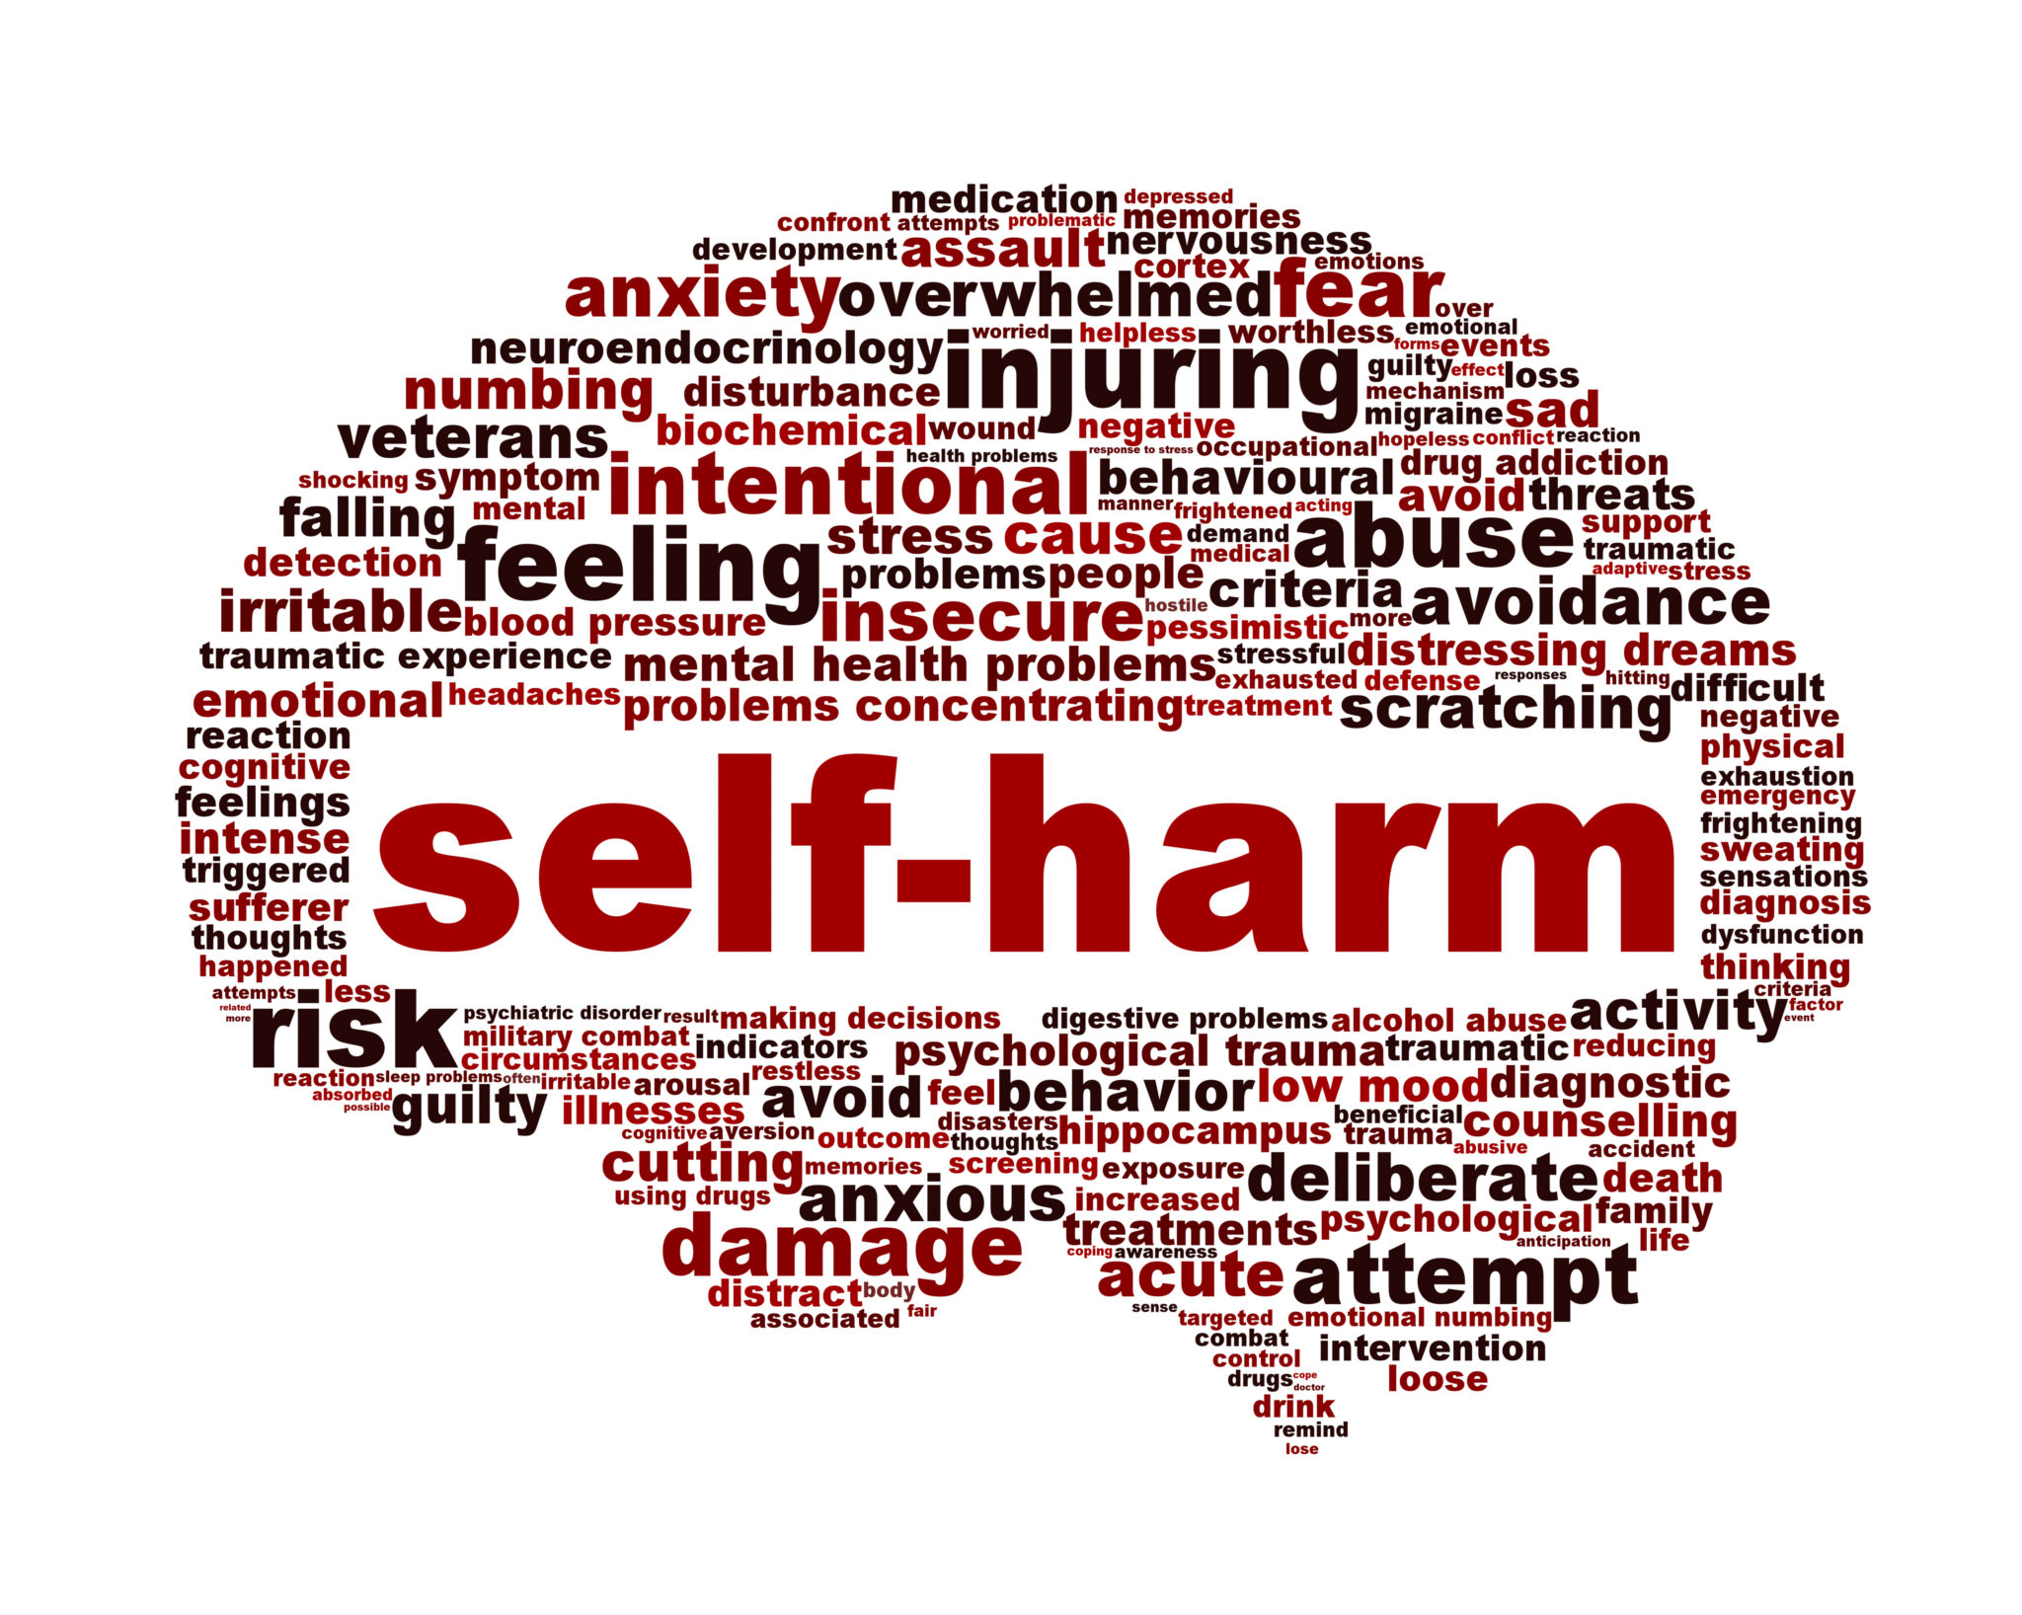

Slide 2
WHY ?
PERSONAL INVOLVEMENT

Slide 3
DEFINITION
A person intentionally hurting and damaging their body, it is a way of dealing with their overwhelming emotional pain and distress.
Main reasons? Punishment, relief of any overbearing tension, or an expression of their distress.
Or all three

Slide 4
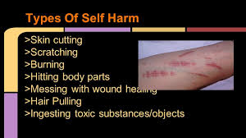
TYPES

Slide 5
HISTORY
Brief history –Chris Millard (London, 2019)
During the 1950s to 1970s there were a high number of overdoses which was termed as attempted suicide. In 1961 attempted suicide was decriminalised and new terms were introduced during the 1960s when psychiatrists and doctors began to realise that someone attempting suicide wasn’t actually trying to end their lives. So new terms were introduced such as parasuicide’, ‘pseudocide’ self-poisoning’ (London, 2019). But attempted suicide remained the most common term. From the late 1970s self harm or self cutting was now being seen in a different way as opposed to attempted suicide but as a way of getting rid of emotional deadness and controlling internal tension.

Slide 6
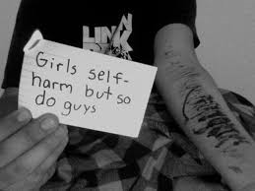
AGES
All ages mainly children and young people. More predominant in girls but boys self-harm too

Slide 7
MYTHS
THEY MUST ENJOY IT, IT FEELS NICE
Once the act of self-harm has taken place, the person realises they are not numb, and the physical pain can suddenly feel almost unbearable. Let’s get one thing straight right here: self-harm doesn’t feel nice, it just sometimes feels better than the emotional pain it’s trying to hide. In reality, it doesn’t even do that; not really. Self-harm isn’t nice, the person you care about isn’t hurting themselves because it feels good, whatever they may say.
(SelfharmUk, 2019)

Slide 8
STATISTICS
(Statswales.gov.wales, 2019)
Main Presenting Issues on referral for Children and Young People receiving Counselling by Area and Presenting Issues
In Wales the total number of children and young people for 2017 – 18 was
21,561

Slide 9
SMALL SAMPLE TAKEN

Slide 10
SMALL SAMPLE
Anger – 1746, Family – 4044
Anxiety – 2784, Relationships Other – 1359
Bullying – 810 Self Harm – 804
Bereavement – 1101 Self Worth – 1479
Behaviour related – 1368, Stress - 1839
Depression – 1116 Suicide - 423

Slide 11
?
804 children and young people self harmed 2017-18 but how many slipped through the net (not just for self harm) (Statswales.gov.wales, 2019)
News beat Emma’s story (3minutes 36)
https://www.youtube.com/watch?v=ysEdaNb_q9c

Slide 12
TREATMENTS
(Self-harm - what you need to know., 2019) recommended treatments
GP
CBT
Dialectical Behavioural Therapy
Psychodynamic Therapy
Support groups
Online support

Slide 13
Dialectical Behavioural Therapy
Seems to have the better results
DBT was developed by Marsha Linehan in the 1970s
Based on CBT, mainly used to treat Borderline Personality Disorder

Slide 14
What's the difference between DBT and CBT?
CBT focuses on helping you to change unhelpful ways of thinking and behaving.
DBT also helps you to change unhelpful behaviours, but it differs from CBT in that it also focuses on accepting who you are at the same time. DBT places particular importance on the relationship between you and your therapist, and this relationship is used to actively motivate you to change.
(Mind.org.uk, 2019)

Slide 15
What are the goals of DBT?
The goal of DBT is to help you learn to manage your difficult emotions by letting yourself experience, recognise and accept them. Then as you learn to accept and regulate your emotions, you also become more able to change your harmful behaviour. To help you achieve this, DBT therapists use a balance of acceptance and change techniques.
(Mind.org.uk, 2019)

Slide 16
What does ‘dialectics’ mean?
What does ‘dialectics’ mean?
In a nutshell, ‘dialectics’ means trying to balance opposite positions and look at how they go together. For example, in DBT, you will work with your therapist to find a good balance between:
Acceptance – accepting yourself as you are.
Change – making positive changes in your life.
You might eventually come to feel that these goals are not as conflicting as they first seem. For example, coming to understand and accept yourself, your experiences and your emotions, can then help you learn to deal with your feelings in a different way.
(Mind.org.uk, 2019)
(Mind.org.uk, 2019)

Slide 17
SELF-HARM,SOCIAL MEDIA, SELFIES
Ten years ago social media hadn’t exploded to what it is today.
An article by Dr Mirriam Stoppard in 2019 relates to the rise in self-harm & suicides mainly due to influences on social media
https://www.youtube.com/watch?v=o4QHxIUiZlc
Russell Howard

Slide 18
Useful organisations
Samaritans – call 116 123 (open 24 hours a day), email jo@samaritans.org, or visit your local Samaritans branch
Mind – call 0300 123 3393 or text 86463 (9am to 6pm on weekdays)
Harmless – email info@harmless.org.uk
National Self Harm Network forums
YoungMinds Parents Helpline – call 0808 802 5544 (9.30am to 4pm on weekdays)

Slide 19
REFERENCES
BBC (2019). Emma's story. [video] Available at: https://www.youtube.com/watch?v=ysEdaNb_q9c [Accessed 12 Nov. 2019].
London, U. (2019). A History of Self-Harm in Britain | SpringerLink. [online] Link.springer.com. Available at: https://link.springer.com/book/10.1007%2F978-1-137-52962-6 [Accessed 12 Nov. 2019].
Mind.org.uk. (2019). Dialectical behaviour therapy (DBT) | Mind, the mental health charity - help for mental health problems. [online] Available at: https://www.mind.org.uk/information-support/drugs-and-treatments/dialectical-behaviour-therapy-dbt/#.XcyLSlf7TIU [Accessed 13 Nov. 2019].
Mirror (2019). Dr Miriam Stoppard: Social media is no help to those who self-harm. [online] Available at: https://www.mirror.co.uk/news/uk-news/dr-miriam-stoppard-social-media-15672033 [Accessed 13 Nov. 2019].
nhs.uk. (2019). Self-harm. [online] Available at: https://www.nhs.uk/conditions/self-harm/ [Accessed 12 Nov. 2019].
SelfharmUk. (2019). They must enjoy it | SelfharmUk. [online] Available at: https://www.selfharm.co.uk/get-information/the-myths/they-must-enjoy-it [Accessed 13 Nov. 2019].
Self-harm - what you need to know. (2019). What is self-harm?. [online] Available at: https://www.rethink.org/advice-and-information/about-mental-illness/learn-more-about-symptoms/self-harm/ [Accessed 13 Nov. 2019].
Sky (2019). It's so sad that selfies are causing girls to self harm. [image] Available at: https://www.youtube.com/watch?v=o4QHxIUiZlc [Accessed 12 Nov. 2019].
Statswales.gov.wales. (2019). [online] Available at: https://statswales.gov.wales/Catalogue/Education-and-Skills/Schools-and-Teachers/Counselling-for-Children-and-Young-

