Slide 1

Police, Policing and Society
(BMCP5001)
WEEK 2
Policing, society and society cohesion

Slide 2

Aims for todays session
Policing
Background to how societies have evolved
Social stratification
Society cohesion

Slide 3
Egon Bittner (1974)
The police service was one of the ‘best known but least understood’ of public institutions.

Slide 4
Policing
The word ‘policing’ relates to ‘politics’
Working within the government rules
Performing a function that process social regulation & order
Notes:
Governance in this country is served by powers:
1. The executive which formulates and implements policy.
2. The legislature, Parliament, which comprises the Crown, the House of Commons and the House of Lords.
3. The judiciary which comprises the judges in the courts of law. Importantly the police are NOT a part of the judiciary itself but do form part of the CJS
“Separation of powers” refers to the idea that the major institutions of state should be functionally independent and that no individual should have powers that span these offices. The principal institutions are usually taken to be the executive, the legislature and the judiciary.

Slide 5
Police
Term police is to represent the whole ability of regulating social order and policies which contribute to the control of crime and order in society
Individuals who carry out the functions of the policing role.
Agents of Social Control
Policing by consent
Notes:
READ SLIDE
So lets now look at how the police achieve this

Slide 6
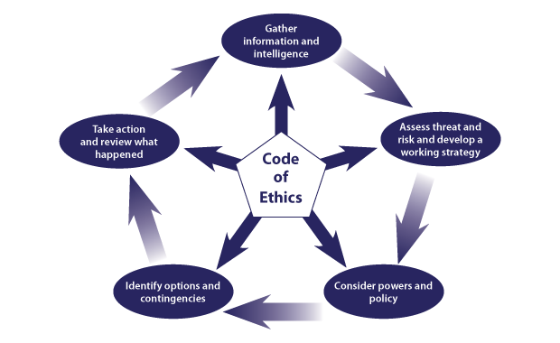
National Decision Model and Code of Ethics
Notes:
The NDM is the primary decision model for the police service. However, responding to emergencies is a multi-agency activity and the resolution of an emergency will usually involve collaboration between police, fire and rescue, and ambulance services.
The Joint Emergency Services Interoperability Programme (JESIP) has been established to improve the ways in which the three emergency services work together at major and complex incidents.
Code of Ethics – Principles and standards of professional behaviour
Information – Gather information and intelligence
Assessment – Assess threat and risk and develop a working strategy
Powers and policy – Consider powers and policy
Options – Identify options and contingencies
Action and review – Take action and review what happened
Code of ethics
The public expect the police to do the right thing in the right way; basing decisions and actions on a set of policing principles will help to achieve this.
﻿﻿﻿Accountability: you are answerable for your decisions, actions and omissions.
﻿﻿﻿Fairness: you treat people fairly.
﻿﻿﻿Honesty: you are truthful and trustworthy
﻿﻿﻿Integrity: you always do the right thing
﻿﻿﻿Leadership: you lead by good example.
﻿﻿﻿Objectivity: you make choices on evidence and your best professional judgement.
﻿﻿﻿Openness: you are open and transparent in your actions and decisions.
﻿﻿﻿Respect: you treat everyone with respect.
﻿﻿﻿Selflessness: you act in the public interest.
Standards of professional behaviour: These standards reflect the expectations that the public and the force have of the behaviour of those working in

Slide 7

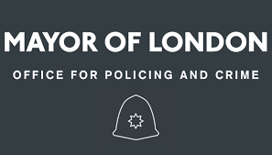



Organisations
Notes:
Who regulates our polices forces and ensures they are being transparent, accountable and doing their job properly?
• Her majesty's Inspectorate of Constabulary (HMICFRS)
For over 160 years, Her Majesty's Inspectorate of Constabulary has independently assessed and reported on the efficiency and effectiveness of police forces and policing, in the public interest.
They provide authoritative information to allow the public to compare the performance of their police force against others.
Their evidence is used to drive improvements in the services they provide to the public.
They are appointed by the Crown and act independently to the government and the
police
• National Police Chiefs Council (NPCC)
The NPCC brings police forces in the UK together to help policing coordinate operations, reform, improve and provide value for money.
•Mayors Office for Policing & Crime (MOPAC)
The Police Reform and Social Responsibility Act 2011 established a Police and Crime Commissioner for each police force area across England and Wales. In London, the elected Mayor - Sadiq Khan. is the equivalent of the Police and Crime Commissioner and is responsible for the totality of policing in the capital (outside of the City of London) The Mayor of London, as occupant of the Mayor's Office for Policing and Crime (MOPAC) is required by law to produce a plan that explains how the police, community safety partners and other criminal justice agencies will work together to reduce crime. The Police and Crime Plan reflects the Mavor's manifesto and priorities for making London a safer city for all Londoners and the Mayor's Office for Policing and Crime (MOPAC) is the strategic oversight body tasked with devising the Police and Crime Plan and ensuring that it is delivered over four years
Independent Office for Police Conduct (IOPC) (Previously Independent Police
Handle complaints. They use learning from our work to infusuca They are independent, and make decisions entirely independently of govemment
• College of Policing
The College of Policing was established in 2012 as the professional body for everyone who works for the police service in England and Wales. The purpose of the College is to provide those working in policing with the skills and knowledge necessary to prevent crime, protect the public, and secure public trust.
We have three complementary functions: Knowledge, Education & Skills
• Professional Standards
The principle of policing by consent relies on the trust and confidence that the public has in the police service and the wider law enforcement community. Professional standards departments (PSDs) can play an important role in the maintenance of that trust and confidence. Trust and confidence can be undermined by a failure to vet and manage misconduct and complaints or investigate counter-corruption activities effectively. It is, therefore, essential that such issues are dealt with openly and robustly in accordance with the Coule of Ethics Professional standards consist of the following
Alongisde these we also have police and crime commisionners....

Slide 8
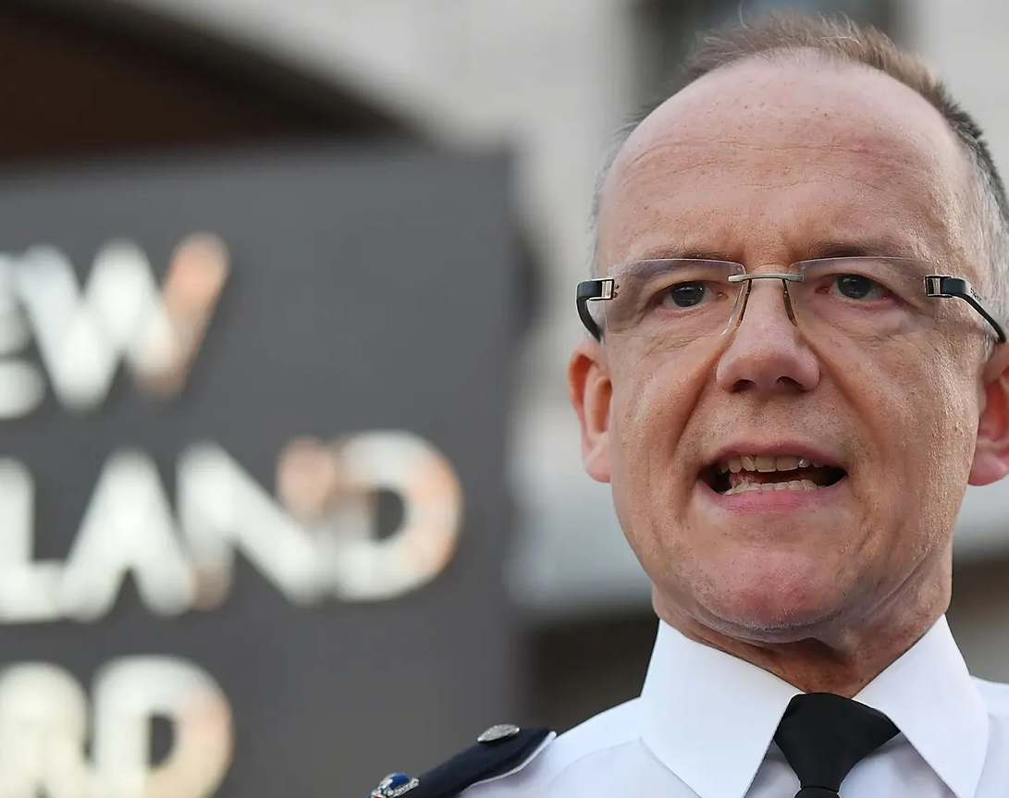
Police Crime Commissioner
https://youtu.be/9lZX4k3lSNs
Notes:
In the 2010 British general election campaign, both the Conservative Party and Liberal Democrats' manifestos outlined plans to replace or reform the existing police authorities, due to concerns about the perceived lack of accountability of police authorities to the communities they serve. They introduced legislation such as the Police Reform and Social Responsibility Act (2011) to make the police more accountable through locally elected representatives.
Police and Crime Commissioners are locally elected officials who have the responsibility of making the police accountable to the public and holding chief constables and their forces to account.
PCs are expected to work in partnership with a number of agencies at a local and national level and are accountable to the Home Secretary
The police can also be held accountable:
﻿through other elected representatives e.g. local council officers and members of parliaments
﻿﻿during face-to-face encounters with members of the public when on patrol
﻿﻿via social media
﻿﻿online contact with local forces or at www.police.uk
﻿﻿at neighbourhood meetings.
People require detailed information about what is being done to tackle crime and Anti-social behaviour in their area and how that compares with other areas.
In order for the local community to be able to hold the police to account, they need access to data that gives an accurate picture of crime at a local level as possible
PLAY VIDEO

Slide 9

Task.... 5 mins
Find the PCC for South Wales and note his priorities
Notes:
Swp cc
ALUN MICHAEL
His priorities for policing in South Wales include:
• We will reduce and prevent crime and anti-social behaviour to keep people safe and confident in their homes and communities
We will iraprove the u
malice
communities
We will work to protect the most vulnerable in our communities
﻿We will make sure that the local Criminal Justice System works effectively and efficiently, meeting the needs of victims and challenging offenders
﻿﻿We will make our contribution to the Strategic Policing Requirement and successfully police major events
We will spend your money wisely to protect policing in your community

Slide 10
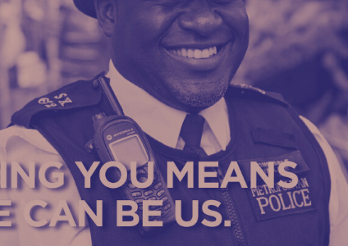
Why is policing by consent important?
It should be noted that it refers to the power of the police coming from the common consent of the public, as opposed to the power of the state. It does not mean the consent of an individual. No individual can chose to withdraw his or her consent from the police, or from a law.
(Home Office, 2012)
Notes:
As we can see, all of these practices that the police conform to (NDM, CODE OF ETHICS, PCC) to mention a few, are all there to help enhance the trust of the public to ensure policing by consent can happen.
The principle of policing by consent relies on the trust and confidence that the public has in the police service and the wider law enforcement community. Professional standards departments (PSDs) can play an important role in the maintenance of that trust and confidence. Trust and confidence can be undermined by a failure to vet and manage misconduct and complaints or investigate counter-corruption activities effectively. It is, therefore, essential that such issues are dealt with openly and robustly in accordance with the Code of Ethics Professional standards.
BUT what about when it goes wrong....

Slide 11
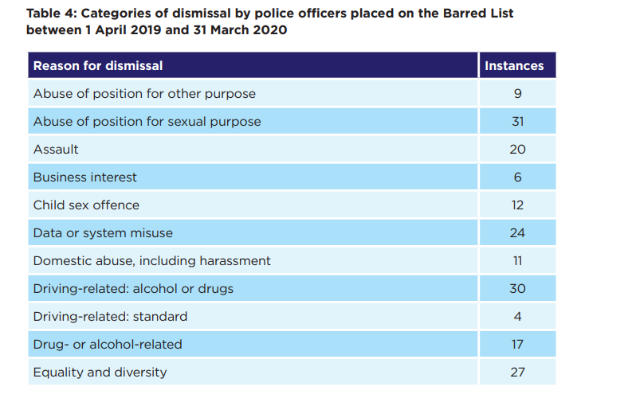
Professional agents of social control? Total of 492
https://leftfootforward.org/2020/06/five-shocking-stats-about-police-brutality-in-the-uk/
(College of policing, 2016)
Notes:
We looked last week at the case of Cissick and the impact that has had on our policing. Looking at these figures here, it does not aid the public in having faith and trust in our police forces/ officers.
The government have identified that something needs to change and have proposed a new 2025 policing vision.
Look at LINK

Slide 12
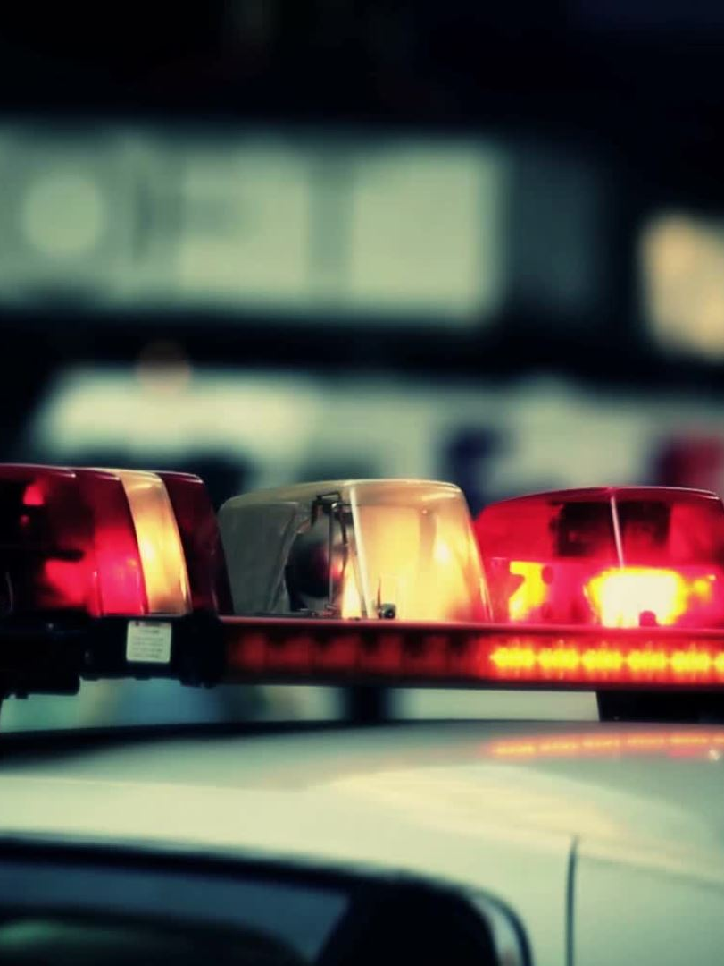
Does policing have a positive impact on our society?
Crime in Britain: Are Things Getting Worse? - YouTube

Slide 13
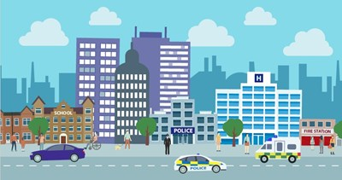
Task.....10 mins
Reasearch into the policing vision 2025 and answer the following questions:-
Why does policing need to change?
What will change on a local level?
Notes:
What impact do we feel this will have on public confidence?
Will this make policing by consent easier?

Slide 14
Policing vision 2025
Local policing remains the bedrock of British policing
Specialist capabilities
Police officers will be trained and equipped to respond to the dramatic rise in criminals taking advantage of the internet
The College of Policing will work with forces to give our workforce the skills and powers they need to meet these challenging requirements.
Business support functions like IT and human resources
(NPCC, 2016)
Notes:
To bring things right up to date, this is the document which sets out the policing vision for the next ten years. The document also includes the policing mission.
This Policing Vision 2025 sets out our plan for policing over the next ten years. It will shape decisions around transformation and how we use our resources to help to keep people safe and provide an effective, accessible and value for money service that can be trusted. This Vision comes from the service itself. It must inspire officers, staff and volunteers, as much as police and crime commissioners and chief constables and of course the public as a whole.
The communities we serve are increasingly diverse and complex, necessitating a more sophisticated response to the challenges we face now and in the future.
Whether it be child sexual exploitation, domestic abuse, cybercrime or new threats from serious and organised crime like human trafficking or terrorism, the leaders of the service - police and crime commissioners and chief constables - acknowledge that if we are to meet our communities' needs, the service must continue to adapt to the modern policing environment.
This Vision is about more than making savings or incremental reform; our ambition is to make transformative change across the whole of policing.
1-Local policing remains the bedrock of British policing but with far more integration with health, education, social services and community projects to intervene early to resolve the problems that cause crime and anti-social behaviour, reducing demand on policing and other public services. The ambition is for more multi-agency teams or hubs, which will pool funds rather than addressing problems in silos.
2-Specialist capabilities, like armed policing, surveillance and major investigations, will be delivered through a network; making them more affordable with surplus costs available to reinvest in other priorities.
3- Police officers will be trained and equipped to respond to the dramatic rise in criminals taking advantage of the internet. The processes for sharing evidence will become completely digital saving significant resources and the public will have the option of contacting the police and reporting crime quickly and easily online
4- There will be a focus on making policing more representative of its communities and finding a better balance between personal accountability and a bureaucratic fear of making mistakes.
5- Business support functions like IT and human resources will be consolidated in cross-force units or integrated with local authorities and emergency services with more shared procurement to reduce costs.

Slide 15

Break

Slide 16
Society
What is meant by the term "society"?​
Definition: noun (plural societies)
[mass noun] the aggregate of people living together in a more or less ordered community
the community of people living in a particular country or region and having shared customs, laws, and organisations
Basic societies
Revolution of societies
Notes:
(Oxford Dictionaries online)

Slide 17
Hunting and Gathering Societies
Survive by hunting
Until about 12,000 years ago, only had hunting and gathering societies.
Five characteristics of these societies:
1. The primary institution is the family, which decides how food is to be shared and how children are to be socialized, and which provides for the protection of its members.
2. They tend to be small, with fewer than fifty members.
3. They tend to be nomadic, moving to new areas when the current food supply in a given area has been exhausted.
4. Members display a high level of interdependence.
5. Labour division was based on sex: men hunt, and women gather.

Slide 18
First Social Revolution
Horticultural society - hand tools are used to tend crops.
Sprang up about 10,000–12,000 years ago in the most fertile areas of the Middle East, Latin America, and Asia.
Simple tools used
Able to plant crops - no longer had to depend on the gathering of edible plants—they could now grow their own food.
No longer had to leave an area when the food supply was exhausted, as they could stay in one place until the soil was depleted.

Slide 19
Pastoral Societies
The domestication of plants and animals
Breeding of animals for food and working land
Taming of plants
Only moved when the grazing land ceased to be usable.
Many pastoral societies still exist in Africa, Latin America, and parts of Asia.

Slide 20
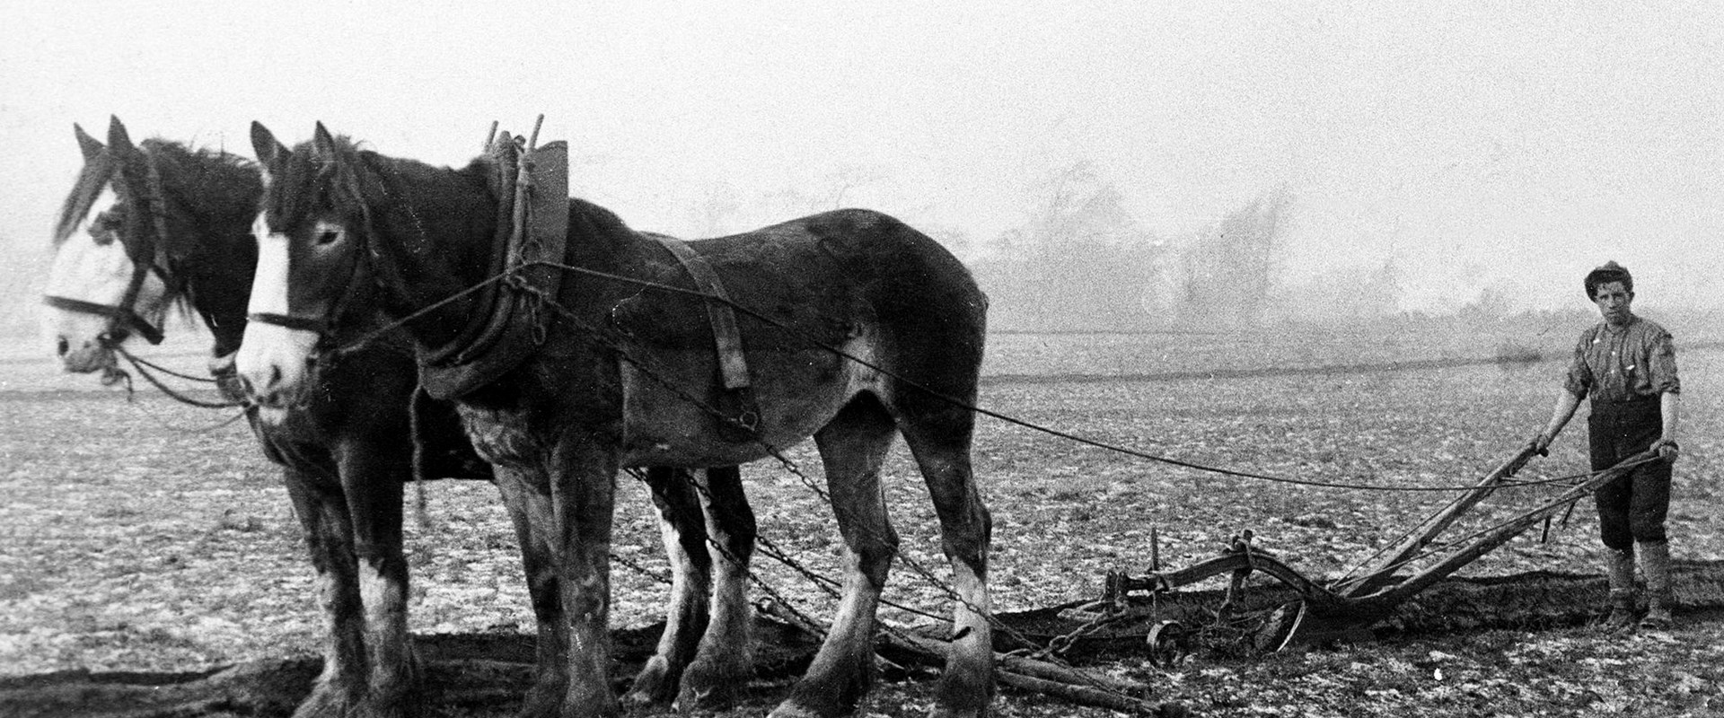
Second Social Revolution
The invention of the plough
Led to the establishment of agricultural societies approximately five thousand to six thousand years ago.
Domesticated animals to plough land – more crops to grow
Led to the creation of cities and formed the basic structure of most modern societies

Slide 21
Second Revolution Sequence
1. Animals are used to pull ploughs.
2. Larger areas of land can then be cultivated.
3. Soil conditions can harvests more crops for longer periods of time.
4. Productivity increases, and as long as there is plenty of food, people do not have to move.
5. Villages - Towns - Cities.
6. More harvests = job specialisation - no longer necessary for every member of the society to engage in farming, so some people begin developing other skills.
7. Fewer people are directly involved with the production of food, and the economy becomes more complex.

Slide 22
Third Social Revolution
Industrial Revolution 1700’s UK
An industrial society that used sources of energy, rather than humans and animals, to run large machinery.
For society –
Innovation in transportation
Goods could travel
People could travel and leave their community

Slide 23

Effects of 3rd Revolution
Rural areas lost population
Work in cities – Factories/Travel/Docks
Fewer people were needed in agriculture
Better paid jobs in cities/ farmers had machines to help
Societies became urbanized
High population living within the city = problems?
Suburbs grew up around cities
provided city-dwellers with alternative places to live.

Slide 24
Gemeinschaft and Gesellschaft
German words that mean community and society respectively.
Gemeinschaft societies consist primarily of villages in which everyone knows everyone else. Relationships are lifelong and based on kinship.
Gesellschaft society is modernized. People have little in common with one another, and relationships are short term and based on self-interest, with little concern for the well-being of others.

Slide 25
Post-Industrial
There are three major characteristics of a post-industrial economy:
Focus on ideas: Tangible goods no longer drive the economy.
Need for higher education: Factory work does not require advanced training, and the new focus on information and technology means that people must pursue greater education.
Shift in workplace from cities to homes: New communications technology allows work to be performed from a variety of locations.

Slide 26
Social stratification
categorization of people into socioeconomic class
social position of persons within a social group, category, geographic region, or social unit.
three social classes: upper class; middle class and lower class
Wealth, Power, occupations and incomes drive the classes further apart.

Slide 27
Class
Societies are symbolised by patterns of relationships between individuals who share unique cultures
Kinship - social relationships that form and become an important part of individual lives
However - individual achievement is valued over social relationships
Can make individuals feel isolated from one another
Great division among people:
Poverty/class/poor health/poor education attainments/stress/mental health/early death/

Slide 28
Task….. (20 mins)
https://www.youtube.com/watch?v=ndSNjt1J_18&ab_channel=SkyNews
Do we have a clear class division within the UK today?
If so what are they?
What are the implications of the divide?
What is more important to you – ‘quality of life’ or ‘quality of society’?

Slide 29
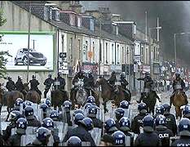
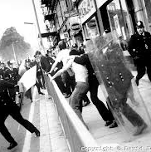
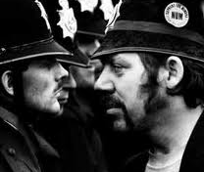

Some notable events
1940s: Realities of post war British society
1950s: Structures of authority transforming
1960s: ‘Decade that Shook Britain’
1970s: Industrial unrest; ‘Life on Mars’
1980s: Inner city riots (Brixton); PACE;
1990s: ‘classless’ ‘Cool Britannia’ - division
2000s: 2001 Bradford riots; Growth of connectivity; globalisation/tech. Financial crisis…
2010s: ‘perpetual crisis’/austerity/polarised society/’Brexit’
Notes:
1945 - Returning service people – aka ‘Golden Generation’ – or, after 5 years armed conflict damaged? Different to before – ‘decline of deference’ – imperial Britain in decline
1950s – Seemingly ‘Black and White’ grey even. Imperial identity/international authority in crisis – Suez 1956 a national embarrassment. Police – ‘halcyon days’ – golden days of police legitimacy - image of ‘citizen in uniform’ as personified in film by ‘George Dixon’ embodying national virtues imperial culture – brave, fair, better than the rest) starting to crumble - didn’t represent reality. Decade of the TV and the washing machine
1960s - If the Fifties were in black and white, then the Sixties were in Technicolor. The ‘Swinging Sixties’ remain the defining decade for Britain. In just ten short years, London had transformed from the bleak, conservative city, only just beginning to forget the troubles of the Second World War, into the capital of the world, full of freedom, hope and promise. It was the centre of all excitement; the city where anything and everything was possible. Psychodelic/free love/Woodstock/drugs/ if you can remember the 60s you weren’t there Policing much the same but societal change moving faster than the establishment
1970s - As late as 1971, women were banned from going into Wimpy Bars on their own, after midnight, on the grounds that the only women out on their own at that hour must be prostitutes.
Yet only eight years after that rule was lifted, Margaret Thatcher was walking into Downing Street as Britain's first woman Prime Minister. There could hardly be a better symbol of change. Reality though – protest – flying pickets – Union power – Scargill – workers rights better than ever
1980s – 1981 – St Pauls; Brixton; Moss Side; Toxteth; Brixton riots – lack of cultural understanding – misuse of power - operation swamp - ‘sus’ law – Stop and search – led to severe rioting on streets of cities notably Brixton in London where young black men – second generation/born British – bore the brunt of police attention. materialism – ‘loadsamoney’ (Enfield) – Miners strike 1984 – Orgreave
PACE – KILL THE BILL protests – such was the impact of PACE – better, fairer treatment of suspects etc but perceived as increase in police powers – State control
1990s - Britain suddenly remembered how to enjoy itself again – Blair the great moderniser – society becoming less equal – wealth – rich getting richer/poor not – disconnection between political class and public.
2000s -The year 2000 was when Britain became more middle class than working class, according to social grading data. The growth of the internet contributed to globalisation during the decade, which allowed faster communication among people around the world. ^{T}he economic growth of the 2000s had considerable social, environmental consequences. Demand increased for energy sources - economic growth still vulnerable – financial crisis 2007 – greed.
2010s – you’ll know better than I. Policing changing – cuts/police stations closed/few ‘bobbies’ on the beat/Cameron & Osbornes austerity policy – direct impact on all of us – unless you happen to be very wealthy – public service seemingly the main target whilst multinational ‘offshore’ bodies benefit from preferential tax arrangements. PEQF – Trump/Johnson/Putin etc – strong leader cults –
Going forward - pending extinction – protest – division – pandemics – role of the police?

Slide 30
GLADS Scotland Universities 2014
Good Live’s and Decent Societies'
individual well-being societal well-being
(“quality of life”) (“quality of society”)
social cohesion
Has COVID effected our ‘Decent Societies? – less crime, most adhering to the law (stay at home rule), air pollution, road traffic accidents and violence/sexually transmitted infections/drunken behaviour. May be only temporary but effected?
Society become more lonely? Have we got good life? Loss of job, reduced income, maybe better financially
Notes:
GLADS was designed to develop cross-sectoral perspectives on wellbeing, in the context of current debates on societal progress and alternatives to GDP. It aimed to increase understanding, facilitate knowledge sharing, and generate new insights about how to integrate considerations about societal wellbeing into decision-making and action.
https://www.bmj.com/content/369/bmj.m1785/rr

Slide 31
Task…. (5 mins)
What is meant by the term “social cohesion”?

Slide 32
Social Cohesion
Refers to a specific aspect of a quality of life:
The solidarity exhibited by the people of that society.
A sense of community and togetherness
https://youtu.be/pKnQ8ZiI-oo

Slide 33
Challenging Social Cohesion
Society challenges social cohesion by:
Growing in diversity
A widening gap between rich and poor
Technological changes
Welfare state cuts
Inter-generational divide
Political polarisation
Notes:
Growth in diversity- such a diverse society, although great, some people fear this. An example is the Windrush, people coming from the Caribbean. When they first came over, they encountered lots of hostility and eventually accepted and transformed large areas with their fantastic culture and arts and food and were accepted.
Rich and Poor- even today, always been there. See it more due to social media, news etc. The gap is clear. Think of images of people queuing for the food banks. Balance is knocked off
Technology- some countries are very advanced and cause unbalance in terms of competition etc. We all want the same opportunities
Welfare cuts- growing cost of living and gvmnt cutting welfare. Some families are struggling to live and support their families.
Intergenerational divide- we are living longer with lots of new people that causes a divide in society. Different ways lof living, older generations are less accepting of certain characteristics which fors a diverse society. Stuck in the mud attitude, especially small communities
Political polarisation- division in political views causes unbalance. EG- America when Trump lost his place, and his followers attached the White House. Brexit is another example where differences of opinions impacted on the cohesion of the society.

Slide 34
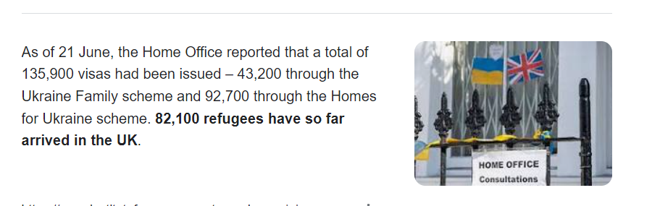
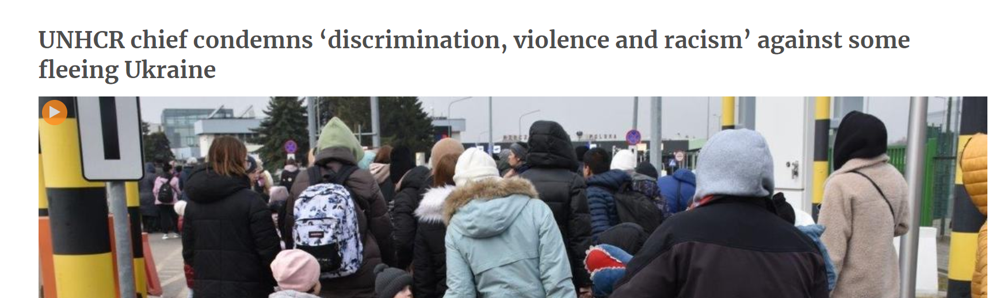
What are the challenges for the police?
Notes:
More people
Cohesive societies- are all accepting?

Slide 35
What determines the levels of social cohesion in society?
The presence of strong social bonds – measured by levels of trust and norms of empathy i.e., social capital
The abundance of associations that bridge social divisions “civil society” - refers to a wide range of organisations: community groups, unions, religious/faith based groups, charities, professional associations, and foundations.
The presence of institutions of conflict management e.g. government, independent judiciary.
  Policies; law making; organisations who deliver justice
Notes:
Presence of gvmnt- CJS, POLICIES, LAWS. We needs that trust in these organisations so we have a genuine belief that they are the right people to do the right thing at the right time. Voting systems is a prime example.

Slide 36
Unstable Cohesive Societies
Consent to laws and society decreases.
Communities break down
Relationship with law and order
Fear in society- Covid 19
Society putting on to organisations
Distrust within society
Lack of equality
Notes:
Can you think of some examples to these?
Break down in society
Non consent to acting in a lawful way within society
Chaos, no one is listening to the police and other organisations that help within society.
There will be fear, outlook on life is glum. Loss of motivation.
Blame game- onto police, its not their problem always somebody elses.
Distrust with society, break down relationships and organisation you once were willing to engage with you no longer trust.
Equality diminishes

Slide 37
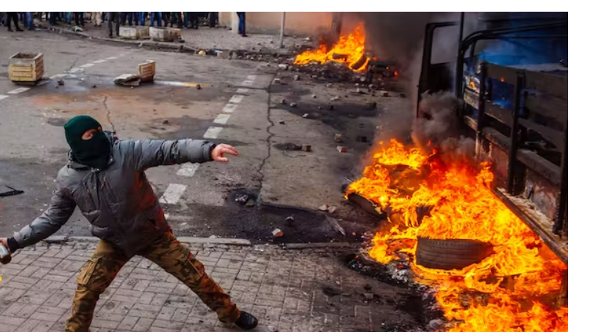
Riots
Notes:
Why do we feel these riots occur?
Frustrations with government?
Frustration with limited opportunities?
Fear of the police?

Slide 38
Riots
https://youtu.be/kfQFIN6Nm2w

Slide 39
Task... 10 mins
Group A- Consider why people cooperate with the police and do not break the law.
Group B- Consider the riots we have just discussed and the impact this has on society. How would you suggest the police rebuild the trust of these communities.

Slide 40
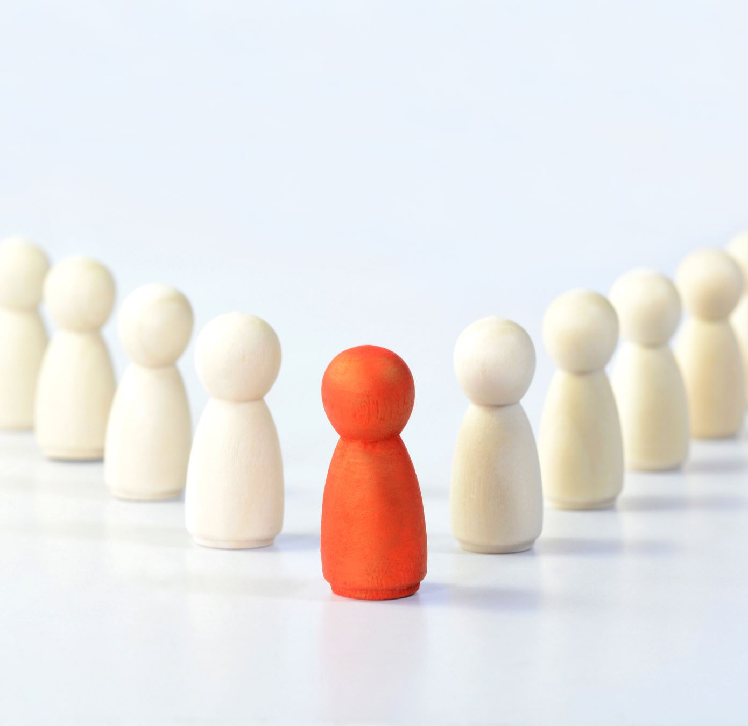
Subcultural theory
A group which has different values that are different to mainstream society
Deviance/crime occurs as a result of the group breaking away from society and social norms
Frustrations are felt due to lack of opportunities which leads to crime
Notes:
Another threat to society cohesion is a theory called sub..
his delinquent subculture reverses the norms and values of mainstream culture, offering positive rewards (status) to those who are the most deviant. Status may be gained by being malicious, intimidating others, breaking school rules or the law and generally causing trouble.

Slide 41
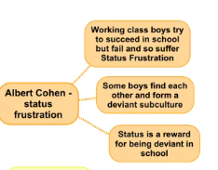
Subculture theory

Slide 42
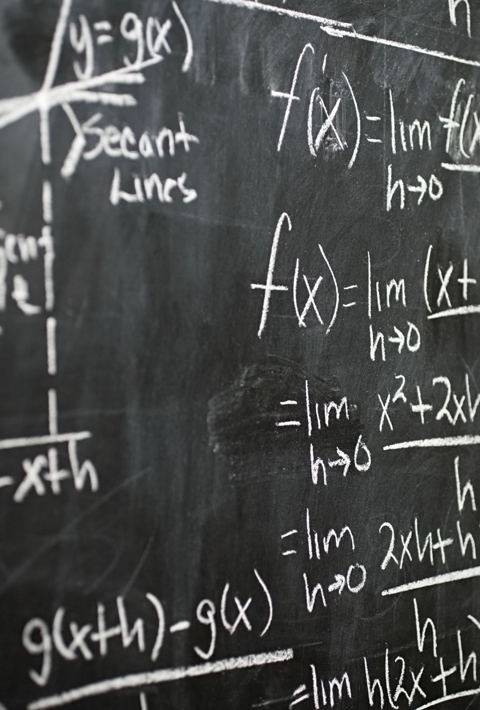
Task…. (10 mins)
Find an example of subcultural theory within today’s society

Slide 43

summary
Social cohesion is focusing on one important aspect of a “decent society”.
Social cohesion mainly depends on economic conditions, equality, and the value climate.
Citizens have higher wellbeing in more cohesive societies.
Cohesion is good for all.
More important than Gross domestic product (GDP) is the total monetary or market value of all goods and services produced within a country
We are happier together!

Slide 44

Presentations- 12th December 2023
Examination date is set, as like an exam
Times available:-
11:30-12pm-
12pm-12:30pm-
12:30pm-1pm-
1pm-1:30pm-
1:30pm-2pm-
2pm-2:30pm-
2:30pm-3pm-
3pm-3:30pm-
3:30pm-4pm-
4pm-4:30pm-
4:30pm-5pm-

Slide 45

Next week....
Police contact with the public
Community policing
Importance of trust

