Slide 1
Theory, Methods and Practice:
Critical Perspectives in Anthropology
Prof Bettina E. Schmidt

Slide 2
Multi-sited Research
Reading:
Clifford, James (1997) Spatial practices: fieldwork, travel, and the disciplining of anthropology. In: Anthropological locations: boundaries and grounds of a field science, ed. by Akhil Gupta and James Ferguson. Berkeley/Los Angeles: Univ. of California Press, pp. 185-222.
    [Also in: Clifford, James (1997b) Routes: Travel and Translation in the late 20th century. Chapter 2. Cambridge: Harvad Univ Press.]

Slide 3
George Marcus defines multi-sited research as “designed around chains, paths, threads, conjunctions, or juxtapositions of locations in which the ethnographer establishes some form of literal, physical presence, with the explicit, posited logic of association or connection among sites that in fact defines the argument of the ethnography” (1995: 105)

Slide 4
Example
Karen McCarthy Brown and her ethnography Mama Lola: a Vodou priestress in Brooklyn. (Berkeley/Los Angeles: Univ. of California Press, 2001 [1991]).

Slide 5
James Clifford (1997) describes her work as ‘multiply located’. Instead of being situated in a place the ethnography is located in relationships, developed based on the friendship between the author and the priestess
Her field is wherever she is with Alourdes!
Notes:
Clifford, James (1997) Spatial practices: fieldwork, travel, and the disciplining of anthropology. In: Anthropological locations: boundaries and grounds of a field science, ed. by Akhil Gupta and James Ferguson. Berkeley/Los Angeles: Univ. of California Press, pp. 185-222.
Also in
Clifford, James (1997b) Routes: Travel and Translation in the late 20th century. Chapter 2. Cambridge: Harvad Univ Press.

Slide 6

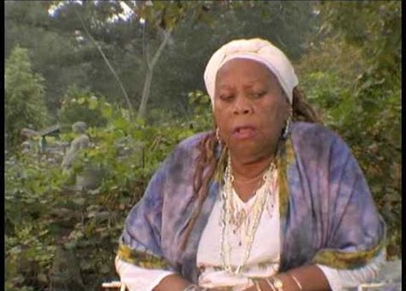
Mama Lola - Alourdes

Slide 7
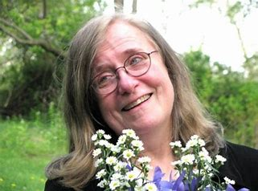
Karen McCarthy Brown (1942-2015)
Professor for anthropology at Drew University
Started to work on Vodou for her PhD which was about the visual imagery (“The Veve of Haitian Vodou: A Structural Analysis of Visual Imagery”)

Slide 8
Worked on Vodou since the 1970s, in Haiti and also in Brooklyn among
In 1978 meeting with the Vodou priestess Marie Thérèse Alourdes Macena Champagne Lovinski (short: Alourdes) when working on an ethnography of the Haitian diaspora community in Brookyln

Slide 9
Growing relationship to Alourdes, from participant observer to close friend
Later she wrote:
"When the lines long drawn in anthropology between participant-observer and informant break down, the only truth is the one in between; and anthropology becomes something closer to a social art form, open to both aesthetic and moral judgment. This situation is riskier, but it does bring intellectual labor and life into closer relation."

Slide 10
Book Mama Lola
Biography of Alourdes (published using the pseudonym Mama Lola to protect her identity)
Ethnography won Victor Turner prize in 1992 as well as the book award from the AAR (American Academy of Religion) in 1991

Slide 11
Impact of Book
Book draw attention to Vodou as religion
  Against stereotypes
But it also highlighted the relationship between Haiti and New York, rural and urban, academic and illiterate, and so on

Slide 12
Impact on Alourdes
McCarthy Brow was aware of her own role in Alourde's life as ethnographer and friend
-> international fame and recognition
  (example from event at the National History Museum in New York)

Slide 13
When McCarthy Brown died her obituary stated:
“…Karen McCarthy Brown is survived by her beloved spouse, Robert Machover of Milford, New Jersey, by her parents, both of whom are now in their late 90s, and by Mama Lola of Brooklyn….”

Slide 14
Vodou drums to celebrate McCarthy Brown
Book launch in 1991, Link to short YouTune clip

Slide 15
Multi-sited Fieldwork
Originally focus on Haitian community in Brooklyn
But following the priestess to ‘home’ temple in Haiti
-> research located in Brooklyn and Haiti

Slide 16
Multiple contexts
Focus on one person in various contexts
  As priestess in ceremonies
  As healer with clients
  As learner in the home temple in Haiti
  As friend in conversations with the author
  As teacher of the author

Slide 17
Robben and Selka write that
“The research topics of multi-sited ethnographers are not bound to particular places, seasons, or people, and cannot reply on research participants immersed in close communities” (p. 334)
However, this is different in the case of Karen McCarthy Brown
  She stays within the ‘world’ of an individual!

Slide 18
Multiple located (Clifford)
James Clifford situates Karen McCarthy Brown’s research therefore not as multi-sited but as multiple located to emphasise the importance of relationships between the two women as the framework for the research

Slide 19
Her research is not just located in different sites
Her ‘field’ is wherever she is with Alourdes
“There is a physical, interpersonal interaction with a distant, often exotic, world, leading to an experience of initiation.” (Clifford 1997b, p. 57)

Slide 20
Challenge of distance to field
Clifford asks “how, for example, does she pull back from her research relationship in order to write about it?.... What difference does it make when one’s ‘informant’ routinely calls one at home to demand help with a ceremony, support in a crisis, a favour?” (p. 57)

Slide 21
Researchers will be always constrained to take a certain ‘distance” from the communities they study.
  critical distance … without appealing to ultimate grounds of authority in scientific objectivity

Slide 22
Clifford argues …
For a multiply-centered anthropology
-> anthropology needs to reinvent itself because
  “Fieldwork has become a ‘problem’ because of its positivist and colonialist historical associations (the field as ‘laboratory’, the field as place of ‘discovery’ for privileged sojourner).” (p. 63)

