Slide 1
Evaluation of Emotional Intelligence in Workplace Context
Module : Developing Emotional Intelligence Skills for the Workplace
Module code : BMSW6106
Lecturer Name : Md Ashikul Khan
Student Name and ID : Alexandra Felicia Merauta 2121306

Slide 2
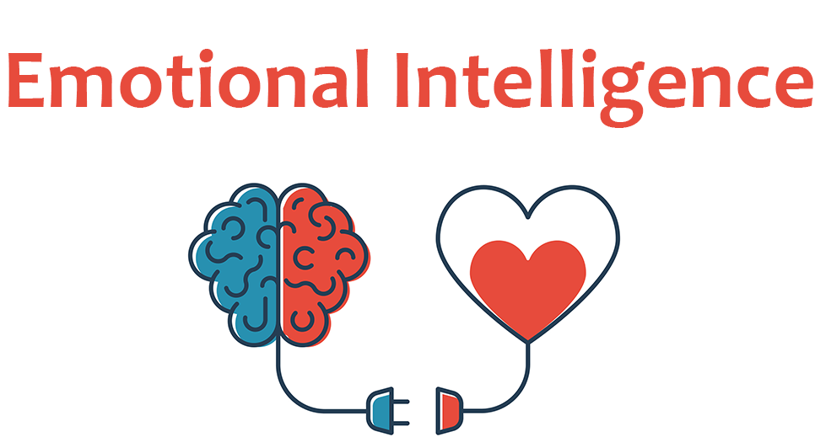
Emotional Intelligence also called Emotional Quotient
The capacity to identify, comprehend, and control
both your own and other people's emotions is known as
emotional intelligence (EI). It requires interpersonal
abilities in addition to emotional awareness and regulation.
The primary elements of emotional intelligence are:
Self-awareness: the ability to identify and understanding your own feelings.
The ability to control or refocus erratic feelings and impulses is known as
self-regulation.
Social awareness: Having empathy for the feelings and viewpoints of others.
Relationship management involves creating and sustaining good and healthy relationships.

Slide 3
The Potential Benefits of Emotional Intelligence (EI)
Communication: It will be possible to communicate more clearly and successfully through the use of empathy and active listening. Having honest, emotionally conscious talks can help to prevent misunderstandings and foster trust.
Decision Making: EI enables you to control your emotional biases and make more logical, well-rounded judgements. You may make decisions that are advantageous to everyone if you are aware of your own emotions as well as those of others.
Mental and Physical Health: EI is essential to both physical and mental health. EI helps people manage their emotions, which lowers stress, anxiety, and emotional tiredness while fostering resilience and better coping strategies. By reducing the negative consequences of stress, promoting relaxation, improved sleep, and healthier reactions to trying circumstances, this emotional control also has a good influence on physical health.
Relationship Management (Work & Personal): Through efficient communication, empathy, and conflict resolution, EI improves relationships in both the personal and professional spheres. Additionally, it improves leadership, cooperation, and teamwork.
Resilience: Having a high EI makes it easier to bounce back from failures and gives you the mental and emotional fortitude to face obstacles in the future. Strong EI people don't feel discouraged when they don't reach their goals; instead, they learn from the experience, take criticism, and change their strategy.
Self Management: By controlling your feelings and responses, you can make more intelligent decisions and manage stress more effectively while preserving your emotional stability.
Social intelligence: Stronger networks and improved social interactions are fostered by acknowledging and taking into account other points of view.
Work Performance: Better attention, decision-making, and stress management are all facilitated by emotional intelligence, and these skills increase productivity and efficacy at work.

Slide 4
Types of EI Skills
Acknowledge & Give Constructive Feedback: Being able to offer constructive criticism enables progress without offending people. Building trust is facilitated by recognising contributions and providing insightful criticism.
Not Afraid to Apologize: Being able to apologise demonstrates responsibility and humility. It exhibits emotional maturity, which is necessary for settling disputes and upholding confidence.
Empathize with Others: Understanding and identifying other people's feelings is made easier with empathy. It's an essential ability for creating connections that are harmonious and supportive.
Keep Your Word & Control Your Thoughts: Emotional control and trust are mostly dependent on keeping your word and avoiding negative thoughts. By lowering stress, thought control promotes mental and physical health.
Know How to "Forgive and Forget": It is easier to keep good connections and avoid long-term conflict when one can let go of old frustrations.
Know How to Facilitate Thoughts: Building better interpersonal relationships involves assisting people in expressing their emotions and ideas without passing judgement.
Listen to Others: Understanding the needs and viewpoints of others via listening is essential for developing emotional resilience because it enables you to gain insight from their experiences.
Protect Yourself from Manipulation: By establishing limits and identifying manipulative behaviour, you can safeguard your mental health and emotional independence.
Understand/Consider Other Perspectives: Being receptive to different points of view improves connections with others and aids in dispute resolution.
Think Before You Speak or Act: Reflecting before acting helps manage conflict or difficult circumstances at work and avoids rash actions.

Slide 5
How You Could Improve Your EI
Acknowledge the Situation: When communicating, try to be mindful of your own feelings as well as those of others. Openly acknowledge challenging circumstances.
Be Willing to Take Responsibility: Learn to own up to mistakes and view them as learning opportunities.
Empathize with Others' Feelings: To have a deeper understanding of others' feelings, try putting yourself in their position. Deeper connections and improved emotional support result from this.
Feel Certain and Confident: Maintaining physical health via consistent exercise can boost confidence and have a favourable impact on mental wellness.
Focus on Physical Activity: Reduce stress by engaging in physical activities like yoga or team sports, which can help you handle relationships at work more effectively.
Meet New People:
Pay Attention to Yourself: To develop resilience, regularly assess your emotional status and prioritise taking care of yourself.
Take Inspiration from Others: Take inspiration from those who exhibit strong emotional intelligence under trying circumstances.
Take the First Step: Practice being proactive rather than reactive when striking up discussions or settling disputes.
Write it Down: You can find opportunities for growth by keeping a journal or written record of your feelings, responses, and performance.

Slide 6
Conclusion - Applying EI in Daily Life
Reflection on Emotions: Consider your feelings and how they affect your behaviour on a regular basis. You can better analyse and comprehend emotions by keeping a journal or practicing meditation.
Capitalize on EI Benefits: To manage workplace dynamics, improve relationships, and preserve mental and physical well-being, apply emotional intelligence (EI). For example, teamwork will increase if you are more understanding of your coworkers.
Steps for Ongoing Improvement: Establish a personal objective to enhance one area of your emotional intelligence (e.g., self-regulation or empathy). Create techniques like gratitude exercises, active listening, and journaling your emotions.
Next Steps: Start by putting what you've learnt about emotional intelligence into practice. Concentrate on ongoing development, whether it means improving stress management or settling disputes more amicably.

Slide 7
References:
Goleman, Daniel. Emotional Intelligence: Why It Can Matter More Than IQ. Bantam Books, 1995.
Salovey, Peter, and John D. Mayer. "Emotional Intelligence." Imagination, Cognition, and Personality, vol. 9, no. 3, 1990, pp. 185-211.
Bradberry, Travis, and Jean Greaves. Emotional Intelligence 2.0. TalentSmart, 2009.
Harvard Business Review Staff. "The EI Advantage." Harvard Business Review, 2016.
Caruso, David, and Peter Salovey. The Emotionally Intelligent Manager: How to Develop and Use the Four Key Emotional Skills of Leadership. John Wiley & Sons, 2004.
Image 1, https://ensearch.com/the-role-of-emotional-intelligence-in-job-success/

