Slide 1
ECAD6009 / ECAD7003
Session / Sesiwn 3
Perspectif Cymdeithasegol
Sociological Perspectives

Slide 2
Beth yw 'addysg'?
What is ‘education’?
Proses?
Cynnyrch?
Beth mae e'n cynnwys?
Ble mae e'n cymryd lle?
Pwy sy'n talu?
Pwy sy'n elwa?
Beth yw ei bwrpas?
  A process?
  A product?
  What does it involve?
  Where does it take place?
  Who pays?
  Who benefits?
  What it is for?
Notes:
Remind students that we’re dealing with a field that has no fixed ‘right’ answers – and people’s views, beliefs, assumptions (often held without careful consideration) will shape their views.
Ask them to discuss the questions on the board. What alternative answers could different people offer (even if they don’t hold them themselves)

Slide 3
Mae'r syniadau yma yn ddadleuol
These ideas are contested
Damcaniaethwyr/athronwyr addysg fel John Dewey neu E D Hirsh
Cymdeithaseg – astudiaeth o gymdeithasau a rhyngweithio cymdeithasol. Mae addysg yn rhan allweddol o gymdeithas.
Educational theorists / philosophers such as John Dewey or E D Hirsh
Sociology – the study of societies and social interaction. Education is a key part of society.
Notes:
Key point is that there is a field of academic research going on which can inform and provide a helpful view on our choices in education, but have not always been part of PGCE courses, and don’t always enter the professional dialogue in schools.

Slide 4
Beth yw pwrpas addysg (ffurfiol) - yn ôl cymdeithasegwyr?
What is (formal) education for (according to Sociologists)?
Mwy na hyfforddiant neu gymhwyster
Mae'n chwarae rhan allweddol mewn 'cymdeithasoli' sef gwneud yn siwr bod unigolion yn dod yn aelodau cynhyrchiol o gymdeithas
More than training or qualification
Plays a key role in ‘socialisation’ –
Making sure individuals become productive members of society
Notes:
Many sociologists draw a distinction between formal education (sometimes referred to as ‘schooling’) and more general, informal ‘learning’ – although as we’ll see for many the ‘hidden curriculum’ – what schools teach children about how to act and behave outside the classroom is an important area of study and a key aspect of the impact of schools.
Socialisation – learning how to become an active part of your society.

Slide 5
Dau brif farn: Swyddogaethwyr
Two main views: Functionalist
Mae cymdeithas fel peiriant, wedi ei wneud o rannau gwahanol
Mae anegn i'r holl rannau weithio gyda'i gilydd er mwyn i gymdeithas weithredu
Durkheim (1893) Parsons (1964) - mae ysgol yn chwarae rhan allweddol mewn cymdeithasoli plant I mewn I'w rolau mewn cymdeithas gymhleth tu hwnt i'w teulu agos
Damcaniaeth consensws
Society is like a machine, made up of different parts.
All those parts need to work together for society to function
Durkheim (1893) Parsons (1964) – School plays a key role in socialising children into their roles in a complex society beyond their immediate family
Consensus theory
Notes:
Two main views of how society works – and these then have an impact on how people view the role, purpose and impact of schools.
The first is functionalist – consensus theory holds that society works best if everyone agrees on how it works. There are broad links between this view, a conservative (with a small c) political view, and a view of education which prioritises the importance of passing on ‘the best of what is known’.

Slide 6
Dau brif farn: Damcaniaethwyr gwrthdaro
Two main views: Conflict theorists
Mae cymdeithas yn gweithredu ar gyfer lles yr elît mewn cymdeithas
Mae addysg yn ffordd o gynnal hyn – mae pobl yn dysgu bod system anghyfiawn yn normal
Marx (1880au) a Gramsci (1971)
Society functions for the benefit of the elite in society
Education is a way of maintaining this – people are taught that an unjust system is normal
Marx (1880s) and Gramsci (1971)
Notes:
An alternative view is that the engine of society isn’t consensus, it’s conflict.
This grew from Marxist analysis – that society was organised so that the ruling class could exploit the working class for their benefit. Over time this has been updated to include feminist critics as well as those who have looked through a lens of ethnicity and racial origin.

Slide 7
Tensiynau pellach
Further tensions
'Rheoli cymdeithasol' v 'symudedd cymdeithasol'
'Gwybodaeth' v 'Sgiliau'
Diwylliant 'trosglwyddo' v cwestiynu a herio credoau ac arferion sy'n cael eu derbyn
Unigol v Cymdeithas
Rôl yr athro
‘Social control’ vs ‘Social mobility’
‘Knowledge’ vs ‘skills’
‘Passing on’ culture vs questioning and challenging accepted beliefs and practices
Individual vs Society
Role of the teacher
Notes:
Those who have read the ‘Social Justice’ article will have already seem some tensions between different views of social justice, the purpose of education, and the role of education within society. A few more are listed here.
Is the purpose of education to provide people with the training and skills for their role in society or should it give people aspirations, even if those lead to other forms of social conflict.
Is the purpose of education to provide people with skills (perhaps for the jobs market or for economic benefit) or is there something inherently beneficial in knowing things?
Should the curriculum be based on passing on the best of current culture or encouraging children to question the world around them and hopefully improve it. How do we decide what culture should be passed on?
Should an education system prioritise the individual or the society. If social mobility means leaving your community for somewhere else, what happens to the community that is left behind?
Should the teacher be a facilitator of learning, or an expert to be listened to?
Can students identify any more?
Students could briefly discuss one or two of these. It may be helpful to put the discussion in terms of ‘how might someone argue?’ rather than ‘what do you think?’

Slide 8
Gair o ofal
A note of caution
Mae angen osgoi dadleuon wedi polareiddio – mae digon o dir canol
OND
Mae agen I ni ddeall bod gwahaniaethau dilys mewn barn.
Need to avoid polarised debates – there’s lots of ground in the middle
BUT
We need to understand that there are valid differences in views here.
Notes:
It's worth making a link here to the skills required at L7 of critical evaluation. They should be aiming to move beyond simply recounting what different people have thought, but need to avoid the trap of, having looks across a range of arguments, picking a 'right' one.
Rather then need to consider what beliefs and assumptions may have shaped a particular view, and how other positions may have different starting points. They may be able to suggest a position that brings together differing views, but understand that we're not necessarily aiming for a middle ground here – sometimes choices need to be made and teachers / schools can make different choices that are still right for them.

Slide 9
Pam bod hyn yn bwysig?
Why does this matter?
Rydyn ni'n gwneud penderfyniadau am ein ymarfer yn y dosbarth ac mae gan hyn ddylanwad tu hwnt i amcanion ein gwersi
Mae amrywiaeth o ffactorau cymdeithasol yn cyfrannu at ffurfio cymuned ein ysgol – ond nid yw pobl yn cytuno sut, neu sut ddylen ni ymateb
Decisions we make about classroom practice have influences beyond our lesson objectives
A range of social factors help shape our school community – but people don’t agree about how, or how we should respond

Slide 10
TASG: Pa dystiolaeth allwn ni ddefnyddio?
TASK: What evidence could be used?
'Rheoli cymdeithasol' v 'symudedd cymdeithasol'
'Gwybodaeth' v 'Sgiliau'
Diwylliant 'trosglwyddo' v cwestiynu a herio credoau ac arferion sy'n cael eu derbyn
Unigol v Cymdeithas
Rôl yr athro
‘Social control’ vs ‘Social mobility’
Knowledge vs skills
‘Passing on’ culture vs questioning and challenging accepted beliefs and practices
Individual vs Society
Role of the teacher
Notes:
For each bullet point, what evidence from the current education system could someone point to as evidence for their view. For example:
Social control – behaviour systems that reward conformity, many curriculum examples reflect ‘dead white men’
Social mobility – GCSEs as a route to further Quals and better jobs. Some curriculum examples chosen to provide role models for certain groups
Knowledge vs Skills – GCSEs vs Welsh Bacc. Can skills be assessed and measured in the same way?
How much do schools listen to learner voice? Is that the voice of all their learners or just some?

Slide 11
Ffactorau Cymdeithasol
Rhyw
'Dosbarth'
‘Gallu’ a dewis academaidd
‘Hil’
Social factors
Gender
‘Class’
‘Race’
‘Ability’ and academic selection
Notes:
This session will explore four key social factors (that is, beyond the direct control of the individual’) that may affect educational outcome.
The following slides will introduce each of these ideas.
Students may want to use this as the basis for a Mindmap which they use to note down key ideas in the next few slides.

Slide 12
Rhyw
Gender
Yn ystadegol, bechgyn neu ferched sy'n perfformio orau yn yr ysgol?
Faint yn well?
Ydy e'n dibynnu ar sut rydyn ni'n mesur?
Statistically, do boys or girls do better in school?
By how much?
Does it depend on what we measure?
Notes:
Ask students to suggest some answers to these questions. They are animated to appear one after the other.

Slide 13
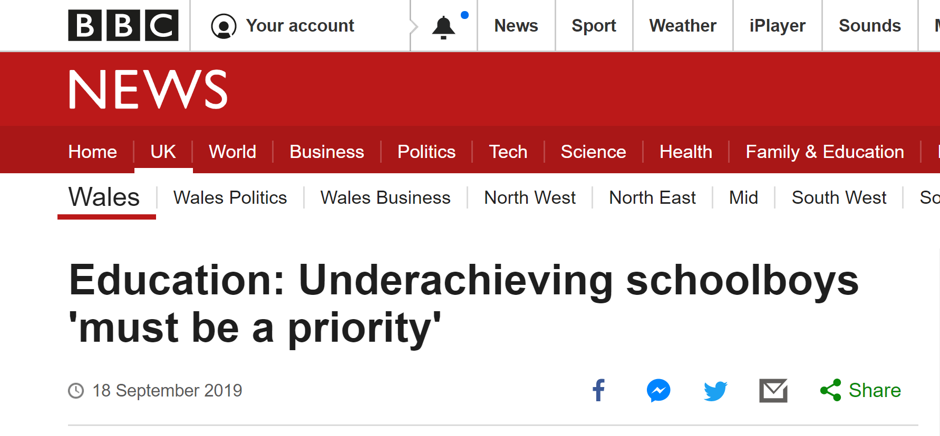
Underachieving schoolboys must be made a higher priority, according to an education consultant.
Overall, GCSE performance at A* to C was 9.8% lower for boys than girls this year, continuing a well-established pattern.
Alan Evans said "We're closing doors to 10-15% of boys who will continually underachieve for the rest of their lives."
The gender attainment gap is particularly pronounced in literacy.
Across the country the proportion of boys achieving top grades in English was 17% lower than girls.
He suggested the issue did not get much attention because the top 10% of boys perform well at A-level, including getting more A* grades, and average salaries for men are higher than for women.
Notes:
https://www.bbc.co.uk/news/uk-wales-49729041

Slide 14
Last year, when Lucy Hacker joined all-boys Lewis School Pengam in Caerphilly county as head of English, she noticed some of the pupils seemed afraid of trying and failing, and avoided making too much effort to save face.
"There was no lack of ability but there was certainly a lack of confidence in their own ability," she said.
Mr Evans said there were 14 subjects in Wales where the gap between boys and girls was between 10 and 20%.
Crucially, those subjects include English (16.9%), English literature (15.9%), Welsh first language (16%), Welsh literature (16.2%) and Welsh second language (21.1%).
In the two Maths GCSEs there is a more equal picture - the number of boys getting A* to C was 2% higher in maths: numeracy and 2.4% lower in mathematics.
Notes:
https://www.bbc.co.uk/news/uk-wales-49729041

Slide 15
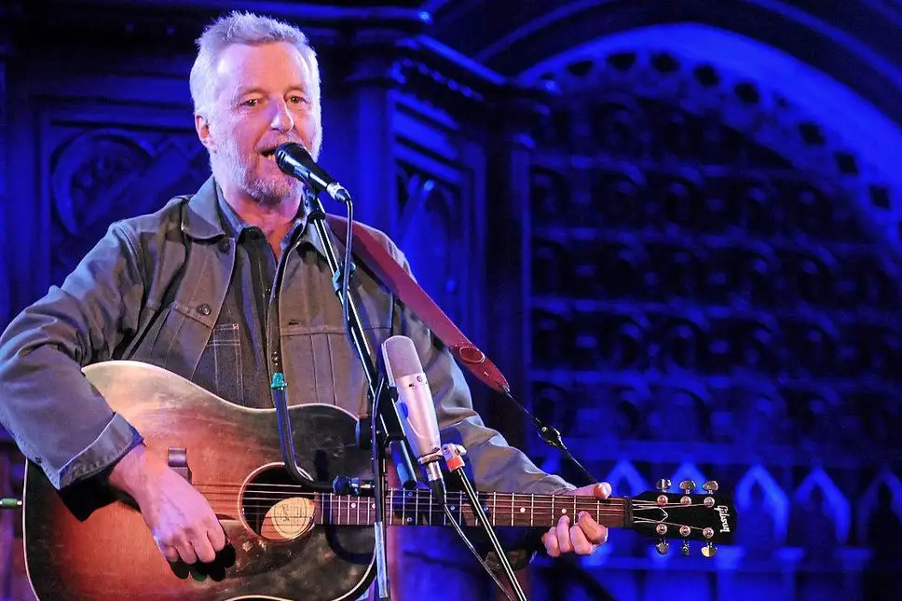
Up in the morning and out to school
Mother says there'll be no work next year
Qualifications, once the Golden Rule
Are now just pieces of paper
At twenty one you're on top of the scrapheap
At sixteen you were top of your class
All they taught you at school
Was how to be a good worker
The system has failed you don't fail yourself
Billy Bragg
To have and to have not
Notes:
This was written in 1983. In what ways could it still be relevant today.
If you fancy a quick blast - https://www.youtube.com/watch?v=iNcygbTNJyE

Slide 16
Dosbarth
Class
Mae cwestiynau am gynnwys disgyblion dosbarth gweithiol mewn addysg (yn enwedig bechgyn) wedi bodoli ers y 1960au
Mae rhai wedi dadlau ein bod ni wedi symud tu hwnt i'r syniad o 'ddosbarth' gyda llai o hunaniaeth ranedig ers y 1980au
Questions about whether education excluded working class children (especially boys) have existed since the 1960s
Some have argued we have moved beyond 'class', with less shared identity since the 1980s
Notes:
The term class is used less and less, but

Slide 17
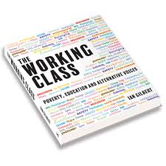
'Rather than trying to rally opinion around an outdated term, I feel the issue is much more straightforward. It is about disadvantage, pure and simple...'
Notes:
Is class still a relevant term? This book was published in 2018. The quote is from the introduction from Dave Harris, who's objection to the title was made into the first thing you read in the book!
It would be interesting to hear the strength of the class identity of the students in the room.

Slide 18
Dosbarth
Class
Er hynny, mae cefndir 'sosio'economaidd' yn parhau yn ffactor alweddol mewn cyrhaeddiad academaidd
However 'socio-economic' background is still a key factor in academic achievement
Notes:
Socio-Economic – More than just how much money you have – it can also reflect the level of deprevation within a community, rather than just in indvidual terms, and reflect things like average local wage and availabily of high wage, stable employent.

Slide 19
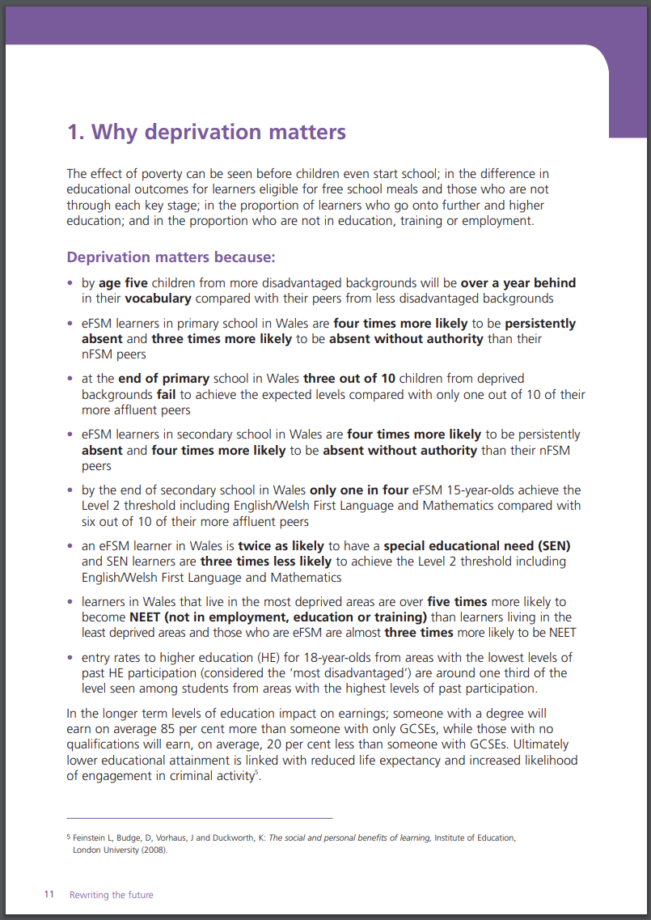
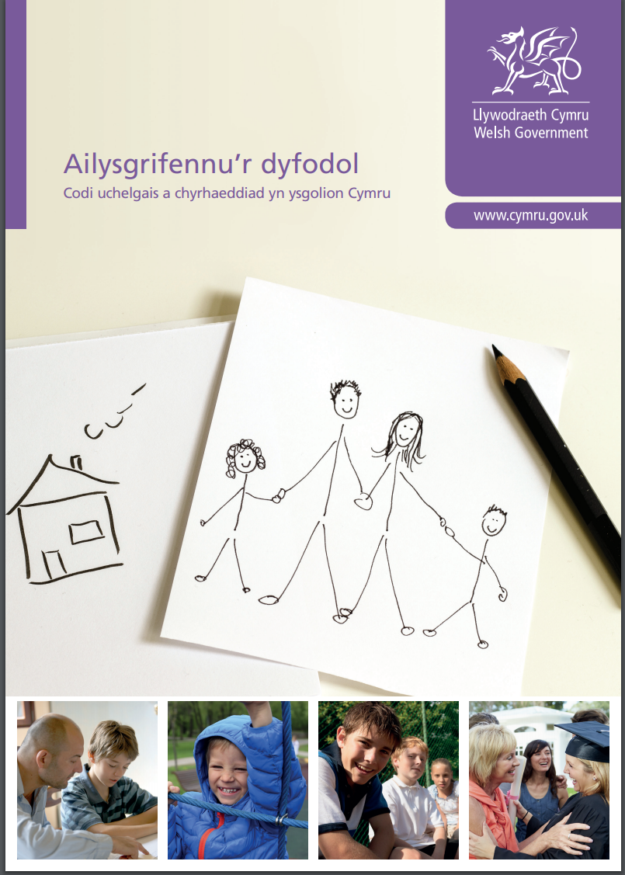

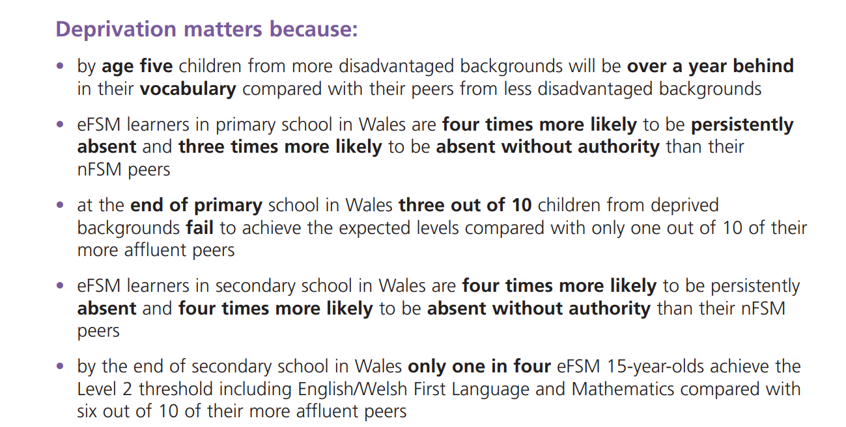
Notes:
https://gov.wales/sites/default/files/publications/2018-03/rewriting-the-future-raising-ambition-and-attainment-in-welsh-schools.pdf
https://llyw.cymru/sites/default/files/publications/2018-03/ailysgrifennu%E2%80%99r-dyfodol-codi-uchelgais-a-chyrhaeddiad-yn-ysgolion-cymru.pdf

Slide 20
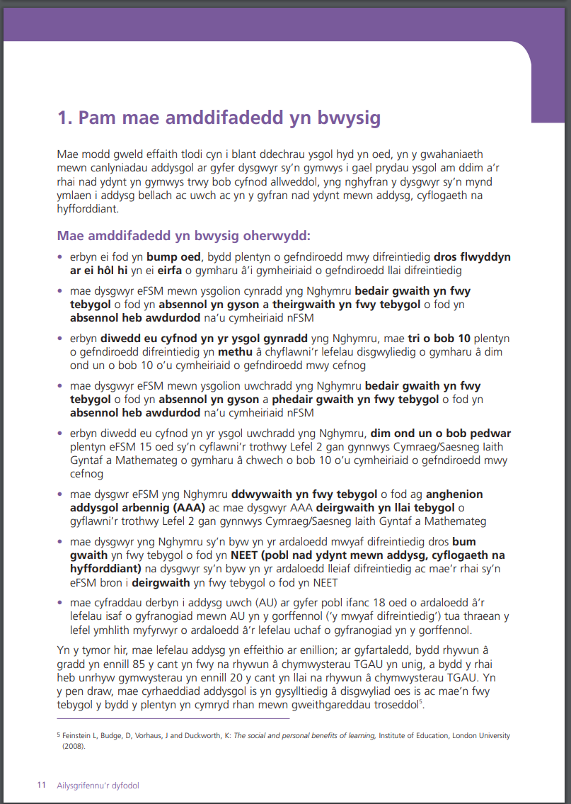
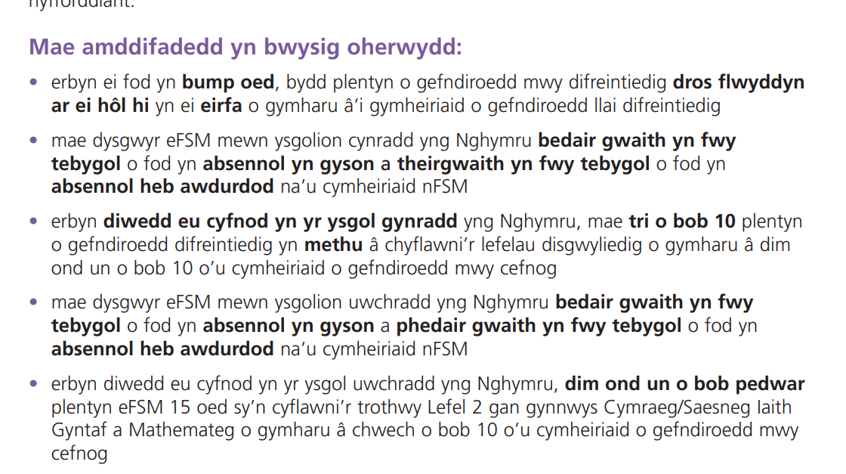
Notes:
https://gov.wales/sites/default/files/publications/2018-03/rewriting-the-future-raising-ambition-and-attainment-in-welsh-schools.pdf
https://llyw.cymru/sites/default/files/publications/2018-03/ailysgrifennu%E2%80%99r-dyfodol-codi-uchelgais-a-chyrhaeddiad-yn-ysgolion-cymru.pdf

Slide 21
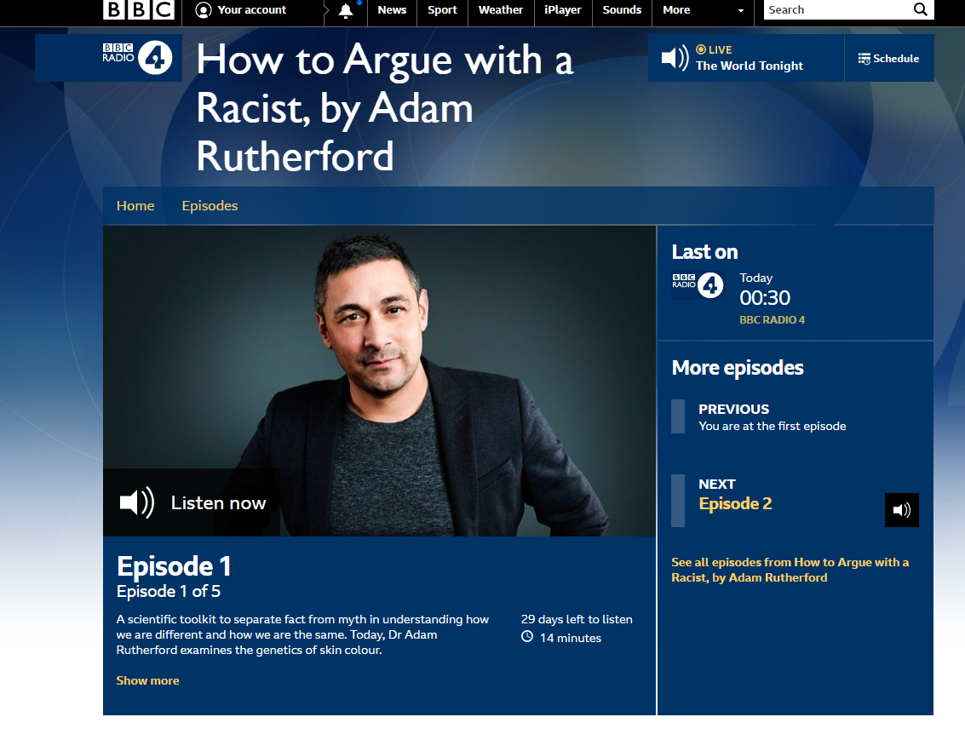
Hil
Race
BYDDWCH YN OFALUS!!
Mae'r term 'hil' yn gallu arwain at broblemau.
Mae'n ymddangos bod gwahaniaethau sosio-ddiwylliannol mewn canlyniadau
CAUTION!!
The term 'race' can be problematic.
There do seem to be socio-cultural differences in outcomes
Notes:
We need to be careful with the term 'Race'. It has it's origins in the 19th Century desire to classify things, often based on physical features, and developed into the idea that you could group people by physical appearance or geographical origin and then categorise them. There is no biological basis in this at all.
It is still a term used in Sociology, but is increasingly being replaced by terms such as ‘Socio-cultural background’ or ‘ethnicity’.
Adam Rutherford has an excellent new book on this, which is being serialised on Radio 4 this week!

Slide 22
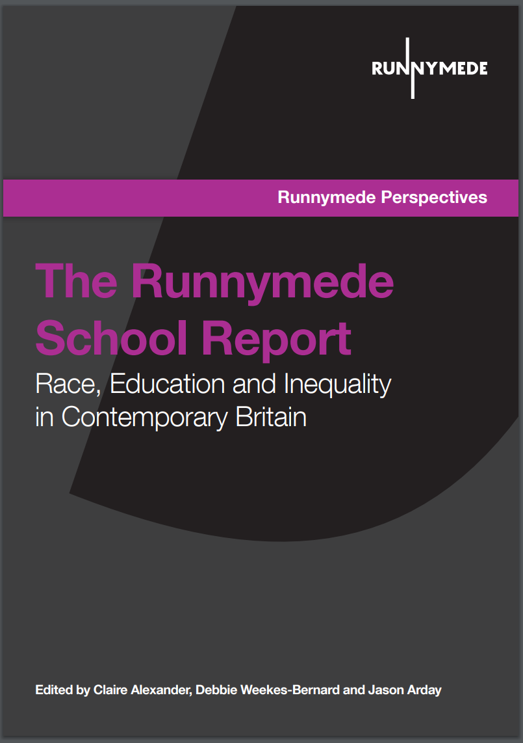
"Nearly 17 per cent of children aged 0−15 in England and Wales are from Black and minority ethnic backgrounds, making up over 23 per cent of state funded secondary schools and nearly 28 per cent of state funded primary schools (Office for National Statistics, 2011).
Recent figures (DfE, 2015) suggest that educational attainment for BME young people is improving, with Indian and Chinese young people consistently outperforming White British students, Bangladeshi and African descent young people achieving near or above the national average for GCSE attainment, and African Caribbean and Pakistani descent young people showing clear gains in the past decade.
Notes:
http://www.runnymedetrust.org/uploads/The%20School%20Report.pdf

Slide 23
Gallu
Ability
Oes gan rai plant fwy o allu academaidd naturiol nag eraill?
Are some children naturally more academically able than others?
Notes:
Ask students to consider this question.
Hopefully they will start to unpick the idea of 'academic ability' - some people have different aptitudes
However, despite this variation, some students do seem to have a general intelligence and aptitude for learning.
This is likely to be partially genetic, and partially a reflection of upbringing and environment.

Slide 24
Dewis yn ôl gallu
Ability selection
Yn draddodiadol mae system o ddewis yn ôl gallu yn 11 oed yn Lloegr/Cymru
Cafodd hwn ei ddisodli gan system gyfun yn y 1960au
Mae ysgolion gramadeg yn bodoli o hyd yn Lloegr, ond mae gan Gymru system gyfun gyflawn
Traditionally England / Wales had a system which selected at 11 based on the 11+ exam
This was replaced by a comprehensive system in the 1960s
Grammar schools still exist in England, but Wales has a fully comprehensive system.

Slide 25
Gallu
Ability
Beth fyddai'r dadleuon o blaid rhyw fath o system o ddewis yn ôl gallu?
What might the arguments be for some kind of selective system?

Slide 26
Tasg
Task
Select one of the four areas that interests you.
Note down what you think you'll find before you start your research.
Read around the topic, starting with the links on Moodle. Make notes, considering what supports and what challenges your views.
Be ready to share your reflections
Dewiswch un o'r pedwar maes sy'n eich diddori chi
Nodwch beth rydych chi'n meddwl cyn i chi ddechrau eich ymchwil
Darllench o amgylch y testun gan gychwyn gyda'r lincs ar Moodle. Gwnewch nodiadau, yn ystyried beth sy'n cefnogi ac yn herio eich syniadau
Byddwch yn barod i rannu eich adfyfyrio

Slide 27
Rhannu
Sharing
Chwiliwch am rywun sydd wedi edrych ar yr un testun â chi
Cymharwch fannau cychwyn a'r dystiolaeth rydych chi wedi casglu
Chwiliwch am rywun syddd wedi edrych ar destun gwahanol i chi
Rhannwch grynodeb llafar o'ch canfyddiadau. Yw eich barn gychwynnol wedi newid?
Find someone who looked at the same topic as you.
Compare starting points, and the evidence you've noted
Find some who looked at a different topic to you
Give them a brief verbal overview of your findings. Have your views been challenged?

Slide 28
Crynhoi
Recap
Mae'r syniadau yma i gyd yn bwysig
Does dim un o'r rhain yn ffactor pwysicach wrth ystyried canlyniadau disgyblion
Data cohort v myfyriwr unigol
All of these ideas are important
None of these are the most important determinant in student outcomes
Cohort data vs Individual student
Notes:
This last part is important – cohort data can be useful in identifying trends and patterns and even likely outcomes. However, data sets form a bell curve – there will be individual children who fall along any trend line and we need to be careful not to apply labels on children based on any of the categories we've discussed today – there will often be more variation within a group than between two individuals in different groups.

Slide 29
Beth yw eich Mantra?
What's your Mantra?
Fe ddylen ni ddefnyddio'r wybodaeth yma i ddileu rhwystrau, nid ychwanegu labelau.
Beth yw eich cynnig chi?
We should use this information to remove barriers, not add labels.
What's yours?
Notes:
Often publication contain these kind of mantra which attempt to sum up a complex idea in a pithy saying. I've had a go at creating one, but it's not very good. Ask the students to sum up their views at the end of the session in a pithy saying or mantra.

Slide 30
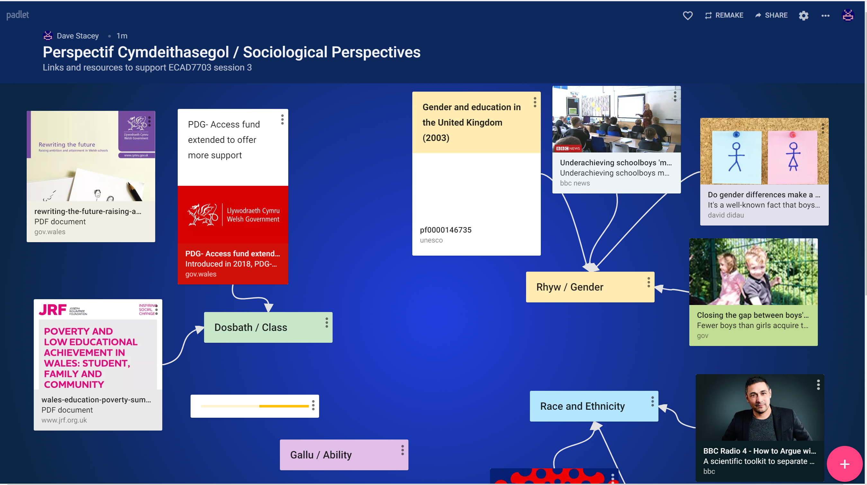
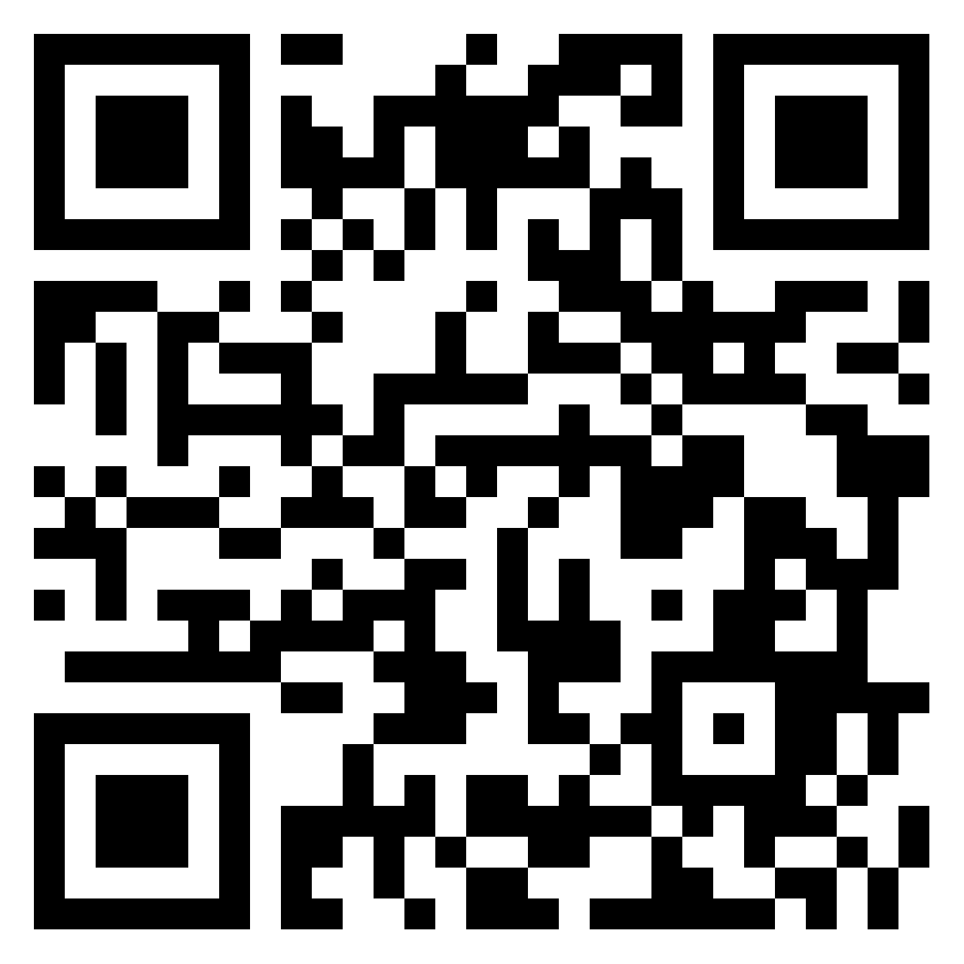
PADLET
https://padlet.com/teaching_mrstacey/ecad7003s3

