Slide 1

CRITICAL THINKING
ANALYSIS vs. DESCRIPTION
Academic Survival Skills

Slide 2
What is critical thinking?

Slide 3
Critical Thinking
Noun
the objective analysis and evaluation of an issue in order to form a judgment: professors often find it difficult to encourage critical thinking amongst their students.
From New Oxford English Dictionary

Slide 4
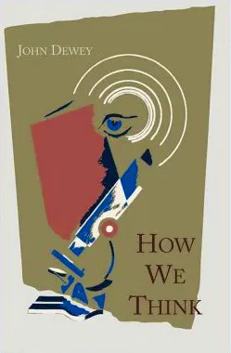
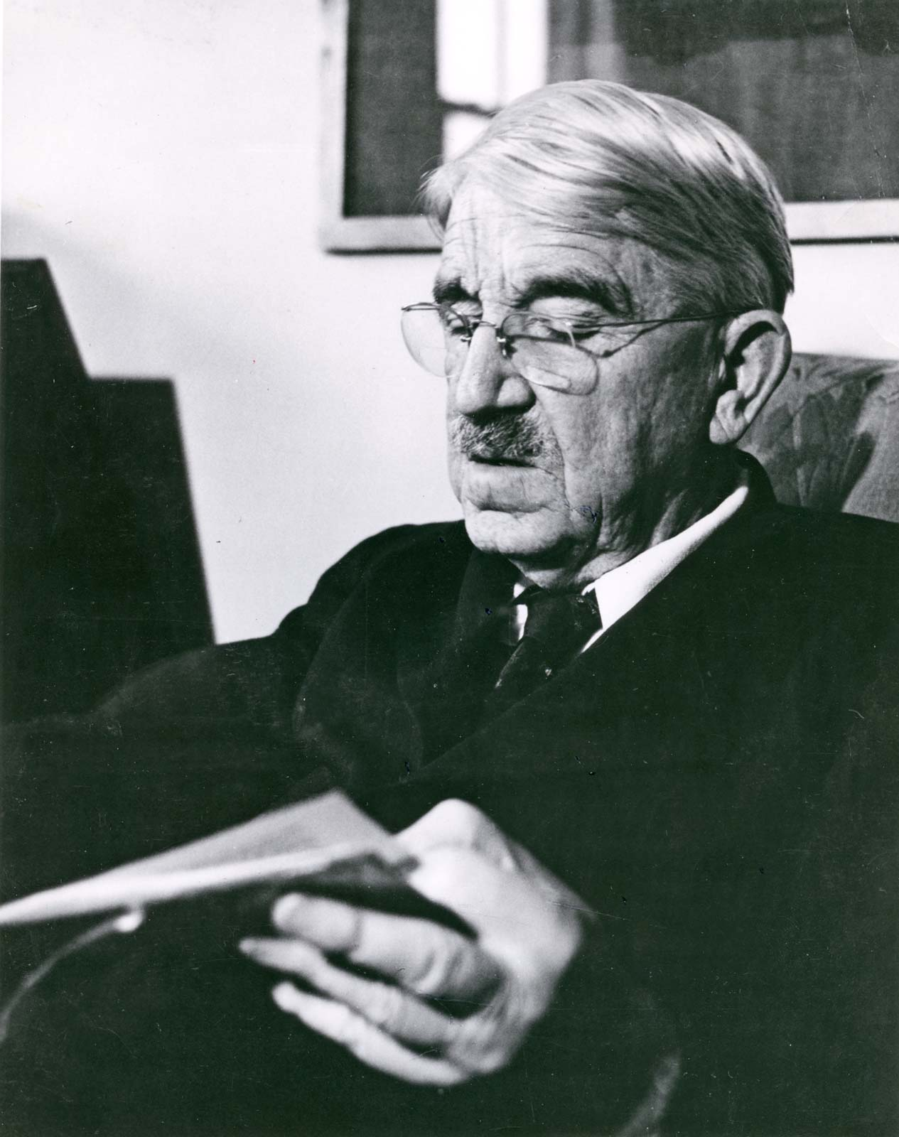
Critical Thinking
“Active, persistent, and careful consideration of any belief or supposed form of knowledge in the light of the grounds that support it, and the further conclusions to which it tends, constitutes reflective thought.”
- John Dewey, US philosopher and educationalist (1859—1952) in How We Think (1910)

Slide 5
Critical Thinking
“The essence of critical thinking is suspended judgment; and the essence of this suspense is inquiry to determine the nature of the problem before proceeding to attempts at its solution. This, more than any other thing, transforms mere inference into tested inference, suggested conclusions into proof.”

Slide 6
Dewey’s Five Phases of Critical Thinking
Starts with:
1. suggestions, in which the mind leaps forward to a possible solution;
followed by
2. an intellectualization of the difficulty or perplexity into a problem to be solved, a question for which the answer must e sought;
then
3. the use of one suggestion after another as a leading idea,or hypothesis,
to initiate and guide observation and other operations in collection of factual material;
then
4. the mental elaboration of the idea or supposition as an idea or supposition (reasoning);
concluding with
5. testing the hypothesis

Slide 7
Critical Thinking
“If the suggestion that occurs is at once accepted, we have uncritical thinking, the minimum of reflection. To turn the thing over in mind, to reflect, means to hunt for additional evidence, for new data, that will develop the suggestion, and will either, as we say, bear it out or else make obvious its absurdity and irrelevance.”

Slide 8
What is analysis?

Slide 9
OED definitions
1. a) A detailed examination or study of something so as to determine its nature, structure, or essential features. Also: the result of this process; a detailed examination or report; a particular interpretation or formulation of the essential features of something.
b) The action or process of carrying out such a detailed examination; the methodical or systematic investigation of something complex in order to explain or understand

Slide 10
OED definitions
2. a. The resolution or breaking up of a complex whole into its basic elements or constituent parts
- Relevant to textual analysis

Slide 11
Elements of analytical thinking
(according to Dewey)
… search, of hunting, of projection, of trying this and that
… emphasis of the features that are significant, so that they will stand out clearly.
… Connection, relationship with a larger whole

Slide 12
How does analysis differ from description?
Description = an account of something
The ‘WHAT’
Analysis = an evaluation of something
The ‘SO WHAT’

Slide 13
DESCRIPTION | ANALYSIS
Narrative | Evaluation
States what happened | Identifies the significance
States what something is like | Judges strengths and weaknesses
Outlines others’ ideas | Weighs up others’ ideas and adds own ‘spin’
Lists details, factors, data | Assesses details, factors, data
States how something works | States why something works in a particular way
‘Passive’ | ‘Active’
‘Surface’ | ‘Depths’
Enumerates possible conclusions | Draws an evidence-based conclusion

Slide 14
Perils of analysis!
analysis paralysis n. inability to respond effectively to a situation due to an over-analytical approach or to an excess of available information.
1972 Times 12 Sept. 2/6 The whole church was suffering from ‘analysis paralysis’.
1980 Harvard Business Rev. (Nexis) Jan. 122 Managers..may become more exasperated with the problem of information overload. They will also be expected to continue making effective decisions... But, in the process of doing so, managers may become more engulfed with the problem of analysis paralysis.
2005 Computerworld (Nexis) 10 Oct. 36 Don't overanalyze. It can lead to analysis paralysis.

