Slide 1
STUDENT Name – JAIMIN JADAV
Student Email ID – 2437156@student.uwtsd.ac.uk
Supervisor Name – Dr Zeno Leung
Module: Practice-Based Research
Module code:- LCHS7008
Assignment Title:- Component 1 Poster Presentation

Slide 2
Table Of Content
Content | Page Number
Research Title | 3
Prevalence | 4-6
Rationale of the research | 7-8
Research Aim | 9
Objectives | 10
Question | 11
Research Impact | 12
References | 13

Slide 3
Research Title
Exploring the Relationship Between Racism and Mental Health Outcomes Among School-Aged Children in the UK

Slide 4

Prevalence
Racial discrimination leads to anxiety, depression, and other psychological problems among children in schools in the UK (Ghezae et al., 2025).
Many non-white Children aged 3-14 years old face racism driven microaggressions and other social inequalities (Bains and Gutman, 2021).
Evidence suggests racialised bullying is underreported due to fear of retaliation and normalisation of racist behaviour (UNICEF UK, 2022).

Slide 5
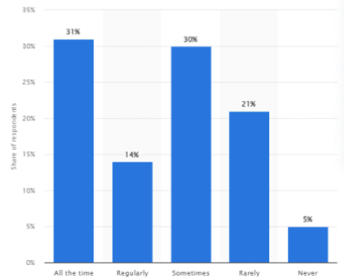
Prevalence
(Contd.)
(Source: Clark, 2025)
According to a 2020 survey, 95% black kids face racist language at school, and 31% of them experienced racism all the time (Clark, 2025).
Racism in UK schools often manifests as microaggressions, exclusion, and teacher bias, not only overt abuse (Priest et al., 2023).

Slide 6
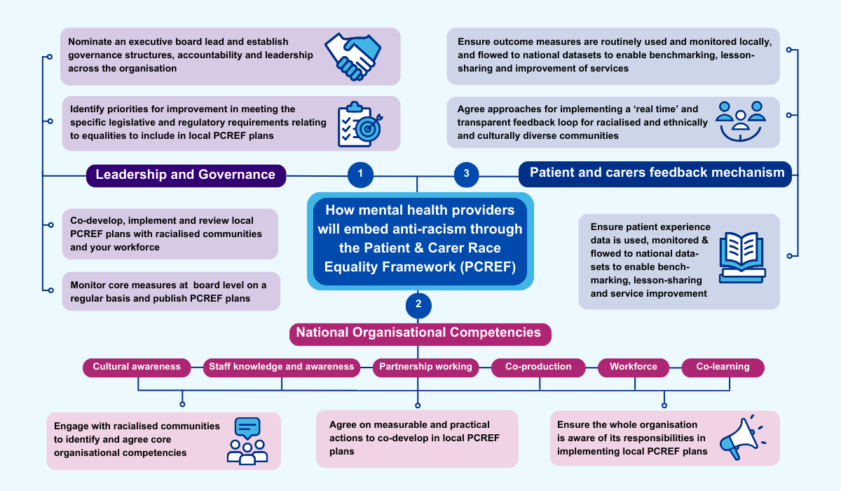
Prevalence (Contd.)
Chronic exposure to racism activates toxic stress pathways, negatively affecting emotional regulation and cognitive development (Williams & Mohammed, 2023).
NHS England launched its first antiracist framework: Patient and carer race equality framework (PCREF) (NHS England, 2026).

Slide 7

Rationale of the Research
Schools are critical intervention settings, as children spend over 35% of 24 hour in educational environments that shape identity and wellbeing (Hakkim, and Konantambigi, 2023).
1 in 8 children aged 5 to 19 face mental health issues in the UK (Bains and Gutman, 2021).
Racism is still present, but The United Nations Convention on the Rights of the Child is trying to protect children's rights (English et al., 2024).
Addressing racism early can reduce long-term mental health inequalities in adulthood (NHS Digital, 2023).

Slide 8
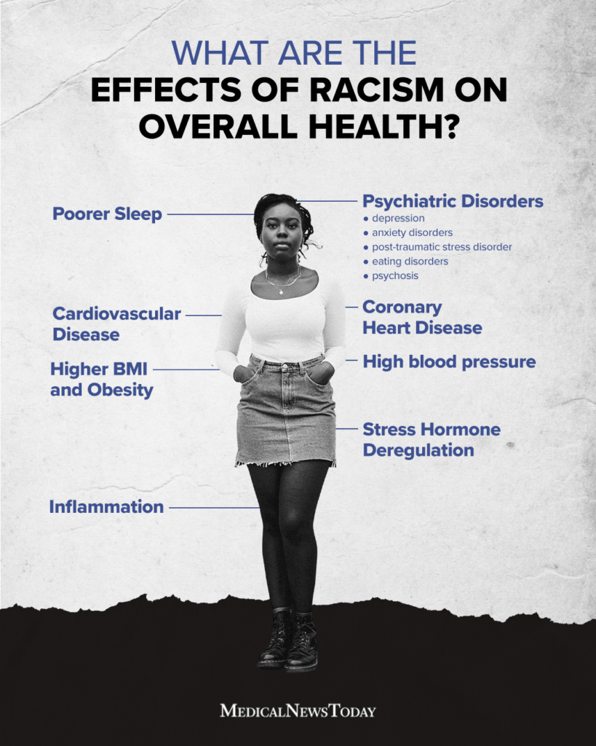
Rationale of the Research (Contd.)
Poor family conditions of these victims with immigrant backgrounds exacerbate this issue (Metzner et al., 2022).
Racism causes mental health issues, which hampers both their academics and physical health (Jones Harden, B. and Slopen, 2022).
Therefore, this research is necessary to raise awareness among people in the UK.

Slide 9
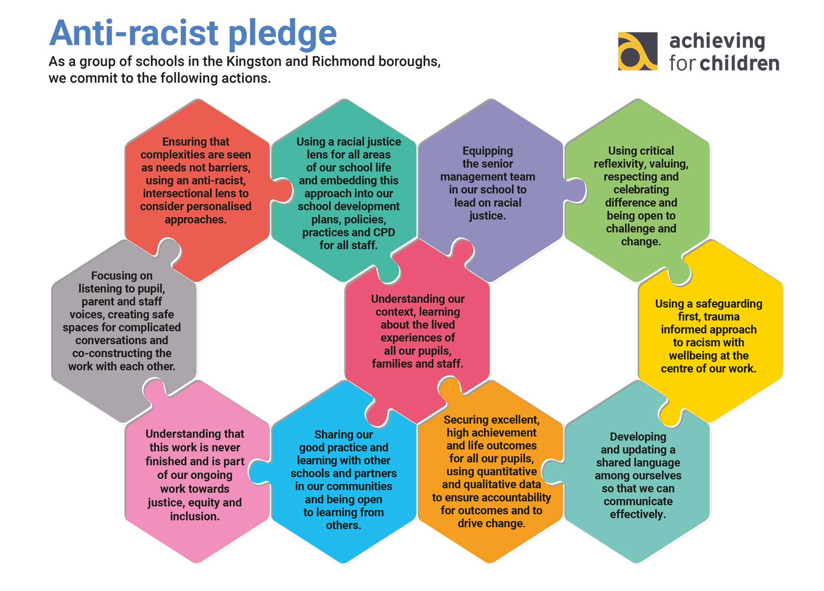
Research Aim
The research aims to identify the adversity of racism and find solutions to improve mental health conditions of UK school students.

Slide 10
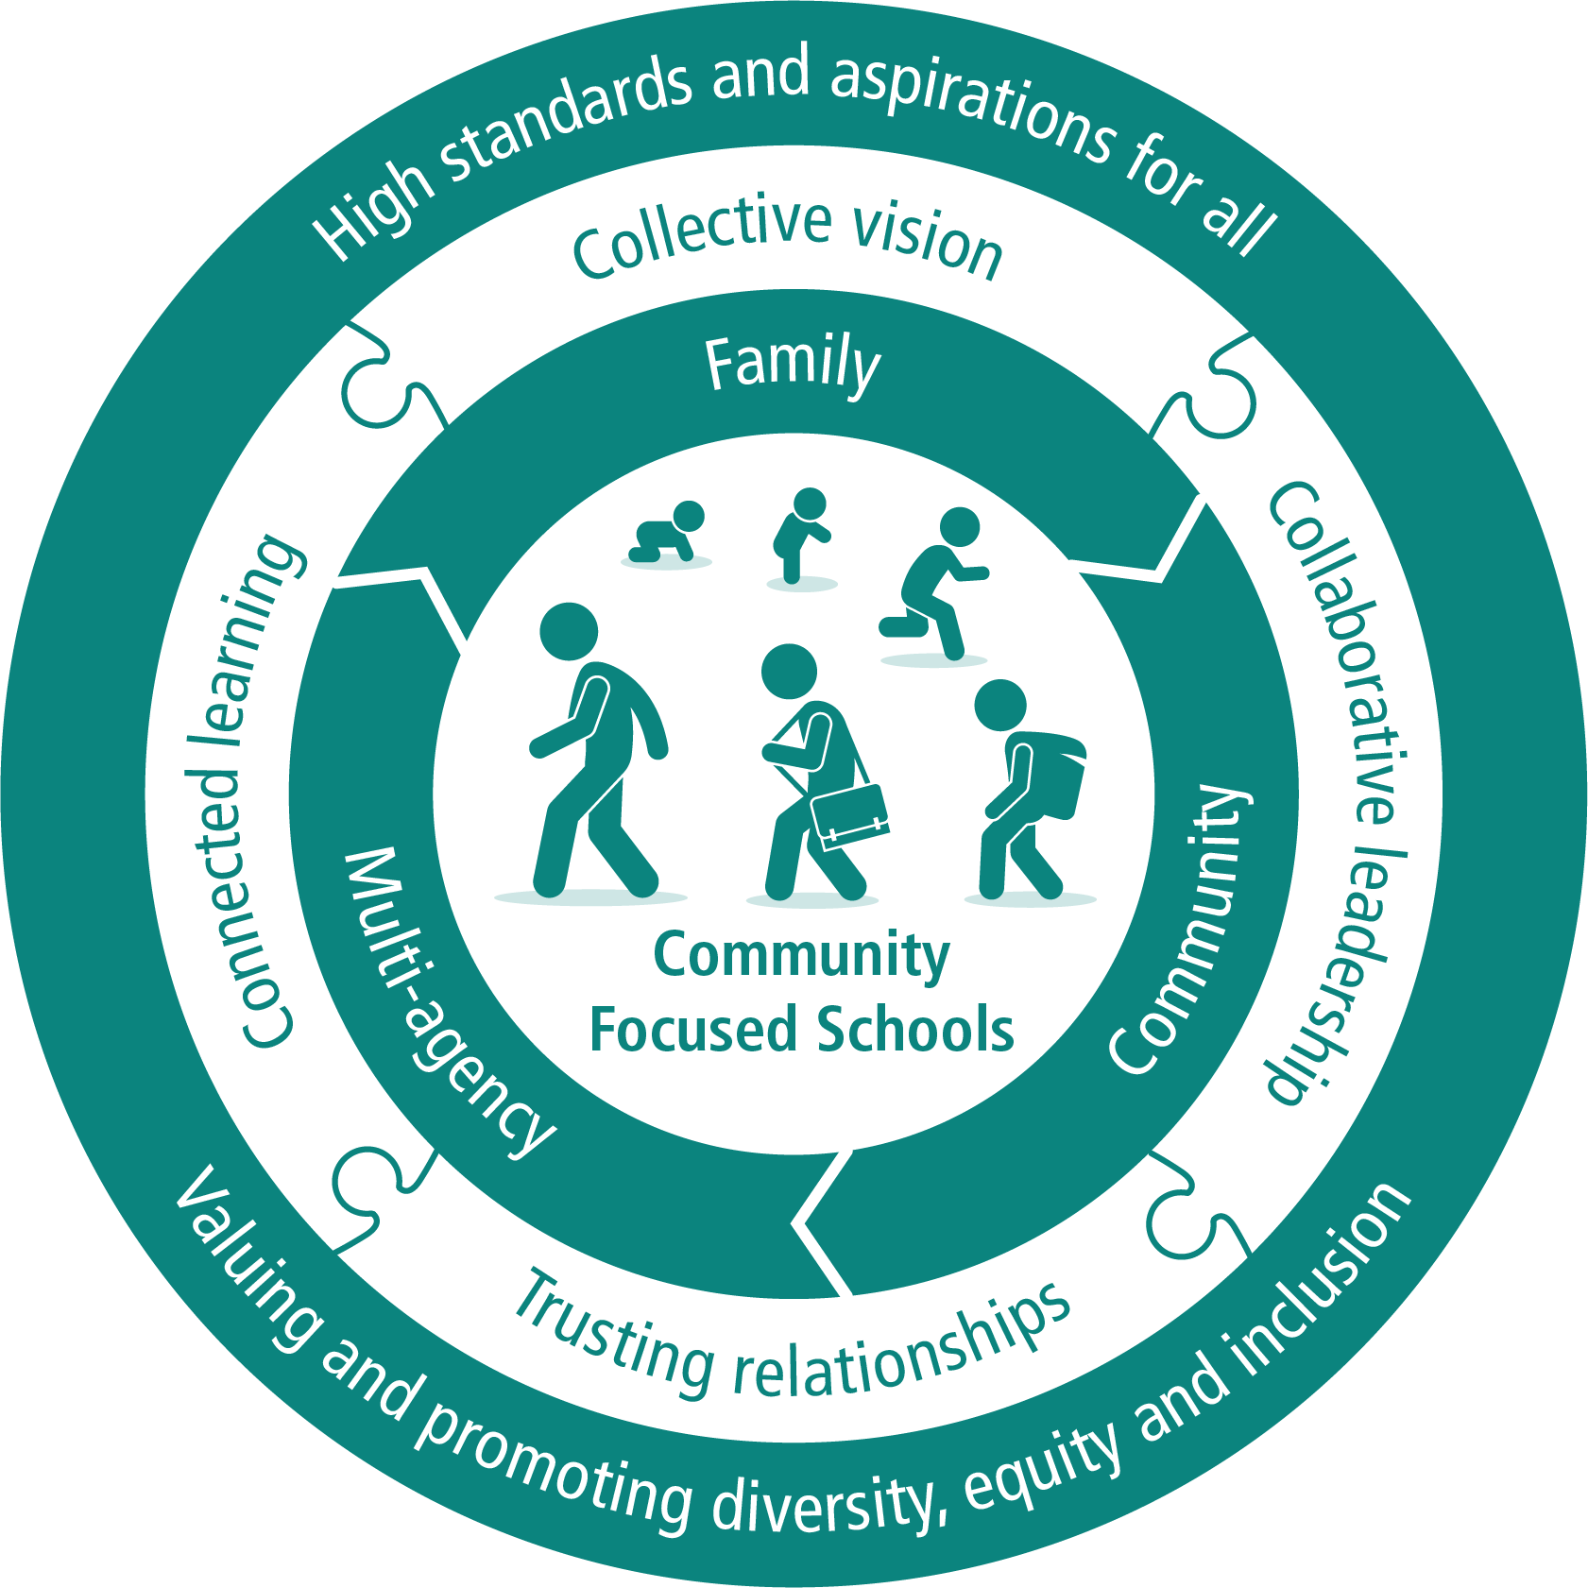
Objectives
To establish the relationship between racist taunts and the confidence of kids at school in the UK
To address adverse mental health effects on UK kids due to racism in their academic life.
To enhance a community engagement-based approach to mitigate racism at school in the UK

Slide 11
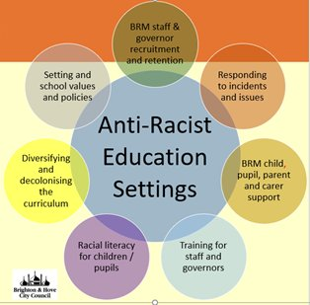
Question
What are the ways to tackle racist taunts and poor mental health conditions of kids at school in the UK ?

Slide 12
Research Impact
The research may help to lower the racialisation among kids at school in the UK.
The study may focus on addressing the issue and finding urgent way are extremely essential for school kids in the UK in the future.
Addressing the negative sides of racism, UK society and school authorities can be made aware to take initiatives to bridge the mental gap created at such an early age (Stoll et al., 2025).
Findings may inform anti-racist school policies, staff training, and inclusive mental health support systems (DfE, 2023).
Evidence-based interventions can strengthen community–school partnerships to protect vulnerable children (WHO, 2023).

Slide 13
References
Bains, S. and Gutman, L.M. (2021) ‘Mental health in ethnic minority populations in the UK: developmental trajectories from early childhood to mid adolescence’, Journal of Youth and Adolescence, 50(11), pp.2151-2165. Available at: https://link.springer.com/article/10.1007/s10964-021-01481-5
Burns, A., DeAtley, T. and Short, S.E., (2023). The maternal health of American Indian and Alaska Native people: A scoping review. Social Science & Medicine, 317, p.115584. Available at: https://doi.org/10.1016/j.socscimed.2022.115584 (Accessed: 27 January 2026).
Clark D. (2025) How often did/do you hear racist language or witness racism in school? Statista. Available at: https://www.statista.com/statistics/1190819/experiences-of-racism-at-uk-schools/?srsltid=AfmBOopm4npsmnjQ2yuziitC0M7hwbVR5P9B1W45tG7NIUs8f3QQWheN (Accessed: 15 January 2026).
English, S., Abi Deivanayagam, T., Bignall, T., Box, L., Butt, J. and Devakumar, D. (2024) ‘Protecting children from racism: urgent health system actions’, The Lancet, 403(10436), pp.1535-1536. Available at: https://www.thelancet.com/journals/lancet/article/PIIS0140-6736(24)00299-X/abstract
Ghezae, F.T., Zungu, Z., John, A., Abdinasir, K., Bhui, K., Adebiyi, A. and Creswell, C. (2025) ‘The association between experiences of racism and mental health on children and young people in the UK: rapid scoping review’, JPsych Open, 11(1), p.e26. Available at: https://doi.org/10.1192/bjo.2024.836
Gov.UK (2025). Keeping children safe in education. Available at: https://www.gov.uk/government/publications/keeping-children-safe-in-education--2 (Accessed: 27 January 2026).
Hakkim, A. and Konantambigi, R.M., (2023). Experiencing childhood in the context of societal academic expectations. Psychological Studies, 68(2), pp.149-164.Avaiable at: https://pmc.ncbi.nlm.nih.gov/articles/PMC9110281/ (Accessed: 27 January 2026).
Jones Harden, B. and Slopen, N., (2022). Inequitable experiences and outcomes in young children: Addressing racial and social-economic disparities in physical and mental health. Annual Review of Developmental Psychology, 4(1), pp.133-159. Available at: https://doi.org/10.1146/annurev-devpsych-121020-031515 (Accessed: 27 January 2026).
Metzner, F., Adedeji, A., Wichmann, M.L.Y., Zaheer, Z., Schneider, L., Schlachzig, L., Richters, J., Heumann, S. and Mays, D. (2022) ‘Experiences of discrimination and everyday racism among children and adolescents with an immigrant background–Results of a systematic literature review on the impact of discrimination on the developmental outcomes of minors worldwide’, Frontiers in psychology, 13, p.805941. Available at: https://www.frontiersin.org/articles/10.3389/fpsyg.2022.805941/full (Accessed: 15 January 2026).
NHS England (2026) Patient and carer race equality framework. Available at: https://www.england.nhs.uk/mental-health/advancing-mental-health-equalities/pcref/#:~:text=NHS%20England%20has%20launched%20its,providers%20to%20embed%20across%20England. (Accessed: 27 January 2026).
NHS England. (2023). Mental Health of Children and Young People in England, 2023 - wave 4 follow up to the 2017 survey, Available at: https://digital.nhs.uk/data-and-information/publications/statistical/mental-health-of-children-and-young-people-in-england/2023-wave-4-follow-up (Accessed: 27 January 2026).
Stoll, N., Kayn, S., Lempp, H. and Hatch, S., (2025). Impact of racial discrimination in education and other adverse childhood experiences on black students’ mental health and wellbeing: an interpretative phenomenological analysis study. International journal of qualitative studies on health and well-being, 20(1), p.2507754. Available at: https://pmc.ncbi.nlm.nih.gov/articles/PMC12107663/ (Accessed: 27 January 2026).
UNICEF UK (2022). Racism and discrimination against children rife in countries worldwide. Available at:https://www.unicef.org/press-releases/racism-and-discrimination-against-children-rife-countries-worldwide (Accessed: 27 January 2026).
WHO, (2025). Social determinants of health, Available at:https://www.who.int/news-room/fact-sheets/detail/social-determinants-of-health (Accessed: 27 January 2026).
Williams, D.R. and Mohammed, S.A., (2013). Racism and health I: Pathways and scientific evidence. American behavioral scientist, 57(8), pp.1152-1173. Available at: https://doi.org/10.1177/0002764213487340 (Accessed: 27 January 2026).

