Slide 1
Media and Consumer Psychology
SSAP5003

Slide 2
Learning Outcomes
Critically evaluate and apply the main theories underpinning consumer psychology;
Contextualise understandings of complex issues in consumer psychology;
Critically evaluate psychological theory and research exploring the impact of the media’s influence on human behaviour;
Critically evaluate psychological research investigating human interaction with the media;
Organise their knowledge and learning through the use of a range of information resources and present their work at the appropriate level.

Slide 3
Assessments
Essay: 3,000 words (70%) – 30th March 2018
Using empirical evidence, critically explore the impact of pro-social and/or educational media on tackling issues associated with health and well-being.
Project & Presentation (30%) – 1st May 2018
Using one of the attitude scales provided, conduct research comparing the attitudes of two groups of participants towards a television advertisement of your choice. With the use of psychological theory and evidence, present your findings to the rest of your group.

Slide 4
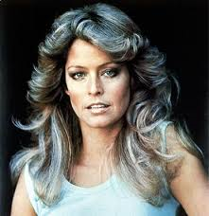
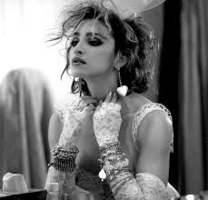
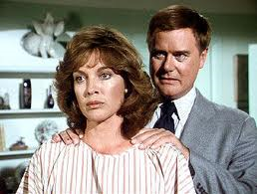
Watch this!
https://www.youtube.com/watch?v=HeEWtNaW6KE

Slide 5
What is it?
Media Psychology:
“…any method of communication, other than one to one interactions, which is facilitated by some type of technology, such as printed newspapers through to news podcasts”. (Brewer, 2011, p 2).
Consumer Psychology:
“…an interdisciplinary subject area and it combines theories and research methods from Psychology, Marketing, Advertising, Economics, Sociology and Anthropology”. (Jansson-Boyd, 2011, p1).

Slide 6
Questions
How much digital media do you receive on an average day?
What is meant by the `age of interruption?`
Who uses the most digital media (as measured in time) - Young mobiles, Prime timers or average households?

Slide 7
Short (2014)
Average American receives more than 15 hours a day of digital media.
How much of that time are we/they really paying attention?
Young mobiles: Accounting for selective attention and multitasking, their daily media hours are 6:52, with 39% spent on video (Internet and mobile video and TV) and 26% on communications (social media, messaging and voice calls).
Prime timers: Daily media hours are 10:35, with 65% of that time spent viewing video and 16% on communications (traditional T.V. viewing).
Average Americans: Daily media hours are 8:03, with 51% of that time spent on video and 22% on communications (They have more interruptions than the prime timers).

Slide 8
Why study Consumer Psychology? – Why is Media and Consumer Psychology important to us?
People are repeatedly exposed to different aspects of consumption.
All hobbies are linked to consumption.
Holidays are mainly about consumption.

Slide 9
Almost all behaviours engaged in by humans are directly or indirectly linked to consumption; it is part of the everyday lives of humans (Tatzel, 2003; Kasser and Kanner, 2003).
Impact of Consumption
Impact of consumption on people
– e.g. children and development/ health.
How products contribute to shaping identity
– brand labels, products types. Beer!
Effects of consumption on the environment.

Slide 10
Identity:
Often goods and services are bought because people believe that they somehow represent who they are other than for practical reasons.
We judge others by their material possessions.
Consumption is important in the creation and maintenance of our own identities.
Who you are and how you fit into society, consumption generates feelings of belonging and well-being.

Slide 11
Identity
More than one type of identity?
(Jansson-Boyd, 2011) proposes there are as many identities as there are social situations!
People can use different type of products to represent them in different contexts.
We consume in the hope of reinforcing these roles.

Slide 12
Social Categorisation:
Humans categorise the world around them in relation to themselves.
This accentuates the perception of others and objects they come across (Tajfel and Wilkes, 1963).
This makes it easier to find similarities or differences between themselves and those they are categorising.

Slide 13
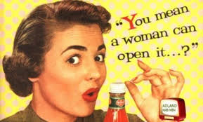
The perception of others is affected by material possessions (Dittmar, 2004).
Categorising objects can be influenced by marketing and advertising.
We focus on the group people belong to – individuals become depersonalised.
  Individuals perceived as prototypes with stereotypical characteristics.
Women and limits!

Slide 14
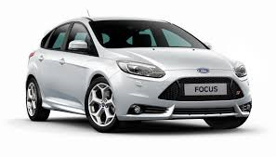
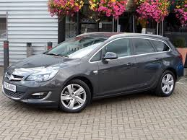
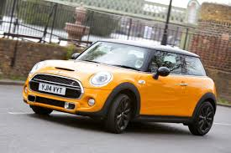
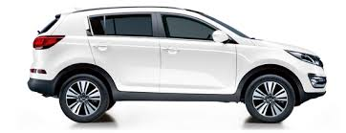
However…
Is categorisation representative of what the person is really like?
Research has shown that brands and products can indeed be used to generate accurate opinions about what others are like (Jannson-Boyd, 2011).
Correct judgements of another’s personality by looking at their office or bedroom (Gosling, Ko, Morris and Thomas, 2002).
Owners correctly matched to their cars (Alpers and Gerdes, 2006).

Slide 15


Social Comparison:
We learn about ourselves by comparing ourselves to others (Festinger, 1954; Suls and Wheeler, 2000).
To maintain or increase our self esteem.
Possessions can indicate group identity - enhances our sense of belonging (Belk, 1988).
Downward social comparisons make us feel better about ourselves
(e.g. Wills, 1981).

Slide 16
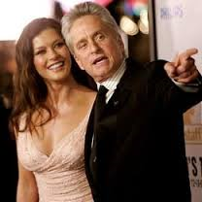
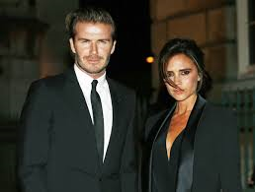
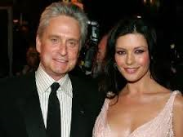
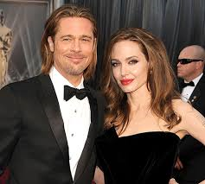
Upward social comparison:
Celebrities are carefully chosen to target a specific audience. We are being `sold to` by advertisers, by using `ideals`. This can have negative effects, with some people being more vulnerable than others.
Cheryl
George

Slide 17


Symbolic meanings:
Often there is a consensus regarding what brands/products represent and which are the best ones to purchase.
We recognize the symbolic meaning of products, with some inanimate objects having human characteristics
(e.g. Aaker, 1997).
Absolut Vodka versus Stoli Vodka.

Slide 18

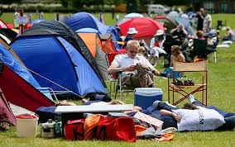
We may have a strong relationship with a product - identification - results in a ‘strong social bond and deep-rooted loyalty’(Muniz and Guinn, 2001).
People who use Applemac`s versus PC`s. (Special or no choice?)

Slide 19
When and how do we learn this?
From a young age.
Indirect learning from observation. E.g.
Only children who have certain toys have lots of friends.
Sainsbury`s christmas 2015

Slide 20
Direct Learning.
Children learn how others respond to them depending on the objects that they own, clothes they wear etc.
Possessions may teach a child about values.
right car, wrong colour!

Slide 21
Advertising
Top ten controversial advertisements

Slide 22
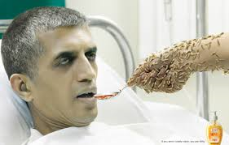
Advertising:
Adverts with vivid stimuli are noticed more frequently because they attract consumer’s attention in an automatic and involuntary way
(e.g. Kisielius and Sternthal, 1986; Taylor and Thompson, 1982)
A vivid stimulus should be:
  - emotionally interesting
  - concrete and image-provoking
  - proximate in a temporal, spatial or sensory way
  (Nisbett and Ross, 1980)

Slide 23
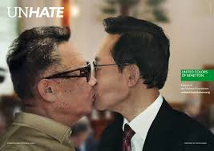
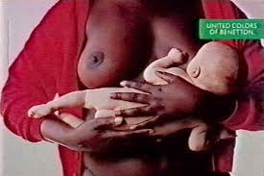
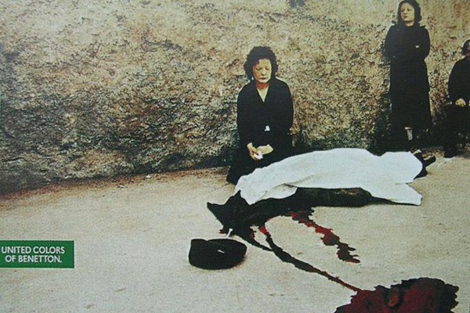
Benetton:

Slide 24
Emotion & mood:
Mood induction is used frequently by advertisers.
However, it can be difficult to measure- it is not just mood that is altered but other factors such as self esteem.
Questionnaires are often utilised and analysed via factor analysis. The use of questionnaires come with the usual host of problems in themselves.
Emotions impact on the ability to encode, store and retrieve information. In consumer psychology, selective attention and recall are two areas widely researched.
Emotion can tell us why people focus on certain factors more than others.

Slide 25
Bower, Gilligan & Montiero (1981)
Pp`s made to feel happy or sad via hypnosis, then asked to read drafts of psychiatric interviews. Happy people focused on happy facts and vice versa, suggesting that subconscious experiences bias later information processing.
Congruent material is semantically elaborated.
Adaval (2001) pp`s given mood induction task to feel happy or sad. Then asked to judge clothing that was described as either according to subjective or non subjective criteria. Pp`s were more likely to pay attention to information matching their feelings regardless of the relevance to the piece of clothing.

Slide 26

Impact on recall:
Positive moods are more likely to generate recall of positive events more than negative moods (Bower & Forgas 2000).
However, Trope & Pomerantz (1998) suggest positive moods help the recall of both positive and negative moods.
And, Raghunathan and Trope (2002) found high caffeine consumers had enhanced recall of negative aspects of caffeine when in good mood, but low caffeine users did not!
Clearly not a simple relationship!

Slide 27
Emotions and decision making:
Are emotional reactions independent of cognition?
When choosing to purchase (or not), we search feelings to see how we feel about it. The “how do I feel about it” heuristic (Peters & Slovic 2000).
And, whilst some research suggests that being in a good mood will more likely result in a positive evaluation, if the stimulus is highly familiar to us it will not have the same effect, as we will refer to the previous evaluations that have become part of our schema.

Slide 28
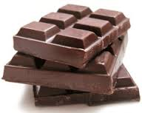
Controlling feelings:
Controlling how we feel is often linked to consumption. The activities we perform do not matter themselves, it is
our belief that they will enhance
our mood!
Therefore, the goal of advertisers is to create associations with their product.

Slide 29
Humour:
Around 10-30% of adverts contain humour (Krishnan and Chakravarti, 2003).
Funny advertisements:
  Attract attention (Weinberger et al, 1995).
  Engage the audience (Spotts et al, 1997).
  Enhance responses to adverts (Scott, Klein and Bryant, 1990).
Funny commercial!
Humour works best under low involvement conditions as a peripheral cue (Zhang and Zinkhan, 2006)

Slide 30
Humour:
- works best as a peripheral cue
- can generate mixed feelings (Gelb and Zinkhan, 1986; Nelson, 1987).
Cultural variations regarding what is deemed funny (Francis, 1994).
Too humorous - can distract from what is being advertised (Belch and Belch, 1984).
To take this into account - brand/product needs to be clearly visible and integrated into the story (Cline and Kellaris, 2007).
Horsing around

Slide 31
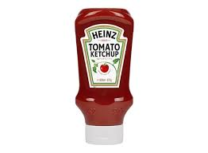
Sex sells:
Advertisements using sexuality:
- generate a more favourable perception.
  - attract attention (Dudley, 1999).
Both males and females were found to find sexy versions of ads more interesting (Bello et al, 1983).
Sexy advertisements often make use of classical conditioning:
- e.g. - repeated pairing of a product with a sexy looking woman.
- the consumer learns to associate a product with the arousal felt
on seeing the woman.
- the conditioned stimulus is the product.
https://www.youtube.com/watch?v=MB9WaV_onps

Slide 32
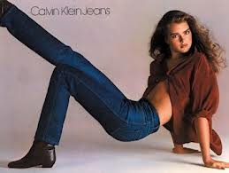
Classical conditioning:
Calvin Klein
Genes/jeans

Slide 33
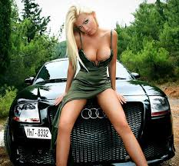
More sex:
Smith & Engle (1968)
Two groups of male pp`s shown car either with sexy female or without.
If female present they rate car as faster, more expensive and better designed.
Would we find the same today?
Lass & Hart (2004)….

Slide 34
Music:
Links between music and:
Recall (Roehm, 2001)- instrumental vs vocal.
Persuasion (Muehling and Bozman, 1990)- both immediate and delayed.
Purchase probability (North and Hargreaves, 1998)- classical, pop and easy listening.
Again, via classical conditioning.

Slide 35


Music and shopping:
Classical music in
supermarkets:
Slow music in
restaurants:
But… confounded by lighting and ambience. Much research conducted in travel agents, jewellers etc…

Slide 36
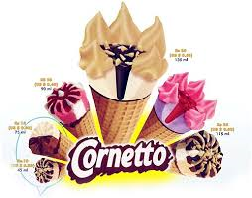
Music:
Shine
More than a feeling
Eliza
Lets go
Bonnie Tyler
Jim Reeves
Cant fight this feeling
Labelle
Oops!
Kiss I was made for lovin you
Classical conditioning - Gorn (1982)
https://www.youtube.com/watch?v=biL6zAMkOQs

Slide 37
Fear:
Using fear can frighten people into changing their attitudes and hopefully their behaviour (e.g. Bennett, 1996).
Design of advertisements - they have to include:
- a moderate amount of fear (so as not to repel people)
- a solution to the problem (e.g. Ruiter, Abraham and Kok, 2001).
If…
  - moderate amount of fear is used,
  - people think that listening to the ad will teach them how to
  behave in appropriate ways.
…they will be more likely to elaborate upon the message and in
turn change their attitudes (Petty, 1995).

Slide 38
Threat:
Ads containing threats fall into two categories:
Physical threats – threats to body, health or life
Social threats – relating to being socially excluded
Ads using physical threats are more commonly used
- But social threats can sometimes be more persuasive
(e.g. Dickinson and Holmes, 2008).

Slide 39
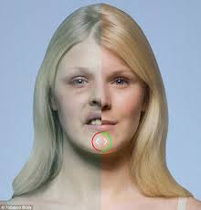
Short or long term?
Michaelidou, Dibb & Ali (2008) Researched anti smoking campaigns.
It appears that the short term cosmetic effects are more persuasive than the long term health benefits.
But age matters too…
How/why?

Slide 40
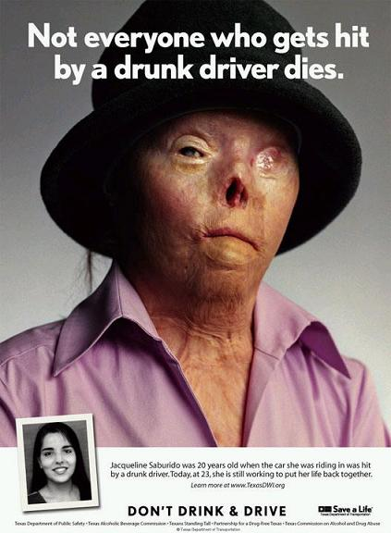
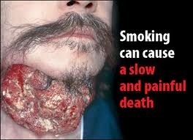
Shock tactics:
Shock advertising appeals deliberately shock and offend the sensibilities of the audience (Gustafson and Yssel, 1994)

Slide 41

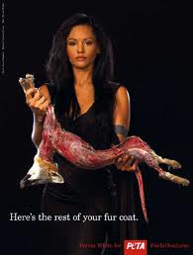
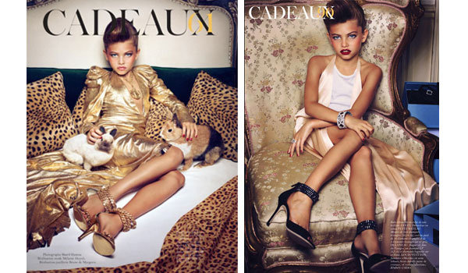
Shock tactics:
Offence is caused by violation of norms created by.
  Legal System
  Culture
  Peoples Customs.

Slide 42
Shock tactics:
Dahl et al (2003).
5 Different Advertisements- AIDS & HIV.
Shocking element captures the attention, and aided recall and recognition.
Conclusion – to capitalise on attention it is better to have a shocking element.

Slide 43
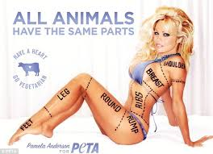
The message:
Primacy effect – we tend to remember information presented at the beginning of a message
- this also influences how we interpret subsequent information in the message
Recency effect – information that is presented at the end of a message is likely to be remembered
But - when messages are short or if the message is compatible with our interests these effects are reduced
- we are less likely to rely on only parts of the message when
processing and memorising

Slide 44
Subliminal messages:
Messages that cannot be consciously perceived but still supposedly affect people’s judgements, attitudes and behaviours.
Considered to be an enduring myth – – no strong evidence that subliminal messages are effective.
Late 1950s James Vicary – ‘eat popcorn’, ‘drink coca cola’ - claimed subliminal messages increased sales during interval.
But not true – there were no subliminal messages. Whilst fascinating
One lab-based study - interesting findings (Murphy & Zajonc, 1993):
- Chinese ideographs - each one preceded by image of happy
or angry face for just 4 milliseconds - participant not aware of seeing face
- Preferred the ideographs preceded by happy face
However - lab studies lack ecological validity

Slide 45
Task:
In groups – Research the product given by and present the findings in terms of:
  Target audience.
  Product History.
  Usability.
  A critique compared to rival products.
  Potential further uses.

Slide 46

The products:
1. `Eminent Move Air` suitcase from Amazon.
2. `i phone 6`
3. `Volkswagen Golf R`
4. `Sharp Aquos LC-60UD20KN 60“ TV`
5. `The Tamarina Boutique Hotel
Mauritius`

